Slide 1
Design Patterns (1)
31 March 2011
CMPT166
Sean Ho
Trinity Western University
See also:
Vince Huston,
JavaCamp,
OODesign.com

Slide 2
Outline for today
UML Sequence diagrams
  Lifecycles, if/else blocks, async messages
Design Patterns
  Creational patterns
    Factory Method
    Abstract Factory
    Builder
    Prototype
    Singleton

Slide 3
UML and reusable designs
Diagrams for
  Use-case scenarios
  Component / CRC diagrams
  Class diagram
  Sequence diagram
  More: state diagrams, activity diagrams, etc.
Christopher Alexander, “Notes on the Synthesis of Form”, Harvard University Press, 1964
Ref: Gamma, Helm, Johnson, Vlissides,
“Design Patterns: Elements of Reusable OO Software”

Slide 4
Sequence diagrams
Describes behaviour via messages passed
  Lower-level than use-cases
Each object / actor / comp. has a lifeline
Messages: arrows Activities: vertical box
Caller
Phone
Phone
Recipient
Pick up
Dial tone
Dial
Ring notify
Ring phone
Ring
Pick up
“Hello?”

Slide 5
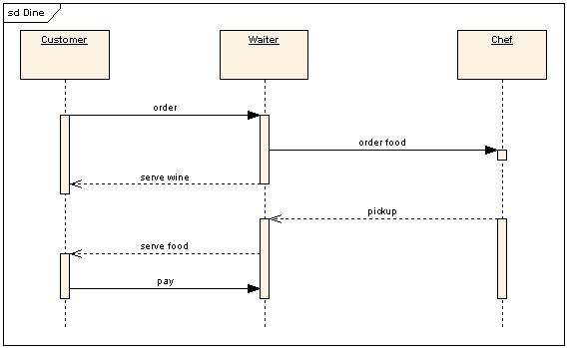
Activity lifecycle
Each vertical box represents an activity performed by the actor / object / comp.
Vertical length is duration of the activity
Messages may trigger activities to start
On completion,
an activity
may trigger a
return message
(dotted)
Wikipedia: UML

Slide 6
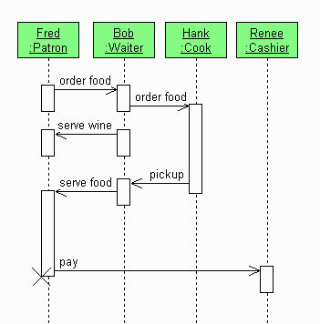
Object lifecycle
When an object dies, an 'X' marks the end of its lifeline:
Wikipedia

Slide 7
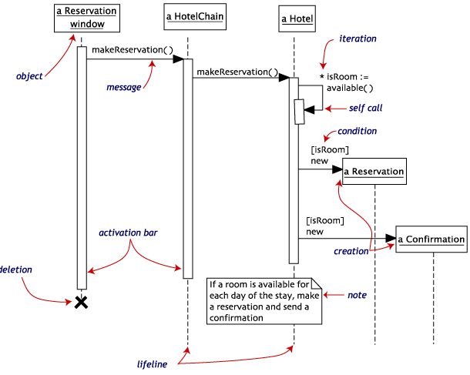
Self-called messages
An object may send a message to itself:
  Arrow loops back to itself
A message may
also be sent
multiple times:
Usually put loops
in a shaded box

Slide 8
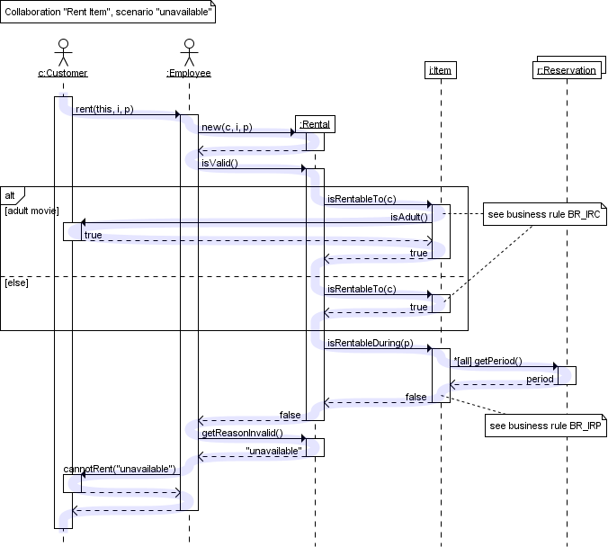
If/else clauses
Put both
cases in
dotted boxes,
with the
if condition
TraceModeler

Slide 9
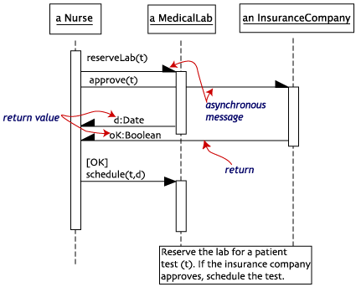
Asynchronous comm.
Synchronous messages (full arrowhead)
require recipient to be listening right then
Asynchronous messages (half arrowhead)
can be read by
recipient at
a later time
  Phone call
  vs. postal mail
  Chat vs. email

Slide 10
UML Software Tools
Eclipse UML2Tools plugin (Model Dev. Tools)
  Help → Install New… → Add …
  Paste URLs for MDT and EMF
  Other plug-ins (M2T) can auto-generate code from your diagrams!
Dia: free diagram editor (not just UML)
IBM Rational Modeler
  free version of commercial Rhapsody prod.
  Complex but complete UML modelling tool
Or draw your own by hand!

Slide 11
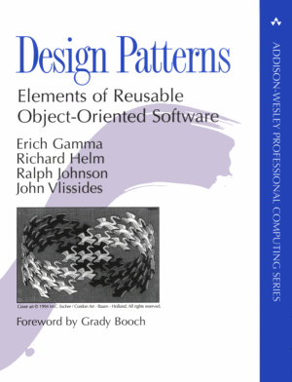
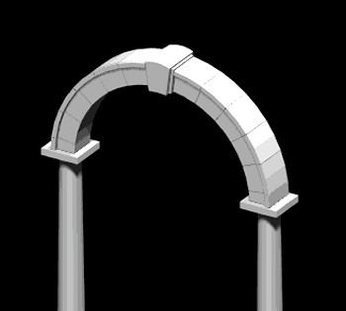
Design patterns
A pattern is a named abstraction
  from a recurring concrete form
  that expresses the essence of
  a proven general solution
A pattern has three parts:
  some recurring problem from the real world
  the context of the problem (when to solve it)
  the rule telling us how to solve it
Describes a class of problems
and how to solve them

Slide 12
Classes of patterns
Conceptual/architectural
  Structural organization of software systems
  Set of predefined components
  Relationships between components
Design
  How to refine each component
  Commonly recurring structure of components
Programming idiom
  How to code a particular component feature

Slide 13

Classes of patterns (GoF)
Creational
  Interfaces to
  generate
  new objects
Structural
  How to organize
  a large system
  in components
Behavioural
  How components interact with each other to accomplish a common goal

Slide 14
Creational patterns
Factory Method: create a variety of objects
Abstract Factory: group of related obj factories
Builder: delegate creation of components
Prototype: clone a template object
Singleton: enforce having only one instance

Slide 15
Creational: factory method
JavaCamp,
Wikipedia
An interface to create an object,
but without specifying which subclass
Analogy: plastic injection-mould
determines shape of output
e.g., need to create a new Person; don't know in advance if it's Student, Staff, or Faculty
PersonCreator
makePerson()
Person
StudentCreator
makePerson()
Student

Slide 16
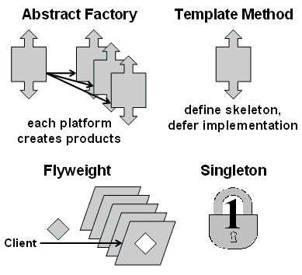
Creational: abstract factory
JavaCamp,
Wikipedia
Family of similar factories
  Client code doesn't know/care which concrete factory is used
  May use a collection of factory methods
Analogy: press to stamp out auto parts
e.g., adaptable look-and-feel of GUI widgets
GUIFactory
newScrollbar()
Scrollbar
MacGUIFactory
newScrollbar()
MacScrollbar

Slide 17
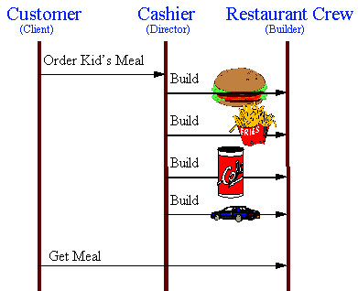
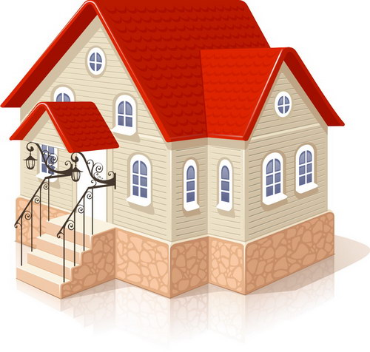
Creational: builder
JavaCamp,
Wikipedia
Separate construction of a complex object
from its representation
  Analogy: assembling fast food kids' meals
Director class parses the request and representation
Hierarchy of Builders
make the objects

Slide 18
Creational: prototype
JavaCamp,
Wikipedia
Create new objects by copying a prototype
  Analogy: biological cell division
  e.g., sheet-music editor: copy and paste notes
    Staves are objects; each note is an object
Design each object so it knows how to copy itself: clone() method
  Copy constructor
MusicElement
clone()
Note
clone()
Rest
clone()
Fermata
clone()

Slide 19
Creational: singleton
JavaCamp,
Wikipedia
Ensure a class only has one instance,
and provide a global point of access to it
    Analogy: only one Prime Minister
Can implement using private constructor
  Provide a static get method for the singleton
    public class PrimeMinister {
private PrimeMinister thePM;
private PrimeMinister() { /* create new PM */ };
public static getPM() {
if (!thePM) thePM = new PrimeMinister();
return thePM; }

