Slide 1
Design Patterns (2):
Structural and Behavioural
5 April 2011
CMPT166
Sean Ho
Trinity Western University
See also:
Vince Huston,
JavaCamp,
OODesign.com

Slide 2

Classes of patterns (GoF)
Creational
  Interfaces to
  generate
  new objects
Structural
  How to organize
  a large system
  in components
Behavioural
  How components interact with each other to accomplish a common goal

Slide 3
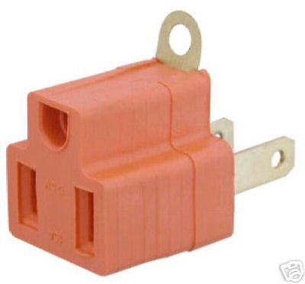

Structural: Adapter
Convert interface of a class so
two incompatible classes
can work together
Like converting 3-prong plug to 2-prong socket, or impedance matching electrical signals
e.g., integrating
prepackaged software
with your existing
system

Slide 4
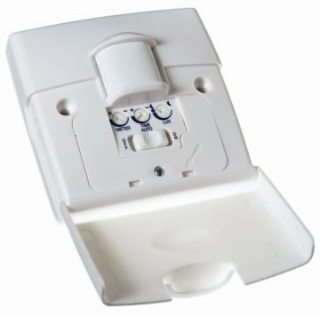
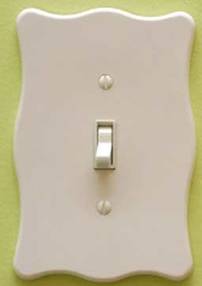
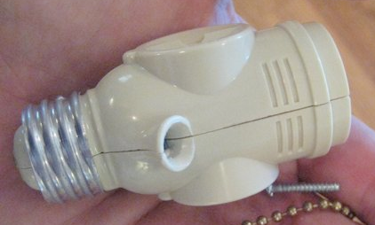
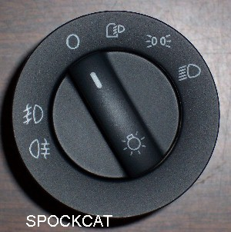
Structural: Bridge
Decouple an abstraction from its implementation so that the two can vary independently
e.g., light switch abstract concept vs.
implementation of kinds of switches
client
abstraction
implementor
refinement
refinement

Slide 5
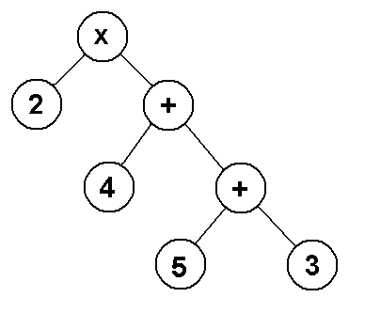
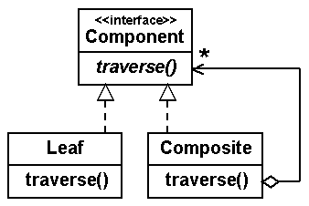
Structural: Composite
Tree structure for objects: treat individual objects and composites in the same way
e.g., file directories have entries, each of which may itself be a directory
e.g., JMenu is a subclass of JMenuItem
e.g., widgets and containers (Android Views)
e.g., expression trees

Slide 6
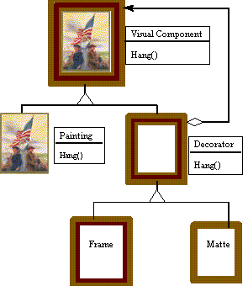
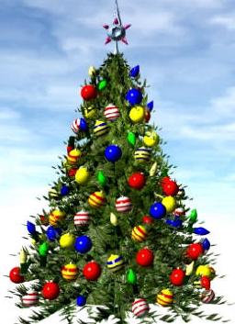
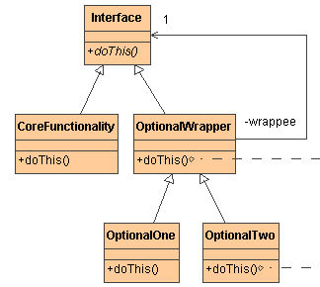
Structural: Decorator
Dynamically add functionality via a wrapper
  More flexible than static subclassing
e.g., JScrollPane for widgets
e.g., ObjectOutputStream on
a FileOutputStream

Slide 7
Structural: Facade
Provide a unified interface to a set of interfaces in a subsystem
  High-level interface: system is easier to use
  e.g., web front-end to complex database:
    want minimal number of widgets, input boxes
complex subsystem
user
facade

Slide 8
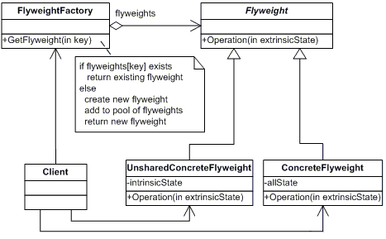
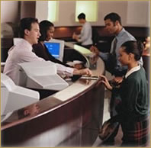
Structural: Flyweight
Draw on-demand from shared pool of
light-weight objects
  May use a factory to create the initial pool
e.g., thread pool for multithread server
Array of
bank tellers

Slide 9
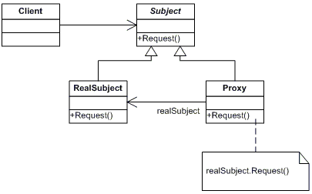
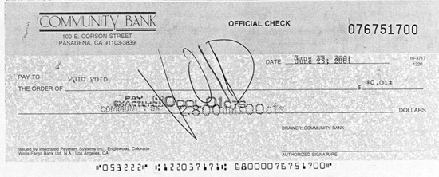
Structural: Proxy
Surrogate for the real object
Access to real object is controlled, but clients think they're talking directly to it
Use superclass over real object and proxy
Contrast: Adapter, Bridge
e.g., proxy HTTP server
e.g., bank cheque

Slide 10
Structural patterns
Adapter/ wrapper: Convert the interface of a class into another interface clients expect
Bridge: split abstraction vs. implementation
Composite: organize objects into trees
Decorator: dynamically add responsibilities / functionality to an object
Facade: hide behind simple interface
Flyweight: use sharing to support large numbers of fine-grained objects efficiently
Proxy: surrogate/placeholder

Slide 11
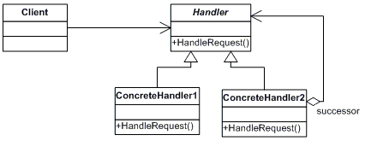
Bhv: Chain of responsibility
Decouple sender from receiver by passing request on a chain of intermediate handlers
  Chain may be reconfigured dynamically
  Single pipeline, but many possible handlers
e.g., coin passing through vending machine
me
my boss
2nd level mgr
regional mgr
vice president
CEO

Slide 12
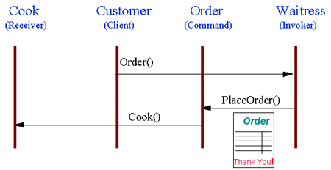
Behavioural: Command
Encapsulate a request as an object
  e.g., function objects, callbacks
Specify: object, method, arguments
e.g., meal order at restaurant
Support undo/redo
client
callback
interface
concrete
callback
concrete
callback
receiver

Slide 13
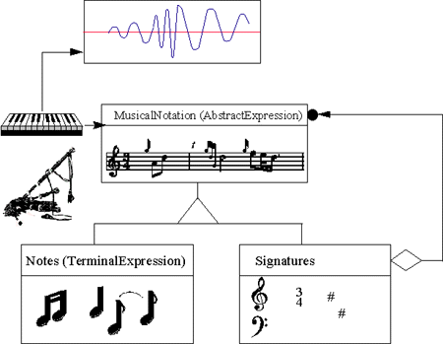
Behavioural: Interpreter
Given a domain-specific language,
define a grammar for the language and
an engine to translate into objects
Vocabulary + syntax
e.g., parse config file
e.g., read music →
produce sound
Useful for repeated,
similar problems in a
well-defined domain

Slide 14
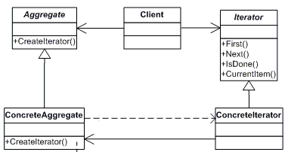
Behavioural: Iterator
Abstract interface to traverse a collection
Hide how the collection is stored
Client interface: first, next, isDone
e.g., secretary knows her own filing system;
boss only needs ask for “next document”
e.g., for/each loop
through dictionaries
  Order irrelevant

Slide 15
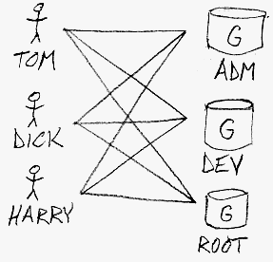
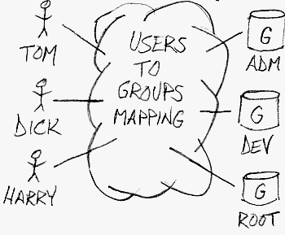
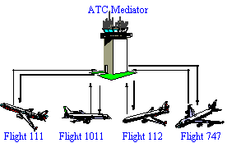
Behavioural: Mediator
Simplify many-to-many relationships: one central object that all actors interact with
  Loose coupling of peers
Encapsulate many interactions
(e.g., methods) into one object
e.g., ATC
w/o mediator
with mediator

Slide 16

Behavioural: Memento
Transparently save/restore object state
  e.g., pickling/serialization
Allows undo/redo, checkpoint/snapshot, etc.
Originator: object that can snapshot
Caretaker: requests snapshot fr Originator, keeps Memento, later restores Originator
Memento: object representing
Originator state

Slide 17
Behavioural: Observer
One-to-many dependency among objects:
When the subject changes state,
all its observers are notified and updated
  e.g., TV/radio broadcast
  e.g., server message “send to all” clients
  e.g., RSS feeds
subject
observer
observer
observer

Slide 18
Behavioural patterns
Chain of responsibility: uncouple sender from receiver via chain of intermediaries
Command: make requests into objects
Interpreter: define macro language + parser
Iterator: access all elements of a collection
Mediator: encapsulates the interactions of a set of objects → loose coupling
Memento: save/restore state of object
Observer: viewers decoupled from subject

