Slide 1
Quality Assurance:
Testing and Balancing
1 March 2011
CMPT420 / COMM350
Sean Ho
Trinity Western University
Further reading:
SoftwareQATest.com

Slide 2
Quiz ch22
At what milestone in production would
a full team of testers be needed?
What format/layout should a test plan use?
Name 3 out of the 4 common bug definitions (types of bugs) noted in the text.
What's the difference between the Severity and the Priority of a bug?
Who is responsible for closing a bug?

Slide 3
Quiz ch22: answers #1-3
At what milestone in production would
a full team of testers be needed?
  Alpha
What format/layout should a test plan use?
  Checklist or pass/fail
Name 3 out of the 4 common bug definitions (types of bugs) noted in the text.
  Crash, critical, minor, feature request

Slide 4
Quiz ch22: answers #4-5
What's the difference between the Severity and the Priority of a bug?
  Severity: crash/critical/minor/feature.
  Impact on gameplay or user experience.
  Priority: order in which bug will be addressed;
  e.g., several bugs with same severity
Who is responsible for closing a bug?
  QA analyst or tester
  (Not the developer or the one who fixed the bug!)

Slide 5
What's on for today
QA is integral to the production process
Approaches to testing:
  Bottom-up vs. top-down
  Black-box vs. white-box
  Workflow vs. edge
  Automated vs. manual
Milestones in QA
Submitting bug reports
  Traffic flow of tickets

Slide 6
Quality assurance
QA is not just squashing bugs! QA is:
Satisfying requirements of the stakeholders
  Producers, game studio ($$), target market
  Servant leadership: are our clients happy?
Delivering what we promised
  Compare against specification/design docs
  Compare against mission stmt, concept pitch
QA happens at every stage of production
  Prevention over cure

Slide 7
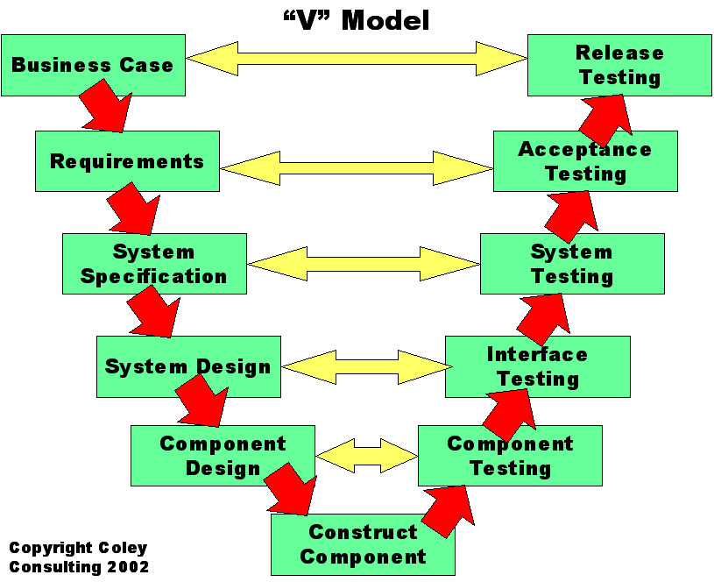
V model (Coley)

Slide 8
Testing reflects requirements
Functionality: pot lifts when we click on it
Performance: pot lifts within 50ms
Usability: Easy to learn? Easy to remember?
Efficient to use? Frequency/severity of errors? Subjective satisfaction of users?
Also: security, scalability, fault-tolerance, accessibility, internationalization,
compatibility / integration, … and more!
Not knowing what to test reflects
not knowing what the requirements are

Slide 9
Approaches to testing: 1
Bottom-up testing: start with unit tests on each chunk of code (method, class, etc.)
  Then integration testing of component intxns
  Then system testing of the whole application
  Exhaustive test coverage is difficult, tedious
Top-down testing: start with end-user play
  Components not used by end-user might not get tested … but they may not be too relevant!
  Multiple bugs may mask each others' effects

Slide 10
Approaches to testing: 2
Black-box testing: without knowledge of the internal workings/code
  e.g., play testing
  (by devs, by beta testers, or by target market)
  e.g., monkey testing
  (random/haphazard clicking)
White-box testing: “Use the source, Luke!”
  Basis path testing: follow the flow of the program
  Use a debugger to track objects, refs, memory
  Document constants, magic numbers, etc.

Slide 11
Approaches to testing: 3
Workflow (end-to-end, user-focused) testing:
  Put yourself in user's shoes: download, install, run, and use it the way a user typically would
  Best is to get a tester from target market
  User might heavily use only 10% of your app
  (but which 10%?)
Edge (boundary, stress) testing:
  Try to break it, deliberately do strange /
  counter-intuitive things
  What is counter-intuitive to you might not be so foreign to your end-users!

Slide 12
Approaches to testing: 4
Automated (regression) testing:
  Test cases organized into test suites
  Fixtures setup toy environment for test cases
  Dashboard shows status of nightly builds
  Often used for lower levels (unit tests, etc.)
Manual (human) testing:
  Writing exhaustive automated test cases is just as hard as writing the code in the first place!
  Usability, look-and-feel, user satisfaction are human intangibles

Slide 13
Milestones in QA
  Pre-alpha: internal white-box testing is ongoing and concurrent with development
Alpha: send to internal black-box testing
  Test team of non-developers
Beta: send to external testers
  Feature freeze; focus on usability testing
Release candidate: ready for release
  Acceptance testing: approved by stakeholders
Gold master / RTM: release to public / sale
Production / live: in daily use by clients

Slide 14
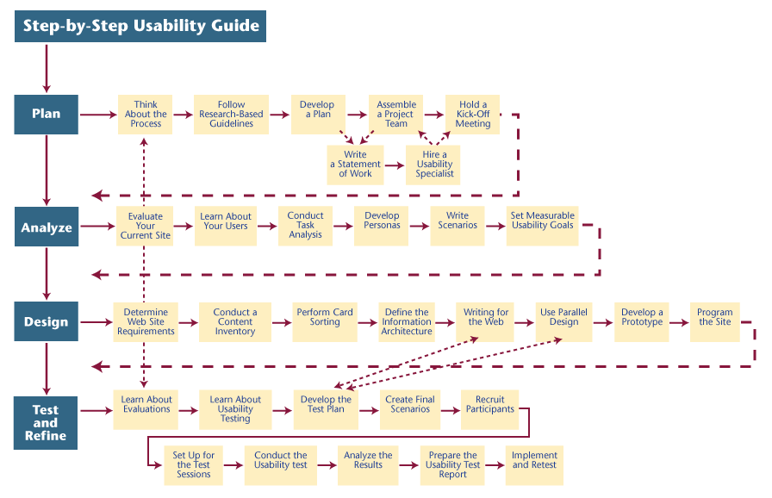
Example QA plan

Slide 15
How-to submit a bug report
Refer to “Policies” and “Testing Procedures” on Trac wiki for details
In the description, include:
  Version you used (e.g., 0.1.6r234)
    And OS (Windows 7, MacOS, etc.)
  Severity of bug (crash, critical, minor, request)
  Minimal sequence of steps to produce the bug
  What behaviour you expected, and
  What actually happened

Slide 16
Traffic flow of tickets
Tester submits / creates new ticket
QA analyst checks ticket for completeness, checks for duplicates, retitles as needed, and assigns to appropriate team lead
Team lead may bounce it to another team, or assign priority and assign it to a member
Team member handles bug and
assigns back to QA analyst
QA analyst coordinates with tester and closes ticket, or sends it back to team lead

Slide 17
Closing tickets
Tickets may be closed as:
  FIXED: tester and QA analyst are happy
  NEEDSINFO: incomplete ticket submission
  (e.g., needs more info on user config, OS, etc.)
  INVALID: not actually a bug
  (e.g., user misconfiguration)
  WONTFIX: low priority, acceptable risk
  DUPLICATE: same as another submitted ticket
  WORKSFORME (Could Not Reproduce):
  may need more info from tester

Slide 18
QA and balancing
QA is ensuring the product / service
satisfies the requirements of stakeholders and delivers what was promised
Usability and playability are important:
  Playing games is voluntary
  Competition in the game market is fierce
  Good game play will make or break your game
→ Game balancing is a vital part of the QA process …

