Slide 1
Finalling: Releasing and
Post-Production
3 March 2011
CMPT420 / COMM350
Sean Ho
Trinity Western University

Slide 2
Quiz ch23-25
Name 2 (out of ≈8) checklist items that should be on a code release checklist.
What 4 questions should a postmortem focus on?
What document does a postmortem produce?
What is the purpose of a closing kit?
What 4 (categories of) items go into a closing kit?

Slide 3
Quiz ch23-25: answers #1-3
Name 2 (out of ≈8) checklist items that should be on a code release checklist.
  Legal/©/EULA, support info, localize, demos, ratings, console/TCR approval, QA approval
What 4 questions should a postmortem focus on?
  Achieve goals? Resources/expectations realistic?
  What went right/wrong? Lessons learned?
What document does a postmortem produce?
  Lessons-learned document

Slide 4
Quiz ch23-25: answers #4-5
What is the purpose of a closing kit?
  Enable a future dev team to continue development
What 4 (categories of) items go into a closing kit?
  Assets, tools, code, documentation

Slide 5
Outline for today: Finalling
Milestones for code release:
  Alpha → Beta → RC → Gold
Closing kits
  Docs + Code + Assets + Tools
Postmortems
  Orig. Plan → Reality → Root Causes → New Goals

Slide 6
Milestones for code release
Closed β:
committed
testers
Console
acceptance
White-box
testing
Internal
black-box
testing
Packaging
Legal,
EULA, ©
Open β:
public
downloads
Manu-
facturing
Content
ratings
Game play
balancing
Playable
prototype
Post-
mortem
Usability
testing
Feature
complete
Code
complete
Closing
kit
Localization
ALPHA
BETA
RC
Gold

Slide 7
Closing kits
Live developer systems (e.g., Trac) may be shutdown after production is complete, so
Closing kit is an archive of the production
Everything a new team would need to continue development or produce a sequel:
  Documentation
  Source code
  Assets
  Tools

Slide 8
Contents of a closing kit: 1
Docs:
  Design docs, UI mockups
  QA test plans / checklists
  External libraries (w/ver): PyGame, PyMunk, …
  Dev tools: Hg, PyDev
  How-to install dev setup, how-to build
  Asset production pipeline
Code:
  Incl. snapshots of gold master code, local tools

Slide 9
Contents of a closing kit: 2
Assets: incl. all asset checklists
  Original source for art (so can tweak)
  Uncompressed audio (music, effects, VO)
  All in-game text (dialogue, tooltips, labels, help)
  Video: in-game FMV, promo trailers
  Localized versions of everything (+ checklists)
Tools: in-house or 3rd-party
  Dev/build tools, asset production tools, localization tools, special plug-ins

Slide 10
Postmortems
Immediately after shipping final product
  While the experience is still fresh in minds
  Budget time for it in schedule, before folks leave
Production process, not details of project
  Lessons need to be portable to next project
Cultivating a culture of learning
  Don't: “Whew, I'm done! Throw it all away!”
  Do: “What can we learn for next time?”
  Learn … history … or repeat …

Slide 11
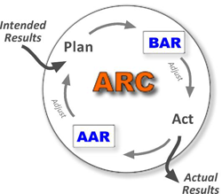
After Action Reviews (AAR)
Conceptual forefather of postmortems
Developed by U.S. Army,
still used in training,
peacekeeping, and combat
What was planned? (objective)
What actually happened? (reality)
What were the root causes? (learning)
What will we sustain or improve? (goals)
Further reading: USAID ppt, USArmy TC25, Signet Consulting

Slide 12
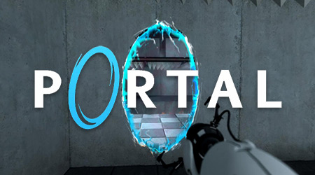
Case study: Valve's “Portal”
(GamaSutra / Game Developer Jan 2008)
8 fresh grads from DigiPenIT
  Senior project: Narbacular Drop
  Job fair → hired by Valve → dev Portal in 26mos
Play tests: e.g., difficulty ramps
Story: GLaDOS character
Using frameworks: extending Source
Performance: LOD+stencils for render speed

Slide 13
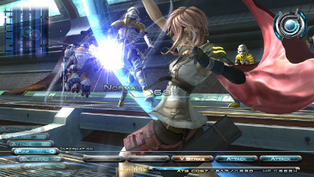
Square/Enix FFXII
GamaSutra: "What Went Wrong?"
and "Behind the Scenes of FF XIII"
Poor communication:
“During the development of Final Fantasy XII, the pressure to succeed was at such a high point that we were on the brink of losing control during even the slightest misunderstanding. What happened was our team was given the freedom to make changes at various stages of development, but the adverse affect of this freedom was miscommunication, confusion, and disorder. How work was to be distributed was also often ambiguous, which contributed to the problem.”
Attaining a shared vision through demo:
“With a tangible version of the game that could actually be played, internal debates transitioned from theoretical discussions based solely on abstract concepts to concrete dialogue. The demo not only unified the vision and understanding of the game’s direction across the entire development team, but it was also the first time that everyone could see exactly how the assets they worked on would function within the game”

Slide 14
Further reading
Postmortems:
  GamaSutra's extensive archive (GameDev mag)
    2009 summary: top 10 “What Went Wrong?”
  Vector Unit's “Hydro Thunder Hurricane”
  (≤7-man, 14-mo, startup)
  AtomicBoy's “Empires of Steel” (1-man failure)
  Lazy8's “Cogs” (indie success)

