Slide 1
DyeWorks – TWU 2011
Game Development Program
28 Jan 2010
Presented to ESLI visitors
Dr. Sean Ho
Trinity Western University

Slide 2
Game Development Program
Interdisciplinary, project-based capstone course
3rd and 4th year students from
  Computing, Art, Music, Business, Communic., …
15 credit hours for Certificate in Game Design:
  3cr discipline-specific prep work (Su-Fa 2010)
    Game design, management, software engineering
  6cr production (Spr 2011)
  6cr beta production and post-prod. (Sum 2011)
Objectives: interdisciplinary teamwork, production, and creating a fun, compelling game!

Slide 3
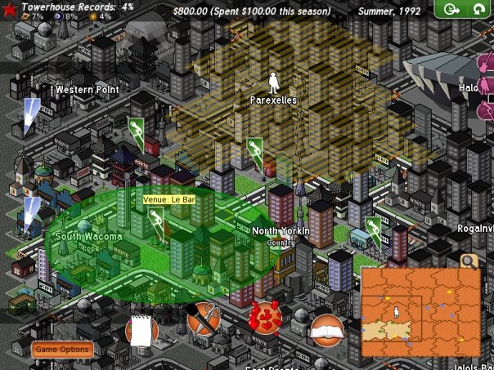
2009: Label: Rise of Band
In 2009, we produced “Label: Rise of Band”
  Turn-based, strategy game
  You play an independent music label
  Decide how to spend money, time
All original artwork,
sound/music
Implementation in
Python / pygame
Freely downloadable:
labelriseofband.com

Slide 4
2011: DyeWorks
In 2011, we are producing “DyeWorks”:
  Collect materials, make dyes, and conquer the market to earn the biggest profit as a manufacturer in the historical world of the booming 19th century textile industry!
Target market is grade 8-9 (13-14 year olds)
Educational game, touching on chemistry, exploration, marketing, fashion design, etc.
  Original concept: life of E.I. duPont
Story: your family has died of typhoid and left you in charge of the business: make decisions and build up the family business!

Slide 5
Mission Statement
Our mission is to educate and entertain grade 7-10 students about the historical aspects of the dye industry of the 19th century by creating an original computer game while providing a learning experience for the interdisciplinary Game Development Team within the framework of a Christian worldview.

Slide 6
Game structure: goal
Game player attention span is limited, so we offer six mini-games, each playable within a few mins
  Can play each mini-game several times
“Shell” game ties them all together,
provides navigation and “levels” of difficulty
Maximize profit by:
  maximizing price per unit
  minimizing cost per unit
  maximizing total sales
Each mini-game affects one of these components

Slide 7
Mini-games
Chemistry research game (affects price):
    mix colours and create new dyes
Temperature control game (affects cost):
    pots of dyes: don't let them overcook!
Resource gathering game (affects sales):
    Mario-like exporation of environments, gather plants
Transportation game (affects cost):
    Decide on fastest/cheapest route to deliver goods
Marketing game (affects sales):
    Send out more salespeople than competitors
Clothing / fashion matching game (affects price):
    Match with fashion magazines, using our dyes

Slide 8
Team organization
3 Executive Producers (faculty):
  Kevin Schut, Alma Barranco, Sean Ho
1 Program Manager: Tabitha Ewert (Bus. student)
Skills-based teams:
  Game design team (lead: Kevin Schut)
  Art team (lead: Alenka Kyslik)
  Writing team (lead: Heather Cerny)
  Software team (lead: Joy Roodnick)
Interdisciplinary teams:
  User Interface, Quality Assurance, ...

Slide 9
Pre-Production
Concept: mission (of project), concept (of game), genre, stakeholders, risk analysis: → pitch
Features: decomposition of the task
  Assets: art, sound, text
  Software components
  Prioritize: MoSCoW must / should / could / won't
Milestones: date + deliverables
Schedule / Game Plan:
  Dependencies amongst features/assets/tasks
  Estimate needed time/resources (this is hard!)
  Feasibility: reduce features if necessary

Slide 10
Agile development model
“Waterfall” method does each stage completely before moving on, in a rigid fashion:
Requir. → Planning → Production → QA → Release
  Hard to determine requirements in advance
  Hard to estimate needed time/HR/tools
Agile (aka Spiral) methods are “iterated waterfall”
  Scrum is one such method
  Each iteration through the spiral is a sprint
    Sprints need to be short! 1-4 weeks
  Early prototypes → early feedback
Requir.
Release
Design
QA
Production

