Slide 1
Ch6-7: Heapsort & Quicksort
25 Sep 2012
CMPT231
Dr. Sean Ho
Trinity Western University

Slide 2
Outline for today
  Overview of sorting algorithms
Binary max-heaps
  heapify(): maintaining the max-heap property
  build_max_heap(): creating a max-heap
  Application: Heap Sort
  Application: Priority Queue
Quicksort
  Partition & pivot
  Randomised quicksort
  Complexity analysis
Review for exam next week (ch1-4)

Slide 3
Summary of sorting algorithms
Comparison sorts (ch2, 6, 7)
  Insertion sort: Θ(n²), easy to program, slow
  Merge sort: Θ(n lg(n)), out-of-place sorting,
  slow due to lots of copying / memory operations
  Heap sort: Θ(n lg(n)), in-place, uses max-heap
  Quick sort: Θ(n²) worst-case, Θ(n lg(n)) average, in-place, fast (small) constant factors
Linear-time non-comparison sorts (ch8):
  Counting sort: k distinct values: Θ(k)
  Radix sort: d digits w/k values: Θ(d(n+k))
  Bucket sort: for uniform distrib. of values: Θ(n)

Slide 4
Outline for today
  Overview of sorting algorithms
Binary max-heaps
  heapify(): maintaining the max-heap property
  build_max_heap(): creating a max-heap
  Application: Heap Sort
  Application: Priority Queue
Quicksort
  Partition & pivot
  Randomised quicksort
  Complexity analysis
Review for exam next week (ch1-4)

Slide 5
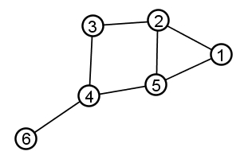
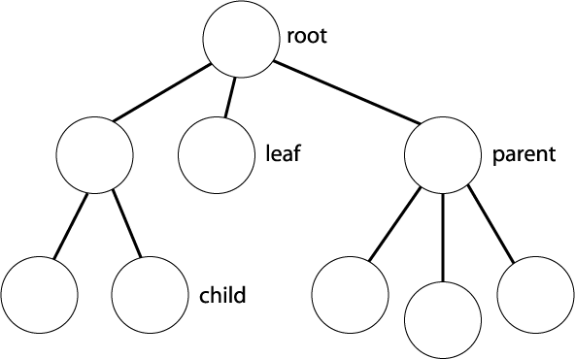
Binary trees
Graph: collection of nodes and edges
  Edges may be directed or undirected
Tree: directed acyclic graph (DAG)
  Choose a node as root
  Parent: immediate neighbour toward root
  Leaf: node with no children
  Degree: maximum number of children
  Node height: max # edges to leaf child
  Node depth: # edges to root
  Level: all nodes of same depth
Binary tree: tree with degree=2

Slide 6
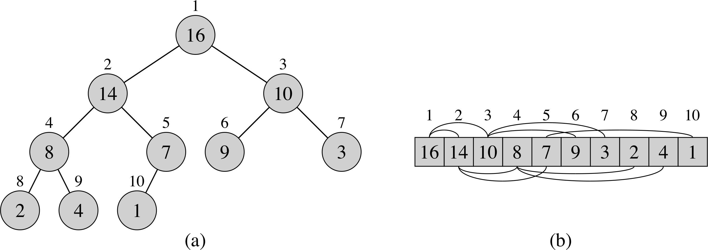
Binary heaps
Array storage for
certain binary trees
  Children of node i are at 2i and 2i+1
  Must fill tree left-to-right, one level at a time
Max-heap: value of a node is ≤ value of its parent
  Min-heap: ≥
max_heapify() (O(lg n)): reposition a given node i so it satisfies the max-heap property
build_max_heap() (O(n)):
construct a max-heap from an unordered array
heapsort() (O(n lg n)): sort array in-place

Slide 7
max_heapify(): for single node
max_heapify(A, i):
  Precondition: left and right sub-trees of i
  satisfy the max-heap property
  Postcondition: subtree at i satisfies max-heap
Algorithm:
  Amongst {i, left(i), right(i)}, find the largest
  If i is not the largest, then
    Swap i with the largest, and
    Recurse/iterate on that subtree

Slide 8
max_heapify(): pseudocode
max_heapify(A, i):
    largest = i
    if 2i ≤ length(A) and A[2i] > A[largest]:
      largest = 2i
    else if 2i+1 ≤ length(A) and A[2i+1] > A[largest]:
      largest = 2i+1
    if largest ≠ i:
      swap( A[i], A[largest] )
      max_heapify(A, largest)
A=[2, 8, 4, 7, 5, 3, 1, 6], i=1:
Running time?
2
8
4
7
5
3
1
6

Slide 9
Outline for today
  Overview of sorting algorithms
Binary max-heaps
  heapify(): maintaining the max-heap property
  build_max_heap(): creating a max-heap
  Application: Heap Sort
  Application: Priority Queue
Quicksort
  Partition & pivot
  Randomised quicksort
  Complexity analysis
Review for exam next week (ch1-4)

Slide 10
Building a max-heap
build_max_heap(A):
  Input: array of items in any order
  Output: array has max-heap property
Algorithm:
  Leave last half of array as all leaves
  Apply max_heapify() to each item in first half:
    for i = floor( length(A)/2 ) .. 1:
      max_heapify( A, i )
    Descending order: each time max_heapify() is called on a node, its subtrees are already max-heaps
Exercise: try it on [5, 2, 7, 4, 8, 1]

Slide 11
build_max_heap(): complexity
Group iterations of for loop by height h of node:
  Each call to max_heapify(i) takes O(h)
  # of nodes with height h is ≤ ceil(n / 2^{h+1})
    Attains that bound when tree is full
So algorithmic complexity is Σ( (n / 2^{h+1}) O(h) )
    Sum for h = 0 .. lg(n) is ≤ sum for h = 0 .. ∞
  = n O( Σ (1/2)^{h+1} ), where sum is for h = 0 .. ∞
  = O(n)
We can build a max heap in linear time!
  But it's not quite a sorting algorithm....

Slide 12
Using max-heaps for sorting
Algorithm:
  Make array a max-heap
  Repeat, working backwards from end of array:
    Swap root of max-heap with last leaf of heap
    Shrink heap by 1 and apply max_heapify()
At each iteration of the loop:
  First portion of array is a max-heap
  Last portion is a sorted array (largest items)
Complexity: Θ(n) calls to max_heapify() (Θ(lg n))
  ⇒ Θ(n lg(n) )
Exercise: try it on [5, 2, 7, 4, 8, 1]

Slide 13
Outline for today
  Overview of sorting algorithms
Binary max-heaps
  heapify(): maintaining the max-heap property
  build_max_heap(): creating a max-heap
  Application: Heap Sort
  Application: Priority Queue
Quicksort
  Partition & pivot
  Randomised quicksort
  Complexity analysis
Review for exam next week (ch1-4)

Slide 14
Binary heap for priority queue
Binary heaps can implement a priority queue:
  Set of items with attached priorities
Interface (set of operations):
  insert(A, item, pri): add item to the queue A
  find_max(A): return item with highest priority
  pop_max(A): same but also delete item
  set_pri(A, item, pri): set new priority for item (must be higher than old priority)
Setup queue by building a max-heap
  find_max() is easy: return A[1]
  pop_max() also easy: remove A[1] and heapify

Slide 15
Inserting into priority queue
set_pri(A, i, pri): starting from i,
“bubble” item up until we find the right place:
      A[i] = pri
      while i>1 and A[ i/2 ] < A[ i ]:
        swap( A[ i/2 ], A[ i ] )
        i = i/2
  Complexity: # iterations = Θ(lg n)
insert(A, pri): make a new node and set its priority
      A.length++
      set_pri( A, A.length, pri )
    Typically, use pre-allocated fixed-length array, and use separate variable to track size of queue
  Complexity: same as set_pri(): Θ(lg n)

Slide 16
Priority queue: summary
Build priority queue using a max-heap: Θ(n)
Get highest priority item: Θ(1)
Get and delete highest priority item: Θ(lg n)
Set new priority for an item: Θ(lg n)
Insert new item into queue: Θ(lg n)

Slide 17
Outline for today
  Overview of sorting algorithms
Binary max-heaps
  heapify(): maintaining the max-heap property
  build_max_heap(): creating a max-heap
  Application: Heap Sort
  Application: Priority Queue
Quicksort
  Partition & pivot
  Randomised quicksort
  Complexity analysis
Review for exam next week (ch1-4)

Slide 18
Quicksort
Divide: partition array A[p .. r] such that:
    max( A[ p .. q-1 ] ) ≤ A[ q ] ≤ min( A[ q+1 .. r ] )
Conquer: recurse on each part:
    quicksort(A, p, q-1) and quicksort(A, q+1, r)
No combine/merge step needed
In-place sort
Worst-case turns out to still be Θ(n²), but
average-case is Θ(n lg(n)), with small constants
In practise, quicksort is one of the best algorithms when input values can be arbitrary

Slide 19
Quicksort: partition
How to do the partitioning?
  Pick last item as the pivot
  Walk through array, partitioning array into items ≤ pivot and items > pivot
  Lastly, swap pivot into place
    partition(A, p, r):
        pivot = A[ r ]
        split = p
        for cur = p .. r-1:
          if A[ cur ] ≤ pivot:
            swap( A[ split ], A[ cur ] )
            split++
        swap( A[ split ], A[ pivot ] )
        return split
p
split
cur
r
≤ pivot
> pivot
unseen
piv
Complexity?

Slide 20
Quicksort: complexity
Worst-case if every partition is the most uneven:
    pivot (last item) is either largest or smallest item
    T(n) = T(n-1) + T(0) + Θ(n)
    ⇒ T(n) = Θ(n²)
  Example inputs that give worst case?
Best-case if every partition is exactly in half:
    T(n) = 2T(n/2) + Θ(n)
    ⇒ T(n) = Θ(n lg(n))
  Example inputs that give best case?
Average-case, assuming random input?

Slide 21
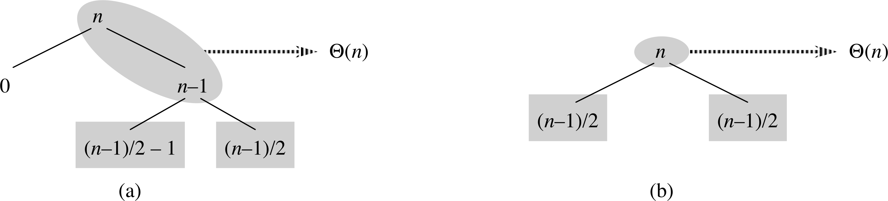
Quicksort: average case
Not every partition will be best-case ½ – ½
  On average, in between best and worst cases
  Even if average split is, say, 9/10 – 1/10:
      T(n) = T( (9/10)n ) + T( (1/10)n ) + Θ(n)
      ⇒ T(n) = O( n lg(n) )
E.g., assume splits alternate between best+worst:
  Only adds O(n) work to each of O(lg n) levels
  ⇒ still O( n lg(n) ) (albeit w/higher constant)

Slide 22
Quicksort with constant splits
p.178, #7.2-5: assume every split is α vs 1-α,
with constant 0 < α < ½.
  Min/max depth of a leaf in the recursion tree?
Min depth: follow smaller side (α) of each split
  How many splits until reach leaf (1 item)?
    α^{m} n = 1 ⟹ m = -lg(n) / lg(α)
Max depth: follow larger side (1-α) of each split
  How many splits until reach leaf (1 item)?
    (1-α)^{m} n = 1 ⟹ m = -lg(n) / lg(1-α)
Both are Θ(lg n), so with constant-ratio splits, depth of recursion tree is Θ(lg n),
⇒ total complexity is Θ(n lg n)

Slide 23
Outline for today
  Overview of sorting algorithms
Binary max-heaps
  heapify(): maintaining the max-heap property
  build_max_heap(): creating a max-heap
  Application: Heap Sort
  Application: Priority Queue
Quicksort
  Partition & pivot
  Randomised quicksort
  Complexity analysis
Review for exam next week (ch1-4)

Slide 24
Randomised quicksort
We saw how giving quicksort pre-sorted data results in worst-case behaviour
  Always chose last element (r) as pivot
We can alleviate this risk by randomising our choice of pivot:
      rand_partition(A, p, r):
        swap( A[ r ], A[ rand(p, r) ] ) # swap w/random item
        partition(A, p, r)
  It is still possible our random pivot choices result in worst-case Θ(n²) time – but unlikely!

Slide 25
Randomised quicksort: average
Assume items are distinct, and name them in order: {z₁, z₂, …, z_{n}}. How many comparisons?
    Worst case: all pairs (z_{i}, z_{j}) compared ⟹ Θ(n²)
    A pair cannot be compared >1 time, because comparisons are only made against pivots, and
    once a pivot is used by partition(), it is not revisited
When is a pair (z_{i}, z_{j}) compared?
  Only if either z_{i} or z_{j} are chosen as a pivot before any other item inbetween {z_{i}, z_{i+1}, …, z_{j}}
    (If any other item is chosen first, then z_{i}, z_{j} will be on opposite sides of the split, and will not be compared)
  ⇒ probability is 2( 1 / (j - i + 1) )

Slide 26
Randomised quicksort: average
Summing over all pairs (z_{i}, z_{j}):
=
=
<
=
=

Slide 27
Outline for today
  Overview of sorting algorithms
Binary max-heaps
  heapify(): maintaining the max-heap property
  build_max_heap(): creating a max-heap
  Application: Heap Sort
  Application: Priority Queue
Quicksort
  Partition & pivot
  Randomised quicksort
  Complexity analysis
Review for exam next week (ch1-4)

Slide 28
Review for Exam1: ch1-4
Open-book, open (paper) notes!
    But no laptop/mobile/tablet, no communication
  Similar to textbook Exercises
Algorith. complexity: Θ(=), O(≤), Ω(≥), o(<), ω(>)
    Know their technical definitions!
    Proofs!
Solving recurrences: induction, master method
Algorithms to be familiar with:
  Insertion sort, bubble, merge, max subarray
  Matrix multiply (3 algorithms!)

