Slide 1
Ch10, 12: Data Structures using Pointers
16 Oct 2012
CMPT231
Dr. Sean Ho
Trinity Western University

Slide 2
Outline for today
Dynamic data structures: using pointers
Linked lists
  Variants: doubly-linked, circular
Stacks and queues
Trees
Binary search trees (BSTs)
  Tree traversals
  Searching
  Min/max and successor/predecessor
  Insert and delete

Slide 3
Pointers
Local variables created as a program runs are stored in a region of memory called the heap
  Static variables & formal parameters are stored in the stack frame (size known at compile time)
A pointer is a variable whose value refers to a memory location in the heap
      int myAge = 20;
      int* myAgePtr;
      myAgePtr = &myAge; // get address of myAge
      cout << *myAgePtr; // dereference the pointer
  Pointer arithmetic can be dangerous
      *(myAgePtr+1); // segfault!
      *(103883); // ref random spot in mem
0xff0...
20
myAgePtr
myAge

Slide 4
Pointer-less languages
To prevent segfaults, most languages (besides C/C++) do not have explicit pointers
Instead, you can create references (“aliases”):
      ages = [ 3, 5, 7, 9] # Python list (mutable obj)
      myAges = ages # create an alias
      myAges[2] = 11 # overwrites “7”
      ages # [ 3, 5, 11, 9 ]
Variables are entries
in a namespace,
mapping to locations
in the heap
Be aware of when a reference is made vs a copy!
Namespace: __main__
ages | 0xff0...
myAges | 0xff0...
<list>
3, 5, 7, 9
Heap

Slide 5
Outline for today
Dynamic data structures: using pointers
Linked lists
  Variants: doubly-linked, circular
Stacks and queues
Trees
Binary search trees (BSTs)
  Tree traversals
  Searching
  Min/max and successor/predecessor
  Insert and delete

Slide 6
Linked lists
Linear, array-like data structure, but
  Dynamic (can change length)
    Length does not need to be known at compile time)
  Mid-list insertion/deletion is fast
    Don't need to shift by copying
  But random access is slower than array
    Need to walk down list from head
class Node:
def __init__(self, key=None, next=None):
self.key = key
self.next = next
head = Node(9)
head = Node(7, head)
head = Node(5, head)
head = Node(3, head)
3
5
7
9 /
head
key
next

Slide 7
Linked list variants
The basic list is a singly-linked list
Doubly-linked lists have both .prev and .next pointers in each node:
      class Node:
        def __init__(self, key=None, prev=None, next=None):
          (self.key, self.prev, self.next) = (key, prev, next)
  Also good to have both head and tail pointers
    Better to have separate datatype for the overall list:
      class LinkedList:
        def __init__(self, head=None, tail=None):
          (self.head, self.tail) = (head, tail)
      x = LinkedList(Node(3), Node(5))
      x.head.next = x.tail
      x.tail.prev = x.head
prev
next
key
3
5
head
tail

Slide 8
Circularly-linked lists
In a circular singly-linked list, the next pointer of the last node points back to the first node:
  When traversing the list, make sure we don't just keep circling endlessly!
    e.g., store length of list, and track how many nodes we've traversed
    or: add a sentinel node with a special key
In a circular doubly-linked list, both next and prev links wrap around
3
5
7
9
head

Slide 9
Operations on linked lists
Insert(key): create a new node with given key,
and insert it at the head of the list
      def insert(self, key=None):
        self = Node(key, self)
Search(key): return a reference to node with given key, or return None if it doesn't exist
      def search(self, key):
        cur = self
        while cur != None:
          if cur.key == key:
            return cur
          cur = cur.next
        return None
3
5
7
9 /
head
cur

Slide 10
Splicing nodes
Delete(node): splice given node out of list
  Can be given a reference directly to the node
    Or given a key (for which we first search)
  Update prev/next links in neighbouring nodes to skip over the deleted node
      node.prev.next = node.next
      node.next.prev = node.prev
  Free the unused memory so it can be reused
      del node
    Otherwise it becomes garbage: allocated memory in the heap that is unused and unreachable
    Source of memory leaks: heap grows and grows as program runs
3
5
7

Slide 11
Outline for today
Dynamic data structures: using pointers
Linked lists
  Variants: doubly-linked, circular
Stacks and queues
Trees
Binary search trees (BSTs)
  Tree traversals
  Searching
  Min/max and successor/predecessor
  Insert and delete

Slide 12


Stacks and queues
©Dennis Galante/evolveimages.com
Stack: LIFO: last-in-first-out
  like papers on a memo spike
Queue: FIFO: first-in-first-out
  like a pipeline, or a queue at the bank
Interface:
  length(), isempty(): # items
  push(x): add x to stack/queue
  peek(): get item without deleting
  pop(): peek and remove item
Underflow: peek/pop on an empty stack/queue
Overflow: push on a full stack/queue
leadenergy.org

Slide 13
Implementing stacks/queues
Stacks/queues are abstract data types (ADTs):
  Defined in terms of their operations / interface
  Various implementations have different memory usage, computational complexity, etc.
Can use either arrays or linked-lists to implement
  e.g., stack with a singly-linked list:
      class Stack:
        def __init__(self):
          self.head = None
        def push(self, key): # overflow not a concern
          self.head = Node(key, self.head)
        def pop(self): # watch for underflow!
          item = self.head
          self.head = self.head.next

Slide 14
Outline for today
Dynamic data structures: using pointers
Linked lists
  Variants: doubly-linked, circular
Stacks and queues
Trees
Binary search trees (BSTs)
  Tree traversals
  Searching
  Min/max and successor/predecessor
  Insert and delete

Slide 15
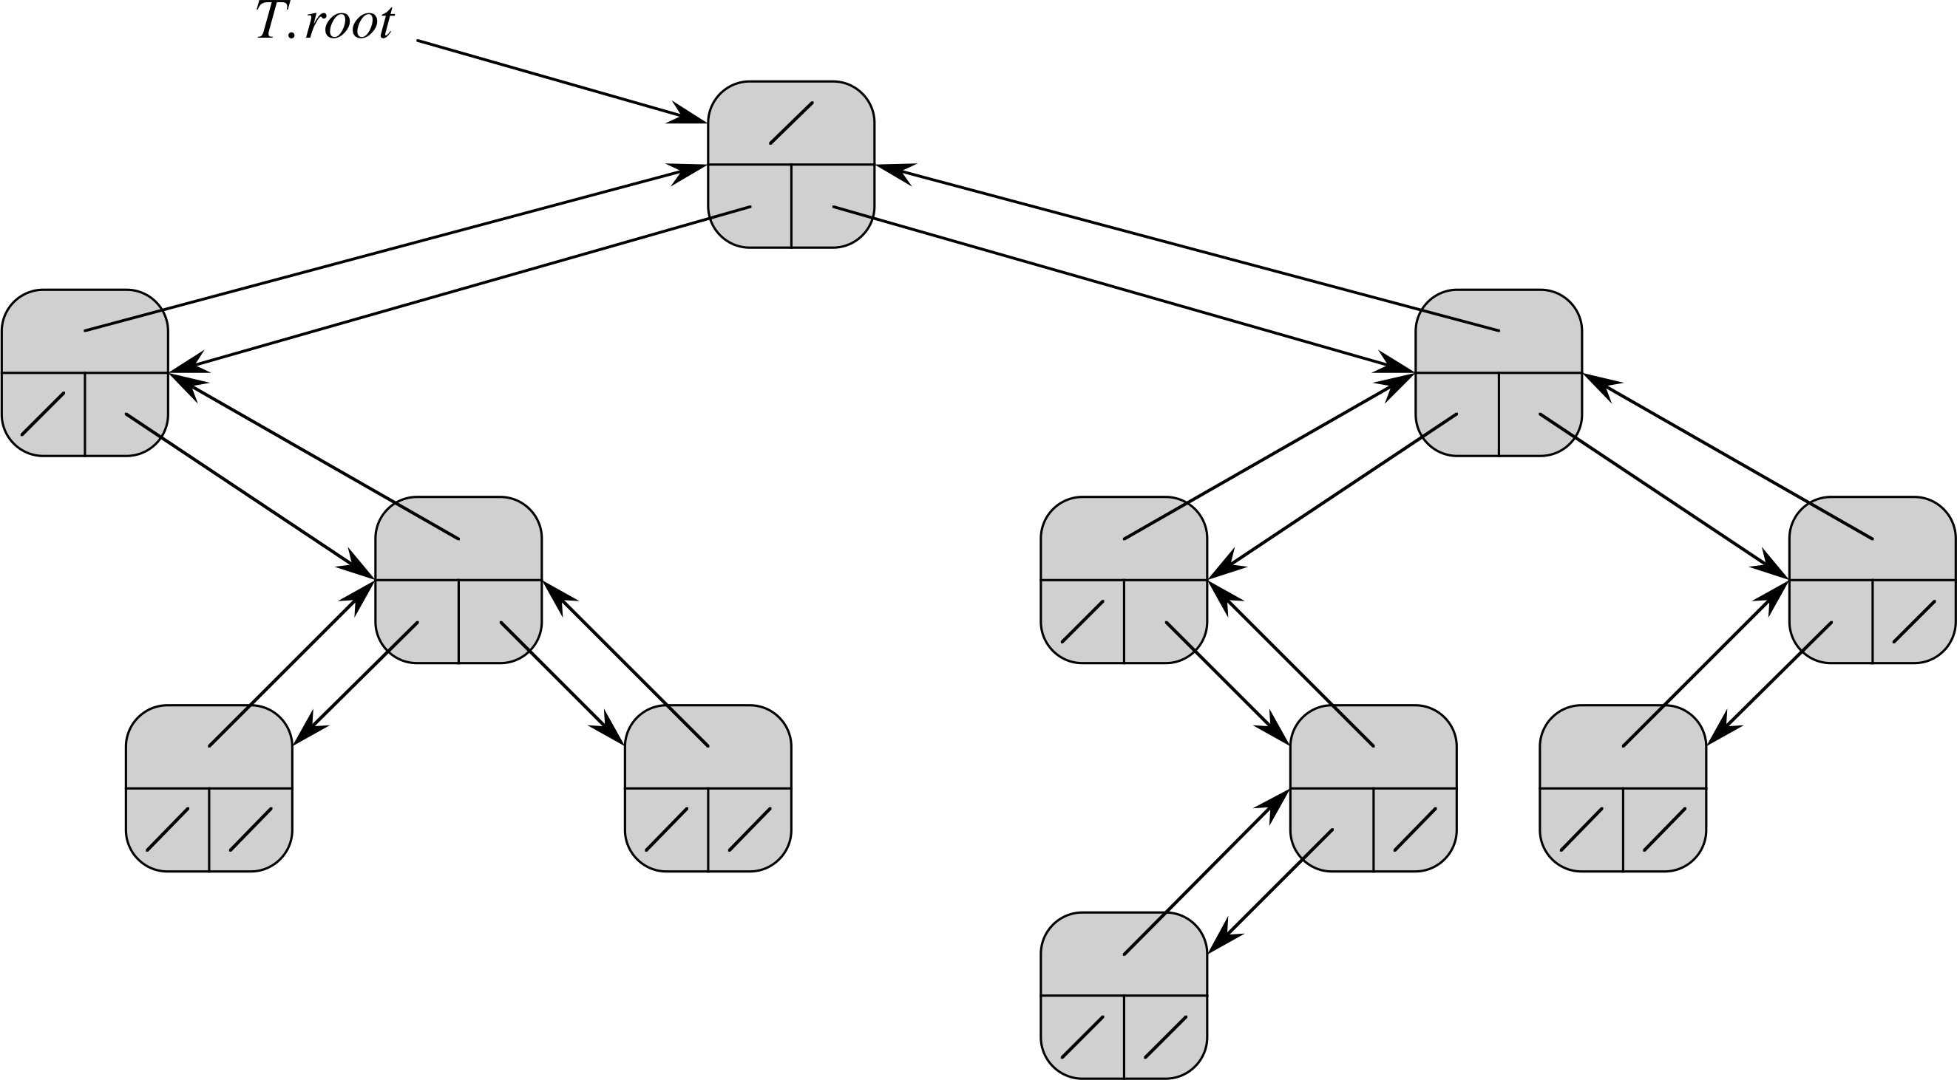
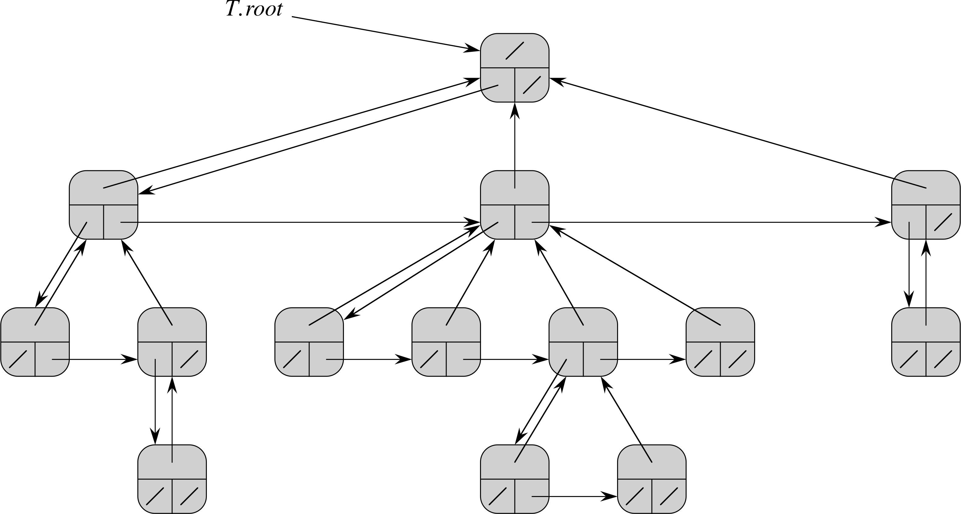
Trees
For binary trees, use 3 pointers:
  Parent, left child, right child
      class TreeNode:
        def __init__(self, par=None, left=None, right=None):
          (self.par, self.left, self.right) = (par, left, right)
      class Tree:
        def __init__(self, root=None):
          self.root = root
For d-way trees, with unknown degree d:
  Pointers: parent,
  first child, next sibling

Slide 16
Search trees
Trees for fast searching
Operations: insert, delete, search
  Θ(height of tree): for full tree, Θ(lg n)
  Can implement a dictionary or priority queue
Kinds of trees include binary search trees (ch12), red-black trees (ch13), B-trees (ch18)
Binary search tree (BST): a binary tree with
  BST property: at any node x,
    Every node y in left sub-tree has y ≤ x
    Every node y in right sub-tree has y ≥ x
5
3
8
2
4
5

Slide 17
Tree traversals
5
Traversals/walks print out all nodes
Preorder: print self before either child
      preorder(node):
        print node.key
        preorder( node.left )
        preorder( node.right )
  Output: 5, 3, 2, 4, 5, 8
Postorder: print both children first before self
  Output? Pseudocode?
Inorder: print left child, then self, then right child
  Output? Pseudocode?
Which is useful on a tree with the BST property?
3
8
2
4
5

Slide 18
Expression trees
+
*
9
Trees are also used to
parse & evaluate expressions:
    e.g., ( 2 * (-4) ) + 9
  Which traversal produces this expression?
  What tree would represent 2 * (-4 + 9)?
Reverse Polish Notation (RPN):
    e.g.: 2, 4, -, *, 9, +
  Which traversal produces RPN?
  Make an RPN calculator using a stack:
2
-
4
.
2
4
4
2
–
-4
2
*
.
-8
9
9
-8
+
.
1

Slide 19
Outline for today
Dynamic data structures: using pointers
Linked lists
  Variants: doubly-linked, circular
Stacks and queues
Trees
Binary search trees (BSTs)
  Tree traversals
  Searching
  Min/max and successor/predecessor
  Insert and delete

Slide 20
Searching a BST
root
5
3
8
Comparison with node's key tells us
which subtree to recurse down:
      search(node, key):
        if node is NULL or node.key == key:
          return node
        if key < node.key:
          return search( node.left, key )
        else:
          return search( node.right, key )
    e.g., search(root, 4)
Complexity is O(height of tree)
  If tree is full, this is Θ(lg n)
  But in worst-case: linked-list is also a tree!
  ⇒ want to keep tree balanced
2
4
5
3
4
5
8

Slide 21
Min/max of BST
5
3
8
Find the smallest/largest keys in a BST:
Smallest:
  Keep taking left child as far as we can
      min(node):
        while node.left is not NULL:
          node = node.left
        return node.key
Largest: keep taking right child as far as we can
      max(node):
        while node.right is not NULL:
          node = node.right
        return node.key
Could also implement recursively, but iterative solution is faster, less memory
2
4
5

Slide 22
Successor / predecessor
8
4
s?
9
The successor of a node is
next in line in an in-order traversal
  Predecessor is previous in line
If right subtree is not NULL:
  Successor = min of right subtree
If right subtree is NULL:
  Walk up the tree until a parent link turns right
      successor(node):
        if node.right is not NULL:
          return min( node.right )
        (cur, par) = (node, node.parent)
        while par is not NULL and cur == par.right:
          (cur, par) = (par, par.parent)
        return par
2
5
p?
1
3
4
8
s?
7

Slide 23
Inserting into a BST
8
4
9
Do a search to find spot to add node:
      insert(root, key):
        cur = root
        while cur is not NULL:
          if key < cur.key:
            if cur.left is NULL:
              cur.left = new Node(key)
              cur.left.parent = cur
              return
            cur = cur.left
          else:
            if cur.right is NULL:
              cur.right = new Node(key)
              cur.right.parent = cur
              return
            cur = cur.right
2
5
1
3
4
8
7
go left
insert(6)?
go right

Slide 24
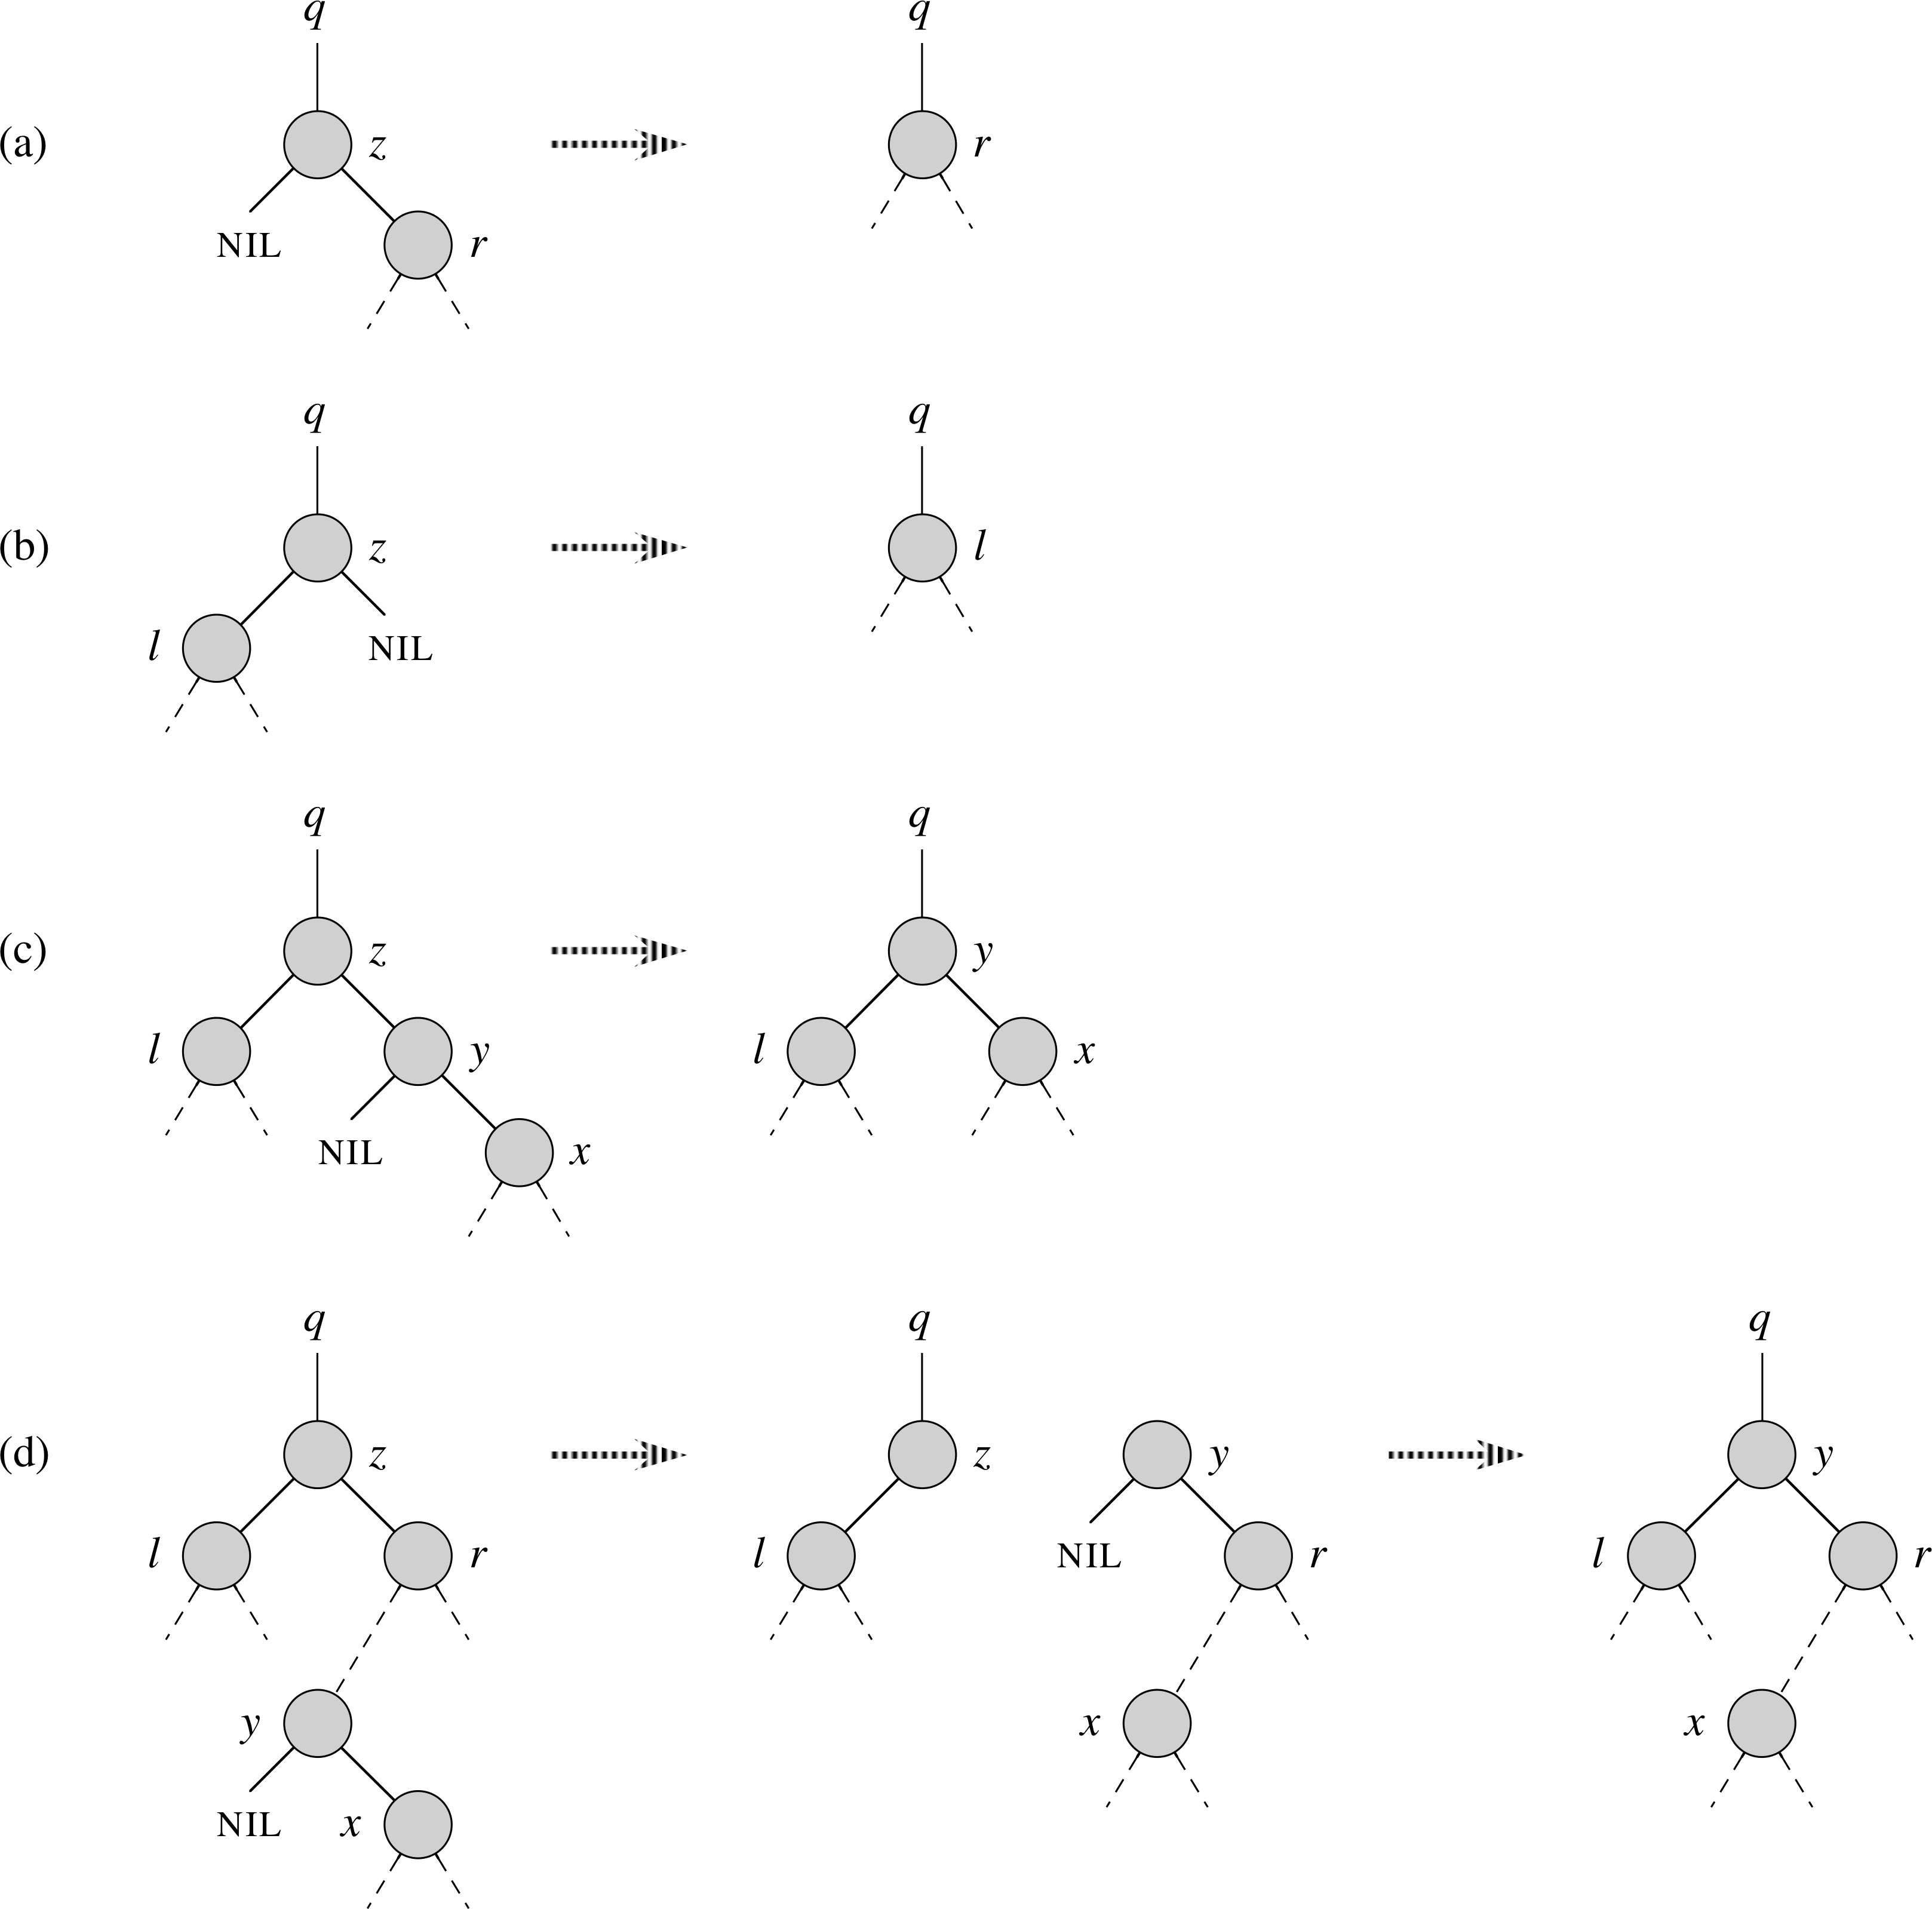
Deleting from a BST
If node z is a leaf, just delete it
(and update links)
If node has one child, promote it to node's place
  Child brings its subtrees along with it
If node has two children, find its successor y:
  Successor must be in right subtree,
  with no left child (why?)
  Need to do a bit more splicing
6
3
8
2
4
del?
5

Slide 25
Deletion, continued
If the node z has two children, find its successor y:
  if successor is
  a direct child,
  just promote it:
  If successor is elsewhere in right tree:
    Replace it with its own right child r, then
    Replace the node z with the successor y
End result: y replaces z, and the rest of
z's old right subtree
becomes
y's right subtree
3
del?
1
8
5
9
7

Slide 26
Outline for today
Dynamic data structures: using pointers
Linked lists
  Variants: doubly-linked, circular
Stacks and queues
Trees
Binary search trees (BSTs)
  Tree traversals
  Searching
  Min/max and successor/predecessor
  Insert and delete

