Slide 1
Ch18: B-Trees
23 Oct 2012
CMPT231
Dr. Sean Ho
Trinity Western University

Slide 2
Outline for today
B-Trees
  Motivation: properties of spinning disks
  B-tree concept
  Search in O(t log_{t} n)
  Insert in O(t log_{t} n)
  Delete in O(t log_{t} n)
  Application to filesystems
Midterm review (ch6-8, 11)

Slide 3
Balancing search trees
Complexity of most tree ops depends on height
  Search, insert, delete
  Worst case: tree becomes a linked list
How to keep tree balanced, bushy (low height)?
BSTs with tree rotations:
  Red-black trees (ch13)
    Levels alternate colour: longest path ≤ 2 * shortest
  AVL trees
    Rotate after insert/delete
  Splay trees
    Search/ins/del rotate node to root and rebalance

Slide 4
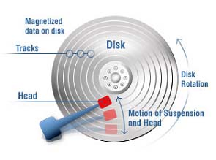
Trees for disk storage
Accessing a spinning disk:
  Seek: move head to desired track,
  wait until desired sector comes to head (slow)
  Throughput: reading consecutive sectors (fast)
Lots of small iops (I/O operations/sec) are bad
  ⇒ so buffer and do I/O in large pages at a time
    Minimise # disk accesses (also good for network fs)
  Read pages to RAM, modify, and write back
    Only a limited # pages can be in RAM at a time
Tree-based disk filesystem: 1 node ↔ 1 page
  Very low, bushy tree with large degree
victimoftechnology.com

Slide 5
Outline for today
B-Trees
  Motivation: properties of spinning disks
  B-tree concept
  Search in O(t log_{t} n)
  Insert in O(t log_{t} n)
  Delete in O(t log_{t} n)
  Application to filesystems
Midterm review (ch6-8, 11)

Slide 6
B-trees
  Generalisation of BST: (left) ≤ key ≤ (right)
In a B-tree of min-degree t, every node has:
  nkeys sorted keys (t-1 ≤ nkeys ≤ 2t-1)
  (if non-leaf) nkeys+1 links to child nodes, interleaved between the keys
    Hence degree is between t and 2t
All leaves are at same depth h
  For a tree of min-degree t and height h,
  what are min/max # of keys stored?
B+-tree: data/payload stored in leaves
B*-tree: 2t-1 < nkeys < 3t-1

Slide 7
B-tree with t=2
Also called 2-3-4 tree:
 | k₁ |  | k₂
 | k₁ |  | k₂
 | k₁
 | k₁
 | …
∅ | k₁ | ∅ | k₂ | ∅ | k₃ | ∅
∅ | k₁ | ∅
∅ | k₁ | ∅ | k₂ | ∅
∅ | k₁ | ∅
...
data (logical block addrs) go here in a B+ tree

Slide 8
B-tree operations
Standard search tree interface:
  Search, insert, delete
Track not only CPU complexity, but also
# disk accesses: read()s & write()s
  Complexity in terms of t and h = Θ(log_{t} n)
  Constrained variable degree (between t and 2t) keeps tree balanced
Keep root node in RAM
  Other nodes need to be read from disk
  Root needs to be written to disk if modified

Slide 9
B-tree: search
search(node, key):
  // Linear search for the right key
  for (i = 1; i ≤ node.size and key > node.key[i]; i++)
  // Found it in this node!
  if i ≤ node.size and key == node.key[i]:
  return (node, i)
  // Not here and we're a leaf
  if x.isleaf: return NULL
  // Load child node from disk and recurse
  read( node.child[i] )
  return search( node.child[i], key )
Complexity (worst-case): O(th) = O(t log_{t} n)
Disk accesses (worst-case): O(h) = O(log_{t} n)

Slide 10
Outline for today
B-Trees
  Motivation: properties of spinning disks
  B-tree concept
  Search in O(t log_{t} n)
  Insert in O(t log_{t} n)
  Delete in O(t log_{t} n)
  Application to filesystems
Midterm review (ch6-8, 11)

Slide 11
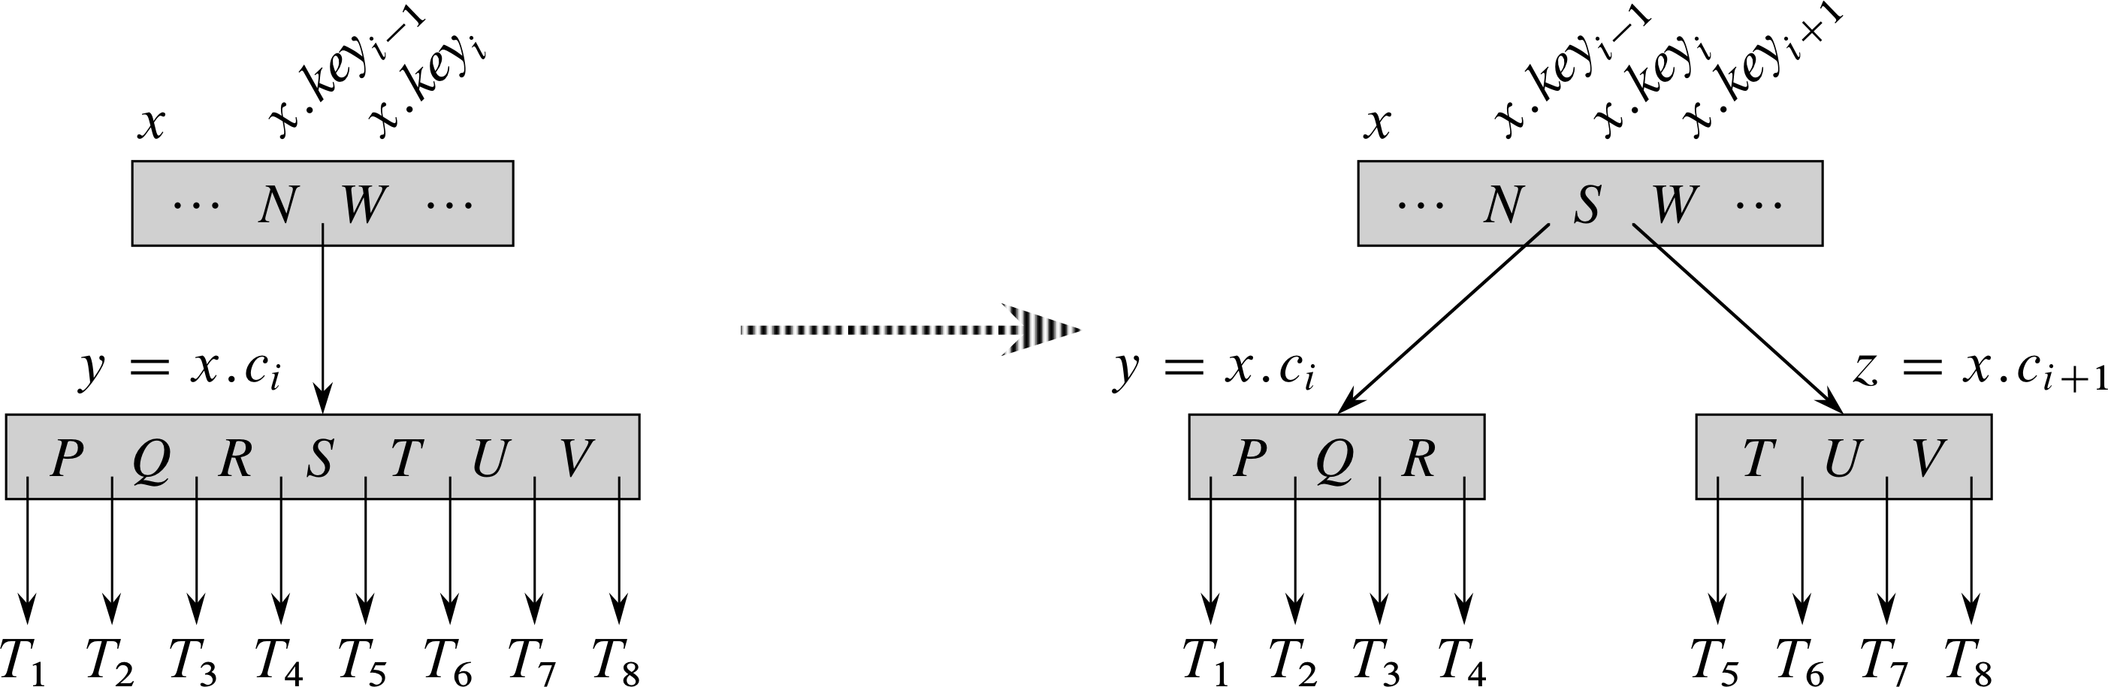
B-tree: insert
As with BST, first search for where key should go
  Search down to leaf node
If leaf node is not full, just insert new key there
If leaf node is full (2t-1 keys), need to split:
  Create two nodes each with t-1 keys
  Median key (key_{t}) moves up to parent
  Iterate on parent, splitting as needed
CPU: O(th)
Disk: O(h)
t=4

Slide 12
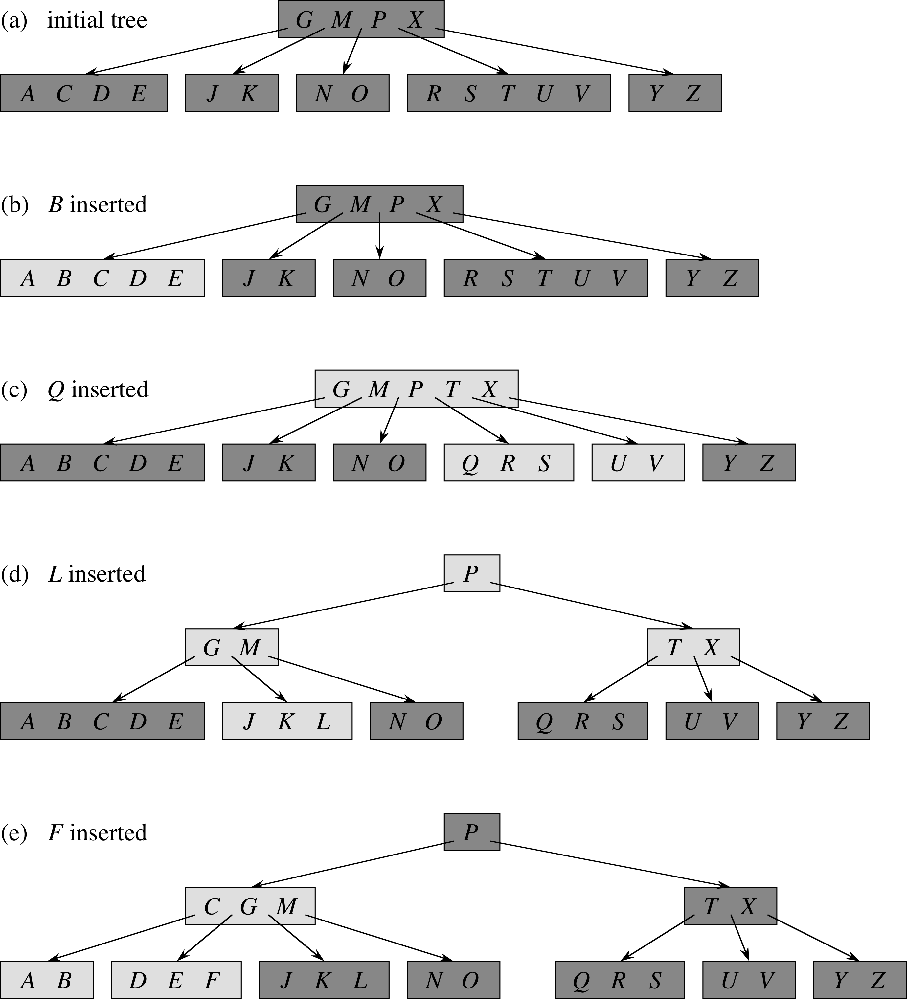
Insert ex.
(a) initial tree
(t=3)
(b) insert into
non-full leaf
(c) insert into
full leaf: split
(d) insert and
split up to root
(e) 1-level split

Slide 13
B-tree: delete
Descend tree, ensuring each node has ≥ t keys before we examine it (space for deletion):
If key is in node and it's a leaf, just delete it
If key is in node and it's not a leaf:
  If left child has ≥ t keys, replace w/predecessor
  If right child has ≥ t keys, replace w/successor
  Else, merge left+right children & delete key
If key is not in node and it's not a leaf:
Find the child that key should be in: if t-1 keys,
  If left/right sibling has ≥ t keys, steal one
  Else, merge child with a sibling

Slide 14
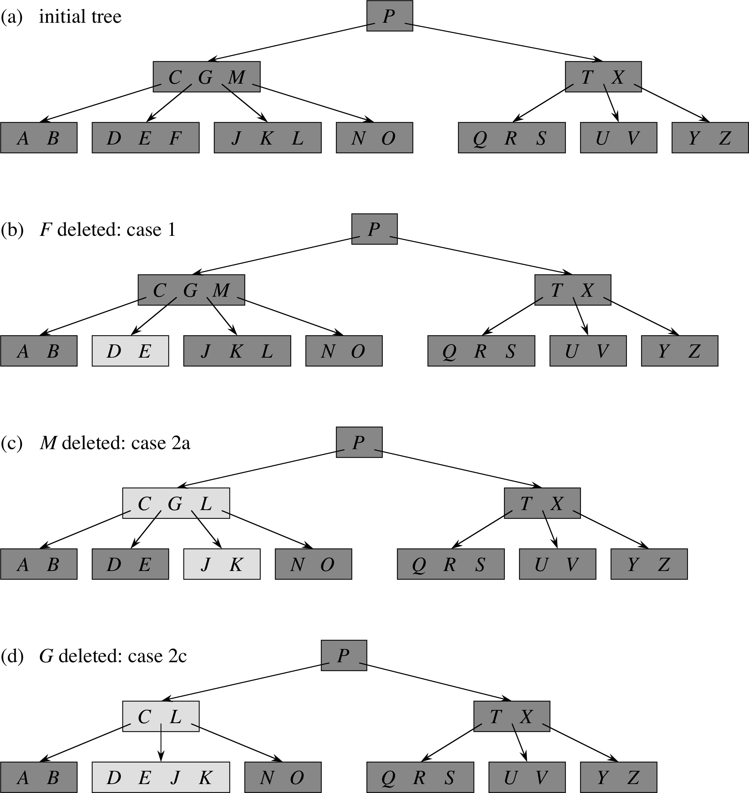
Delete
(a) (t=3)
(b) internal
nodes ≥ t,
key in leaf
(c) key in
non-leaf: use
predecessor
(d) key in non-leaf: merge children

Slide 15
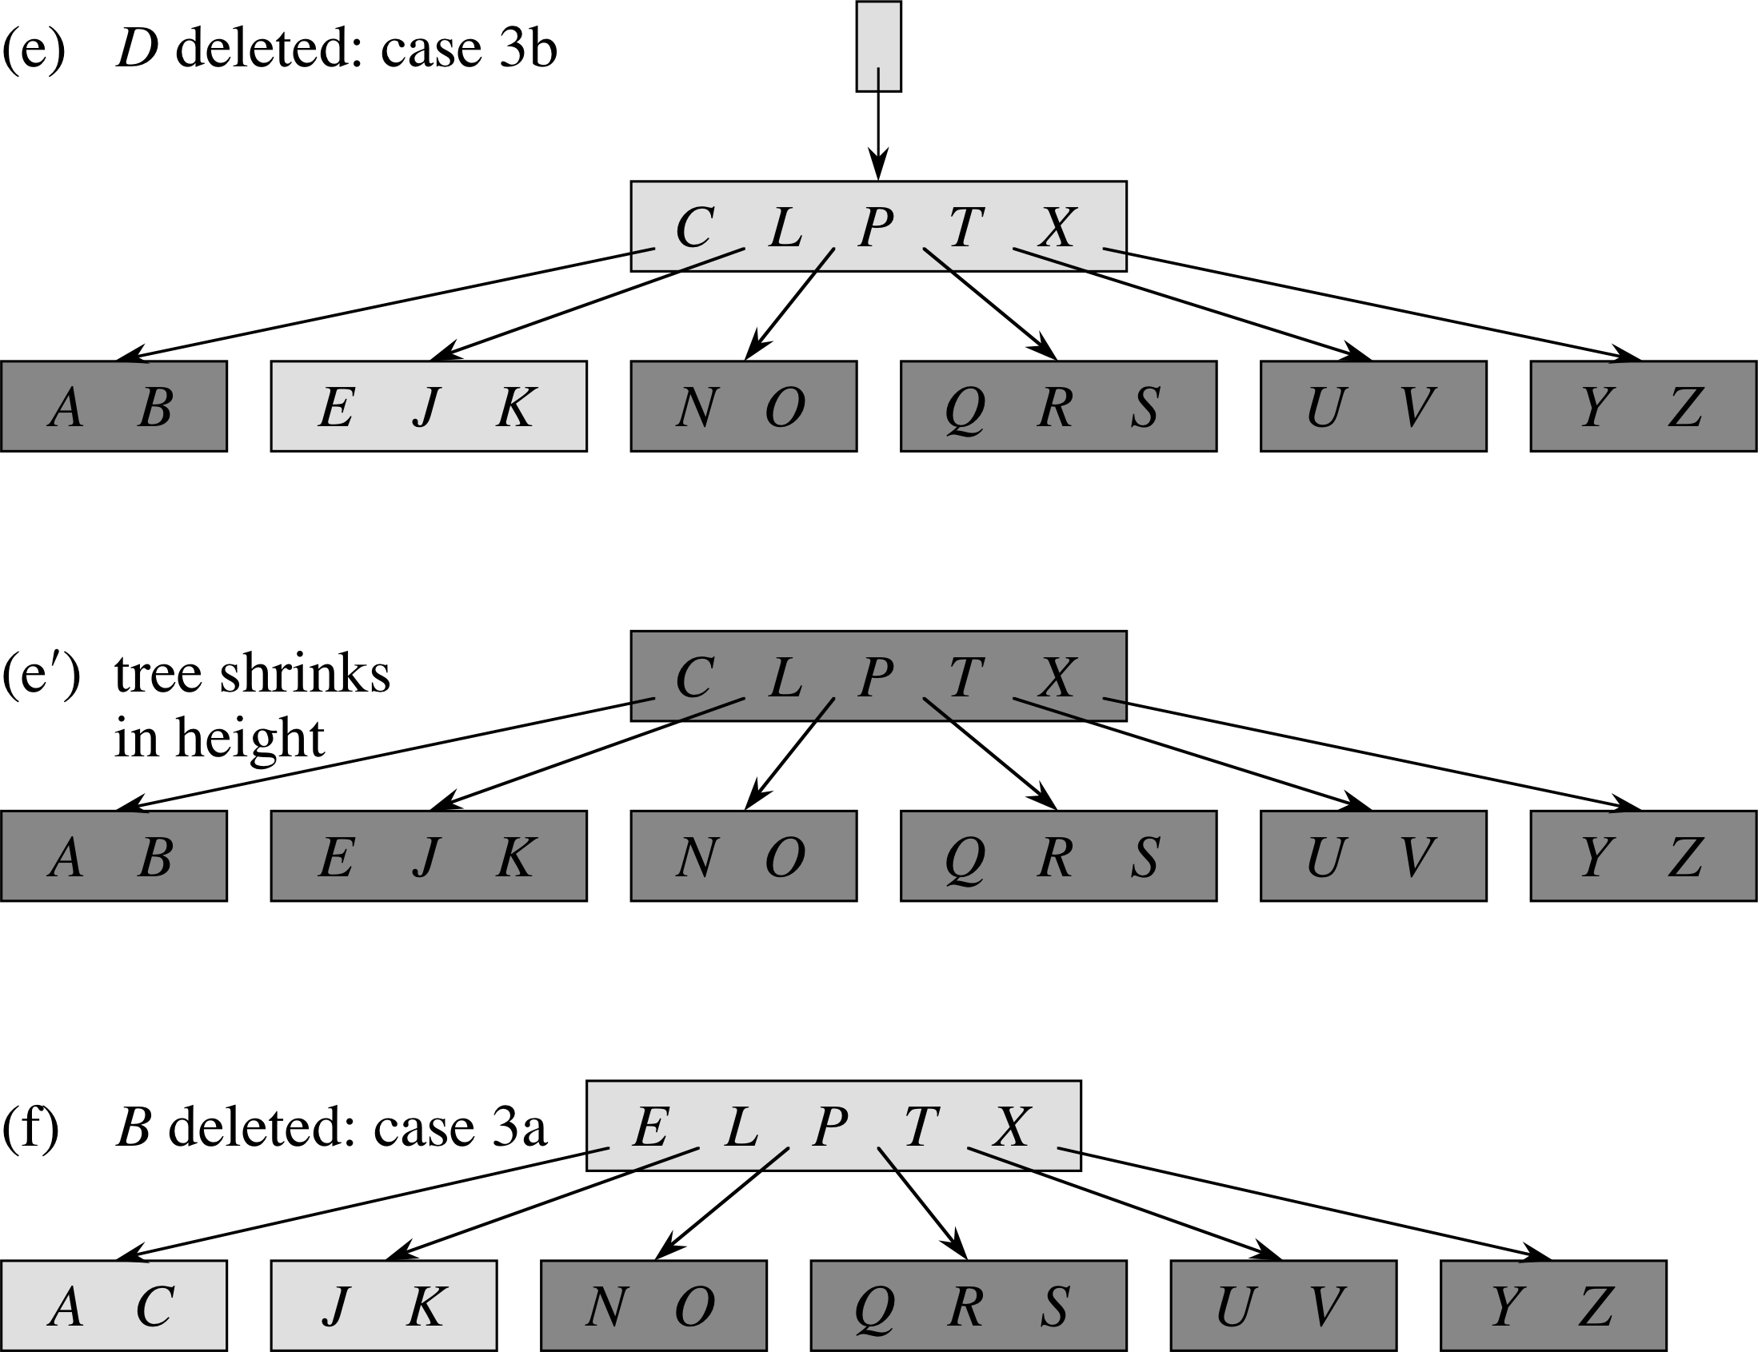
Delete, cont.
(e) internal node CL too small, and sibling too small to steal from
  ⇒ Merge w/sibling
(e') Merging pushes key P down from root
(f) B not in CLPTX,
AB child too small:
  ⇒ Steal from EJK

Slide 16
B-tree summary
Generalisation of BST, but:
  All leaves at same height h (= Θ(log_{t} n))
  Degree of each node is between t and 2t
Operations:
  Create: CPU O(1), disk O(1)
  Search, insert, delete: CPU O(th), disk O(h)
  When modifying tree, need to ensure that degree of every node stays between t and 2t
  (so # keys is between t-1 and 2t-1)

Slide 17
Outline for today
B-Trees
  Motivation: properties of spinning disks
  B-tree concept
  Search in O(t log_{t} n)
  Insert in O(t log_{t} n)
  Delete in O(t log_{t} n)
  Application to filesystems
Midterm review (ch6-8, 11)

Slide 18
B-trees in filesystems
Filesystems store: files, directories, metadata (e.g., name, owner, permissions, update time)
Contents of files are in (1 or more) extents on disk
  Logical Block Addresses interpretable by HDD
Filesystems can use B-trees for lookup tables:
  Inode table: metadata for each object
    Indexed by inode, unique to each object
  Extents table: LBAs for each extent
    Or the actual data, if it's small enough
  Journal: transaction log
    Preserve integrity in case a long write fails

Slide 19
Filesystems that use B-trees
NTFS indexes (inode tables)
Mac HFS catalog records (inodes): B+-trees
Linux ext3/ext4 directory indexes: Htrees
  store hashed filenames for fast lookup
Linux BTRFS (“B-TRee FileSystem”):
  B-trees used for everything:
    Directory trees (with hashed filenames)
    Extent tree (file data as LBA or actual data)
    Log tree
    Root tree storing links to all other trees!
    … much more

Slide 20
Outline for today
B-Trees
  Motivation: properties of spinning disks
  B-tree concept
  Search in O(t log_{t} n)
  Insert in O(t log_{t} n)
  Delete in O(t log_{t} n)
  Application to filesystems
Midterm review (ch6-8, 11)

Slide 21
Review for exam2: ch6-8, 11
Hand-simulation, complexity analysis
  “What if?” questions: tweaks to std algorithms
Ch6: Heapsort
  Trees
  Max heaps: max-heap property, heapify()
  Heapsort: building a heap, using it for sorting
  Priority queue: ops, complexity
Ch7: Quicksort
  Naive quicksort with fixed pivot
  Randomised pivot
  Complexity analysis: expected running time E[]

Slide 22
Review for exam2: ch6-8, 11
Ch8: Linear-time sorts (assumptions!)
  Decision tree model, why Ω(n lg n) comparisons
  Counting sort (census + move): Θ(n + k)
  Radix sort (with r-bit digits): Θ(d(n + k))
  Bucket sort: Θ(n) expected time
Ch11: Hash tables
  Hash function, hash collisions, chaining
  Load factor α = n/(# buckets), search in Θ(1+α)
  Hashes: div, mul, universal hashing
  Open addressing: linear, quad, double-hash

