Slide 1
ch15: Dynamic Programming
6 Nov 2012
CMPT231
Dr. Sean Ho
Trinity Western University

Slide 2
Outline for today
Dynamic programming for optimisation
  Optimal substructure
    Naive top-down
    Top-down with memoisation
    Bottom-up
Examples:
  Rod-cutting problem
  Fibonacci
  Matrix-chain multiplication
  Shortest unweighted path
  Optimal binary search trees

Slide 3
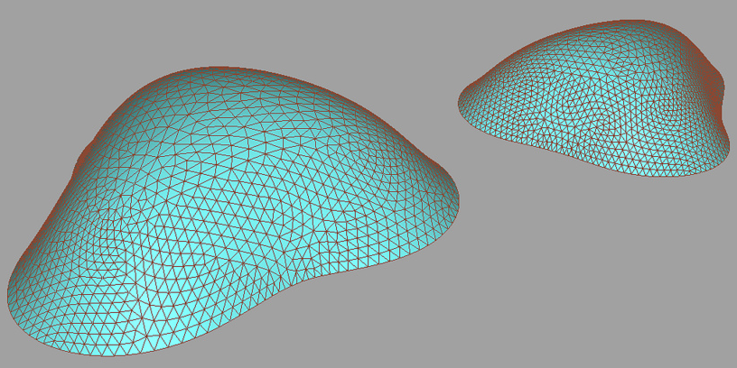
Optimisation
A large class of real-world problems consist of:
  Find the maximum (or minimum) value of some goal/cost function, over some search space
Search space may be discrete or continuous,
low-dimensioned or very high (10⁶ or more) dim
Goal function may be analytic or some black-box
  May or may not have accessible derivatives
Exhaustive search is
usually way too slow
Andreas Hopf

Slide 4
Dynamic programming
“Programming” as in tables, e.g., linear prog.
Divide-and-conquer approach, but
  Store and re-use solutions to sub-problems
3 implementation schemes:
  Recursive top-down (inefficient)
  Top-down with memoisation (save sub-results)
  Bottom-up (solve smaller sub-problems first)
Efficiency depends on:
  Optimal substructure
  Overlapping subproblems

Slide 5
Outline for today
Dynamic programming for optimisation
  Optimal substructure
    Naive top-down
    Top-down with memoisation
    Bottom-up
Examples:
  Rod-cutting problem
  Fibonacci
  Matrix-chain multiplication
  Shortest unweighted path
  Optimal binary search trees

Slide 6
Rod-cutting problem
Steel rods of length i can be sold for $p_{i} each
How to cut a single rod of length n into pieces
so as to maximise revenue?
  Assume cuts are free
e.g., price table p=[ 1, 5, 8, 9 ]. Rod length n=4
  Exhaustive search:
  $9, $8+1, $1+8, $5+5,
  $5+1+1, $1+5+1, $1+1+5, $1+1+1+1
    Optimal: 2 pieces of length 2 ⇒
    CutRod(p, 4) = r₄ = $5+5
Can we solve by reusing results of sub-problems?

Slide 7
Optimal substructure
Optimise one cut at a time, left to right
Cut into two pieces, assume first piece won't be cut again; recurse on second piece:
  CutRod(p, n) = max_{1 ≤ i ≤ n}( p[i] + CutRod(p, n-i) )
Re-uses smaller subproblems many times
  CutRod() with small n is called many times
Optimal substructure means:
  Task can be split into subproblems
  which can be solved independently
  The same subproblems show up in multiple branches of recursion tree (overlapping work)

Slide 8
(1) Recursive top-down
Naive implementation of the recurrence above:
      def CutRod(p, n):
        if (n<1): return 0
        q = -infinity
        for i = 1 .. n:
          q = max(q, p[i] + CutRod(p, n-i))
        return q
Each iteration of loop makes recursive call
Complexity? Recursion tree?
  T(n) = 2^{n} (Exercise 15.1-1)
  Increasing input by 1 ⇒ double the run time!
Why so bad? e.g., CutRod(2) is run many times

Slide 9
(2) Top-down with memoisation
Memoisation: cache previously-computed results
      cache = array[0..n] of -infinity
      cache[0] = 0
      def CutRod(p, n):
        if cache[n] ≠ -infinity:
          return cache[n]
        for i in 1 .. n:
          cache[n] = max(cache[n], p[i] + CutRod(p, n-i))
        return cache[n]
CutRod(n) is computed only once for each n
  CutRod(n) takes Θ(n) to compute if not cached
  ⇒ Complexity is Σ_{i} Θ(i) = Θ(n²)

Slide 10
(3) Bottom-up
Start from smaller subproblems, caching as we go
      def CutRod(p, n):
        cache = array[0..n] of -infinity
        cache[0] = 0
        for j = 1 .. n:
          for i = 1 .. j:
            cache[j] = max(cache[ j ], p[ i ] + cache[ j – i ]))
        return cache[n]
Non-recursive! (function calls are expensive)
Doubly-nested for loop calculates each CutRod(j)
Cache stores results of subproblems,
which each are re-used many times
Complexity: Σ_{j} Θ(j) = Θ(n²)

Slide 11
Subproblem graph
Nodes are subproblems (e.g., CutRod(n))
Arrows indicate which other smaller subproblems are needed to compute each node
  Like recursion tree, but collapsing same nodes
Bottom-up: order nodes so that all dependencies are precomputed before we reach a node
Top-down: depth-first search down to leaves
Complexity often Θ( #nodes + #arrows )
4
3
2
1
0

Slide 12
Outline for today
Dynamic programming for optimisation
  Optimal substructure
    Naive top-down
    Top-down with memoisation
    Bottom-up
Examples:
  Rod-cutting problem
  Fibonacci
  Matrix-chain multiplication
  Shortest unweighted path
  Optimal binary search trees

Slide 13
Fibonacci sequence
Recall: F_{n} = F_{n-1} + F_{n-2}
  F₀ = F₁ = 1
Closed form: Θ(1)
def fib(n):
return round( pow( phi, n ) )
Naive top-down: Θ(2^{n})
def fib(n):
if (n<2): return 1
return fib(n-1) + fib(n-2)
Bottom-up: Θ(n)
def fib(n):
c = array[0..n] of -1
c[0] = c[1] = 1
for j = 2 .. n:
c[j] = c[j-1] + c[j-2]
return c[n]
Subproblem graph?
Top-down w/memo: Θ(n)
c = array[0..n] of -1
c[0] = c[1] = 1
def fib(n):
if (c[n]>0): return c[n]
c[n] = fib(n-1) + fib(n-2)
return c[n]

Slide 14
Matrix-chain multiplication
Given a chain of n matrices (diff dims) to multiply:
  (A₁) (A₂) (A₃) … (A_{n})
  (p₀ x p₁) (p₁ x p₂) (p₂ x p₃) … (p_{n-1} x p_{n})
    #cols of left matrix = #rows of right matrix
Any parenthesisation is equivalent:
which is best to minimise number of operations?
e.g., (5 x 500) (500 x 2) (2 x 50):
  Try (A₁A₂)A₃: 5*500*2 + 5*2*50 = 5500 ops
  Try A₁(A₂A₃): 500*2*50 + 5*500*50 = 175000
  Exhaustive search of parentisisations: Θ(2^{n})

Slide 15
Optimal substructure
As with rod-cutting, consider one split at a time:
  Cost if split chain i..j at k:
    Cost(i .. k) + Cost(k+1 .. j) + (p_{i-1})(p_{k})(p_{j})
  Cost of the matrix mult at the split is p_{i-1} p_{k} p_{j}
Naive recursive solution:
      def MatChain(p, i, j):
        if (i == j): return 0
        return min( foreach(k in i .. j-1:
        MatChain(p, i, k) + MatChain(p, k+1, j)
        + p[i-1] * p[k] * p[j] ) )
2n recursive calls; very inefficient! Θ(2^{n})
Smaller chains are computed repeatedly

Slide 16
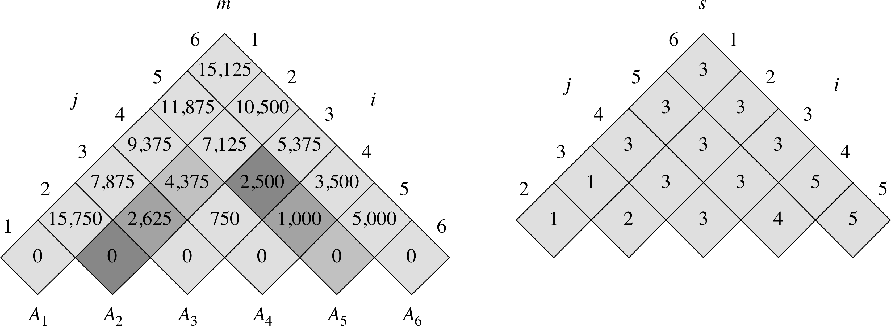
Bottom-up solution
Nodes are indexed by both start (i) and end (j)
  ⇒ 2D grid of nodes, instead of 1D line
def MatChain(p):
n = length(p) – 1
m = array[1 .. n][1 .. n] of 0
s = array[1 .. n-1][2 .. n]
for len = 2 .. n:
for i = 1 .. n – len + 1:
j = i + len - 1
m[i, j] = infinity
for k = i .. j - 1:
q = m[i, k] + m[k+1, j] + p[i-1] * p[k] * p[j]
if q < m[i, j]:
m[i, j] = q
s[i, j] = k
p=[30, 35, 15, 5, 10, 20, 25]
len=4, i=2:
min is @k=3: m[2,3]+m[4,5]+35*5*20

Slide 17
Outline for today
Dynamic programming for optimisation
  Optimal substructure
    Naive top-down
    Top-down with memoisation
    Bottom-up
Examples:
  Rod-cutting problem
  Fibonacci
  Matrix-chain multiplication
  Shortest unweighted path
  Optimal binary search trees

Slide 18
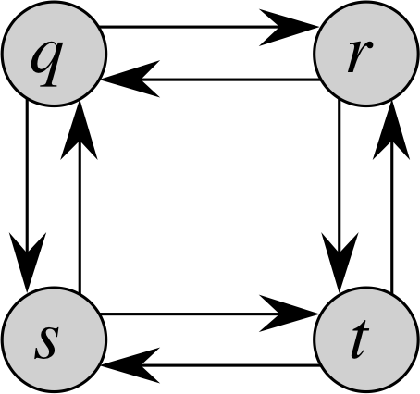
Shortest- and longest-path
Given a set of nodes and (unweighted) edges,
find the shortest path between given nodes u, v:
  Optimal substructure: if split path at node w,
  then we can form the shortest path u → w → v from the shortest paths u → w and w → v
  So we can solve with dynamic programming
What about longest (non-cyclic) path u → v?
  Just gluing together Longest(u → w) and Longest(w → v) won't work!
  Might not be longest u → v
  Might have loops

Slide 19
Optimal binary search trees
BST operations Θ(h): depth of node in tree
Given sorted set of keys K = [k₁, …, k_{n}]
and probabilities P = [p₁, …, p_{n}]:
  Minimise expected (weighted avg) search cost
To handle unsuccessful searches,
add dummy keys d₀, …, d_{n} as leaves:
  Dummy key d_{i} is for all values between (k_{i-1}, k_{i})
  Let q_{i} = probability of d_{i}: then Σp + Σq = 1
Expected search cost =
Σ (h(k_{i}) + 1)p_{i} + Σ (h(d_{i}) + 1)q_{i}

Slide 20
Optimal substructure
As before, consider one split at a time:
  “Split” = choice of root
  To find optimal BST for keys k_{i}, …, k_{j},
    Consider making k_{r} the root (i ≤ r ≤ j)
    Find optimal BST for left subtree k_{i}, …, k_{r-1}
    Find optimal BST for right subtree k_{r+1}, …, k_{j}
Demoting a subtree increases depth to each of its nodes by 1: ⇒ increases expected search cost by w(i,j) = Σ_{m=i}^{j} p_{m} + Σ_{m=i-1}^{j} q_{m}
Cost e(i,j) = min_{r=i}^{j} [ e(i, r-1) + e(r+1, j) + w(i, j) ]

Slide 21
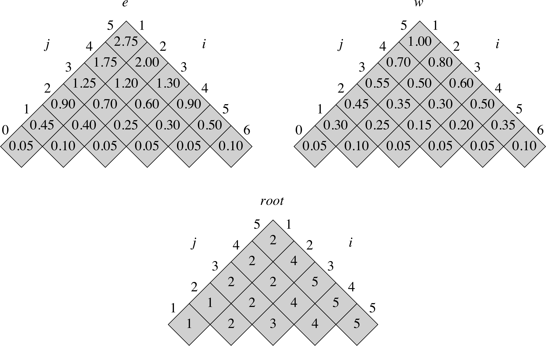
Optimal BST: example
i | p | q
0 |  | 0.05
1 | 0.15 | 0.10
2 | 0.10 | 0.05
3 | 0.05 | 0.05
4 | 0.10 | 0.05
5 | 0.20 | 0.10

