Slide 1
God and Math:
Musings and Comic Strips
19 Oct 2012
NATS487
Dr. Sean Ho
Trinity Western University
twu.seanho.com/NATS487.pdf

Slide 2
Outline for today
What math is and what it isn't
The quest for the Theory of Everything
  Incompleteness
  Ontological arguments
Observation ⇒ abstraction ⇒ application
  Fourier theory: heat, audio, image, electrical
The joy of exploration, the humility of a student

Slide 3
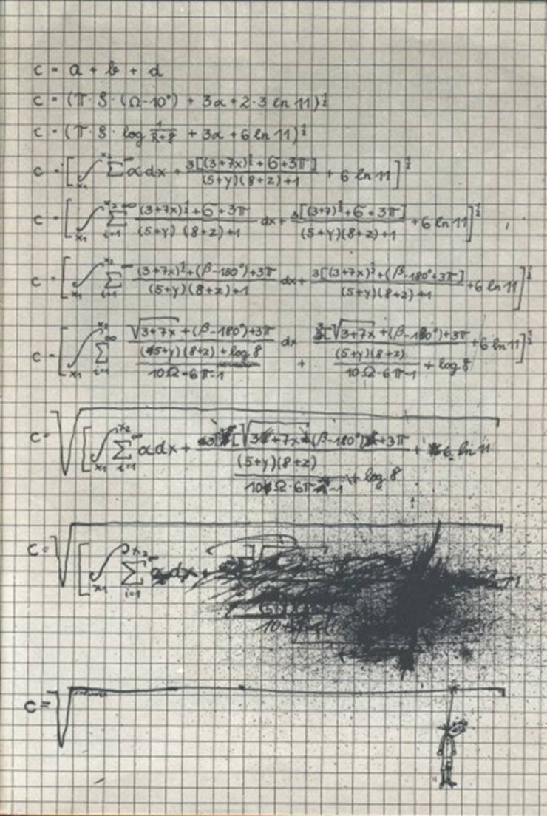
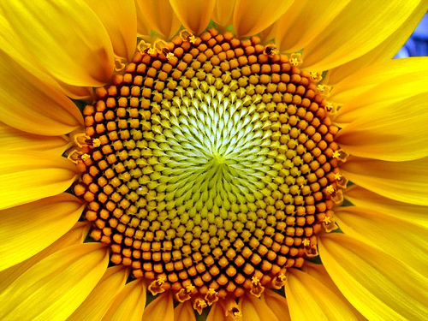
As a math teacher, I apologise!
This is not math, just memorisation and manipulation of symbols
Math is both more beautiful and more difficult than this
Discovery of patterns
Creation of theory
Application to new domains
Quest for
elegance
matthen.com

Slide 4
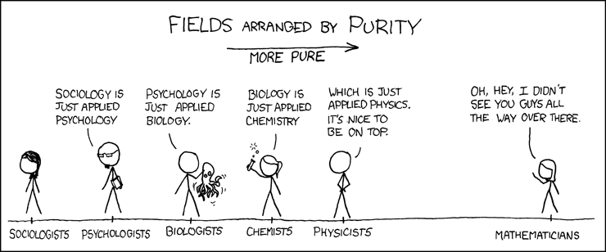
Purity vs. complexity
xkcd.com/435

Slide 5
The quest for the bottom
Axioms: assumptions, statements/definitions
  Formal system: axioms + system of logic
Is there a simplest formal system that allows us to derive/construct all of known math?
e.g., exponentiation = repeated multiplication
  x³ = x * x * x
multiplication = repeated addition
  3*x = x + x + x
addition = repeated increment
  x + 3 = ( ( x++ )++ )++
Formal system to define numbers?

Slide 6
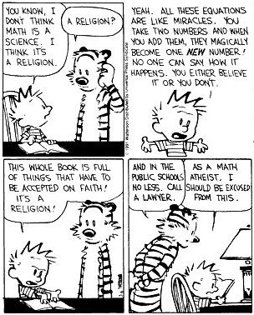
Why is 2 + 2 = 4?

Slide 7
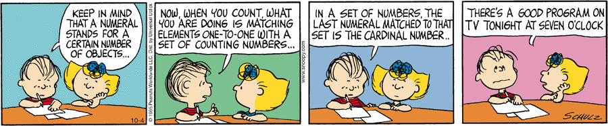
Peano construction of numbers
E.g., Peano construction of the natural numbers
    Axioms in language of set theory (ZF+C)
  Numbers defined via set membership:
  0 = ∅, 1 = {0} = {∅}, 2 = {1} = {{∅}}
Can this describe everything?
    Can every true statement within the system
    be derived from the axioms?
“God made the natural numbers;
the rest is the work of man” (Leopold Kronecker)

Slide 8
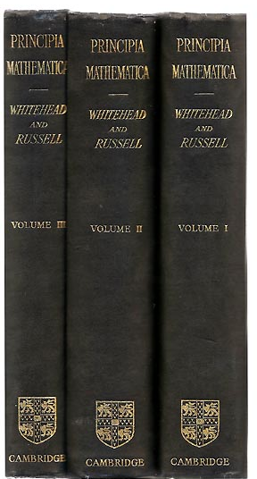
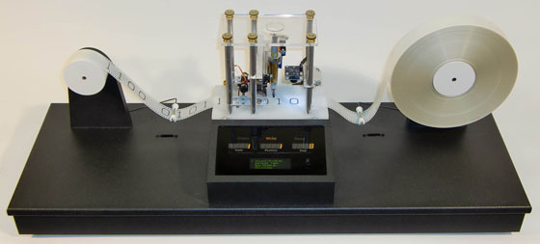
Incompleteness
Bertrand Russell + Alfred Whitehead,
Principia Mathematica, 1910s:
  Attempt to codify all of math in
  a formal system
  Admirable, but ultimately impossible!
Kurt Godel, 2 incompleteness theorems, 1930s:
  Any formal system that can describe arithmetic cannot be both consistent and complete
    incomplete: true but unprovable statements
  Related to Turing's halting problem:
    Can we build a computer
    that can detect infinite loops?

Slide 9
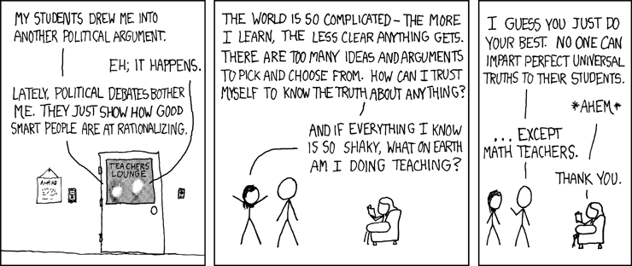
Perfect universal truths
xkcd.com/263

Slide 10
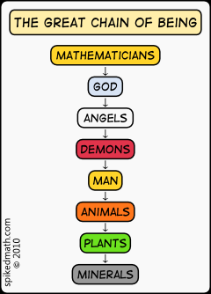
Ontological arguments
οντος (being, existing) + λογικος (word, reason)
“Proof” by logic of the existence (of God)
Key ingredient: operational definition of God?
  Anselm: “greatest being” we can imagine
  Descartes: “supreme perfection”
  Godel: every “positive property”
  Plantinga: “maximal excellence”
  in some world
  (possibility ⇒ necessity in
  some universe)
spikedmath.com/215.html

Slide 11
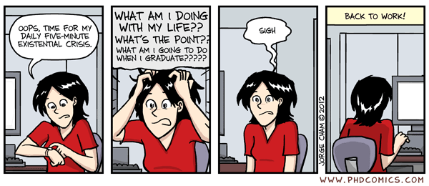
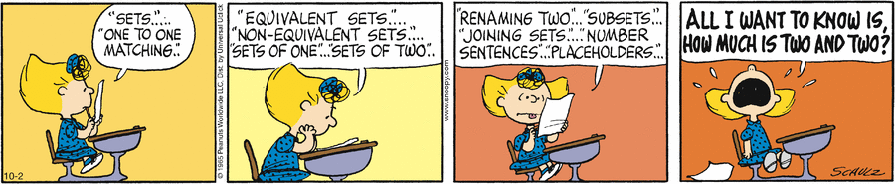
Coming up for fresh air...
PhD Comics
Enough theory! I have work to do .…
  How does math help me get stuff done?
Common toolset for diverse domains
  Observation ⇒ abstraction ⇒ application

Slide 12
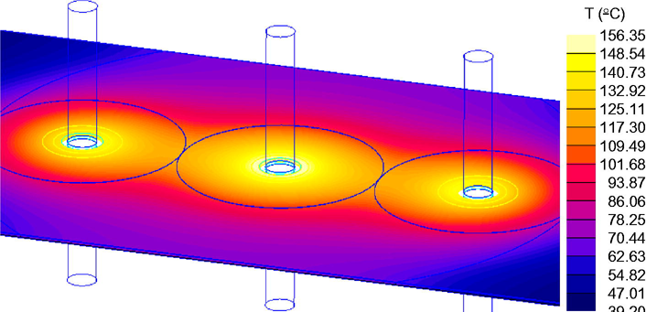
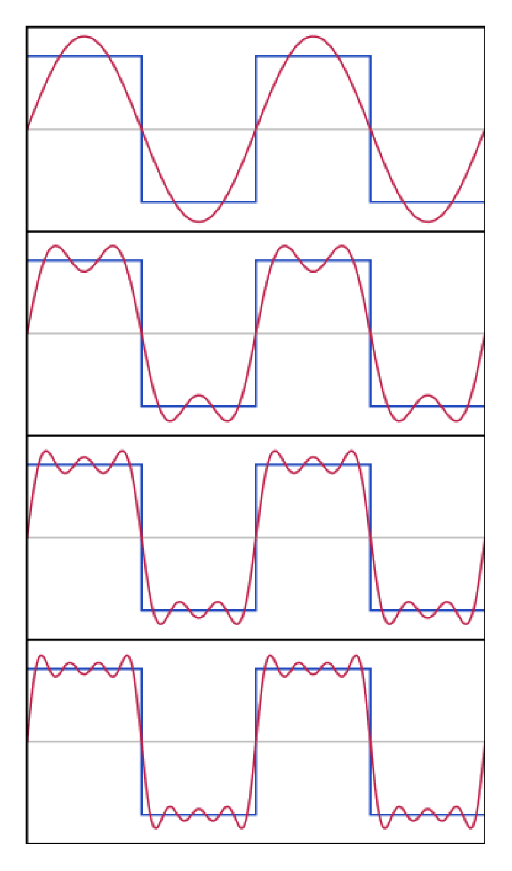
Theory: Fourier transform
Joseph Fourier, 1807
studying heat transfer in
metal plates
Decompose a signal into sines+cosines
  More frequencies ⇒ closer approx
Spatial domain ↔ frequency domain
  u(x,y) ↔ u(ω)
Low-pass filter: only use a few sin/cos
  Attenuate higher-freq components
  ⇒ this happens with the heat eqn!
Wikipedia

Slide 13
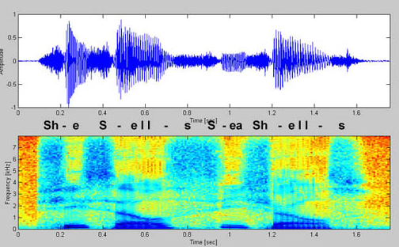
Application: audio signals
Time-domain waveform: air pressure vs. time
Frequency-domain signal: volume vs. frequency
Spectrogram: frequency-domain signal within a sliding window of time: volume vs. freq + time
What does a low-pass filter do to an audio signal?
  Crank up the bass!
The same heat equation
can be applied here, too!
Ferrite for RF interference
FlyingPudding

Slide 14


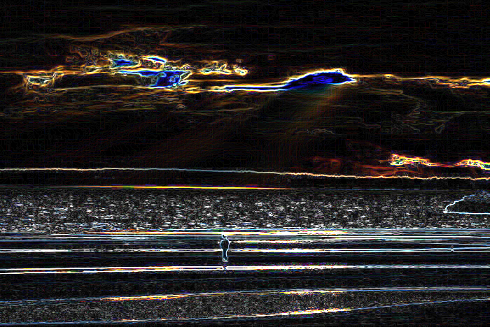
Application: image analysis
Spatial signal: pixel intensity vs. location
  Treat R, G, B separately
What does a low-pass filter do to an image?
  Heat equation ⇒ Gaussian blur!
High-pass: detect edges/noise
Photoshop's “unsharp mask” = high-pass filter only on portions of the image that show edges

Slide 15
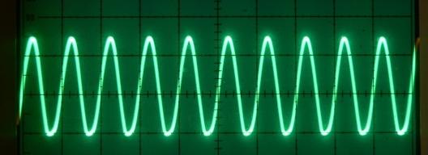

Application: electrical signals
Time-domain signal: voltage vs. time
Alternating current (AC):
60 Hz sine wave
  “Dirty” power:
  disturbances on top of the basic AC signal
VGA cable: image data, serialised
and converted to electrical signal
  RF interference: very high freq
  unwanted extra disturbances
  Ferrite core: low-pass filter
  (heat eqn again!)
Simon Inns
Amazon

Slide 16
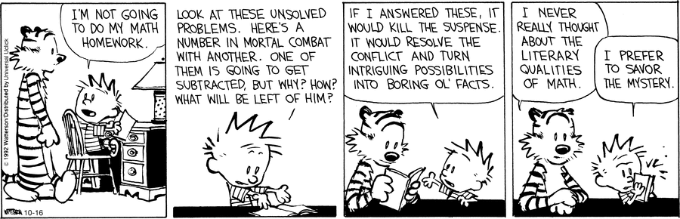
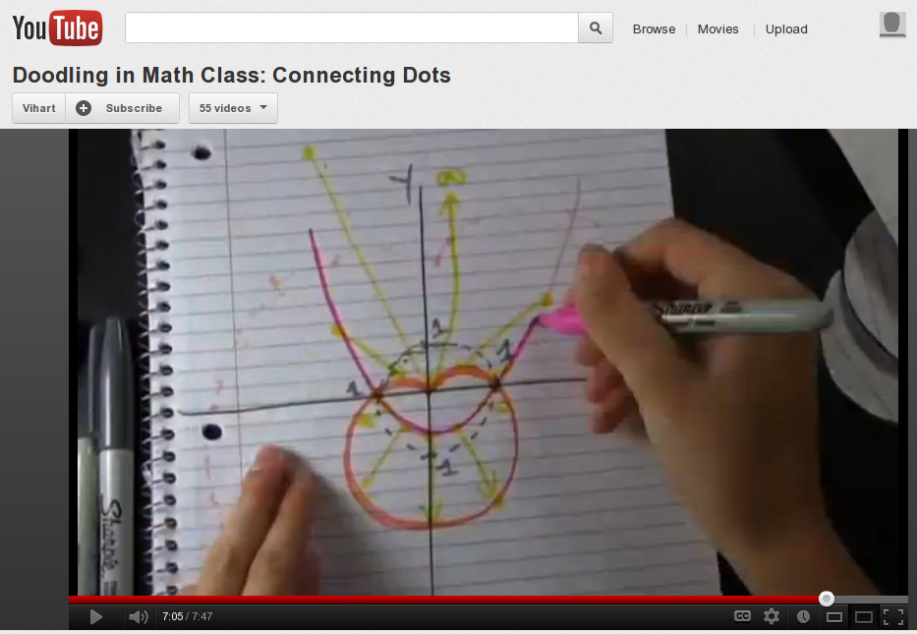
The joy of exploration in math
Go check out
Vi Hart's site!
Vi Hart

Slide 17
Job 38:1-7
Then the Lord answered Job out of the storm. He said: “Who is this that darkens my counsel with words without knowledge? Brace yourself like a man; I will question you, and you shall answer me.”
“Where were you when I laid the earth’s
foundation? Tell me, if you understand.
Who marked off its dimensions? Surely you know!
Who stretched a measuring line across it?
On what were its footings set,
or who laid its cornerstone —
While the morning stars sang together
and all the angels shouted for joy?

Slide 18
Job 38:31-36
“Can you bind the beautiful Pleiades?
Can you loose the cords of Orion?
Can you bring forth the constellations in their
seasons or lead out the Bear with its cubs?
Do you know the laws of the heavens?
Can you set up God’s dominion over the earth?
“Can you raise your voice to the clouds
and cover yourself with a flood of water?
Do you send the lightning bolts on their way?
Do they report to you, ‘Here we are’?
Who endowed the heart with wisdom
or gave understanding to the mind?

Slide 19
Math as servanthood
  Observation ⇒ abstraction ⇒ application
We study math in order to help others and to reveal the beauty & elegance in God's design,
  Not in order to prove God or to elevate
  our own logic so as to judge God's words
“Where is the wise man? Where is the scribe? Where is the debater of this age? Has not God made foolish the wisdom of the world?”
“The foolishness of God is wiser than men,
and the weakness of God is stronger than men.”
      (1 Cor 1:20, 25)

