Slide 1

BUSI 275: Business Statistics
No food/drink in the
computer lab, please!
Syllabus, etc. are
on myCourses
Pre/co-req: ≥ C in
MATH 101 or 120
10 Jan 2012
Dr. Sean Ho
busi275.seanho.com

Slide 2
Outline for today
Welcome, devotional
  Syllabus, text, myTWU, schedule
Introduction to statistics for business:
  Decision making, asking good questions
  Variables: levels, IV/DV, cross-sectional
  Stages/cycles in statistical analysis
Term Project
Exploring Data using Charts
  For qualitative vars, for quantitative vars

Slide 3
What is statistics?
Data-driven decision making
  Evidence-based, not (only) “gut feeling”
Answering vital ?s about business processes
  “Which market segment is most
  price-conscious?”
  “Which app model produces more revenue: free ad-funded or pay to play?”
Asking more relevant questions
  “How do we measure customer satisfaction?”
  “What factors have the strongest influence on employee retention?”

Slide 4
Basic terms
popu-
lation
sampling
sample
inference
Population: group of interest
  e.g., TWU students
Sample: participants in our study
  e.g., 50 passers-by at the cafeteria (time?)
  Sampling: drawing a sample from the pop
  Inferences: estimates (guess) on the pop
Variable: measurable of interest
  e.g., “monthly cellphone bill in $”
Observation: values for a single participant
  e.g., Jane's cell bill is $40/mo

Slide 5
Levels of measurement
“Qualitative”
Nominal (categorical):
  Province, colour, store branch
    Any yes/no (dichotomous) question
  “Are you satisfied as a customer?”
Ordinal (has an ordering, </> makes sense):
  Letter grade, “satsifactory … unsatisfactory”
  “very satisfied, somewhat satisfied, …”
Interval (can do +/-/avg, but 0 is arbitrary):
  ºC/F, Likert scale (“on a scale of 1-5”)
Ratio (can do mult/divide):
  Salary, quantity of sales, height in cm
“Scale”

Slide 6
Direction of influence
Statistical analysis often is about relationships amongst variables:
  “Does advertising medium affect sales?”
Often, one variable drives/influences another:
  Predictor (independent variable, IV) drives
  Outcome (dependent variable, DV) is influenced
Ad. medium
(print, online)
Sales
(quantity)

Slide 7
Cross-sectional vs. time-series
Cross-sectional data look at a snapshot in time:
  e.g., 2011 revenue for various store branches
Time-series data track the same variables on the same participants, at several points in time:
  Annual revenue for branches, 2001-2011
Time-series data need to worry about
  Attrition (missing data)
  Sampling in time (e.g., monthly vs. annual)
  Uneven time (2010, 2009, and “<2009”)
Our class will mostly examine cross-sectional data

Slide 8
Cycles in statistical analysis
Formulate research question (RQ)
Gather data: sampling, metrics
Prep data: input errors/typos,
missing data, obvious outliers
Explore variables: IV, DV, charts
Model building: choose a model based on RQ
Check assumptions of model
  If not, either clean data or change model
  May need to modify RQ!
Run final model and interpret results

Slide 9
Research question: example
RQ: are men taller than women?
  Is this relationship real? How strong is it?
What are the variables? IV/DV? Level of meas?
  Levels of measurement: categorical, ordinal, scale (interval, ratio)
  IV: gender (dichot), DV: height (scale)
What type of test should we use?
  Independent samples t-test
Limitations/assumptions of this test?
  We will learn about these:
  this is the point of this course!

Slide 10
Model-building process
Operationally define a phenomenon: variables
Measure it (collect data): how to do sampling?
Build a model: verify data meet assumptions
and input data into model
Draw conclusions in the “real world” population
  e.g., Child A has 2 apples, B has 6, and C has 1. How many apples is a child most likely to have?
  Individual vs. group
“Everything that can be counted does not necessarily count; everything that counts cannot necessarily be counted.” (Albert Einstein)

Slide 11
e.g.: Retail duration of stay
RQ: Does volume of music affect duration of customer stay in retail shops?
Population, sample: how to gather data?
Variables: how to measure?
  Volume, in dBA
  Duration of stay, in seconds
Predictor (IV) / outcome (DV)?
  Predictor: volume. Outcome: duration of stay
Levels of measurement?
  Volume (dBA): ratio. Duration (seconds): ratio
Moving beyond: other predictors of duration?

Slide 12
Outline for today
Welcome, devo, syllabus, myTWU, schedule
Introduction to statistics for business
Term Project:
  Proposal
  Dataset description
  REB application
  Presentation
  Term Paper
Exploring Data using Charts
  For qualitative vars, for quantitative vars

Slide 13
Term Project
A big part of this course is your term project:
  Find suitable data:
    Use existing (perhaps public) data, or
    Collect your own (subject to REB approval)
  Propose a statistical analysis of it
  Get approval by our Research Ethics Board
  Go through the “spiral” of statistical analysis
  Write it up in an MLA-style manuscript
Groups of up to 4 people
  Email me when you have your group

Slide 14
Project Proposal (23Jan - 3Feb)
Email me to setup your proposal meeting
  All team members must be present
≥24hrs before the meeting, submit a written proposal for your project. Describe
  Your population of interest
  The key DV (outcome) and why it matters
  Predictors that you think influence the DV
  State specific research questions
  Plan for how you will get your data
  Plan for how you will divide the work amongst your team members

Slide 15
Dataset Description (due 7Feb)
Use existing data, or gather your own
  Getting data takes time! (and may need REB)
  No simulated (made-up) data
Minimum sample size: 80 (# observations)
Remember the DV is the focus of your study
  Gather relevant IVs to explain the DV
Possible sources: your own data, faculty members, publicly available / government data (BLS, DataBC, etc.)
  StatCan caveat: getting the original microdata is tricky, sometimes costs $

Slide 16
REB application (due 14Feb)
Approval by TWU Research Ethics Board is required before any new analysis may be done!
You are not allowed to start your analysis until you get REB approval (expect 3-6 weeks)
  Can't even recruit your study subjects!
Use either the “Request for Ethical Review” form or the “Analysis of Existing Data” form
For existing non-public data, you need written permission from the original owner of the data
Some data, e.g., public datasets, may be REB exempt

Slide 17
Presentations (10Apr)
15-min in-class presentation
Target audience may not care about stats
  e.g., your company's CEO or board
  Give practical recommendations or
  lessons-learned
Motivate why we should care about your topic
Have some preliminary results to show
Every team member must participate
Also complete feedback forms for other teams' presentations

Slide 18
Term Paper (due 16Apr)
Aim at non-statistician (CEO, etc.)
  But back up your conclusions with statistical results, using APA style or similar
  Include enough details to reproduce study
Proper, professional English
  Format in MLA, APA, or similar style
Related work / background research
  Cite references
Include relevant figures / tables
  Can include more in appendix or separate Excel

Slide 19
Outline for today
Welcome, devo, syllabus, myTWU, schedule
Introduction to statistics for business
Term Project and milestones
Exploring Data using Charts (ch2)
  Frequency distributions
    Working with Excel array formulas
  Crosstabs / pivot tables
  Histograms and the ogive
  Scatterplots
  Line charts
Please download
from lecture dir:
01-SportsShoes.xls

Slide 20
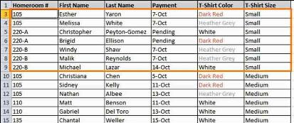
Frequency distributions
How frequently each value of a variable appears in the dataset (either pop or sample)
Data usually come as 1 row = 1 participant:
  Sample size
  = #rows
Compute by tallying up how many occurrences of each value exist in the data:
  e.g., for “T-Shirt Size” (level of meas?):
  Small: 10; Medium: 20; Large: 15

Slide 21
Excel: freq. dist. & bar chart
Dataset: 01-SportsShoes.xls
  Add new sheet: “Charts”
Frequency distribution:
  Enter poss. values (Gender coded as 1, 2)
  Highlight range of cells for output
  Input the FREQUENCY() Excel function
  Array formula: use Ctrl-Shift-Enter
  To get relative freqs (%), divide by total
    Absolute cell refs: '$A$2'
Bar chart: Insert > Bar > 2D > Select Data:
  Data: freqs; Cat. Axis Labels: values

Slide 22

Excel array formulas
Regular formulas (functions) take cells or cell ranges as input and produce a single output
  Array formulas output to a range of cells
Highlight the range where output will go
Enter the formula:
  =FREQUENCY()
  Data: highlight Data!M2:M101
  Bins (values): highlight cells with “1”,”2”
Don't hit OK yet! Use Ctrl-Shift-Enter instead to indicate it is an array formula

Slide 23
Multiple vars: crosstabs
Consider all combinations of values:
  e.g., Gender: 1 or 2; Activity: 1, 2, 3
  so there are 6 combos of (Gender, Act)
Cross-tabulations (Pivot Tables, Joint freq. dist):
  Insert > Pivot Table
  Select Range: L1:M101
  Row Labels: Gender
  Col Labels: Activity
  Values: either
  Summarize By: Count
Count - Activity | Activity
Gender | 1 | 2 | 3 | Total Result
1 | 12 | 27 | 4 | 43
2 | 16 | 29 | 12 | 57
Total Result | 28 | 56 | 16 | 100

Slide 24
Multiple vars: clustered bars
If one of the nominal variables only has a few possible values (categories), then
We can use clustered or stacked bar charts:

Slide 25
Quantitative vars: histograms
For quantitative vars (scale, ratio),
must group data into classes
  e.g., length: 0-10cm, 10-20cm, 20-30cm... (class width is 10cm)
  Specify class boundaries: 10, 20, 30, …
How many classes? for sample size of n,
use k classes, where 2^{k} ≥ n
Can use FREQUENCY()
w/ column chart, or
Data > Data Analysis
> Histogram

Slide 26
Cumulative distrib.: ogive
The ogive is a curve showing the cumulative distribution on a variable:
  Frequency of values
  equal to or less than
  a given value
Compute cumul. freqs.
Insert > Line w/Markers
Pareto chart is an ogive on a nominal var,
with bins sorted by decreasing frequency
  Sort > Sort by: freq > Order: Large to small

Slide 27
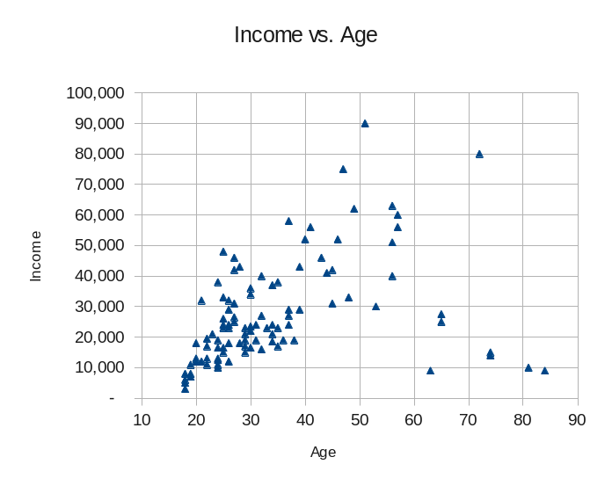
2 quant. vars: scatterplot
Each participant in the dataset is plotted as a point on a 2D graph
  (x,y) coordinates are that participant's observed values on the two variables
Insert > XY Scatter
If more than 2 vars, then either
  3D scatter (hard to see), or
  Match up all pairs:
  matrix scatter

Slide 28
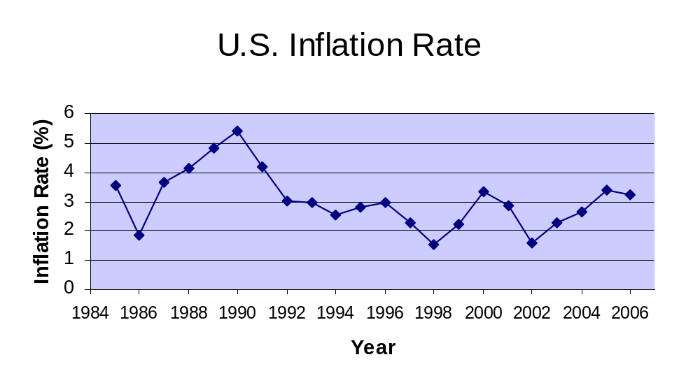
Time series: line graph
Think of time as another variable
  Horizontal axis is time
Insert > Line > Line

Slide 29
TODO
HW1 (ch1-2): due next week Thu 19Jan
  Text document: well-formatted, complete English sentences
  Excel file with your work, also well-formatted
  HWs are to be individual work
Get to know your classmates and form teams
  Email me when you know your team
Discuss topics/DVs for your project
  Find existing data, or gather your own?
Schedule proposal meeting during 23Jan - 3Feb

