Slide 1

Exploring Data
HW1 due Thu 10pm
By Mon, send email
to set proposal
meeting
17 Jan 2012
Dr. Sean Ho
busi275.seanho.com
For lecture,
please download:
01-SportsShoes.xls

Slide 2
Outline for today
Charts
  Histogram, ogive
  Scatterplot, line chart
Descriptives:
  Centres: mean, median, mode
  Quantiles: quartiles, percentiles
    Boxplot
  Variation: SD, IQR
    CV, empirical rule, z-scores
Probability
  Venn diagrams
  Union, intersection, complement

Slide 3
Quantitative vars: histograms
For quantitative vars (scale, ratio),
must group data into classes
  e.g., length: 0-10cm, 10-20cm, 20-30cm... (class width is 10cm)
  Specify class boundaries: 10, 20, 30, …
How many classes? for sample size of n,
use k classes, where 2^{k} ≥ n
Can use FREQUENCY()
w/ column chart, or
Data > Data Analysis
> Histogram

Slide 4
Cumulative distrib.: ogive
The ogive is a curve showing the cumulative distribution on a variable:
  Frequency of values
  equal to or less than
  a given value
Compute cumul. freqs.
Insert > Line w/Markers
Pareto chart is an ogive on a nominal var,
with bins sorted by decreasing frequency
  Sort > Sort by: freq > Order: Large to small

Slide 5
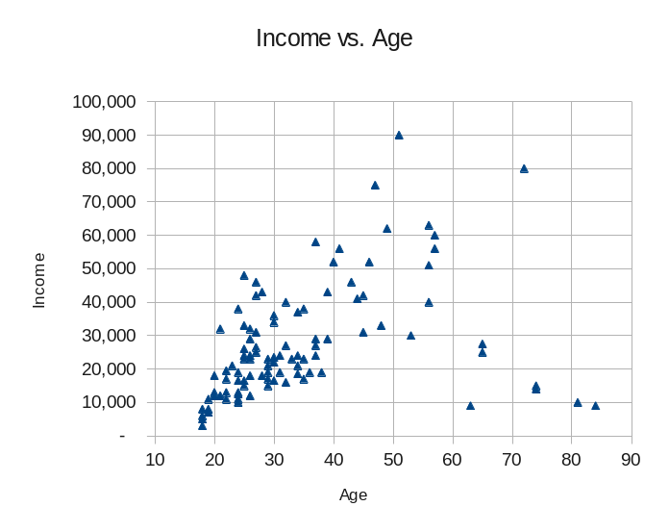
2 quant. vars: scatterplot
Each participant in the dataset is plotted as a point on a 2D graph
  (x,y) coordinates are that participant's observed values on the two variables
Insert > XY Scatter
If more than 2 vars, then either
  3D scatter (hard to see), or
  Match up all pairs:
  matrix scatter

Slide 6
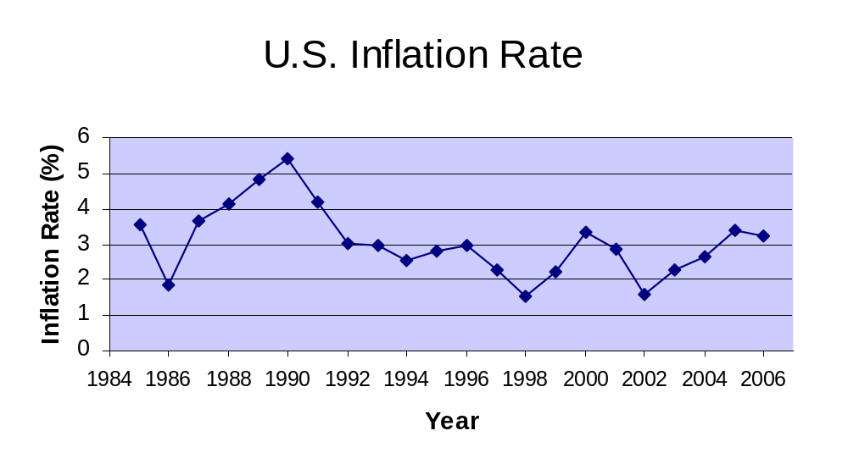
Time series: line graph
Think of time as another variable
  Horizontal axis is time
Insert > Line > Line

Slide 7
Outline for today
Charts
  Histogram, ogive
  Scatterplot, line chart
Descriptives:
  Centres: mean, median, mode
  Quantiles: quartiles, percentiles
    Boxplot
  Variation: SD, IQR
    CV, empirical rule, z-scores
Probability
  Venn diagrams
  Union, intersection, complement

Slide 8
Descriptives: centres
Statistic | Age | Income
Mean | 34.71 | $27,635.00
Median | 30 | $23,250.00
Mode | 24 | $19,000.00
Visualizations are good, but numbers also help:
  Mostly just for quantitative vars
Many ways to find the “centre” of a distribution
  Mean: AVERAGE()
    Pop mean: μ ; sample mean: x
    What happens if we have outliers?
  Median: line up all observations in order and pick the middle one
  Mode: most frequently occurring value
    Usually not for continuous variables

Slide 9
Descriptives: quantiles
The first quartile, Q₁, is the value ¼ of the way through the list of observations, in order
  Similarly, Q₃ is ¾ of the way through
  What's another name for Q₂?
In general the p^{th} percentile is the value p% of the way through the list of observations
  Rank = (p/100)n: if fractional, round up
    If exactly integer, average the next two
  Median = which percentile?
Excel: QUARTILE(data, 3), PERCENTILE(data, .70)

Slide 10
Box (and whiskers) plot
Plot: median, Q₁, Q₃, and upper/lower limits:
  Upper limit = Q₃ + 1.5(IQR)
  Lower limit = Q₁ – 1.5(IQR)
IQR = interquartile range = (Q₃ – Q₁)
Observations outside the limits are considered outliers: draw as asterisks (*)
Excel: try tweaking bar charts
25% 25% 25% 25%
*
*
Outliers
Lower lim
Q1
Median
Q3
Upper lim

Slide 11
Boxplots and skew
Left-Skewed
Symmetric
Right-Skewed
Q1
Q2
Q3
Q1
Q2
Q3
Q1
Q2
Q3

Slide 12
Boxplot Example
Data:
0 2 2 2 3 3 4 5 6 11 27
Right skewed, as the boxplot depicts:
Min Q₁ Q₂ Q₃ Max
*
0 2 3 6 12 27
Upper limit = Q₃ + 1.5 (Q₃ – Q₁)
= 6 + 1.5 (6 – 2) = 12
27 is above the upper limit so is shown as an outlier

Slide 13
Outline for today
Charts
  Histogram, ogive
  Scatterplot, line chart
Descriptives:
  Centres: mean, median, mode
  Quantiles: quartiles, percentiles
    Boxplot
  Variation: SD, IQR
    CV, empirical rule, z-scores
Probability
  Venn diagrams
  Union, intersection, complement

Slide 14
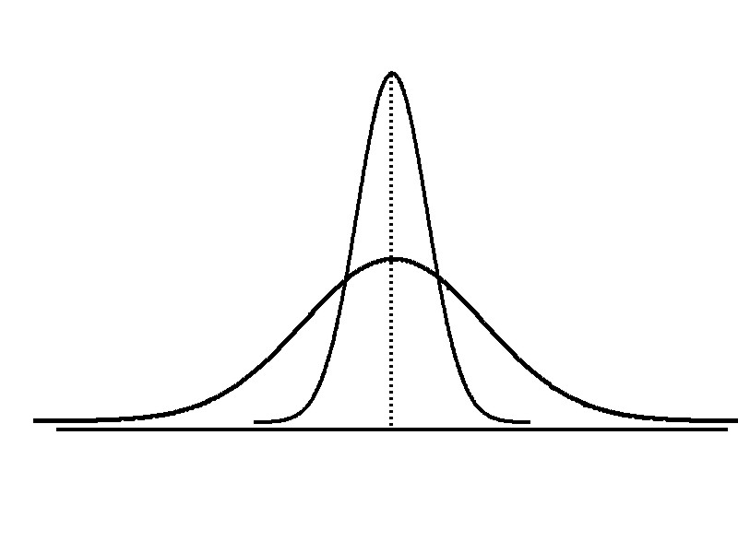
Measures of variation
Spread (dispersion) of a distribution:
are the data all clustered around the centre,
or spread all over a wide range?
Low variation
High variation
Same center,
different variation

Slide 15
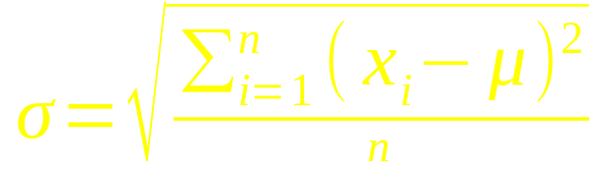
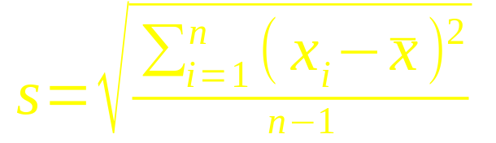
Range, IQR, standard deviation
Simplest: range = max – min
  Is this robust to outliers?
IQR = Q₃ – Q₁ (“too robust”?)
Standard deviation:
  Population:
  Sample:
  In Excel: STDEV()
Variance is the SD w/o square root
 | Pop. | Samp.
Mean | μ | x
SD | σ | s

Slide 16
Coefficient of variation
Coefficient of variation: SD relative to mean
  Expressed as a percentage / fraction
e.g., Stock A has avg price x=$50 and s=$5
  CV = s / x = 5/50 = 10% variation
Stock B has x=$100 same standard deviation
  CV = s / x = 5/100 = 5% variation
Stock B is less variable relative to its average stock price

Slide 17
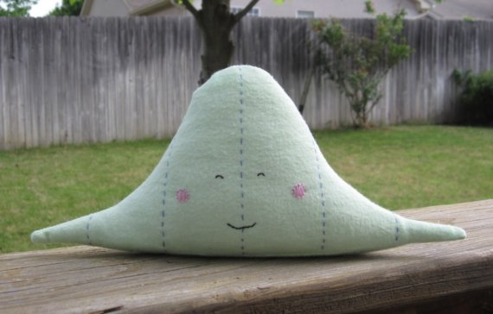
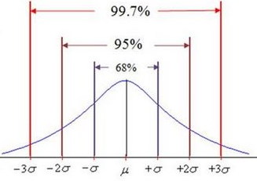
SD and Empirical Rule
Every distribution has a mean and SD, but for most “nice” distribs two rules of thumb hold:
Empirical rule: for “nice” distribs, approximately
  68% of data lie within ±1 SD of the mean
  95% within ±2 SD of the mean
  99.7% within ±3 SD
NausicaaDistribution

Slide 18
SD and Tchebysheff's Theorem
For any distribution, at least (1-1/k²) of the data will lie within k standard deviations of the mean
  Within (μ ± 1σ): ≥(1-1/1²) = 0%
  Within (μ ± 2σ): ≥(1-1/2²) = 75%
  Within (μ ± 3σ): ≥(1-1/3²) = 89%

Slide 19
z-scores
Describes a value's position relative to the mean, in units of standard deviations:
  z = (x – μ)/σ
e.g., you got a score of 35 on a test:
is this good or bad? Depends on the mean, SD:
  μ=30, σ=10: then z = +0.5: pretty good
  μ=50, σ=5: then z = -3: really bad!

Slide 20
Outline for today
Charts
  Histogram, ogive
  Scatterplot, line chart
Descriptives:
  Centres: mean, median, mode
  Quantiles: quartiles, percentiles
    Boxplot
  Variation: SD, IQR
    CV, empirical rule, z-scores
Probability
  Venn diagrams
  Union, intersection, complement

Slide 21
Probability
Chance of a particular event happening
e.g., in a sample of 1000 people,
say 150 will buy your product:
  ⇒ the probability that a random person from the sample will buy your product is 15%
  Experiment: pick a random person (1 trial)
  Possible outcomes: {“buy”, “no buy”}
  Sample space: {“buy”, “no buy”}
  Event of interest: A = {“buy”}
  P(A) = 15%

Slide 22
Event trees
Experiment: pick 3 people from the group
Outcomes for a single trial: {“buy”, “no buy”}
Sample space: {BBB, BBN, BNB, BNN, NBB, …}
P(BNB)
= (.15)(.85)(.15)
Event: A = {at least 2 people buy}: P(A) = ?

Slide 23
Venn diagrams
Box represents whole sample space
Circles represent events (subsets) within SS
e.g., for a single trial:
P(SS) = 1
A
B
P(B) = .15
P(A) = .35
  A = “clicks on ad”
  B = “buys product”

Slide 24
Venn: set theory
Complement: A
= “does not click ad”
  P(A) = 1 - P(A)
A
A
Intersection: A ∩ B
= “clicks ad and buys”
A ∩ B
Union: A ∪ B
= “either clicks ad or buys”
A ∪ B

Slide 25
Addition rule: A ∪ B
P(A ∪ B)
=
P(A)
+
P(B)
-
P(A ∩ B)

Slide 26
Addition rule: example
35% of the focus group clicks on ad:
  P(?) = .35
15% of the group buys product:
  P(?) = .15
45% are “engaged” with the company:
either click ad or buy product:
  P(?) = .45
⇒ What fraction of the focus group
buys the product through the ad?
  P(A ∪ B) = P(A) + P(B) – P(A ∩ B)
  ? = ? + ? - ?

Slide 27
Mutual exclusivity
Two events A and B are mutually exclusive if the intersection is null: P(A ∩ B) = 0
  i.e., an outcome cannot satisfy both A and B simultaneously
e.g., A = male, B = female
e.g., A = born in Alberta, B = born in BC
If A and B are mutually exclusive, then the addition rule simplifies to:
  P(A ∪ B) = P(A) + P(B)

Slide 28
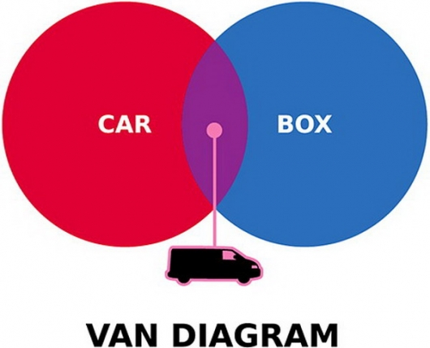
Yep!

Slide 29
TODO
HW1 (ch1-2): due online, this Thu 19Jan
  Text document: well-formatted, complete English sentences
  Excel file with your work, also well-formatted
  HWs are to be individual work
Get to know your classmates and form teams
  Email me when you know your team
Discuss topics/DVs for your project
  Find existing data, or gather your own?
Schedule proposal meeting during 23Jan - 3Feb

