Slide 1

Ch5-6: Common Probability
Distributions
HW3 due Thu 10pm
Dataset description
due next Tue 7Feb
Please download:
04-Distributions.xls
31 Jan 2012
Dr. Sean Ho
busi275.seanho.com

Slide 2
Outline for today
Discrete probability distributions
  Finding μ and σ
  Binomial experiments: BINOMDIST()
  Poisson distribution: POISSON()
  Hypergeometric: HYPGEOMDIST()
Continuous probability distributions
  Normal distribution: NORMDIST()
    Cumulative normal
    Continuity correction
    Standard normal
  Uniform distribution
  Exponential distribution: EXPONDIST()

Slide 3
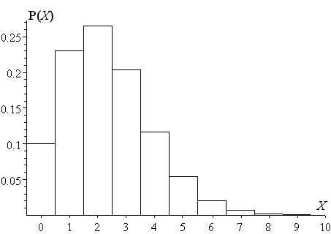
Discrete probability distribs
A random variable takes on numeric values
  Discrete if the possible values can be counted, e.g., {0, 1, 2, …} or {0.5, 1, 1.5}
  Continuous if precision is limited only by our instruments
Discrete probability distribution:
for each possible value X,
list its probability P(X)
  Frequency table, or
  Histogram
Probabilities must add to 1
  Also, all P(X) ≥ 0

Slide 4
Probability distributions
Discrete
Random Variable
Continuous
Random Variable
Ch. 5
Ch. 6
Binomial
Normal
Poisson
Uniform
Hypergeometric
Exponential

Slide 5
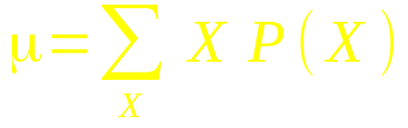
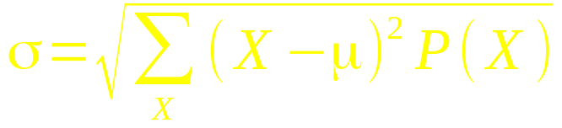
Mean and SD of discrete distr.
Given a discrete probability distribution P(X),
Calculate mean as weighted average of values:
E.g., # of email addresses: 0% have 0 addrs;
30% have 1; 40% have 2; 3:20%; P(4)=10%
  μ = 1*.30 + 2*.40 + 3*.20 + 4*.10 = 2.1
Standard deviation:

Slide 6
Outline for today
Discrete probability distributions
  Finding μ and σ
  Binomial experiments: BINOMDIST()
  Poisson distribution: POISSON()
  Hypergeometric: HYPGEOMDIST()
Continuous probability distributions
  Normal distribution: NORMDIST()
    Cumulative normal
    Continuity correction
    Standard normal
  Uniform distribution
  Exponential distribution: EXPONDIST()

Slide 7
Binomial variable
A binomial experiment is one where:
  Each trial can only have two outcomes: {“success”, “failure”}
  Success occurs with probability p
    Probability of failure is q = 1-p
  The experiment consists of many (n) of these trials, all identical
  The variable x counts how many successes
Parameters that define the binomial are (n,p)
e.g., 60% of customers would buy again:
out of 10 randomly chosen customers,
what is the chance that 8 would buy again?
  n=10, p=.60, question is asking for P(8)

Slide 8
Binomial event tree
To find binomial prob. P(x), look at event tree:
x successes means n-x failures
Find all the outcomes with x wins, n-x losses:
  Each has same probability: p^{x}(1-p)^{(n-x)}
  How many combinations?

Slide 9
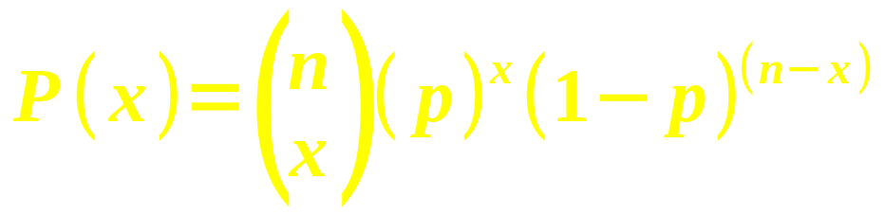
Binomial probability
Thus the probability of seeing
exactly x successes in a binomial experiment with n trials and a probability of success of p is:
Three parts:
  Number of combinations: “n choose x”
  Probability of x successes: p^{x}
  Probability of n-x failures: (1 – p)^{n – x}

Slide 10
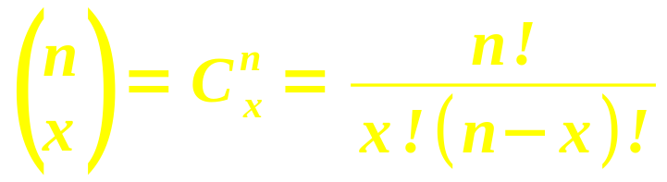
Number of combinations
The first part, pronounced “n choose x”,
is the number of combinations
with exactly x wins and n-x losses
Three ways to compute it:
  Definition:
    n! (“n factorial”) is (n)(n-1)(n-2)...(3)(2)(1),
    the number of permutations of n objects
  Pascal's Triangle (see next slide)
  Excel: COMBIN()

Slide 11
Pascal's Triangle
Handy way to calculate # combinations,
for small n:
1 1
1 2 1
1 3 3 1
1 4 6 4 1
1 5 10 10 5 1
1 6 15 20 15 6 1
n
x (starts from 0)
Or in Excel: COMBIN(n, x)
  COMBIN(6, 3) → 20

Slide 12
Excel: BINOMDIST()
Excel can directly calculate P(x) for a binomial:
  BINOMDIST(x, n, p, cum)
e.g., if 60% of customers would buy again,
then out of 10 randomly chosen customers,
what is the chance that 8 would buy again?
  BINOMDIST(8, 10, .60, 0) → 12.09%
Set cum=1 for cumulative probability:
  Chance that at most 8 (≤8) would buy again?
    BINOMDIST(8, 10, .60, 1) → 95.36%
  Chance that at least 8 (≥8) would buy again?
    1 – BINOMDIST(7, 10, .60, 1) → 16.73%

Slide 13
μ and σ of a binomial
n: number of trials
p: probability of success
Mean: expected # of successes: μ = np
Standard deviation: σ = √(npq)
e.g., with a repeat business rate of p=60%, then out of n=10 customers, on average we would expect μ=6 customers to return, with a standard deviation of σ=√(10(.60)(.40)) ≈ 1.55.

Slide 14
Binomial and normal
When n is not too small and p is in the middle, the binomial approximates the normal:

Slide 15
Outline for today
Discrete probability distributions
  Finding μ and σ
  Binomial experiments: BINOMDIST()
  Poisson distribution: POISSON()
  Hypergeometric: HYPGEOMDIST()
Continuous probability distributions
  Normal distribution: NORMDIST()
    Cumulative normal
    Continuity correction
    Standard normal
  Uniform distribution
  Exponential distribution: EXPONDIST()

Slide 16
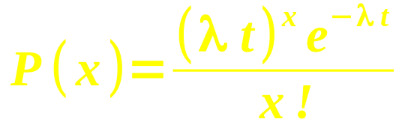
Poisson distribution
Counting how many occurrences of an event happen within a fixed time period:
  e.g., customers arriving at store within 1hr
  e.g., earthquakes per year
Parameters: λ = expected # occur. per period
t = # of periods in our experiment
  P(x) = probability of seeing exactly x occurrences of the event in our experiment
Mean = λt, and SD = √(λt)

Slide 17
Excel: POISSON()
POISSON(x, λ*t, cum)
  Need to multiply λ and t for second param
  cum=0 or 1 as with BINOMDIST()
Think of Poisson as the
“limiting case” of the
binomial as n→∞ and p→0

Slide 18
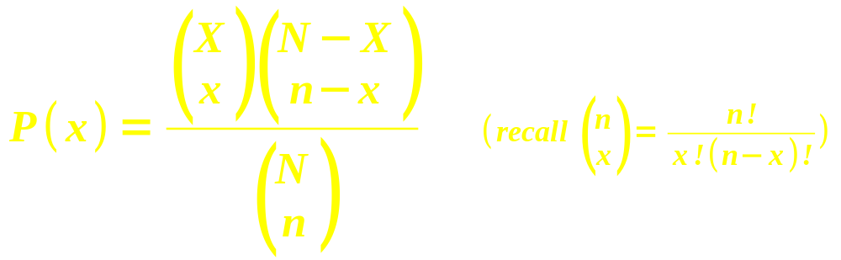
Hypergeometric distribution
n trials taken from a finite population of size N
Trials are drawn without replacement:
the trials are not independent of each other
  Probabilities change with each trial
Given that there are X successes in the larger population of size N, what is the chance of finding exactly x successes in these n trials?

Slide 19
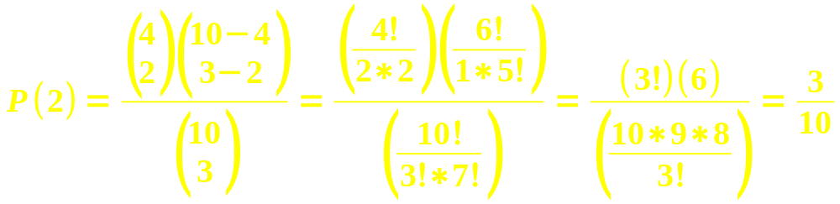
Hypergeometric: example
In a batch of 10 lightbulbs, 4 are defective.
If we select 3 bulbs from that batch, what is the probability that 2 out of the 3 are defective?
  Population: N=10, X=4
  Sample (trials): n=3, x=2
In Excel: HYPGEOMDIST(x, n, X, N)
  HYPGEOMDIST(2, 3, 4, 10) → 30%

Slide 20
Outline for today
Discrete probability distributions
  Finding μ and σ
  Binomial experiments: BINOMDIST()
  Poisson distribution: POISSON()
  Hypergeometric: HYPGEOMDIST()
Continuous probability distributions
  Normal distribution: NORMDIST()
    Cumulative normal
    Continuity correction
    Standard normal
  Uniform distribution
  Exponential distribution: EXPONDIST()

Slide 21
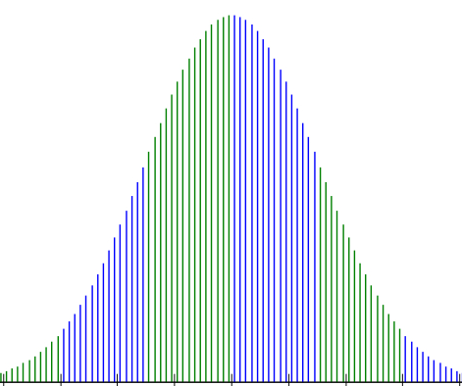
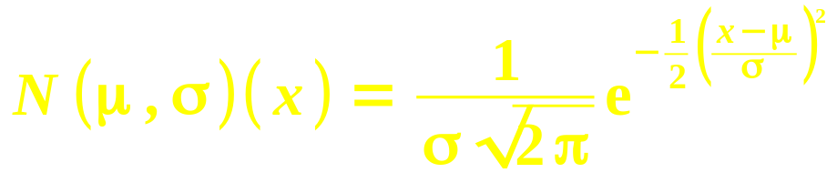
Normal distribution
The normal “bell” curve has a formal definition:
Mean is μ, standard deviation is σ
Drops exponentially with z-score
Normalized so total area under curve is 1
Excel: NORMDIST(x, μ, σ, cum)
  e.g., exam has μ=70, σ=10.
  What is probability of getting a 65?
  =NORMDIST(65, 70, 10, 0) → 3.52%

Slide 22
Cumulative normal
Usually, we are interested in the probability over a range of values:
  Area of a region under the normal curve
The cumulative normal gives area under the normal curve, to the left of a threshold:
  e.g., exam with μ=70, σ=10.
  What is probability of getting below 65?
  =NORMDIST(65, 70, 10, 1) → 30.85%
  e.g., getting between 75 and 90?
  =NORMDIST(90, 70, 10, 1) –
  NORMDIST(75, 70, 10, 1) → 28.58%

Slide 23
Inverse function
Excel can also find the threshold (x) that matches a given cumulative normal probability:
  NORMINV(area, μ, σ)
E.g., assume air fares for a certain itinerary are normally distrib with σ=$50 but unknown μ.
The 90th percentile fare is at $630.
What is the mean air fare?
  We have: NORMINV(.90, μ, 50) = 630, so
  =630 – NORMINV(.90, 0, 50) → μ=$565.92

Slide 24
Continuity correction
72.5
For discrete variables
(e.g., integer-valued):
  e.g., # of students
  per class, assumed to be normally distributed with μ=25, σ=10
The range can be inclusive or exclusive:
  Probability of a class having fewer than 10?
    <10: excludes 10
  At least 30 students? ≥30: includes 30
Edge of the bar is at ±0.5 from the centre
  <10: =NORMDIST(9.5, 25, 10, 1) → 6.06%
  ≥30: =1-NORMDIST(29.5, 25, 10, 1) → 32.6%

Slide 25
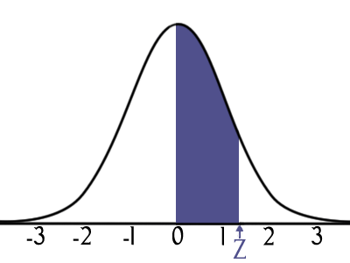
Standard normal
There is a whole family of normal distributions, with varying means and standard deviations
The standard normal is the one that has
μ=0, σ=1
This means z-scores and x-values are the same!
In Excel: NORMSDIST(x) (cumulative only) and
NORMSINV(area)

Slide 26
Outline for today
Discrete probability distributions
  Finding μ and σ
  Binomial experiments: BINOMDIST()
  Poisson distribution: POISSON()
  Hypergeometric: HYPGEOMDIST()
Continuous probability distributions
  Normal distribution: NORMDIST()
    Cumulative normal
    Continuity correction
    Standard normal
  Uniform distribution
  Exponential distribution: EXPONDIST()

Slide 27
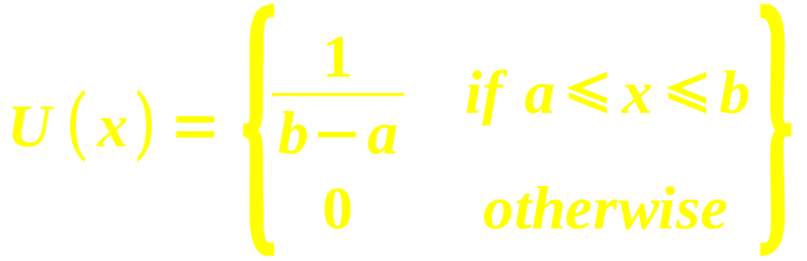
Uniform distribution
With a uniform distribution,
all values within a range are equally likely
  e.g., roll of a fair die:
  {1,2,3,4,5,6} all have probability of 1/6
  Range is from a to b:
μ=(a+b)/2, σ=√( (b-a)²/12 )

Slide 28

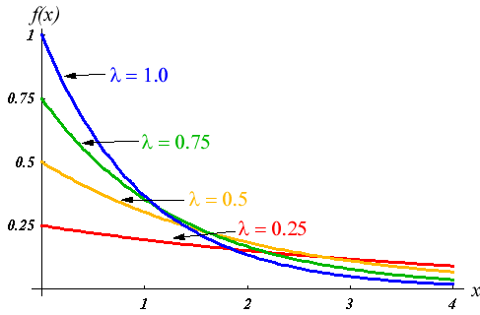
Exponential distribution
Time between occurrences of an event
  e.g., time between two security breaches
Exponential density: probability that the time between occurrences is exactly x is:
  λ = mean #
  occurrences per
  time unit
    As in Poisson
  Need both x, λ > 0
EXPONDIST(x, λ, cum)
  Density: cum=0

Slide 29

Exponential probability
Exponential probability (cumulative distribution) is the probability that the time between occurrences is less than x:
  Excel: EXPONDIST(x, λ, 1)
e.g., average time between purchases is 10min.
What is the probability that two purchases are made less than 5min apart?
  EXPONDIST(5, 1/10, 1) → 39.35%
  Remember: λ = purchases/min

Slide 30
Outline for today
Discrete probability distributions
  Finding μ and σ
  Binomial experiments: BINOMDIST()
  Poisson distribution: POISSON()
  Hypergeometric: HYPGEOMDIST()
Continuous probability distributions
  Normal distribution: NORMDIST()
    Cumulative normal
    Continuity correction
    Standard normal
  Uniform distribution
  Exponential distribution: EXPONDIST()

Slide 31
TODO
HW3 (ch4): due this Thu 26Jan
Proposal meetings this week
  Submit proposal ≥24hrs before meeting
Dataset description next week: 7Feb
  If using existing data, need to have it!
  If gather new data, have everything for your REB application: sampling strategy, recruiting script, full questionnaire, etc.
REB application in two weeks: 14Feb (or earlier)
  If not REB exempt, need printed signed copy

