Slide 1

Ch7-8: Making Inferences
About the Population
HW4 due Thu 10pm
Dataset description
due tonight
REB due next Tue
7 Feb 2012
Dr. Sean Ho
busi275.seanho.com

Slide 2
Outline for today
Sampling distribution of the sample mean
  μ_{x} and σ_{x}
  Central Limit Theorem
Uses of the SDSM
  Probability of x above a threshold
  Estimating needed sample size
Estimates on a binomial proportion
Confidence intervals
  On μ, with known σ
  On the binomial proportion π
  On μ, with unknown σ (Student's t-dist)

Slide 3
Sampling error
Pop.
Sample
μ
x
Sampling is the process of drawing a sample out from a population
Sampling error is the difference between a statistic calculated on the sample and the
true value of the statistic in the population
e.g., pop. of 100 products; avg price is μ=$50
  Draw a sample of 10 products,
  calculate average price to be x=$55
  We just so happened to draw 10 products that are more expensive than the average
  Sampling error is $5

Slide 4
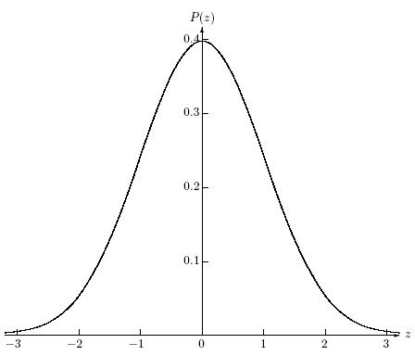
Sampling distribution
  Draw one sample of size n
  Find its sample mean x (or other statistic)
  Draw another sample of size n; find its mean
  Repeat for all possible samples of size n
  Build a histogram of all those sample means
In the histogram for the population,
each block represents one observation
In the histogram for the sampling distribution,
each block represents one whole sample!
Pop.
x
SDSM
sample
sample
x
sample
x

Slide 5
SDSM
Sampling distribution of sample means
  Histogram of sample means (x) of all possible samples of size n taken from the population
  It has its own mean, μ_{x}, and SD, σ_{x}
SDSM is centred around the true mean μ
  i.e., μ_{x} = μ
If μ=$50 and our sample of 10 has x=$55,
we just so happened to take a high sample
  But other samples will have lower x
  On average, the x should be around $50

Slide 6
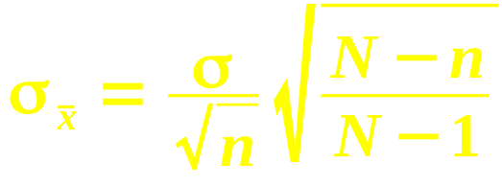
Properties of the SDSM
μ_{x} = μ: centred around true mean
σ_{x} = σ/√n: narrower as sample size increases
  For large n, any sample looks about the same
  Larger n ⇒ sample is better estimate of pop
  σ_{x} is also called the standard error
If pop is normal, then SDSM is also normal
If pop size N is finite and sample size n is a sizeable fraction of it (say >5%), need to adjust standard error:

Slide 7
Central Limit Theorem
In general, we won't know the shape of the population distribution, but
As n gets larger, the SDSM gets more normal
  So we can use NORMDIST/INV to make calculations on it
So, as sample size increases, two good things:
  Standard error decreases (σ_{x} = σ/√n)
  SDSM becomes more normal (CLT)
SDSM
@small n:
SDSM
@large n
Population:
x
x
x
x

Slide 8
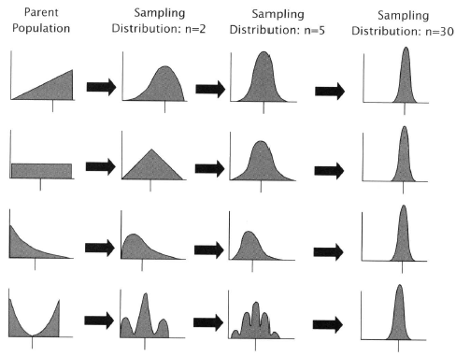
SDSM as n increases
@n=1, SDSM matches original population
As n increases, SDSM gets tighter and normal
Regardless of
shape of original
population!
Note: pop doesn't
get more normal;
it does not change
Only the sampling
distribution
changes
Hemist

Slide 9
Outline for today
Sampling distribution of the sample mean
  μ_{x} and σ_{x}
  Central Limit Theorem
Uses of the SDSM
  Probability of x above a threshold
  Estimating needed sample size
Estimates on a binomial proportion
Confidence intervals
  On μ, with known σ
  On the binomial proportion π
  On μ, with unknown σ (Student's t-dist)

Slide 10
Example 1: SDSM
Say package weight is normal: μ=10kg, σ=4kg
  Say we have to pay extra fee if the average package weight in a shipment is over 12kg
If our shipment has 4 packages, what is the chance we have to pay fee?
  Standard error: σ_{x} = 4/√4 = 2kg
  z = (x – μ_{x})/σ_{x} = (12-10)/2 = 1
  Area to right: 1-NORMSDIST(1)=15.87%
    Or: 1 - NORMDIST(12, 10, 2, 1)
16 pkgs?
  Std err: σ_{x} = 4/√16 = 1kg; z = (12-10)/1 = 2
  Area to right: 1-NORMSDIST(2) = 2.28%
n=4
n=16

Slide 11
Example 2: SDSM
90%
Assume mutual fund MER norm: μ=4%, σ=1.8%
  Broker randomly(!) chooses 9 funds
  We want to say, “90% of the time, the avg MER for the portfolio of 9 funds is between ___% and ___%.” (find the limits)
Lower limit: 90% in middle ⇒ 5% in left tail
  NORMSINV(0.05) ⇒ z = -1.645
  Std err: σ_{x} = 1.8/√9 = 0.6%
  z = (x – μ_{x}) / σ_{x} ⇒ -1.645 = (x – 4) / 0.6
  ⇒ lower limit is x = 4 – (1.645)(0.6) = 3.01%
Upper: x=μ+(z)(σ_{x}) = 4 + (1.645)(0.6) = 4.99%

Slide 12
Example 2 (MER): conclusion
We conclude that, if the broker randomly chooses 9 mutual funds from the population
90% of the time, the average MER in the portfolio will be between 3.01% and 4.99%
  This does not mean 90% of the funds have MER between 3.01% and 4.99%!
  90% on SDSM, not 90% on orig. population
If the portfolio had 25 funds instead of 9,
the range on avg MER would be even narrower
  But the range on MER in the population stays the same

Slide 13
SDSM: estimate sample size
So: given μ, σ, n, and a threshold for x
⇒ we can find probability (% area under SDSM)
  Std err ⇒ z-score ⇒ % (use NORMDIST)
Now: if given μ, σ, threshold x, and % area,
⇒ we can find sample size n
  Experimental design: how much data needed
Outline:
  From % area on SDSM, use NORMINV to get z
  Use (x – μ) to find standard error σ_{x}
  Use σ_{x} and σ to solve for sample size n

Slide 14
Example 3: min sample size
Assume weight of packages is normally distributed, with σ=1kg
We want to estimate average weight to within a precision of ±50g, 95% of the time
  How many packages do we need to weigh?
NORMSINV(0.975) → z=±1.96
  ±1.96 = (x – μ_{x}) / σ_{x} .
  Don't know μ, but we want (x – μ) = ±50g
  ⇒ σ_{x} = 50g / 1.96
  So σ/√n = 50g / 1.96. Solving for n:
  n = (1000g * 1.96 / 50g)² = 1537 (round up)

Slide 15
Outline for today
Sampling distribution of the sample mean
  μ_{x} and σ_{x}
  Central Limit Theorem
Uses of the SDSM
  Probability of x above a threshold
  Estimating needed sample size
Estimates on a binomial proportion
Confidence intervals
  On μ, with known σ
  On the binomial proportion π
  On μ, with unknown σ (Student's t-dist)

Slide 16
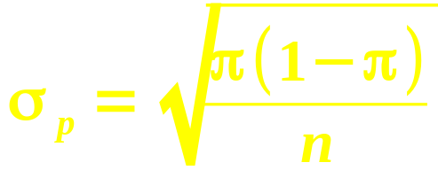
Binomial sampling distribution
For most (n,p), the binomial is approx. normal:
  μ = np, σ = √(npq)
Let π be the “true” prob of success in the pop
  p = observed prob of success in sample
Convert from “number of successes” (x)
to “probability of success” (p):
Just divide by n
(total # of trials):
 | # successes | prob. of success
Mean | μ = np | μ_{p} = π
Std dev | σ = √(npq)

Slide 17
Example 4: Binomial, find n
.01
Assume about 70% of people like our toothpaste. We want to refine this estimate,
to a precision of ±1%, with 95% confidence.
  How many people do we need to poll?
Prob. of success ⇒ binomial
95% conf. ⇒ z = ±1.96
  NORMSINV(.025)
Std. err σ_{p} = √( (.70)(.30)/n )
Putting it together: 1.96 = .01 / σ_{p}.
⇒ n = ( 1.96 / .01 )² (.70)(.30) ≈ 8068
σ_{p}=√(.21/n)
95%

Slide 18
Outline for today
Sampling distribution of the sample mean
  μ_{x} and σ_{x}
  Central Limit Theorem
Uses of the SDSM
  Probability of x above a threshold
  Estimating needed sample size
Estimates on a binomial proportion
Confidence intervals
  On μ, with known σ
  On the binomial proportion π
  On μ, with unknown σ (Student's t-dist)

Slide 19
Confidence intervals
Tip: log(income)
is often normal
“If we were to select another random sample from the same population, 95% of the time
its mean would lie between _____ and _____.”
  Application of the SDSM
E.g., avg income of 25 students is $12,000.
  Assume σ = $4,000 (pop. SD!)
Std err is σ_{x} = σ/√n = $800
95% conf. ⇒ z = ±1.96
So the confidence interval is $12k ± (1.96)(800)
  We think the true mean income lies somewhere between $10,432 and $13,568, with 95% confidence.

Slide 20
Myths about confid. intervals
Myth: “All students in this population have income between $10.4k and $13.5k”
Myth: “95% of students in this population have income between $10.4k and $13.5k”
Myth: “If we repeated the study, 95% of the students surveyed would have income betw….”
Myth: “We are 95% sure the mean income of our sample of 25 students is between ….”

Slide 21
Example 5: Binomial conf int
In a poll of 80 people, 60 like our product
  Point estimate: p = 75%
Obtain a 95% confidence interval:
  95% confid. ⇒ z = ±1.96
Std err: σ_{p} = √(pq/n) = √((.75)(.25)/80) ≈ 4.84%
Put it together: (pt estimate) ± (z)(std err)
  75% ± (1.96)(4.84%)
We are 95% confident that between 65.51% and 84.49% of people like our product
  i.e., that the real proportion π is in that range

Slide 22
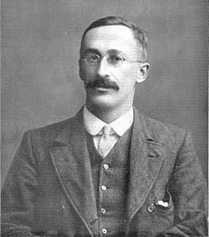
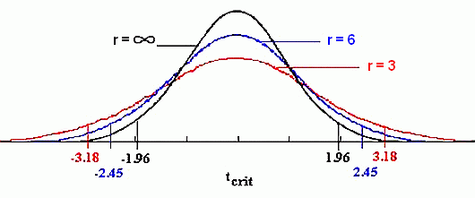
Conf int, with unknown σ
What if we don't know the population σ?
Estimate it from the sample SD: s
  But this adds uncertainty in estimating μ
Use “Student's” t-distribution on SDSM
  Similar to normal,
  but wider (w/uncertainty)
  Degrees of freedom: df = n-1
  Approaches normal as df increases
William Sealy Gosset
in 1908
(Wikipedia)

Slide 23
t-distribution in Excel
t = 1
TDIST(t, df, tails)
  t: t-score, akin to z-score (x – μ) / SE
  df: degrees of freedom, df = n-1 for now
  tails: 1 for area in one tail, or 2 for both tails
  Result: % area under the t-dist in tail(s)
    TDIST(1, 20, 2) → 32.93%
TINV(area, df)
  Always assumes area
  is total in both tails
  Result: t-score
    TINV(0.3293, 20) → 1
32.93%

Slide 24
Example 6: confidence interval
Track sales this month at 25 stores out of 1000:
  Average = 8000 units, SD = 1500
Estimate the average sales this month across all 1000 stores (i.e., 95% confidence interval).
Standard error: s/√n = 1500/5 = 300
Only have s, not σ: so use t-dist (df=24)
  TINV(.05, 24) → t = ±2.0639
Putting it together: 8000 ± (2.0639)(300)
  7380.83 (round down), 8619.17 (round up)
  With 95% confidence, the average sales this month across all stores is between
  7380 and 8620 units

Slide 25
Summary
What is the question asking for?
  Find percent area under SDSM (*DIST)
  Find threshold on SDSM (*INV)
    Find confidence interval (2 thresholds)
  Find min required sample size (n)
What kind of distribution?
  SDSM, σ known (normal)
  SDSM, σ unknown (t-dist)
  Binomial (normal)

Slide 26
TODO
HW4 (ch5-6): due this Thu 9Feb
Dataset description tonight 10pm
  If using existing data, need to have it!
  If gather new data, have everything for your REB application: sampling strategy, recruiting script, full questionnaire, etc.
REB application next week: 14Feb (or earlier)
  If not REB exempt, need printed signed copy

