Slide 1

Ch10: T-tests
Please download:
08-TTests.xls
HW5 this week
Projects
6 Mar 2012
Dr. Sean Ho
busi275.seanho.com

Slide 2
Outline for today
Preview of statistical tests for your projects
T-tests (comparing two groups of values):
  Standard error
    When σ₁, σ₂ are known
    When s₁, s₂ are known, heteroscedastic
    When s₁, s₂ are known, homoscedastic
  Using Excel's TTEST() function on data
  Types of t-test
    Independent groups
    Binomial proportions (σ known)
    Paired data

Slide 3
Exploratory analysis
Choosing good research questions:
Start with the outcome variable (DV)
  e.g., sales volume
Research background (prior literature) on the DV to find likely predictors
  e.g., marketing budget, consumer trends, new products from competitors, etc.
Select some effect/predictor(s) to examine
  In your analysis, control for other covariates
Correlation ≠ causation: look for hidden vars
  e.g., ice cream correlates with drownings!
    Why? What are they both correlated with?

Slide 4
Analysis Types by IV/DV
DV quantitative, IV categorical:
  IV dichotomous (two groups): t-test
  IV has many groups: ANOVA
  Multiple categorical IVs: Factorial ANOVA
    Controlling for covariates: ANCOVA
DV quantitative, IV quantitative:
  One IV: Simple Regression
  Multiple IVs: Multiple Regression
    Also if mix of categorical/quant IVs
DV dichotomous: Logistic Regr. (survival an.)
DV ordinal: Ordinal Regr.
  … and much more!

Slide 5
Comparing two groups
Assume: quantitative DV
Assume: two independent groups
  IV is dichotomous (nominal w/ 2 categories)
  Each participant goes in only one group
Look at difference between pop means: μ₁ – μ₂.
E.g., is CEO salary in US higher than in Can?
  DV: salary. IV: country (US vs. Can)
  H_{A}: μ_{US} – μ_{Can} > 0
E.g., does gender affect invest. risk tolerance?
  DV: risk tolerance. IV: gender (M vs. F)
  H_{A}: μ_{M} – μ_{F} ≠ 0

Slide 6
Hypothesis testing
As before, we can either:
  Estimate a confidence interval on μ₁ – μ₂
    If 0 is not in the interval, then there is a significant difference between groups
  Or do a hypothesis test on μ₁ – μ₂
    x₁ – x₂ is a threshold: p-val is area in tail
Key components to calculate:
  Point estimate (x₁ – x₂),
  t-score, and
  Standard error
  T-distribution also needs a df

Slide 7
How to approach a t-test
What format do you want the output in?
  Hypothesis test (p-value) or conf. interval?
What info on the data do you have?
  Full dataset: use Excel's TTEST() function
  Only means/SD: calculate manually
    Standard error (SE) is key ingredient
What type of t-test?
  Independent groups
    Homoscedastic or heteroscedastic?
  Binomial proportions
  Paired data

Slide 8
Outline for today
Preview of statistical tests for your projects
T-tests (comparing two groups of values):
  Standard error
    When σ₁, σ₂ are known
    When s₁, s₂ are known, heteroscedastic
    When s₁, s₂ are known, homoscedastic
  Using Excel's TTEST() function on data
  Types of t-test
    Independent groups
    Binomial proportions (σ known)
    Paired data

Slide 9
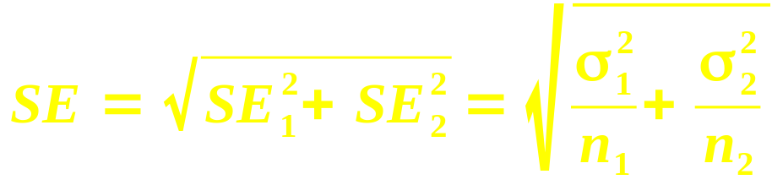
Standard error: σ known
SE is a “yardstick” by which we measure the group difference to see if it is significant
  Larger SE ⇒ wider confidence interval,
  less precision in our estimate
If we have σ₁ and σ₂: the SE is a combination of SE₁ and SE₂ from each of the two groups:
SE
SE₁
SE₂

Slide 10
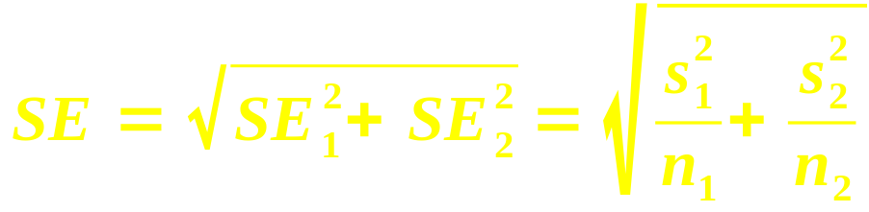
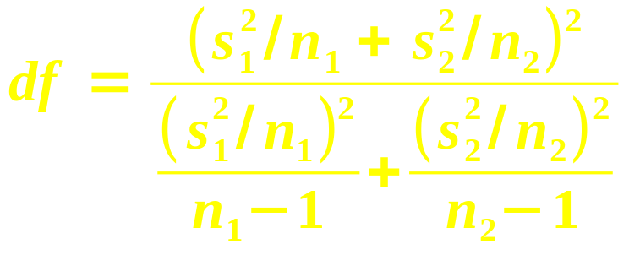
Standard error: using s
More realistically, we would only have s₁, s₂
  As well as n₁, n₂, x₁, x₂
SE is the same:
But the t-dist needs a df, and it is messy:
In general, df is somewhere in between
  min(n₁ – 1, n₂ – 1) (lower bound), and
  n₁ + n₁ – 2 (upper bound)

Slide 11
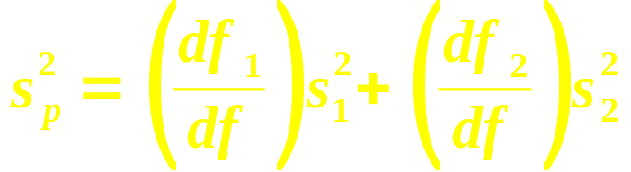
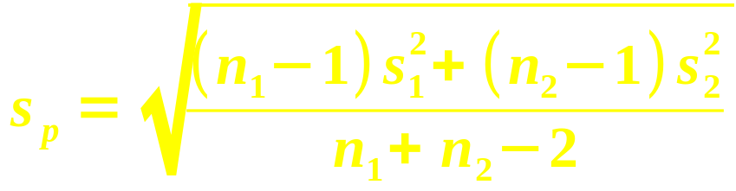
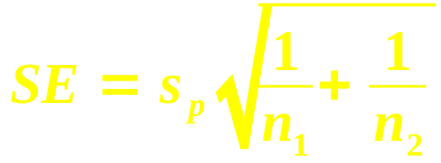
Standard error: homoscedastic
If s₁, s₂ are similar, we can try another method:
  Homoscedasticity: same variance
  Rule of thumb: s₁, s₂ are within a factor of 2
df is simpler: df = df₁ + df₂ = n₁ + n₂ - 2
The pooled variance s_{p}²
is a weighted sum:
So the pooled SD is:
Then the SE simplifies to:

Slide 12
Outline for today
Preview of statistical tests for your projects
T-tests (comparing two groups of values):
  Standard error
    When σ₁, σ₂ are known
    When s₁, s₂ are known, heteroscedastic
    When s₁, s₂ are known, homoscedastic
  Using Excel's TTEST() function on data
  Types of t-test
    Independent groups
    Binomial proportions (σ known)
    Paired data

Slide 13
Example: household income
RQ: did US household income decrease between 2001 and 2004?
Data: income for each of 100 hholds in 2001;
another sample of 100 households in 2004
What format output? (p-value or conf. int.?)
What format input? (raw data or just mean/SD?)
What kind of t-test?
  Indep. groups, proportions, or paired data?
  Homoscedastic or heteroscedastic?
    How can we check?
See “Income” in 08-TTests.xls

Slide 14
Example: risk tolerance
RQ: do M have higher risk tolerance than F?
  Data: 15 males, avg tol 7.8, SD=2
  12 females, avg tolerance 7.2, SD=2.5
Point estimate: difference in tol is x₁ – x₂ = 0.6
Standard error: using s, try heteroscedastic
  SE₁= 2/√15 ≈ 0.5164, SE₂= 2.5/√12 ≈ 0.7217
    SE = √(SE₁² + SE₂²) ≈ 0.8874
  Messy df ≈ 20.8
⇒ t-score is t = (0.6 – 0)/SE = 0.6/0.8874 ≈ 0.68
p-val: TDIST(0.68, 20.8, 1) → 25.3%
Fail to reject H₀: M tol. not significantly higher

Slide 15
Outline for today
Preview of statistical tests for your projects
T-tests (comparing two groups of values):
  Standard error
    When σ₁, σ₂ are known
    When s₁, s₂ are known, heteroscedastic
    When s₁, s₂ are known, homoscedastic
  Using Excel's TTEST() function on data
  Types of t-test
    Independent groups
    Binomial proportions
    Paired data

Slide 16
T-test on proportions
e.g., customer satisfaction vs. bank branch:
  See “Banks” in 08-TTests.xls
  At Langley, 160/200 customers satisfied
  At Abbt., 210/300 satisfied
  Is there a significant difference?
Use normal approximation to binomial:
  When both np, nq > 5 (for both groups)
For confidence intervals, SE = √(SE₁² + SE₂²)
  Where each SE_{i} = √(p_{i}q_{i}/n_{i})
For hypothesis tests, use a different SE
  Uses pooled proportion:

Slide 17
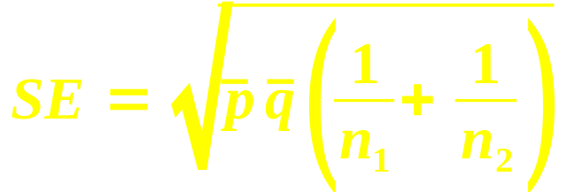
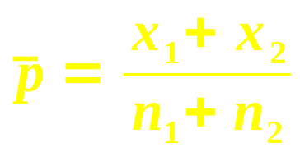
SE for hyp. tests on proportion
The textbook offers a second form of the SE for hypothesis tests on binomial proportions:
Where p is the pooled proportion:
This is equivalent to the
“χ² test of goodness-of-fit” we will learn in ch13
  Most stats software uses this method

Slide 18
Proportions: bank example
Langley: x_{L} = 160, n_{L} = 200
Abbt.: x_{A} = 210, n_{A} = 300
Pooled p = (160+210) / (200+300) = 74%
SE = √ pq (1/n_{L} + 1/n_{A}) ≈ 4.0042%
Sample difference of proportions is
p_{L} – p_{A} = (160/200) – (210/300) = 10%
This means a z-score of z = ((p_{L} – p_{A}) – 0) / SE
  ≈ 10% / 4.0042% ≈ 2.497
Find the p-value (2-tailed):
  =2*NORMSDIST(-2.497) → 0.0125
  Reject H₀: yes, there is a difference

Slide 19
Outline for today
Preview of statistical tests for your projects
T-tests (comparing two groups of values):
  Standard error
    When σ₁, σ₂ are known
    When s₁, s₂ are known, heteroscedastic
    When s₁, s₂ are known, homoscedastic
  Using Excel's TTEST() function on data
  Types of t-test
    Independent groups
    Binomial proportions
    Paired data

Slide 20
Repeated measures
Apply same measurement to same subjects, but at different points in time:
  e.g., annual revenue, 2000-2010
  Time series / longitudinal data
Or under different conditions:
  e.g., highway vs. city mileage (on same car!)
  e.g., wife's income, husband's income
    (What is the unit of observation?)
The measurements are linked to each other
  Not independent
Paired data is the simplest repeated measure
  Use a t-test on the pairwise differences

Slide 21
Types of t-test (as in Excel)
Type 3: two indep groups, most general:
  H_{A}: μ₁ – μ₂ ≠ 0 (or >0)
  SE = √(SE₁² + SE₂²), df is messy
Type 2: two indep groups, similar SD:
  H_{A}: μ₁ – μ₂ ≠ 0 (or >0)
  SE = s_{p}√(1/n₁ + 1/n₂), df = df₁ + df₂
Type 1: paired observations:
  Form pairwise diffs: n = # pairs
  H_{A}: μ_{d} ≠ 0 (or >0)
  SE = s_{d} / √n, df = n-1

Slide 22
Paired data t-test
e.g., “Mileage” in 08-TTests.xls
Calculate the pairwise differences: =A2-B2, fill
Find n, mean (d), and SD (s_{d}) of pairs:
  COUNT(), AVERAGE(), STDEV()
  SD of diffs is not the same as diff of SDs!
Calculate standard error: SE = s_{d}/√n
Find t-score: (d – 0) / SE
Use TDIST() to find p-value, compare w/α
  TDIST(t, n-1, tails)
Or use all-in-one Excel function:
TTEST(before, after, tails, 1)

Slide 23
TODO
HW5 due Thu
Projects: be pro-active and self-led
  If waiting on REB approval:
  generate fake (reasonable) data and
  move forward on analysis, presentation
  Remember your potential clients:
  what questions would they like answered?
  Tell a story/narrative in your presentation

