Slide 1

Ch14: Linear Correlation and Regression
Please download:
09-Regression.xls
HW6 this week
Projects
13 Mar 2012
Dr. Sean Ho
busi275.seanho.com

Slide 2
Outline for today
Correlation
  r² as fraction of variability
  t-test on correlation
Prediction using Simple Linear Regression
  Linear regression model
  Regression in Excel
  Analysis of variance: Model vs. Residual
  The global F-test
  T-test on slope b₁
  Confidence intervals on predicted values

Slide 3
Linear correlation
Correlation measures the strength of
a linear relationship between two variables
Does not determine direction of causation
Does not imply a direct relationship
  There might be a mediating variable
  (e.g., between ice cream and drownings)
Does not account for non-linear relationships
The Pearson product-moment correlation coefficient (r) is between -1 and 1
  Close to -1: inverse relationship
  Close to 0: no linear relationship
  Close to +1: positive relationship

Slide 4
Correlation on scatterplots
y
y
y
r = 0
r = -0.6
r = -1
x
x
x
y
y
r = -0.2
x
x
r = +0.3

Slide 5
Correlation is an effect size
We often want to understand the variance in our outcome variable:
  e.g., sales: why are they high or low?
What fraction of the variance in one variable is explained by a linear relationship w/the other?
  e.g., 50% of the variability in sales is explained by the size of advertising budget
The effect size is r²: a fraction from 0% to 100%
  Also called the coefficient of determination
Sales
Advert
(shared
variability)

Slide 6
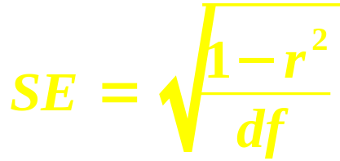
Correlation: t-test
r is sample correlation (from data)
ρ is population correlation (want to estimate)
Hypothesis: H_{A}: ρ ≠ 0 (is there a relationship?)
Standard error:
  1 – r² is the variability not explained by the linear relationship
  df = n–2 because we have two sample means
Test statistic: t = r / SE
  Use TDIST() to get p-value

Slide 7
Correlation: example
e.g., is there a linear relationship between
caffeine intake and time spent in Angry Birds?
  H_{A}: ρ ≠ 0 (i.e., there is a relationship)
  Data: 8 participants, r = 0.72
Effect size: r² = 0.72² = 51.84%
  About half of variability in AB time is explained by caffeine intake
Standard error: SE = √((1-0.5184) / 6) ≈ 0.2833
Test statistic: t = 0.72 / 0.2833 ≈ 2.54
P-value: TDIST(2.54, 6, 2) → 4.41%
At α=0.05, there is a significant relationship

Slide 8
Correlation: Excel
Example: “Trucks” in 09-Regression.xls
Scatterplot: POE Gross (G:G), WIM Gross (H:H)
Correlation: CORREL(dataX, dataY)
  Coefficient of determination: r²
T-test:
  Sample r
  → SE
  → t-score
  → p-value

Slide 9
Correl. and χ² independence
Pearson correlation is for two quantitative (continuous) variables
For ordinal variables, there exists a
non-parametric version by Spearman (r_{s})
What about for two categorical variables?
  χ² test of goodness-of-fit (ch13)
  2-way contingency tables (pivot tables)
  Essentially a hypothesis test on independence

Slide 10
Outline for today
Correlation
  r² as fraction of variability
  t-test on correlation
Prediction using Simple Linear Regression
  Linear regression model
  Regression in Excel
  Analysis of variance: Model vs. Residual
  The global F-test
  T-test on slope b₁
  Confidence intervals on predicted values

Slide 11
Regression: the concept
Regression is about using one or more IVs
to predict values in the DV (outcome var)
  E.g., if we increase advertising budget,
  will our sales increase?
The model describes how to predict the DV
  Input: values for the IV(s). Output: DV value
Linear regression uses linear functions
(lines, planes, etc.) for the models
  e.g., Sales = 0.5*AdvBudget + 2000
  Every $1k increase in advertising budget yields 500 additional sales, and
  With $0 spending, we'll still sell 2000 units

Slide 12
Regression: the model
y
ε
trend
line
The linear model has the form
  Y = β₀ + β₁X + ε
X is the predictor, Y is the outcome,
  β₀ (intercept) and β₁ (slope)
  describe the line of best fit (trend line), and
  ε represents the residuals: where the trend line doesn't fit the observed data
    ε = (actual Y) – (predicted Y)
The residuals average out to 0, and if the model fits the data well, they should be small overall
  Least-squares fit: minimize SD of residuals
x

Slide 13
Regression: Trucks example
Trucks example
Scatterplot:
X: POE Gross (G:G)
Y: WIM Gross (H:H)
Layout → Trendline
  Linear, R²
Regression model:
  Slope β₁: SLOPE(dataY, dataX)
  Intercept β₀: INTERCEPT(dataY, dataX)
SD of the residuals: STEYX(dataY, dataX)

Slide 14
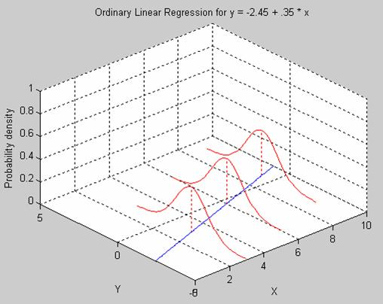
Regression: assumptions
Both IV and DV must be quantitative
  (extensions exist for other levels of meas.)
Independent observations
  Not repeated-measures or hierarchical
Normality of residuals
  DV need not be normal, but residuals do
Homoscedasticity
  SD of residuals
  constant along the line
These 4 are called: parametricity
  T-test had similar assumptions
Omid Rouhani

Slide 15
Regression: Banks example
“Banks” in 09-Regression.xls
Scatterplot:
X: Employees (D:D)
Y: Profit (C:C)
Layout → Trendline
Correlation r:
  CORREL(datY, datX)
Regression model:
  Intercept b₀: INTERCEPT(dataY, dataX)
  Slope b₁: SLOPE(dataY, dataX)
  SD of residuals (s_{ε}): STEYX(dataY, dataX)

Slide 16
Using regression for prediction
Assuming that our linear model is correct,
we can then predict profits for new companies, given their size (number of employees)
  Profit ($mil) = 0.039*Employees – 36.45
e.g., for a company with 1000 employees, our model predicts a profit of $2.558 million
  This is a point estimate; s_{ε} adds uncertainty
Predicted Ŷ values: using X values from data
  Citicorp: Ŷ = 0.039*93700 – 36.45 ≈ 3618
Residuals: (actual Y) – (predicted Y):
  Y - Ŷ = 3591 – 3618 = -27.73 ($mil)
  Overestimated Citicorp's profit by $27.73 mil

Slide 17
Outline for today
Correlation
  r² as fraction of variability
  t-test on correlation
Prediction using Simple Linear Regression
  Linear regression model
  Regression in Excel
  Analysis of variance: Model vs. Residual
  The global F-test
  T-test on slope b₁
  Confidence intervals on predicted values

Slide 18
Analysis of variance
In regression, R² indicates the fraction of variability in the DV explained by the model
  If only 1 IV, then R² = r² from correlation
Total variability in DV: SS_{tot} = Σ(y_{i} – y)²
  =VAR(dataY) * (COUNT(dataY) – 1)
Explained by model: SS_{mod} = SS_{tot} * R²
Unexplained (residual): SS_{res} = SS_{tot} – SS_{mod}
  Can also get from Σ(y_{i} – ŷ_{i})²
Hence the total variability is decomposed into:
  SS_{tot} = SS_{mod} + SS_{res}
  (book: SST = SSR + SSE)

Slide 19
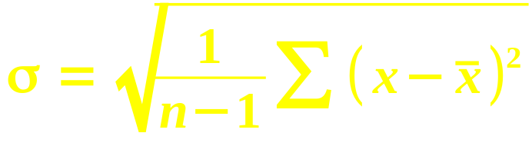
Regression: global F-test
Follow the pattern from the regular SD:
 | Total (on DV) | Model | Residual
SS | SS_{tot} = Σ(y - y)² | SS_{mod} = Σ(ŷ - y)² | SS_{res} = Σ(y - ŷ)²
df | n – 1 | #vars – 1 | n - #vars
MS = SS/df | SS_{tot} / (n-1) | SS_{mod} / 1 | SS_{res} / (n–2)
SD = √(MS) | s_{Y} | - | s_{ε} (=STEYX)
The test statistic is F = MS_{mod} / MS_{res}
  Get p-value from FDIST(F, df_{mod}, df_{res})

Slide 20
Calculating the F test
Key components are the SS_{mod} and SS_{res}
If we already have R², the easiest way is:
  Find SS_{tot} = VAR(dataY) * (n-1)
    e.g., Banks: 38879649 (≈ 39e6)
  Find SS_{mod} = SS_{tot} * R²
    e.g., 39e6 * 88.53% ≈ 34e6
  Find SS_{res} = SS_{tot} – SS_{mod}
    e.g., 39e6 – 34e6 ≈ 5e6
Otherwise, find SS_{res} using pred ŷ and residuals
Or, work backwards from s_{ε} = STEYX(Y, X)
    e.g., SS_{res} = (301)² * (n-2)

Slide 21
F-test on R² vs. t-test on r
If only one predictor, the tests are equivalent:
  F = t²,
    e.g., Banks: F ≈ 378, t ≈ 19.4
  F-dist with df_{mod} = 1 is same as t-dist
    Using same df_{res}
If multiple IVs, then there are multiple r's
  Correlation only works on pairs of variables
F-test is for the overall model with all predictors
  R² indicates fraction of variability in DV explained by the complete model,
  including all predictors

Slide 22
Outline for today
Correlation
  r² as fraction of variability
  t-test on correlation
Prediction using Simple Linear Regression
  Linear regression model
  Regression in Excel
  Analysis of variance: Model vs. Residual
  The global F-test
  T-test on slope b₁
  Confidence intervals on predicted values

Slide 23
T-test on slopes b_{i}
In a model with multiple predictors,
there will be multiple slopes (b₁, b₂, …)
A t-test can be run on each b_{i} to test if that predictor is significantly correlated with the DV
Let SS_{X} = Σ(x – x)² be for the predictor X:
Then the standard error for its slope b₁ is
  SE(b₁) = s_{ε} / √SS_{X}
Obtain t-score and apply a t-dist with df_{res}:
  =TDIST( b₁ / SE(b₁), df_{res}, tails )
If only 1 IV, the t-score is same as for r

Slide 24
Summary of hypothesis tests
 | Correlation | Regression | Slope on X₁
Effect size | r | R² | b₁
SE | √( (1-r²) / df ) | - | s_{ε} / √SS_{X}
df | n - 1 | df1 = #var – 1 df2 = n - #var | n - #var
Test statistic | t = r / SE(r) | F = MS_{mod} / MS_{res} | t = b₁ / SE(b₁)
Regression with only 1 IV is same as correlation
  All tests would then be equivalent

Slide 25
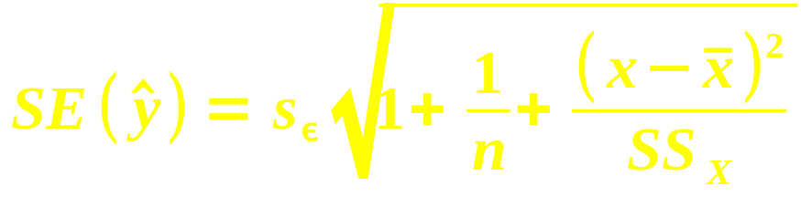
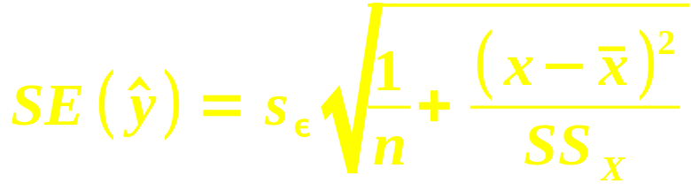
Confidence int. on predictions
Given a value x for the IV, our model predicts a point estimate ŷ for the (single) outcome:
  ŷ = b₀ + b₁*x
The standard error for this estimate is
  Recall that SS_{X} = Σ(x – x)²
Confidence interval: ŷ ± t * SE(ŷ)
When estimating the average outcome, use

Slide 26
TODO
HW6 due Thu
Projects: be pro-active and self-led
  If waiting on REB approval:
  generate fake (reasonable) data and
  move forward on analysis, presentation
  Remember your potential clients:
  what questions would they like answered?
  Tell a story/narrative in your presentation

