Slide 1

Ch15: Multiple Regression
12.1: One-way ANOVA
Please download:
10-MultRegr.xls
HW7 this week
Projects
20 Mar 2012
Dr. Sean Ho
busi275.seanho.com

Slide 2
Outline for today
Multiple regression
  Interpreting Analysis ToolPak output
  Ranking predictors
  Moderation (interaction of predictors)
  Regression diagnostics: check assumptions
  Transforming variables
One-way ANOVA
  Assumptions & concepts: between vs. within
  Global F-test
  Follow-up analysis with Tukey-Kramer

Slide 3
Summary of hypothesis tests
Distributions:
  Sample mean with σ known → NORM
  Sample mean with s known → T
  Binomial proportion (dichot var) → NORM
Data collection:
  One sample (compare vs. threshold)
  Paired data (compare vs. 0 diff)
  Two samples (dichot. IV, compare means)
  Multiple samples (nom. IV → 1-way ANOVA)
  Multiple quant. vars (correl + regression)
Conf. Int. (critical value) vs. p-value approach

Slide 4
Multiple regression
1 outcome (scale), k predictors (scale)
Linear model: hyperplane
  ŷ = b₀ + b₁x₁ + b₂x₂ + … + b_{k}x_{k}
Residuals still assumed normal, homoscedastic
y
y_{i}
ŷ_{i}
Regression plane:
ŷ = b₀ + b₁x₁ + b₂x₂
ε_{i}
slope b₁
x₂
slope b₂
x₁

Slide 5
Multiple regression in Excel
Dataset: 10-MultRegr.xls
DV (y): Output (units/wk)
IV (x₁): Employees
IV (x₂): Age of Plant (yrs)
Pairwise scatters are helpful
  Note R² for each predictor
Data → Analysis → Regression
  Y Range: B1:B160
  X Range: C1:D160
  Check “Labels” and “Standardized Residuals”

Slide 6
Interpreting the output
R Square (R²): fraction of DV var explained
  Adjusted R² compensates for adding more IVs
ANOVA table: F, p, and dfs
  “Number of employees and plant age significantly predicted output:
  R² = .72, F(2, 156) = 200.7, p < .001.”
Coefficient table:
  For each predictor: slope b_{i}, t-score, and p
  Both slopes are significantly nonzero
Standardized residuals: z-scores
  Can use to look for observations that don't fit the model (e.g., |z| > 3)

Slide 7
Unique contributions
Output
Emp.
From the Employees scatter,
it predicts Output pretty well (R² = 71%)
Age? Not so well (R² = 12%)
When use both together, why is R² only 72%?
  Most of the 12% of variability in Output explained by Age is shared variability:
  Age doesn't tell us much more about Output than we already knew from Employees
  Age's unique contribution is only 1%
Compare regression using all predictors
against regression using all except Age
Age

Slide 8
Drawing conclusions
We see that Employees and Age do significantly predict Output (global F test), and
Each predictor does contribute significantly
(t-tests on slope), but
The unique contribution of Age is very small, so
Most of the predictive power is in the number of employees.
In a formal write-up, you usually want to include details such as R², F, dfs, and p,
for those who understand the stats and might want to replicate your results.

Slide 9
Outline for today
Multiple regression
  Interpreting Analysis ToolPak output
  Ranking predictors
  Moderation (interaction of predictors)
  Regression diagnostics: check assumptions
  Transforming variables
One-way ANOVA
  Assumptions & concepts: between vs. within
  Global F-test
  Follow-up analysis with Tukey-Kramer

Slide 10
Moderation
Moderator: a predictor that affects the strength of another predictor's influence on the outcome
  Interacts with the other predictor
E.g., natural disasters may affect your supply, but having multiple suppliers buffers the effect
Supply
Disasters
Supply
Many
suppliers
# of
Suppliers
Few
suppliers
Disasters

Slide 11
Testing for moderation
How do we know if predictors are interacting?
Add an interaction term to the regression:
  ŷ = b₀ + b₁x₁ + b₂x₂ + b₁₂x₁x₂
In Excel, centre both IVs (subtract their means), then make a 3rd column with the product
  Include it in the regression as if it were an IV
Check the t-test to see if the slope (b₁₂) of the interaction term is significantly nonzero
If so, check R² both with and without the interaction term to see the size of its effect
Also 3-way (x₁x₂x₃) and higher interactions!

Slide 12
Diagnostics: check assumptions
Normality of residuals:
  Check histogram of standardized residuals
Homoscedasticity:
  Residual plot: residuals vs. predicted values
  Look for any odd or “fan shaped” patterns
Linearity: curves on the residual plot
  Try adding x₁² or x₂², etc. to the model
  And/or apply transforms to variables
Indep. of residuals (time series are usually bad)
Collinearity of IVs: check correlations of IVs
Outliers / influential points: see residual plot

Slide 13
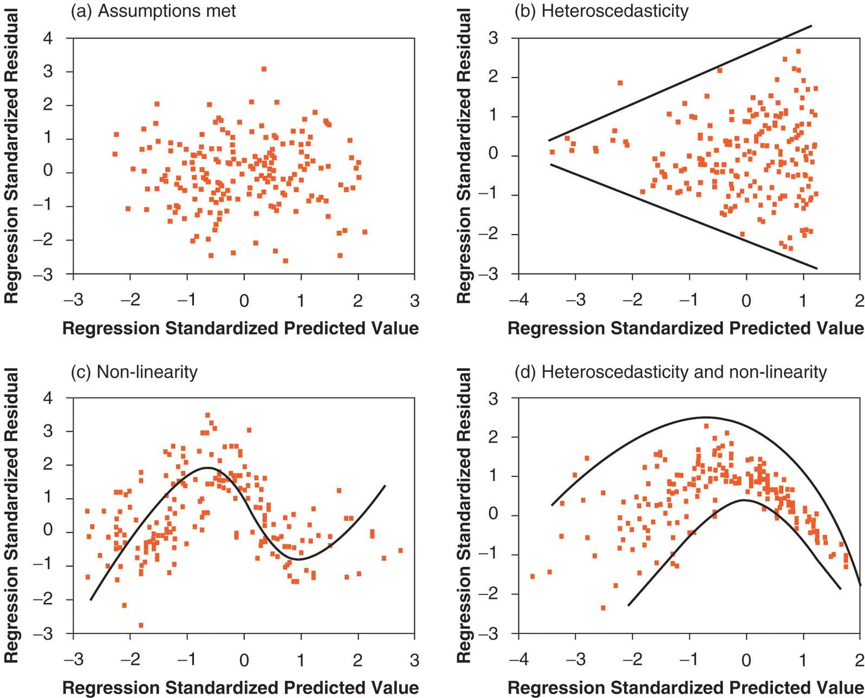
Homoscedasticity & linearity

Slide 14
Transforms
Some variables (either IVs or DV) may be so heavily skewed that they break assumptions (esp. heteroscedasticity and nonlinearity)
You can try applying a transform to make them roughly more symmetric or normal
  But strict normality is not required
  E.g., log(income) is usually more normal
The family of power transforms includes:
  √x, x², 1/x, x^{-5.2}, etc., as well as log(x)
  May need to shift (x+c) or reflect (c-x) first
  The Box-Cox procedure “automatically” selects a power transform for your variable

Slide 15
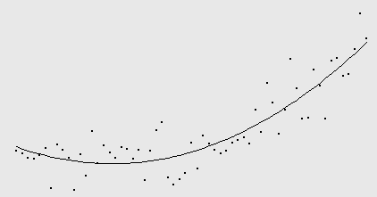
Polynomial regression
Add terms to the regression equation: e.g.,
  ŷ = b₀ + b₁x + b₂x² (quadratic regression)
Allows the regression line to curve
  Quadratic ⇒ parabola
Check whether quadratic term is needed:
  t-test on its slope b₂ to check its significance
  R² and adjusted-R² to see its contribution
  partial F-test: model w/ vs. w/o the term
U Baltimore

Slide 16
Automated predictor selection
Adding predictors always increases R², but
  Want to find the smallest set of predictors that still explains the outcome variable
  Parsimony: simpler model to understand
“Best subsets” automatic selection:
  Several random combinations of predictors
“Stepwise” regression adds/removes
1 predictor at a time to try to do the same
  Backward: eliminate the least significant IV
  Forward: add the next most significant IV
Use PHStat add-on, or SPSS, Stata, R, etc.
Not magic! What do the vars mean?

Slide 17
Outline for today
Multiple regression
  Interpreting Analysis ToolPak output
  Ranking predictors
  Moderation (interaction of predictors)
  Regression diagnostics: check assumptions
  Transforming variables
One-way ANOVA
  Assumptions & concepts: between vs. within
  Global F-test
  Follow-up analysis with Tukey-Kramer

Slide 18
ANOVA: Analysis of Variance
1 DV (scale) and one or more IVs (nominal)
  One-way ANOVA: just one IV, with k levels
  e.g., does country affect avg purchase amt?
    Groups: Canada, US, China, UK, etc.
The independent-groups t-test is a special case
  One IV that is dichotomous
ANOVA performs one global F-test to assess if the predictor has any effect on the outcome
  H₀: μ₁ = μ₂ = … = μ_{k}
  Omnidirectional (generalization of 2-tailed)
Follow-up tests then identify which groups differ

Slide 19
ANOVA: assumptions
DV is continuous
  If DV is dichotomous, try Logistic Regression
  If all vars are nominal, try Log-Linear analysis
Observations are independent, and
Groups (levels of the IV) are independent
DV is normally distributed within each group
  If not, try transforming the DV
Variance (SD) of DV in each group is roughly similar across all the groups (homoscedasticity)
  Not crucial if n in each group is large and if
  balanced design: similar n in each group

Slide 20
ANOVA: concepts
How much of variability in purchase amount is due to country of origin?
  SS_{tot} = SS_{Country} + SS_{residual}
  SS_{Country} is “between-group” variation (SSB)
  SS_{residual} is “within-group” variation (SSW)
Do the group means
differ significantly?
  F-test, p-value
Fraction of variability
explained by country?
  η² (equiv. to R²)
Sale ($)
y_{US}
y_{CA}
y
y_{Ot}
Ctry
Can
US
Other

Slide 21
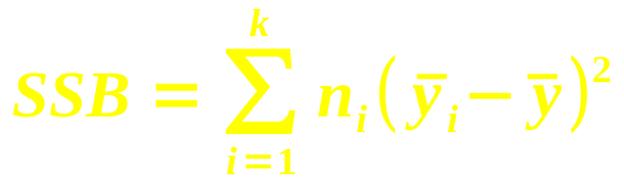
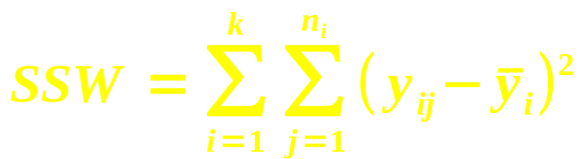
ANOVA table
Model: Y = (offset due to group) + (residual ε)
- | Group (Between) | Residual (Within)
SS
df | k – 1 | n – k
MS = SS/df | MSB = SSB / (k – 1) | MSW = SSW / (n – k)
Test statistic is F = MSB / MSW
  Model vs. residual (as in regression!)
  Use FDIST() with two dfs to get p-value

Slide 22
Example: Delivery minivans
Dataset: “Delivery” in 10-MultRegr.xls
  (See p.496, #12-15)
DV: operating cost per mile
  IV: manufacturer (3 companies)
  Unit of observation: one minivan (total n=13)
ANOVA table: df = (2, 9)
  SS = (6.07, 3.45) ⇒ MS = (3.04, 0.38)
  ⇒ F = 7.91 ⇒ p = 0.010
Reject H₀: operating costs per mile do differ significantly depending on manufacturer

Slide 23
Outline for today
Multiple regression
  Interpreting Analysis ToolPak output
  Ranking predictors
  Moderation (interaction of predictors)
  Regression diagnostics: check assumptions
  Transforming variables
One-way ANOVA
  Assumptions & concepts: between vs. within
  Global F-test
  Follow-up analysis with Tukey-Kramer

Slide 24
Follow-up analysis
ANOVA's global F test is an omnibus test:
  Just says there is a difference somewhere
  Doesn't tell us which groups differ!
There may be sets of groups that
don't differ significantly from each other
Follow-up analysis tries to find these
  Post-hoc: try all pairs of groups
    The multiple comparisons problem:
    a blind “shotgun” approach
    leads to inflated Type I error
  Planned contrasts: if theory guides us to try certain comparisons of groups

Slide 25
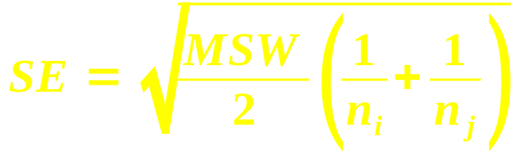
Post-hoc: Tukey-Kramer
Considers all possible pairings of groups
  (Can vs. US), (Can vs. Other), (US vs. Other)
  In general, k*(k-1) pairings!
From table in Appendix J, find critical value for q
  Test statistic for studentized range (like F)
  Use α (.05 or .01) and both dfs to look up
For each pairing (group i vs. group j):
  Find standard error:
  Compare difference of means: |x_{i} – x_{j}|
  against critical range: (q)*(SE)
  If larger, then these groups differ significantly

Slide 26
Delivery ex.: Tukey-Kramer
Which manufacturers differ significantly?
Appendix J (p.867): α=0.05 (95% conf)
  df = (2, 9) ⇒ q = 3.20
Calculate SE for each pairing
Calculate critical range
for each pair: q*SE
Compare against
mean differences:
Conclusion: manufacturer 3 is the odd one out, with significantly higher operating costs
3
1
2
q | 3.20
Pair: | 1 vs 2 | 1 vs 3 | 2 vs 3
SE | 0.303 | 0.279 | 0.317
Crit Range: | 1.024 | 0.940 | 1.071
Mean diff: | 0.633 | 1.175 | 1.808
Result | FALSE | TRUE | TRUE

Slide 27
ANOVA vs. regression
Sale ($)
y_{US}
With only 1 dichotomous IV:
  ANOVA = t-test = regression
  Code the IV as 0/1
    Intercept b₀ = mean of group 0 (y₀)
    Slope b₁ = difference of means
  Effect size η² = R²
If the IV has multiple levels, use dummy coding:
  Choose a reference level
  Make k-1 dummy variables, for
  each of the other levels:
  each coded 0/1
  Use multiple regression
y_{CA}
Can
US
Cty | US | Ot
Ca | 0 | 0
US | 1 | 0
Ot | 0 | 1

Slide 28
TODO
HW7 due Thu
Projects: be pro-active and self-led
  All groups have passed REB by now
  Presentations on 10Apr (3 weeks from now!)
  Remember your potential clients:
  what questions would they like answered?
  Tell a story/narrative in your presentation

