Slide 1

Ch12-13: Factorial ANOVA,
Blocking ANOVA, and χ² Test
Please download:
11-ANOVA.xls
HW8 this week
Presentations
in two weeks!
27 Mar 2012
Dr. Sean Ho
busi275.seanho.com

Slide 2
Outline for today
Factorial ANOVA (multiple nominal IVs)
  Graphing
  Main effects and interaction
Randomized Complete Block ANOVA
  Fixed vs. random effects
  Post-hoc analysis: Fisher's LSD
χ² goodness-of-fit test: observed vs. expected
  Test against uniform distribution
    CHIDIST(), CHITEST()
  Test of normality
  Test 2 nominal vars for independence
    Marginal probabilities

Slide 3
Overview: regression / ANOVA
Both: DV (outcome) quantitative
Regression: IVs quant. (or use dummy coding)
  ANOVA: IVs nominal
Global F-test: do all IVs together impact DV?
  R²: fraction of variability in DV explained
Main effects: each IV's contribution
  Significance (p-val) vs. effect size (unique R²)
  Follow-up (nominal IVs): Tukey-Kramer
    See “Delivery” in 11-ANOVA.xls
Interaction:
  Multiple regr: include X₁*X₂ as a predictor
  Factorial ANOVA (2-way, 3-way, etc.)

Slide 4
2-way ANOVA
DV: Purch Amt
 | IV1: Gender
IV2: Src | $40 $20 $25 $32 | $17 $21 $19 $22
 | $30 $26 $25 | $22 $19
 | $40 $45 $52 $43 $39 $48 | $50 $60 $55
Equivalent to multiple regression
  Except with nominal predictors
  N-way ANOVA for N predictors
IVs are “between-groups” factors:
  Divide up sample into cells
  Each participant in only 1 cell
If your IVs are mixed continuous / nominal,
try regression using dummy-coded variables
  Although this may result in many IVs!
You can also try ANCOVA:
  Continuous “covariates” are first factored out then regular ANOVA is done on residuals

Slide 5
2-way: assumptions
DV: Purch Amt
 | IV1: Gender
IV2: Src | $40 $20 $25 $32 | $17 $21 $19 $22
 | $30 $26 $25 | $22 $19
 | $40 $45 $52 $43 $39 $48 | $50 $60 $55
Same as for regular ANOVA, per cell:
  DV continuous
  Independent observations and
  independent cells (groups)
  DV normal within each cell
  Variance of DV similar across all cells:
    (largest SD) / (smallest SD) < 2
    Better: Levene's test of homoscedasticity
The last two are less important as long as:
  Total sample size is reasonably large (>50)
  Balanced design: all cells similar sample size
  No rows/cols are completely empty

Slide 6
Graphing 2-way ANOVA data
Dataset: “Eukanuba” in 11-ANOVA.xls
The DV has a different distribution in each cell
One way to visualize: condense it down to the
average of DV within each cell
Pivot Table:
  Formula (row)
  Plant (col)
  Average of
  Fat (data)
Try a line chart:

Slide 7
2-way ANOVA: model
Main effects on each IV, plus interactions:
  Fat = b₀ + (Formula effect) + (Plant effct) + (Formula*Plant effect) + ε
Decomposition of variance:
  SS_{tot} = SS_{For} + SS_{Plt} + SS_{For*Plt} + SS_{resid}
Global F-test looks for any effect of IVs on DV
  If not significant, check for violations of assumptions
Effect size η² is akin to R²: 1 – (SS_{resid} / SS_{tot})

Slide 8
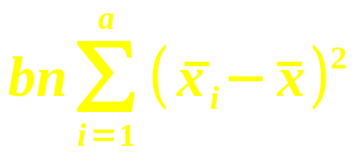
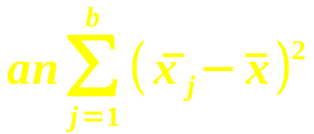
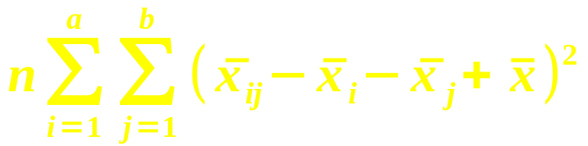
2-way ANOVA: calculating
- | IV₁ (a levels) | IV₂ (b levels) | IV₁*IV₂ (Interaction)
SS
df | a – 1 | b – 1 | (a – 1) * (b – 1)
Also find SS_{tot} as before, and SS_{res}
  df_{tot} = n – 1, and df_{res} = n – ab
  The SS and df always add up:
    Tot = IV₁ + IV₂ + (IV₁*IV₂) + Resid
3 F-tests: IV₁, IV₂, and interaction
  e.g., main effect on IV₁: F = MS₁ / MS_{res}

Slide 9
Main effects
A main effect is a one-way ANOVA on one IV, after controlling for the other predictors
  Analogous to t-tests on slope for each IV in multiple regression
  Here, the main effects are themselves F-tests
E.g., do females spend more at your site, after accounting for source?
  2-way ANOVA on both Gender and Source,
  then look at main effect of Gender
E.g., do different formulas have different fat content, across all plants?

Slide 10
Interactions
When the effect of one IV on the DV changes, depending on the level of the moderator
e.g., females spend more in response to print ads, but males spend more in response to web
e.g., Henderson generally has lower fat than the other plants, except for Large Breed, where it has the second-
highest fat:
Plot means, note
change in shape
of the curves

Slide 11
Outline for today
Factorial ANOVA (multiple nominal IVs)
  Graphing
  Main effects and interaction
Randomized Complete Block ANOVA
  Fixed vs. random effects
  Post-hoc analysis: Fisher's LSD
χ² goodness-of-fit test: observed vs. expected
  Test against uniform distribution
    CHIDIST(), CHITEST()
  Test of normality
  Test 2 nominal vars for independence
    Marginal probabilities

Slide 12
Randomized Complete Block
Special case of 2-way ANOVA, where
each cell has only 1 observation
IV1 is the factor: typically a fixed effect
  Fixed: levels are set in the hypothesis: e.g., gender, province, store branch, plant
IV2 is the block: typically a random effect
  Random: levels are sampled
  from a population:
  e.g., customer, truck, day
e.g, “Applebees” in 11-ANOVA.xls
  Factor: Restaurant
  Block: Week
  DV: Revenue
 | Restaurant
Week | 8.34 | 6.79 | 9.18
 | 10.7 | 10.0 | 12.8
 | ... | ... | ...
 | ... | ... | ...
 | ... | ... | ...

Slide 13
Randomized Block model
A complete 2-way ANOVA on this data would have zero residual in each cell
  So the interaction term serves as “residual”
  Tot = Factor + Blocking + Residual
    df_{res} = (a – 1)(b – 1)
Factor effect (IV₁): F = MS₁ / MS_{res}
  This is usually what we're most interested in
Blocking effect (IV₂): F = MS₂ / MS_{res}
  If non-sig, then blocking was not necessary and we could've just done a 1-way ANOVA

Slide 14
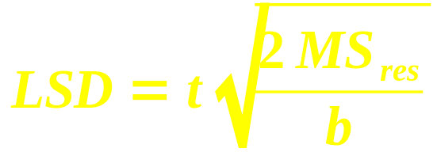
Post-hoc: Fisher's LSD test
If the factor effect is significant, one post-hoc test we can use is Fisher's least sig. diff. test
  Like Tukey-Kramer, but for equal-size cells
Critical range:
  t: 2-tails, use df_{res}
  b: # blocks (IV₂)
For all pairs of levels of the main factor,
if the difference of means |x_{i} – x_{j}| exceeds LSD, then those two groups differ significantly
  Use the results to cluster the factor levels

Slide 15
Outline for today
Factorial ANOVA (multiple nominal IVs)
  Graphing
  Main effects and interaction
Randomized Complete Block ANOVA
  Fixed vs. random effects
  Post-hoc analysis: Fisher's LSD
χ² goodness-of-fit test: observed vs. expected
  Test against uniform distribution
    CHIDIST(), CHITEST()
  Test of normality
  Test 2 nominal vars for independence
    Marginal probabilities

Slide 16
Goodness of fit
The χ² (chi-squared) test is one way to assess goodness of fit:
  How well an observed distribution fits
  a hypothesized distribution
  Hypothesized distribution can be
  uniform, normal, etc.
χ² can also be applied to test if two nominal variables are independent
  Compare pivot table (contingency table) with hypothesized results if vars independent
  Analogous to correlation for continuous vars

Slide 17
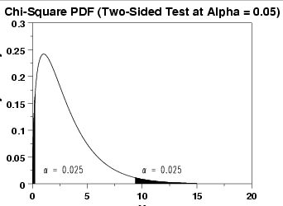
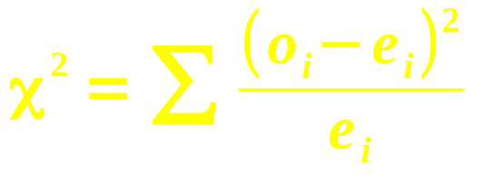
χ² vs. uniform distribution
e.g., are technical support calls
evenly distributed across the weekdays?
  H₀: evenly distributed, matches uniform dist.
Expected # calls per day (uniform distribution):
  Total observed calls (1300), divided by 5
Test statistic:
Use CHIDIST( χ², #cells – 1 )
  Or CHITEST( obs, exp )
Observed | 290 | 250 | 238 | 257 | 265
Expected | 260 | 260 | 260 | 260 | 260
itl.nist.gov

Slide 18
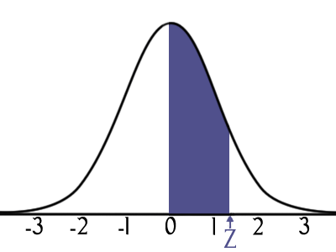
χ² vs. normal distribution
e.g., are student test scores normally distrib?
  Other normality tests: Shapiro-Wilk, K-S
Count frequency of test scores by bins
How to find expected frequencies?
  Find mean, SD of the data
  Use NORMDIST() to find percentage
  of the data that would lie within
  each bin on the ideal normal:
    NORMDIST(80, μ, σ, 1) –
    NORMDIST(75, μ, σ, 1)
Bin | Freq | Norm Freq
40
45 | 1 | 1.30
50 | 4 | 2.77
55 | 15 | 5.14
60 | 7 | 8.28
65 | 5 | 11.60
70 | 7 | 14.11
75 | 11 | 14.93
80 | 15 | 13.72
85 | 22 | 10.97
90 | 9 | 7.62
95 | 4 | 4.60
100 | 0 | 2.41

Slide 19
Outline for today
Factorial ANOVA (multiple nominal IVs)
  Graphing
  Main effects and interaction
Randomized Complete Block ANOVA
  Fixed vs. random effects
  Post-hoc analysis: Fisher's LSD
χ² goodness-of-fit test: observed vs. expected
  Test against uniform distribution
    CHIDIST(), CHITEST()
  Test of normality
  Test 2 nominal vars for independence
    Marginal probabilities

Slide 20
Contingency tables
Joint freq. distribs for multiple nominal variables
  Each cell of the table holds the # (frequency) of observations that match that combo
  Pivot tables, with Count in the Data field
E.g., Handedness vs. Gender
  H₀: handedness is independent of gender:
  the probability of being left-handed
  stays the same, regardless of the gender
    P( left | M ) = P( left | F ) = P( left )
Observed | Left | Right
Male | 17 | 163
Female | 33 | 167

Slide 21
χ² on 2-way contingency
Expected values assume independence
Calculate marginal probabilities:
  P( female ) = 200/380 ≈ 52.6%
  P( left ) = 50/380 ≈ 13.2%
Assuming independence,
  P( F ∩ L ) = P(F) * P(L) = (.526)(.132)
Thus the expected count for (F ∩ L) is
  P(F) * P(L) * (total) = (.526)(.132)(380)
Calculate χ² summed over all cells
  df = (#rows – 1) (#cols – 1)
    = 1 in this case!
 | L | R | Tot
M | 17 | 163 | 180
F | 33 | 167 | 200
Tot | 50 | 330 | 380

Slide 22
Summary on χ²
Test of goodness-of-fit: observed vs. expected
May apply to a single nominal variable:
  Expected distrib. may be uniform, normal, …
May apply to two nominal variables:
  Expected distrib. is that vars are independent
  Akin to correlation on continuous variables
    Large χ² ↔ |r| ≈ 1
But only an approximation to the true distrib:
  Results may be invalid if cell counts are <5
  May need to combine levels of a var

Slide 23
TODO
HW8 due Thu
Projects: be pro-active and self-led
  All groups have passed REB by now
  Presentations on 10Apr (2 weeks from now!)
  Remember your potential clients:
  what questions would they like answered?
  Tell a story/narrative in your presentation
Email me your preferences for presentation slot

