Slide 1




Business 275
Spring 2012
Business Proposal
Dr. Sean Ho

Slide 2


Business opportunity for increased profit if air-conditioner sales under Colombia and Chile new Free Trade Agreements qualify
  Statistical analysis required for 2 models,
  Assembled at two manufacturing locations
  Including fixed overhead (labor, facilities averages)
  Including freight charges for US and Mexico
  Where final qualifying content either
    Does or does not meet 30% threshold for qualification by location and by model.
  Decision Point: Will investing $1.5 million capital in an export system to automate calculation meet 2 year ROI?
  Describe the population of interest and the
  primary outcome variable.

Slide 3


Using actual 2011 manufacturing data representing key variables for 2 models
    FOH/Freight/content)
    By manufacturing location
    Based on manual content calculation processes
    The Business investment of $1.5 million dollars to automate the calculation process will lead to two outcomes:
      Increased sales orders against new FTA’s
      Return on the $1.5 investment within 2 years
  Describe the predictors and the nature of the relationships that you think those predictors will have with the outcome, e.g., "we think that increased corporate taxes
  lead to increased unemployment rate".

Slide 4

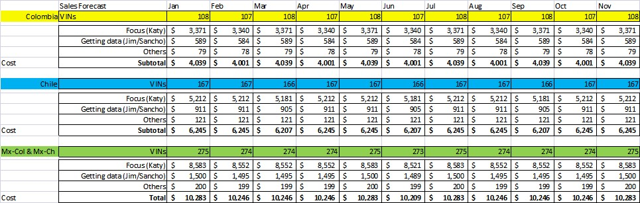
Using manual accounting processes, associated costs, compared to system investment and volume increase forecast …
We can determine ROI and quantify the net export duty savings by truck model, by month, by location based on historical data and forecasted sales monthly.
  Describe the unit of observation and possible sampling strategy:
  e.g., the unit of observation might be per-person, or per-company,
  or per-country, or even per-year (for time-series).

Slide 5

Data is available representing
Orders received by model
Manufacturing location schedule
Historical data for all of the above, plus monthly
  actual costs for variables, including
  fixed overhead, labor
  freight US, freight Mexico
  pricing and concession generation
  sales gross and net with incentives to dealers
  Describe your plan for where to get the data.
  If you will use existing data, what sources have you already explored?
  If you will be gathering your own data, what is your plan?

Slide 6

Work plan and task assignments
Milestones
TBD based on final team agreement and membership.
  Discuss a preliminary plan to divide the work amongst your team members.

