Slide 1
CMPT 231: Data Structures and Algorithms
cmpt231.seanho.com and myCourses
10 Sep 2013
CMPT231
Dr. Sean Ho
Trinity Western University

Slide 2
Outline for today
Administrivia
Algorithms and asymptotic complexity
  Example: Insertion sort
    Notation: Θ, O, Ω, o, ω
Divide-and-conquer
  Example: Merge sort
    Recursion and recurrence relations
  Example: Maximum-subarray
  Example: Matrix multiply
    Naive method, divide-and-conquer method
    Strassen's method

Slide 3
What is an algorithm?
Well-defined process for solving a problem
  Input → Computation → Output
May be expressed in any appropriate language
  Pseudocode, English, etc.
May be implemented in many programming languages
  Python, C, Java, etc.
Computing science is not about
toolkits (Python, C++, Java, etc.)
but about problem solving

Slide 4
Algorithmic complexity
Number of machine instructions needed to execute the algorithm
  Expressed as a function of size of input
  Constant factors are not important
Depends on machine architecture
  e.g., GPUs can perform many parallel operations very quickly
  We'll ignore this in our machine model
“Running time” (speed) is a more complex topic than just algorithmic complexity
  Cache/memory hierarchy plays a big role

Slide 5
Basic machine model
The basic instruction set we assume roughly follows most CPU architectures:
  Arithmetic: + - * /, < > ≠, left/right bitwise shift
  Data: load (read), store (assign), copy
  Control: if/else, for/while, functions
  Types: char, int, float (with fixed word size)
    Not arbitrarily large numbers
  Basic data structures: pointers, fixed-length arrays (not Python lists / STL vectors)
Each of these basic instructions is assumed to take constant execution time

Slide 6
Outline for today
Administrivia
Algorithms and asymptotic complexity
  Example: Insertion sort
    Notation: Θ, O, Ω, o, ω
Divide-and-conquer
  Example: Merge sort
    Recursion and recurrence relations
  Example: Maximum-subarray
  Example: Matrix multiply
    Naive method, divide-and-conquer method
    Strassen's method

Slide 7
Example task: sorting
Input: array of key-value pairs
  wlog, let keys be the integers 1 … n
  values (payload) can be any data,
  staying attached to respective keys
Output: array with elements sorted in increasing order by key
  In-place: modify original array
  Out-of-place: return a sorted copy
    We'll focus on in-place sorting for now
Standard fun: Python sort/ed(), C++/Java sort()
  How do they do it?

Slide 8
Simple solution: insertion sort
Input | 5 | 2 | 4 | 6 | 1 | 3
j=3: | 2 | 5 | 4 | 6 | 1 | 3
j=4: | 2 | 4 | 5 | 6 | 1 | 3
j=5: | 2 | 4 | 5 | 6 | 1 | 3
j=6: | 1 | 2 | 4 | 5 | 6 | 3
Out: | 1 | 2 | 3 | 4 | 5 | 6
e.g., a hand of cards
insertion_sort(A, n):
  for j = 2 to n:
    key = A[ j ]
    i = j – 1
    while i > 0 and A[ I ] > key: # scoot over items
      A[ i + 1 ] = A[ i ]
      i = i - 1
    A[ i + 1 ] = key
Loop invariant: A[1 .. j-1] are in sorted order
  Check: before loop, during loop, after loop

Slide 9
Insertion sort: complexity
Let t_{j} = # times the 'while' condition is checked
insertion_sort(A, n):
  for j = 2 to n: # cost c0 * n times
    key = A[ j ] # c1 * n-1
    i = j – 1 # c2 * n-1
    while i > 0 and A[ I ] > key: # c3 * Σ₂^{n} t_{j}
      A[ i + 1 ] = A[ i ] # c4 * Σ₂^{n} (t_{j} - 1)
      i = i – 1 # c5 * Σ₂^{n} (t_{j} - 1)
    A[ i + 1 ] = key # c6 * n-1
Summation notation: Σ₂^{n} t_{j} = t₂ + t₃ + … + t_{n}

Slide 10
Insertion sort: worst-case
Best-case is if input is already sorted:
  Still need to scan through, but all t_{j} = 1
  → Linear in n: can express total complexity as
  T(n) = a*n + b, for some constants a,b
Worst case? Input in reverse-sorted order!
  'while' loop is always max length: t_{j} = j
  e.g., line 5: c4 * Σ₂^{n} (t_{j} – 1) = c4 * Σ₂^{n} (j – 1)
  = c4 * (n – 1)(n)/2 = (c4 / 2) * n² – (½) * n
    Similarly for the other lines in the function
  → Quadratic in n
Average case: random order: t_{j} = j/2, quadratic

Slide 11
Θ() notation
The constants c1, c2, … may vary on different platforms, but as n gets big, constants irrelevant
  Even the n term gets dominated by n²
Insertion sort has complexity on the order of n²
  Notation: T(n) = Θ(n²) (“big theta”)
Θ(1) means the algorithm runs in constant time

Slide 12
Outline for today
Administrivia
Algorithms and asymptotic complexity
  Example: Insertion sort
    Notation: Θ, O, Ω, o, ω
Divide-and-conquer
  Example: Merge sort
    Recursion and recurrence relations
  Example: Maximum-subarray
  Example: Matrix multiply
    Naive method, divide-and-conquer method
    Strassen's method

Slide 13
Divide and conquer
Insertion sort is incremental:
  At each step, given that A[1 … j-1] is sorted,
  insert A[j] such that A[1 … j] is sorted
Another design strategy:
  Split up the task into smaller chunks
  When chunks are small enough, solve directly (base case)
  Combine results and return up the stack
Can implement via function recursion or loops
Merge sort is an example, which ends up being more efficient than insertion sort

Slide 14
Divide and conquer: merge sort
In English:
  Split array in half
    If array has only one element, we're done
  Recurse to sort each half
  Merge two sorted sub-arrays
In pseudocode:
  merge_sort(A, p, r):
    if p < r:
      q = floor( (p + r) / 2 )
      merge_sort(A, p, q)
      merge_sort(A, q+1, r)
      merge(A, p, q, r)
1 | 2 | 2 | 3 | 4 | 4 | 5 | 6 | 6 | 7 | 7
1 | 2 | 4 | 4 | 6 | 7 | 2 | 3 | 5 | 6 | 7
2 | 4 | 7 | 1 | 4 | 6 | 3 | 5 | 7 | 2 | 6
4 | 7 | 2 | 1 | 6 | 4 | 3 | 7 | 5 | 2 | 6
4 | 7 | 2 | 6 | 1 | 4 | 7 | 3 | 5 | 2 | 6

Slide 15
Linear-time merge
How to do the merge?
A[p .. q] and A[q+1 .. r] are each sorted, p ≤ q < r
Make temp copies of each sub-array (left + right)
  Append “infinity” item to end of each copy
Step through both sub-array copies:
  Compare first item from each sub-array
  Copy smaller one into main array
  and move to next item in that list
1 | 2 | 2 | 3 | 4 | 4
1 | 2 | 4 | 4 | 6 | 7 | ∞
2 | 3 | 5 | 6 | 7 | ∞

Slide 16
Linear-time merge: pseudocode
merge(A, p, q, r):
  ( n1, n2 ) = ( q – p + 1, r – q )
  new arrays: L[ 1 .. n1+1 ], R[ 1 .. n2+1 ]
  for i in 1 .. n1: L[ i ] = A[ p + i – 1 ]
  for j in 1 .. n2: R[ j ] = A[ q + j ]
  ( L[ n1+1 ], R[ n2+1 ] ) = ( ∞, ∞ )
  ( i, j ) = ( 1, 1 )
  for k in p .. r:
    if L[ i ] ≤ R[ j ]:
      A[ k ] = L[ i ]
      i = i + 1
    else:
      A[ k ] = R[ j ]
      j = j + 1
Complexity: Θ(n)
where n = r – p + 1

Slide 17
Merge sort: complexity
How to analyse complexity of a recursive algo?
Recurrence relation: base case + inductive step
Base case: if n = 1, then T(n) = Θ(1)
Inductive step: if n > 1,
then T(n) = 2 * T( n/2 ) + Θ(n)
cn
lg(n) levels
Total complexity:
Θ(n lg(n))
cn/2
cn/2
cn/4
cn/4
cn/4
cn/4
c
c
c
c
c
c
c
c
c
c

Slide 18
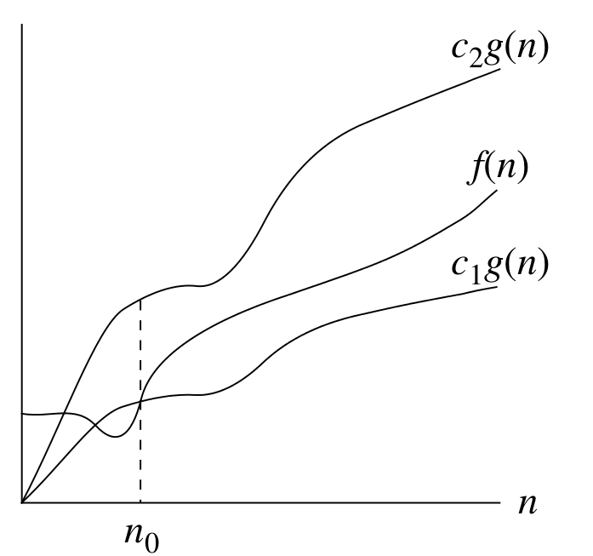
Asymptotic growth
Behaviour “in the limit” (for big n)
Def: f(n) ∊ Θ( g(n) )
iff ∃ constants c₁, c₂, n₀ such that
0 ≤ c₁ g(n) ≤ f(n) ≤ c₂ g(n)
for all n > n₀
  Θ( g(n) ) is a set of functions
  f(n) is “sandwiched” between c₁ g(n) and c₂ g(n)
“Big O”: O( g(n) ) specifies an upper-bound
  e.g., Θ( n² ) ⊂ O( n² ) ⊂ O( n³ )
“Big Omega”: Ω( g(n) ) specifies a lower-bound
  Other examples?

Slide 19
Mathematical logic
Some notation:
  ¬A, or !A: “not A”
    if A = “it is Tuesday”, then ¬A = “it is not Tuesday”
  A ⇒ B: “A implies B”; “if A, then B”
    The contrapositive of “A ⇒ B” is “¬B ⇒ ¬A”
      Contrapositive is equivalent to original statement
      “If Tues, then meatloaf” ⟺
      “If not meatloaf, then not Tues”
    The converse of “A ⇒ B” is “¬A ⇒ ¬B”
      Converse is not equivalent to original statement
      converse: “If not Tues, then not meatloaf”
  ∀: “for all”: e.g., “x² > x, ∀ x > 1”
  ∃: “there exists”: e.g., “∃ x s.t. x² < x”

Slide 20
Asymptotic short-hand
When Θ et al. are used on the right side of =,
  Means “there exists” f ∊ Θ( g )
  e.g., 2n² + 3n = Θ(n²)
When Θ et al. are used on the left side of =,
  Means “for all” f ∊ Θ( g )
  e.g., 4n² + Θ(n lg(n)) = Θ(n²)
  (this holds true for any function in Θ(n lg(n)))

Slide 21
Asymptotic domination
“Little o”: f ∊ o( g ) iff for all c > 0, there exists n₀
such that 0 ≤ f(n) < cg(n) for all n > n₀.
  i.e., as n → ∞, f(n) / g(n) → 0
“Little omega”: f ∊ ω( g ) iff
for all c > 0, there exists n₀
such that 0 ≤ cg(n) < f(n) for all n > n₀.
  i.e., as n → ∞, f(n) / g(n) → ∞
E.g.: n^{1.9999} = o(n²), n² / lg(n) = o(n²),
but n² / 100000 ≠ o(n²),
n^{2.000001} = ω(n²), n² lg(n) = ω(n²)

Slide 22
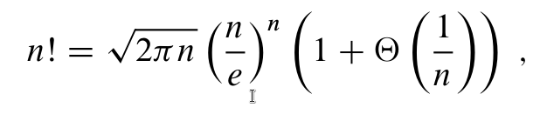
Useful math identities
All logs are the same up to a constant factor:
  log_{a}(n) = log_{b}(n) / log_{b}(a)
  So we just use lg = log₂ for convenience
Θ(1) ⊂ o(lg(n)) ⊂ o(n) ⊂ o(n^{p>1}) ⊂ o(p^{n})
In fact, for all a>1 and b: n^{b} / a^{n} → 0 as n → ∞.
  Hence, n^{b} = o(a^{n})
n! = n(n-1)(n-2)...(2)(1)
Stirling's approximation:
  hence lg(n!) = Θ(n lg(n))

Slide 23
Outline for today
Administrivia
Algorithms and asymptotic complexity
  Example: Insertion sort
    Notation: Θ, O, Ω, o, ω
Divide-and-conquer
  Example: Merge sort
    Recursion and recurrence relations
  Example: Maximum-subarray
  Example: Matrix multiply
    Naive method, divide-and-conquer method
    Strassen's method

Slide 24
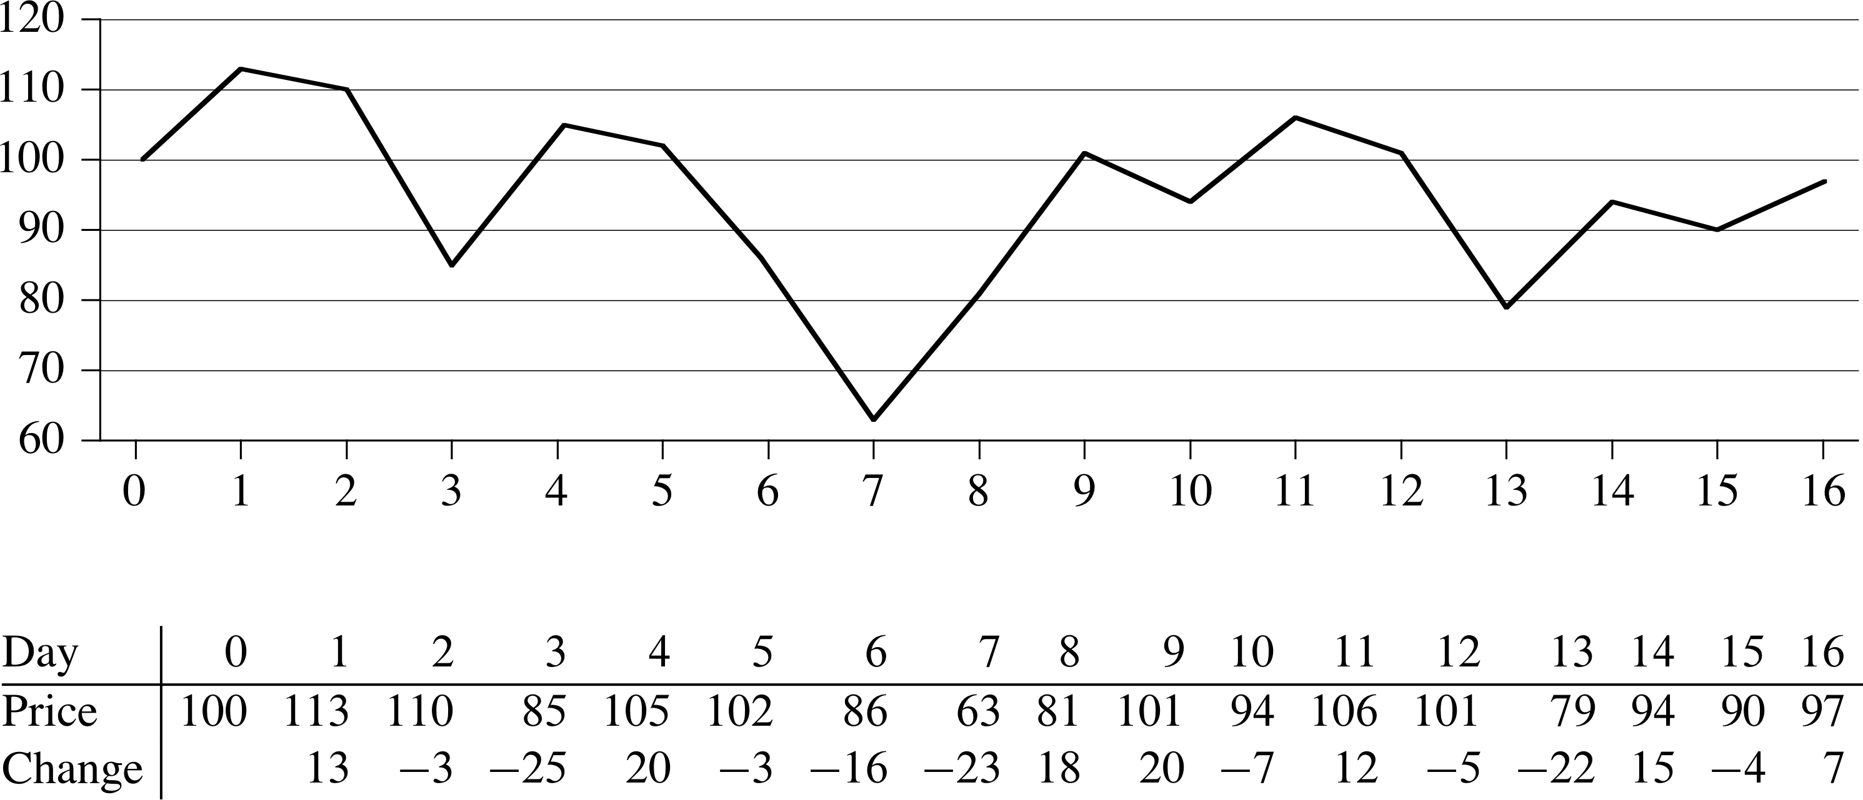
Maximum subarray
A more complex example of divide-and-conquer
Input: array A[1..n] of numbers (some negative)
Output: indices (i,j) that maximize sum( A[i..j] )
  e.g., daily change in stock price:
  when was optimal time to buy (i) & sell (j)?
i
j
Brute force: θ(n²)
A[]

Slide 25
Max subarray: algorithm
Divide-and-conquer can do it in θ(n lg(n)):
  Split array in half
  Recursively find max subarray in each half
    (What's the base case?)
  Find max subarray which spans the midpoint
  Pick the best out of the 3 subarrays and return
Finding max subarray spanning midpoint in θ(n):
  Decrement i from mid down to low to maximize sum( A[i .. mid] )
  Increment j from mid+1 up to high to maximize sum( A[mid+1 .. j] )
7 | -2 | -1 | 4 | -5 | 3 | 7 | 2 | -1 | 3 | -4

Slide 26
Max subarray: complexity
max_subarray(A, low, mid, high): → T(n)
  Split → θ(1)
  Recurse on each half → 2T(n/2)
  Subarray spanning midpoint → θ(n)
  Return best of 3 → θ(1)
Recurrence relation:
  Inductive step: T(n) = 2T(n/2) + θ(n)
  Base case: T(1) = θ(1)
Same recurrence as merge sort: θ(n lg(n))
Actually, max subarray can be done in θ(n)!
  See exercise #4.1-5

Slide 27
Outline for today
Administrivia
Algorithms and asymptotic complexity
  Example: Insertion sort
    Notation: Θ, O, Ω, o, ω
Divide-and-conquer
  Example: Merge sort
    Recursion and recurrence relations
  Example: Maximum-subarray
  Example: Matrix multiply
    Naive method, divide-and-conquer method
    Strassen's method

Slide 28
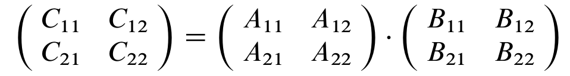
Example: matrix multiply
Input: two n x n matrices A[i,j] and B[i,j]
Output: n x n matrix C = A * B:
  C[i,j] = Σ^{n}_{k=1} ( A[i,k] B[k,j] )
Simplest method:
  for i in 1 .. n:
    for j in 1 .. n:
      for k in 1 .. n:
        C[i,j] += A[i,k] * B[k,j]
  Complexity? Can we do better?

Slide 29
Basic divide-conquer algorithm
Divide-and-conquer: split matrices into 4 parts:
  (assume n
  is a power of 2)
Recurse 8 times to get products of sub-matrices
Add and combine into result:
  C₁₁ = A₁₁ * B₁₁ + A₁₂ * B₂₁,
  C₁₂ = A₁₁ * B₁₂ + A₁₂ * B₂₂,
  C₂₁ = A₂₁ * B₁₁ + A₂₂ * B₂₁,
  C₂₂ = A₂₁ * B₁₂ + A₂₂ * B₂₂.
Base case?
(Generalise to when n is not a power of 2?)

Slide 30
Basic div-conq: complexity
Split of matrices can be constant time if done using indices rather than copying matrices
Each recursive call takes T(n/2); do 8 of them
Combining results takes Θ(n²) due to addition (each entry in C[] requires one addition)
⇒ Recurrence relation: T(n) = 8T(n/2) + Θ(n²)
  Base case: T(1) = Θ(1)
Doing 8 recursive calls kills us here;
total complexity is still Θ(n³),
no better than brute-force
If we can save even 1 recursive call,
even at the expense of o(n²) of work, it will help

Slide 31
Strassen's method
Make 10 sums of submatrices: S₁ = B₁₂ – B₂₂,
S₂ = A₁₁ + A₁₂, S₃ = A₂₁ + A₂₂, S₄ = B₂₁ – B₁₁,
S₅ = A₁₁ + A₂₂, S₆ = B₁₁ + B₂₂, S₇ = A₁₂ – A₂₂,
S₈ = B₂₁ + B₂₂, S₉ = A₁₁ – A₂₁, S₁₀ = B₁₁ + B₁₂.
Recurse 7 times to get 7 products: P₁ = A₁₁ * S₁,
P₂ = S₂ * B₂₂, P₃ = S₃ * B₁₁, P₄ = A₂₂ * S₄,
P₅ = S₅ * S₆, P₆ = S₇ * S₈, P₇ = S₉ * S₁₀.
Add products and combine for result:
C₁₁ = P₅ + P₄ – P₂ + P₆, C₁₂ = P₁ + P₂,
C₂₁ = P₃ + P₄, C₂₂ = P₅ + P₁ – P₃ – P₇.

Slide 32
Strassen: complexity
Even though more sums are done, they are all still Θ(n²) and so don't change asymptotic cplxity
  Although for smaller n it may not be worth it
Recurrence: T(n) = 7T(n/2) + Θ(n²)
  T(1) = Θ(1)
Solution to the recurrence is T(n) = Θ(n^{lg7})
In general, for T(n) = a T( n/b ) + Θ( f(n) ):
  if f(n) is smaller than O(n^{log_b(a)}):
    Then T(n) = Θ(n^{log_b(a)})
    Leaves dominate recursion tree
One case of the “master theorem”

