Slide 1
Ch4: Proofs & Recurrences
Ch6: Heap-sort
24 Sep 2013
CMPT231
Dr. Sean Ho
Trinity Western University

Slide 2
Outline for today
Review of discrete math:
  Monotonicity, limits, iterated funs, Fibonacci
  Mathematical proofs, asymptotic behaviour
ch4: Solving recurrences
  Proof by induction (“substitution”)
  Proof by “master method”
ch6: Sorting: Heap-sort
  Binary max-heaps
  Application: Heap-sort

Slide 3
Discrete math review
f(x) is monotone increasing
(“non-decreasing”) iff x < y ⇒ f(x) ≤ f(y)
f(x) is strictly increasing iff x < y ⇒ f(x) < f(y)
a mod n (in programming: “a % n”)
is the remainder of a when divided by n
    17 mod 5 = 2
lim_{x→a}f(x) = b (“limit as x goes to a of f(x) is b”)
means ∀ ε>0, ∃ δ>0: (|x – a| < δ) ⇒ (|f(x) – b| < ε)
lim_{n→∞}f(n) = b (“limit as n goes to ∞ of f(n) is b”)
means ∀ ε>0, ∃ n₀: (n > n₀) ⇒ (|f(n) – b| < ε)

Slide 4
Math review: iterated functions
Iterated functions (e.g., recursion):
  f^{(i)}(x): the function f applied i times to x
    f(f(f( … f(x) … )))
    Not the same as f^{i}(x) = (f(x))^{i}
    e.g., log⁽²⁾(1000) = log(log(1000) = log(3) ≈ 0.477
      but log²(1000) = (log(1000))² = 3² = 9
    f⁽⁰⁾(x) is defined to be just x (apply f zero times)
Iterated log: lg*(n) = min( i≥0 : lg^{(i)}(n) ≤ 1 )
  “number of times lg needs to be applied to n until the result is ≤ 1”
    lg*(16) = 3: lg(lg(lg(16))) = lg(lg(4)) = lg(2) = 1

Slide 5

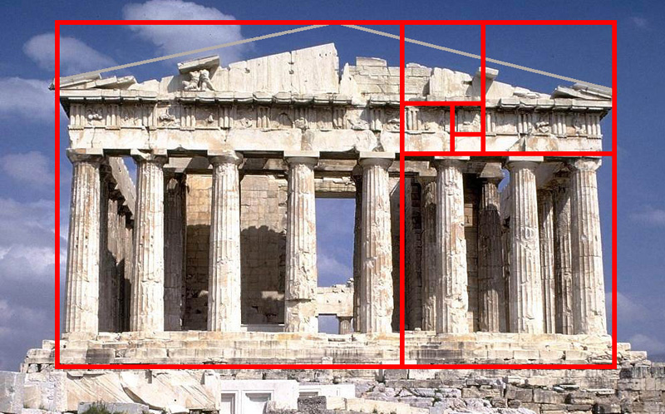
Fibonacci and golden ratio
The n^{th} Fibonacci number
is F_{n} = F_{n-1} + F_{n-2}
  Start with F₀ = 0, F₁ = 1
    0, 1, 1, 2, 3, 5, 8, 13, 21, …
      (also see Lucas numbers: F₀ = 2)
Golden ratio φ (and conjugate φ) satisfy x² = x + 1
    φ = (1 ± √5)/2 ≈ 1.61803... and -0.61803...
#3.2-7 proves that F_{n} = (φ^{n} – φ^{n}) / √5
    The second part |φ^{n}| / √5 < ½,
    so F_{n} = ⎣ φ^{n}/√5 + ½ ⎦
      i.e., F_{n} = round( φ^{n}/√5 )
      grows exponentially!

Slide 6
Proving asymptotic behaviour
e.g., p.52 #3.1-2: show that for all constants a, b, with b>0: (n + a)^{b} = Θ(n^{b})
  i.e., find n₀, c₁, c₂: ∀ n>n₀, c₁n^{b} ≤ (n + a)^{b} ≤ c₂n^{b}
  Find lower and upper bounds on (n + a)^{b}
We observe that n+a ≥ n/2 if n > 2|a|,
and that n+a ≤ 2n if n > |a|
  so n/2 ≤ n+a ≤ 2n, as long as n > 2|a|
Then by the monotonicity of x^{b} (x>1, b>0),
  (n/2)^{b} ≤ (n + a)^{b} ≤ (2n)^{b}, when n > 2|a|
So we pick n₀ = 2|a|, c₁ = 2^{-b}, and c₂ = 2^{b}.

Slide 7
Proving asymptotic behaviour
e.g., p.62 #3-3: (lg n)! = ω(n³)
  Approach: take lg of both sides
  LHS: use Stirling: n! = √(2πn) (n/e)^{n} (1 + Θ(1/n))
    ⇒ lg(n!) = Θ(n lg n) (p.58, Eq 3.19)
    ⇒ lg( (lg n)! ) = Θ( (lg n) lg(lg n) )
      Substitute n → lg n and use monotonicity of lg
  RHS: lg(n³) = 3 (lg n)
    lg(lg n) = ω(3), so now put it together:
  lg( (lg n)! ) = Θ( (lg n) lg(lg n) )
  = ω(3 lg n)
  = ω(lg( n³ ))
  Hence, by monotonicity of lg, (lg n)! = ω(n³)

Slide 8
Outline for today
Review of discrete math:
  Monotonicity, limits, iterated funs, Fibonacci
  Mathematical proofs, asymptotic behaviour
ch4: Solving recurrences
  Proof by induction (“substitution”)
  Proof by “master method”
ch6: Sorting: Heap-sort
  Binary max-heaps
  Application: Heap-sort
  Application: Priority Queue
ch7: Quick-sort

Slide 9
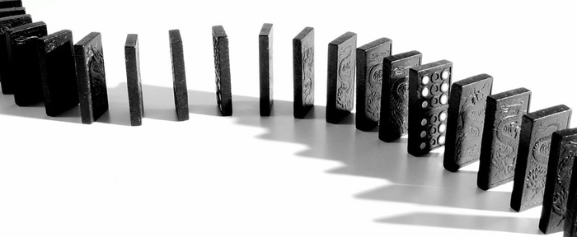
Mathematical induction
Deduction: general principles ⟹ specific case
Induction: representative case ⟹ general rule
Needs at least two axioms (givens):
  Base case: starting point, e.g., rule at n=1
  Inductive step: if the rule holds at some n,
  then it also holds at n+1
From these two axioms, we prove that the given rule holds for all (positive) n

Slide 10
Proof by induction: example
Last time, we mentioned Gauss' formula for
  1 + 2 + … + (n-1) + n = (n)(n+1)/2
Now we prove it by induction:
Proof of base case (n=1): 1 = (1)(1+1)/2
Proof of inductive step:
  Assume: 1 + … + n = (n)(n+1)/2
  Want to prove: 1 + … + (n+1) = (n+1)(n+2)/2
  i.e., prove: (n)(n+1)/2 + (n+1) = (n+1)(n+2)/2
    (n+1)(n+2)/2 = (n²+3n+2)/2
    = ( (n²+n) + (2n+2) )/2
    = (n²+n)/2 + (2n+2)/2
    = n(n+1)/2 + (n+1)

Slide 11
Induction for recurrences
Proof by induction also can apply to recurrences:
e.g., complexity of merge sort:
  T(1) = θ(1), and
  T(n) = 2T(n/2) + θ(n)
If we have a “guess” about the solution to T(n), we can prove by induction if that guess is correct:
Guess: T(n) = θ(n lg(n))
Proof:
  Base case: T(1) = θ(1 lg(1) ) = θ(1)
  (i.e., constant time)
  Inductive step: (next slide)

Slide 12
Inductive proof for merge sort:
Assume: T(m) = θ(m lg(m)), for m = n-1
    In fact, can assume this holds for all m < n
Want to prove: T(n) = θ(n lg(n))
    i.e., for big n, there exist c₁, c₂ such that
    c₁(n lg(n)) ≤ T(n) ≤ c₂(n lg(n))
T(n) = 2T(n/2) + θ(n) (from the recurrence)
    ⇒ ∃ c₁, c₂: 2T(n/2) + c₁(n) ≤ T(n) ≤ 2T(n/2) + c₂(n)
but T(n/2) = θ( (n/2) lg(n/2) ), so
    ⇒ ∃ c₃, c₄: c₃(n/2 lg(n/2)) ≤ T(n/2) ≤ c₄(n/2 lg(n/2))
    ⇒ (c₃/2)(n lg(n) – n lg2) ≤ T(n/2) ≤ c₄(...)
    ⇒ (c₃/2)(n lg(n)) – (c₁ lg2 / 2)n ≤ T(n/2) ≤ c₄(...)

Slide 13
Inductive proof, continued
Combining the two, ∃ c₁, c₂, c₃, c₄ such that:
    2T(n/2) + c₁(n) ≤ T(n) ≤ 2T(n/2) + c₂(n)
    ⇒ 2(c₃/2)(n lg(n)) – 2(c₁ lg2 / 2)n + c₁(n) ≤ T(n) ≤ …
    ⇒ c₃(n lg(n)) – (c₁ lg2 + c₁)n ≤ T(n) ≤ …
    ⇒ c₃(n lg(n)) – (2c₁)n ≤ T(n) ≤ c₄(n lg(n)) – (2c₂)n
    ⇒ c₃(n lg(n)) ≤ T(n) ≤ c₅(n lg(n))
  LHS of last step: just need c₁>0
  RHS of last step: we can't choose c₂, c₄,
  but we can find an n₀ such that for all n>n₀,
  the c₄(n lg(n)) term overwhelms the (2c₂)n term
This proves that T(n) = θ(n lg(n))

Slide 14
Master method for recurrences
If the recurrence has this specific form:
  T(n) = a T(n/b) + f(n)
    e.g., merge sort: a = 2, b = 2, f(n) = θ(n)
Then compare f(n) with n^{log_b(a)}:
  If f(n) = θ(n^{log_b(a)}):
    Leaves/roots balanced: T(n) = θ(n^{log_b(a)} lg(n))
  Else if f(n) = O(n^{log_b(a)-ε}) for some ε>0,
    Leaves dominate the work: T(n) = θ(n^{log_b(a)})
  Else if f(n) = Ω(n^{log_b(a)+ε}) for some ε>0
  and a f(n/b) ≤ c f(n) for some c<1 and big n,
    Roots dominate the work: T(n) = θ(f(n))
    Regularity condition is fine for, e.g., f(n) = n^{k}

Slide 15
Master method: examples
Merge sort: T(n) = 2T(n/2) + θ(n)
    a=2, b=2, f(n) = θ(n)
  f(n) = θ(n) = θ(n^{log_2(2)})
    so leaves and roots contribute work equally
  ⇒ T(n) = θ(n^{log_2(2)} lg(n)) = θ(n lg(n))
Strassen matrix multiply: T(n) = 7T(n/2) + θ(n²)
    a=7, b=2, f(n) = θ(n²)
  f(n) = θ(n²) = O(n^{log_2(7)-ε})
    log₂7 ≈ 2.8, so pick an ε between 0 and 0.8
    Leaves dominate the work
  ⇒ T(n) = θ(n^{log_2(7)}) ≈ θ(n^{2.8})

Slide 16
Gaps in master thm coverage
Not all recurrences aT(n/b) + f(n) work in master!
  e.g., T(n) = 2T(n/2) + n lg(n)
    n lg(n) ≠ θ(n^{log_2(2)}) = θ(n)
    n lg(n) ≠ O(n^{1-ε}), for any ε>0
    n lg(n) ≠ Ω(n^{1+ε}), for any ε>0
    (because lg(n) ≠ Ω(n^{ε}) for any ε>0)
Polylog extension to master theorem:
  If f(n) = θ(n^{log_b(a)} lg^{k}(n))
    where lg^{k}(n) = (lg(n))^{k}
    Then T(n) = θ(n^{log_b(a)} lg^{k+1}(n))
  (old case was with k=0)
Above example: T(n) = θ(n lg²(n))

Slide 17
Outline for today
Review of discrete math:
  Monotonicity, limits, iterated funs, Fibonacci
  Mathematical proofs, asymptotic behaviour
ch4: Solving recurrences
  Proof by induction (“substitution”)
  Proof by “master method”
ch6: Sorting: Heap-sort
  Binary max-heaps
  Application: Heap-sort
  Application: Priority Queue
ch7: Quick-sort

Slide 18
Summary of sorting algorithms
Comparison sorts (ch2, 6, 7)
  Insertion sort: Θ(n²), easy to program, slow
  Merge sort: Θ(n lg(n)), out-of-place sorting,
  slow due to lots of copying / memory operations
  Heap sort: Θ(n lg(n)), in-place, uses max-heap
  Quick sort: Θ(n²) worst-case, Θ(n lg(n)) average, in-place, fast (small) constant factors
Linear-time non-comparison sorts (ch8):
  Counting sort: k distinct values: Θ(k)
  Radix sort: d digits w/k values: Θ(d(n+k))
  Bucket sort: for uniform distrib. of values: Θ(n)

Slide 19
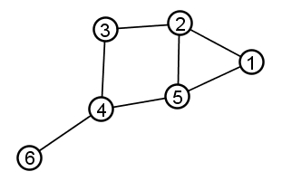
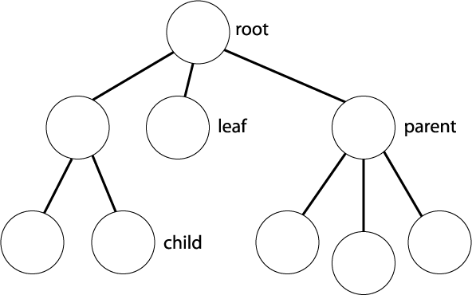
Binary trees
Graph: collection of nodes and edges
  Edges may be directed or undirected
Tree: directed acyclic graph (DAG)
  Choose a node as root
  Parent: immediate neighbour toward root
  Leaf: node with no children
  Degree: maximum number of children
  Node height: max # edges to leaf child
  Node depth: # edges to root
  Level: all nodes of same depth
Binary tree: tree with degree=2

Slide 20
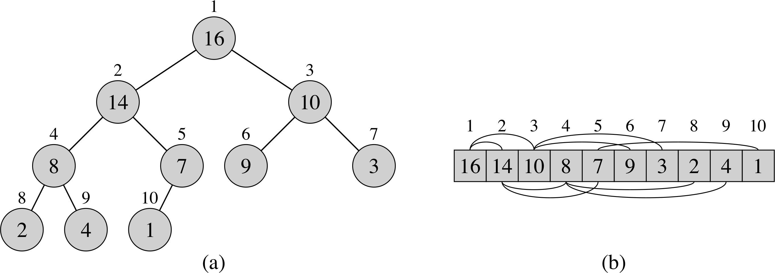
Binary heaps
Array storage for
certain binary trees
  Children of node i are at 2i and 2i+1
  Must fill tree left-to-right, one level at a time
Max-heap: value of a node is ≤ value of its parent
  Min-heap: ≥
max_heapify() (O(lg n)): reposition a given node i so it satisfies the max-heap property
build_max_heap() (O(n)):
construct a max-heap from an unordered array
heapsort() (O(n lg n)): sort array in-place

Slide 21
max_heapify(): for single node
max_heapify(A, i):
  Precondition: left and right sub-trees of i
  satisfy the max-heap property
  Postcondition: subtree at i satisfies max-heap
Algorithm:
  Amongst {i, left(i), right(i)}, find the largest
  If i is not the largest, then
    Swap i with the largest, and
    Recurse/iterate on that subtree

Slide 22
max_heapify(): pseudocode
max_heapify(A, i):
    largest = i
    if 2i ≤ length(A) and A[2i] > A[largest]:
      largest = 2i
    else if 2i+1 ≤ length(A) and A[2i+1] > A[largest]:
      largest = 2i+1
    if largest ≠ i:
      swap( A[i], A[largest] )
      max_heapify(A, largest)
A=[2, 8, 4, 7, 5, 3, 1, 6], i=1:
Running time?
2
8
4
7
5
3
1
6

Slide 23
Building a max-heap
build_max_heap(A):
  Input: array of items in any order
  Output: array has max-heap property
Algorithm:
  Leave last half of array as all leaves
  Apply max_heapify() to each item in first half:
    for i = floor( length(A)/2 ) .. 1:
      max_heapify( A, i )
    Descending order: each time max_heapify() is called on a node, its subtrees are already max-heaps
Exercise: try it on [5, 2, 7, 4, 8, 1]

Slide 24
build_max_heap(): complexity
Group iterations of for loop by height h of node:
  Each call to max_heapify(i) takes O(h)
  # of nodes with height h is ≤ ceil(n / 2^{h+1})
    Attains that bound when tree is full
So algorithmic complexity is Σ( (n / 2^{h+1}) O(h) )
    Sum for h = 0 .. lg(n) is ≤ sum for h = 0 .. ∞
  = n O( Σ (1/2)^{h+1} ), where sum is for h = 0 .. ∞
  = O(n)
We can build a max heap in linear time!
  But it's not quite a sorting algorithm....

Slide 25
Outline for today
Review of discrete math:
  Monotonicity, limits, iterated funs, Fibonacci
  Mathematical proofs, asymptotic behaviour
ch4: Solving recurrences
  Proof by induction (“substitution”)
  Proof by “master method”
ch6: Sorting: Heap-sort
  Binary max-heaps
  Application: Heap-sort
  Application: Priority Queue
ch7: Quick-sort

Slide 26
Using max-heaps for sorting
Algorithm:
  Make array a max-heap
  Repeat, working backwards from end of array:
    Swap root of max-heap with last leaf of heap
    Shrink heap by 1 and apply max_heapify()
At each iteration of the loop:
  First portion of array is a max-heap
  Last portion is a sorted array (largest items)
Complexity: Θ(n) calls to max_heapify() (Θ(lg n))
  ⇒ Θ(n lg(n) )
Exercise: try it on [5, 2, 7, 4, 8, 1]

