Slide 1
Quiz ch1-3
Ch6: Priority Queue
Ch7: Quick-sort
Quiz: Open book,
open paper notes.
No elec devices
(phone, tablet, laptop)
1 Oct 2013
CMPT231
Dr. Sean Ho
Trinity Western University

Slide 2
Exam 1: 30pts
[6] (Dis)prove: If f(n) ∊ O(g(n)) and g(n) ∊ O(h(n)), then h(n) ∊ Ω(f(n))
[6] (Dis)prove: If f(n) ∊ O(g(n)) and g(n) ∊ O(f(n)), then f(n) = g(n)
[6] (Dis)prove: f(n) ∊ Θ(f(n/2))
The function uniq(A) should return a list of all the elements in A which are unique: e.g.,
    uniq([5, 3, 4, 3, 6, 5]) → [4, 6] (or [6, 4])
    Elements may be arbitrarily large, or even floats
  [8] Implement uniq() as efficiently as you can
  [4] Derive the algorithmic complexity

Slide 3
Exam 1 solutions: #1-3
[6] (Dis)prove: If f(n) ∊ O(g(n)) and g(n) ∊ O(h(n)), then h(n) ∊ Ω(f(n))
  True: transitivity ⇒ f ∊ O(h)
  Transpose symmetry ⇒ h ∊ Ω(f)
[6] (Dis)prove: If f(n) ∊ O(g(n)) and g(n) ∊ O(f(n)), then f(n) = g(n)
  False: e.g., f(n) = n, g(n) = 2n
[6] (Dis)prove: f(n) ∊ Θ(f(n/2))
  False: e.g., f(n) = 2^{n}:
    lim_{n→∞}(f(n)/f(n/2)) = lim_{n→∞}(2^{n} / 2^{n/2}) = lim_{n→∞}(2^{n/2}) = ∞
    Hence f ∊ ω(f(n/2)), so f ∉ Θ(f(n/2))

Slide 4
Exam 1 solutions: #4
[8] Implement uniq() as efficiently as you can
  function uniq(A):
    MergeSort(A)
    result = [ A[1] ]
    for i in 2 .. length(A):
      if (A[i] != A[i-1]) result.append( A[i] )
    return result
[4] Derive the algorithmic complexity
  MergeSort takes average Θ(n lg n)
  Linear scan for uniques takes Θ(n)
  ⇒ average Θ(n lg n)

Slide 5
Outline for today
ch6: Binary max-heaps
  Application: Priority Queue
ch7: Quicksort
  Partition & pivot
  Randomised quicksort
  Complexity analysis

Slide 6
Binary heap for priority queue
Binary heaps can implement a priority queue:
  Set of items with attached priorities
Interface (set of operations):
  insert(A, item, pri): add item to the queue A
  find_max(A): return item with highest priority
  pop_max(A): same but also delete item
  set_pri(A, item, pri): set new priority for item (must be higher than old priority)
Setup queue by building a max-heap
  find_max() is easy: return A[1]
  pop_max() also easy: remove A[1] and heapify

Slide 7
Inserting into priority queue
set_pri(A, i, pri): starting from i,
“bubble” item up until we find the right place:
      A[i] = pri
      while i>1 and A[ i/2 ] < A[ i ]:
        swap( A[ i/2 ], A[ i ] )
        i = i/2
  Complexity: # iterations = Θ(lg n)
insert(A, pri): make a new node and set its priority
      A.length++
      set_pri( A, A.length, pri )
    Typically, use pre-allocated fixed-length array, and use separate variable to track size of queue
  Complexity: same as set_pri(): Θ(lg n)

Slide 8
Priority queue: summary
Build priority queue using a max-heap: Θ(n)
Get highest priority item: Θ(1)
Get and delete highest priority item: Θ(lg n)
Set new priority for an item: Θ(lg n)
Insert new item into queue: Θ(lg n)

Slide 9
Outline for today
ch6: Binary max-heaps
  Application: Priority Queue
ch7: Quicksort
  Partition & pivot
  Randomised quicksort
  Complexity analysis

Slide 10
Quicksort
Divide: partition array A[p .. r] such that:
    max( A[ p .. q-1 ] ) ≤ A[ q ] ≤ min( A[ q+1 .. r ] )
Conquer: recurse on each part:
    quicksort(A, p, q-1) and quicksort(A, q+1, r)
No combine/merge step needed
In-place sort
Worst-case turns out to still be Θ(n²), but
average-case is Θ(n lg(n)), with small constants
In practise, quicksort is one of the best algorithms when input values can be arbitrary

Slide 11
Quicksort: partition
How to do the partitioning?
  Pick last item as the pivot
  Walk through array, partitioning array into items ≤ pivot and items > pivot
  Lastly, swap pivot into place
    partition(A, p, r):
        pivot = A[ r ]
        split = p
        for cur = p .. r-1:
          if A[ cur ] ≤ pivot:
            swap( A[ split ], A[ cur ] )
            split++
        swap( A[ split ], A[ pivot ] )
        return split
p
split
cur
r
≤ pivot
> pivot
unseen
piv
Complexity?

Slide 12
Quicksort: complexity
Worst-case if every partition is the most uneven:
    pivot (last item) is either largest or smallest item
    T(n) = T(n-1) + T(0) + Θ(n)
    ⇒ T(n) = Θ(n²)
  Example inputs that give worst case?
Best-case if every partition is exactly in half:
    T(n) = 2T(n/2) + Θ(n)
    ⇒ T(n) = Θ(n lg(n))
  Example inputs that give best case?
Average-case, assuming random input?

Slide 13
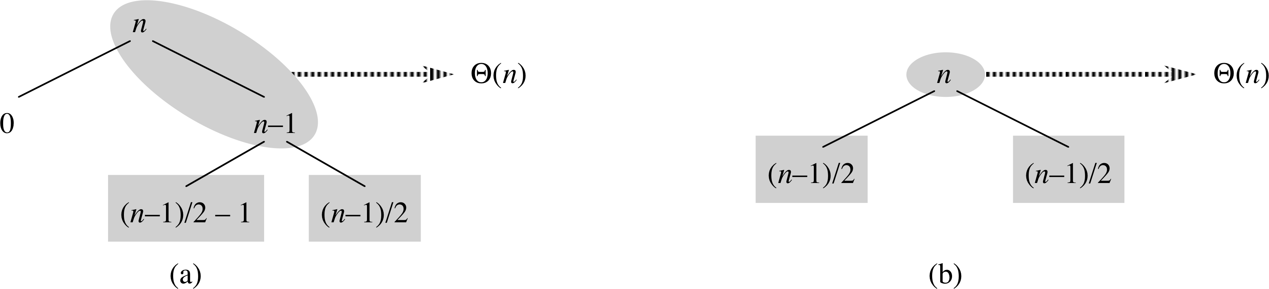
Quicksort: average case
Not every partition will be best-case ½ – ½
  On average, in between best and worst cases
  Even if average split is, say, 9/10 – 1/10:
      T(n) = T( (9/10)n ) + T( (1/10)n ) + Θ(n)
      ⇒ T(n) = O( n lg(n) )
E.g., assume splits alternate between best+worst:
  Only adds O(n) work to each of O(lg n) levels
  ⇒ still O( n lg(n) ) (albeit w/higher constant)

Slide 14
Quicksort with constant splits
p.178, #7.2-5: assume every split is α vs 1-α,
with constant 0 < α < ½.
  Min/max depth of a leaf in the recursion tree?
Min depth: follow smaller side (α) of each split
  How many splits until reach leaf (1 item)?
    α^{m} n = 1 ⟹ m = -lg(n) / lg(α)
Max depth: follow larger side (1-α) of each split
  How many splits until reach leaf (1 item)?
    (1-α)^{m} n = 1 ⟹ m = -lg(n) / lg(1-α)
Both are Θ(lg n), so with constant-ratio splits, depth of recursion tree is Θ(lg n),
⇒ total complexity is Θ(n lg n)

Slide 15
Outline for today
ch6: Binary max-heaps
  Application: Priority Queue
ch7: Quicksort
  Partition & pivot
  Randomised quicksort
  Complexity analysis

Slide 16
Randomised quicksort
We saw how giving quicksort pre-sorted data results in worst-case behaviour
  Always chose last element (r) as pivot
We can alleviate this risk by randomising our choice of pivot:
      rand_partition(A, p, r):
        swap( A[ r ], A[ rand(p, r) ] ) # swap w/random item
        partition(A, p, r)
  It is still possible our random pivot choices result in worst-case Θ(n²) time – but unlikely!

Slide 17
Randomised quicksort: average
Assume items are distinct, and name them in order: {z₁, z₂, …, z_{n}}. How many comparisons?
    Worst case: all pairs (z_{i}, z_{j}) compared ⟹ Θ(n²)
    A pair cannot be compared >1 time, because comparisons are only made against pivots, and
    once a pivot is used by partition(), it is not revisited
When is a pair (z_{i}, z_{j}) compared?
  Only if either z_{i} or z_{j} are chosen as a pivot before any other item inbetween {z_{i}, z_{i+1}, …, z_{j}}
    (If any other item is chosen first, then z_{i}, z_{j} will be on opposite sides of the split, and will not be compared)
  ⇒ probability is 2( 1 / (j - i + 1) )

Slide 18
Randomised quicksort: average
Summing over all pairs (z_{i}, z_{j}):
=
=
<
=
(e.g., by Riemann sums)
=

Slide 19
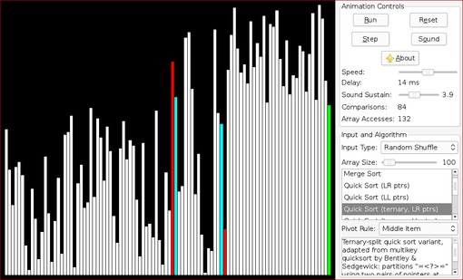
Visualisations of Sorting algos
The Sound of Sorting - Visualization and "Audibilization" of Sorting Algorithms

