Slide 1
Ch8: Linear-time sorts
Ch11: Hash tables
8 Oct 2013
CMPT231
Dr. Sean Ho
Trinity Western University

Slide 2
Outline for today
  Proof why comparison sorts must be Ω(n lg n)
Linear-time non-comparison sorts:
  Counting sort
  Radix sort, complexity
  Bucket sort: proof w/ probabilistic analysis
Hash tables:
  Collision handling by chaining
  Hash functions and universal hashing
  Collision handling by open addressing

Slide 3
Summary of sorting algorithms
Comparison sorts (ch2, 6, 7)
  Insertion sort: Θ(n²), easy to program, slow
  Merge sort: Θ(n lg(n)), out-of-place sorting,
  slow due to lots of copying / memory operations
  Heap sort: Θ(n lg(n)), in-place, uses max-heap
  Quick sort: Θ(n²) worst-case, Θ(n lg(n)) average, in-place, fast (small) constant factors
Linear-time non-comparison sorts (ch8):
  Counting sort: k distinct values: Θ(n+k)
  Radix sort: d digits w/k values: Θ(d(n+k))
  Bucket sort: for uniform distrib. of values: Θ(n)

Slide 4
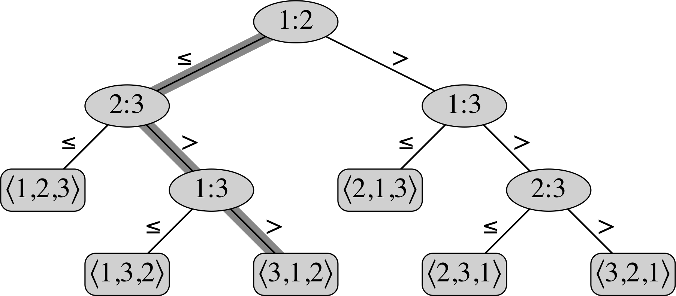
Comparison sorts are Ω(n lg n)
Decision tree model of computation:
  Leaves are possible outputs
    i.e., permutations of the input
  Nodes are decision points
    when comparisons are made
  Path through tree is one run on an input
# leaves = # permutations = n!
# comparisons = # nodes along path
  = depth of tree
  = Ω(lg(# leaves)) = Ω(lg n!)
  = Ω(n lg n) (by Stirling, Eq3.19)

Slide 5
Outline for today
  Proof why comparison sorts must be Ω(n lg n)
Linear-time non-comparison sorts:
  Counting sort
  Radix sort, complexity
  Bucket sort: proof w/ probabilistic analysis
Hash tables:
  Collision handling by chaining
  Hash functions and universal hashing
  Collision handling by open addressing

Slide 6
Linear-time sorts
Linear-time sorts use assumptions on input data
  e.g., range of possible values is limited+known
  e.g., distribution of values is known
In practise, Θ(n) and Θ(n lg n) are very similar
    e.g., up to n=10⁶: lg n < 21, a smallish factor
  A fast n lg n sort (like quicksort) may have smaller constants than a linear-time sort
Hybrid algorithms: e.g., (7.4-5)
  Pass 1 w/quicksort, stop when length < c
  Pass 2 w/insertion sort on “nearly sorted” data
Recursion (function call) is expensive

Slide 7
Counting sort
Assume: values are integers in {0, …, k}
    countingSort(A, n, k):
      let B[1 .. n] be new (output) array
      let C[0 .. k] be temp array, initialised to 0
      for j in 1 .. n:
        C[ A[ j ] ] ++
      for i in 1 .. k:
        C[ i ] += C[ i-1 ]
      for j in n .. 1:
        B[ C[ A[ j ] ] ] = A[ j ]
        C[ A[ j ] ] ––
      return B
Stable: preserves order of duplicate keys
Complexity: Θ(n+k) (watch out if k gets big!)
A: | 2 | 5 | 3 | 0 | 2' | 3' | 0' | 3''
C: | 2 | 0 | 2 | 3 | 0 | 1
C: | 2 | 2 | 4 | 7 | 7 | 8
B: | 0 | 0' | 2 | 2' | 3 | 3' | 3'' | 5
census
move

Slide 8
Radix sort
    (How IBM made its fortune! punch cards ~1900)
Sort one digit at a time, least-significant first
Assume: values have max #digits d
    radixSort(A, n, d):
      for i in 1 .. d:
        stableSort(A on digit i)
  stableSort() can be,
  e.g., counting sort
  (why is stability important?)
  (why start from
  least-significant digit?)
3 | 7 | 4 | 5
2 | 9 | 1 | 3
1 | 0 | 1 | 6
2 | 0 | 1 | 6
 | 9 | 1 | 3

Slide 9
Radix sort: complexity
Using counting sort, we have d loops of Θ(n+k):
  ⇒ complexity of radix sort is Θ(d(n+k))
    n items of d digits,
    where each digit can take k values (e.g., k=10)
Given b-bit items, find r to get optimal r-bit digits:
    d = b/r and k = 2^{r} – 1
      e.g., 32-bit ints, 8-bit digits ⇒ b=32, r=8, d=4, k=255
    Complexity is Θ(d(n+k)) = Θ( (b/r) (n + 2^{r}) )
  Balance the b/r with the n + 2^{r}
    e.g., by choosing r = lg n:
    Θ( (b/r) (n + 2^{r}) ) = Θ( (b / lg n) (2n) ) = Θ( bn / lg n )
      e.g., to sort n=2¹⁶ ints of b=32-bits, use r=16-bit digits

Slide 10
Outline for today
  Proof why comparison sorts must be Ω(n lg n)
Linear-time non-comparison sorts:
  Counting sort
  Radix sort, complexity
  Bucket sort: proof w/ probabilistic analysis
Hash tables:
  Collision handling by chaining
  Hash functions and universal hashing
  Collision handling by open addressing

Slide 11
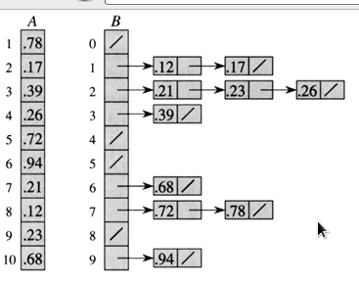
Bucket sort
Assume: values uniformly distributed over [0,1)
Idea: Divide range [0,1) into n equal-size buckets
    e.g., each bucket can be a small array or linked list
  Distribute input into buckets
  Sort each bucket
    e.g., by insertion sort
    should be fast because
    we expect small buckets
  Pull from each bucket in order
Correctness: if A[i] ≤ A[j], then either:
  A[i]/n = A[j]/n (same bucket: insertion sort), or
  A[i]/n < A[j]/n (diff bucket: order of buckets)
Kent U

Slide 12
Bucket sort: complexity
Let n_{i} = # items in i^{th} bucket
  Intuitively, if items are uniformly distrib, n_{i} ≈ 1
  so whole thing should be T(n) = Θ(n)
To be rigorous: notice that
Find expected value:
Claim that E[n_{i}²] = 2 – (1/n) for all i:
  if so, then E[ T(n) ] = Θ(n) + O(Σ (2 – 1/n))
  = Θ(n) + O(2n – 1)
  = Θ(n), and the proof is complete

Slide 13
Bucket sort: E[n_{i}²] = 2 – (1/n)
Use indicator variable:
    X_{ij} = 1 if A[j] falls in bucket i, and 0 if not
    So n_{i} = Σ_{j} X_{ij} (count of items in this bucket)
So E[ n_{i}² ] = E[ ( Σ_{j} X_{ij} )² ] (count items)
= Σ_{j} E[ X_{ij}² ] + 2Σ_{j} Σ_{k} E[ X_{ij}X_{ik} ] (expand)
Consider each term separately:
  Applying probability rules:
  E[ X_{ij}² ] = 0² P(X_{ij} = 0) + 1² P(X_{ij} = 1)
  = 0² (1 – 1/n) + 1² (1/n) = 1/n
  Since items j ≠ k are independent:
  E[ X_{ij}X_{ik} ] = E[ X_{ij} ] E[ X_{ik} ] = (1/n)(1/n) = 1/n²

Slide 14
Bucket sort: finish proof
So E[ n_{i}² ] = Σ_{j} E[ X_{ij}² ] + 2Σ_{j}Σ_{k} E[ X_{ij}X_{ik} ]
= Σ_{j} (1/n) + 2Σ_{j}Σ_{k} (1/n²)
= (1/n) Σ_{j} (1) + (2/n²) Σ_{j}Σ_{k} (1)
= (1/n)(n) + (2/n²)( n(n-1)/2 )
= 1 + n(n-1)/n²
= 2 – 1/n
Hence expected running time for bucket sort is
E[ T(n) ] = Θ(n) + Σ (2 – 1/n)
= Θ(n) + 2n – 1
= Θ(n), linear time
Assumptions: input uniformly distributed on [0,1)

Slide 15
Outline for today
  Proof why comparison sorts must be Ω(n lg n)
Linear-time non-comparison sorts:
  Counting sort
  Radix sort, complexity
  Bucket sort: proof w/ probabilistic analysis
Hash tables:
  Collision handling by chaining
  Hash functions and universal hashing
  Collision handling by open addressing

Slide 16
Hash tables
Dictionary of key-value pairs, e.g., Python dict
Interface:
  insert(T, k, x): add item x with key k
  search(T, k): find an item with key k
  delete(T, x): delete specific item x
Better than regular array (direct addressing) when
  Range of possible keys is too huge to allocate
  Actual keys are sparse subset of possible keys
  e.g., only have items at keys 0, 2, 40201300
    Regular array would allocate 40201300 entries!

Slide 17
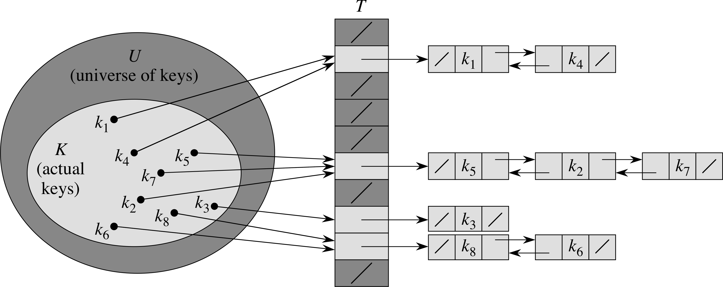
Hashing
Main idea:
  Hash function
  h(k): U → {0, …, m-1}
  maps from set U of possible keys
  into a set of m buckets
  Use h(k) as key instead of k
Hash collision when two keys hash to same bucket
  Hopefully, this is rare
  Chain multiple items via linked list
Idea is similar to bucket sort, but
  Don't know distribution or range of keys, so
  Use hash function to get uniform distribution

Slide 18
Implementing hash tables
insert(T, k, x):
  Insert x at the head of the linked list at slot h(k)
  Complexity: O(1)
  Assumes x is not already in the list
search(T, k):
  Linear search through the list at slot h(k)
  Complexity: O( length of list at h(k) )
delete(T, x):
  If given pointer directly to item x, then O(1)
  If not, then need to do a search first

Slide 19
Hash table load factor
Efficiency of hash table depends on search()
  Which depends on # items n_{h(k)} in each bucket
Load factor α = n/m:
  n = # items currently stored in hash table
  m = # buckets
So E[ n_{h(k)} ] = α (average # items per bucket)
An unsuccessful search takes average Θ(1 + α):
  Computing hash function takes Θ(1)
  Linear search needs to search entire bucket
  Expected length of bucket is α

Slide 20
Complexity of search()
A successful search also takes average Θ(1 + α):
# items searched = # collisions after x inserted
Use indicator X_{ij} = { 1 if h(k_{i}) = h(k_{j}), 0 else }
  E[ X_{ij} ] = (prob. of collision) = 1/m
E[ # items searched ] = E[ (1/n) Σ_{i}( #items ) ]
= E[ (1/n) Σ_{i}( 1 + Σ_{j} X_{ij} ) ]
= (1/n) Σ_{i}( 1 + Σ_{j} E[ X_{ij} ] )
= (1/n) Σ_{i}( 1 + Σ_{j} (1/m) )
= 1 + (1/n) Σ_{i}Σ_{j} (1/m)
= 1 + (1/nm) n(n-1)/2
= 1 + α/2 – α/2n

Slide 21
Outline for today
  Proof why comparison sorts must be Ω(n lg n)
Linear-time non-comparison sorts:
  Counting sort
  Radix sort, complexity
  Bucket sort: proof w/ probabilistic analysis
Hash tables:
  Collision handling by chaining
  Hash functions and universal hashing
  Collision handling by open addressing

Slide 22
Hash functions
Wlog, assume keys k are natural numbers
  If not, convert (e.g., ASCII codes)
Want h(k) to be uniformly distributed on 0..m-1
  But distribution of keys k is unknown
  Keys k_{i} and k_{j} might not be independent
Division hash: h(k) = k mod m
  Fast, but if m=2^{p}, this is just the p least-sig bits
    If k is a string using radix-2^{p} representation,
    then permuting the string gives same hash (11.3-3)
  Choose m prime, not too close to a power of 2

Slide 23
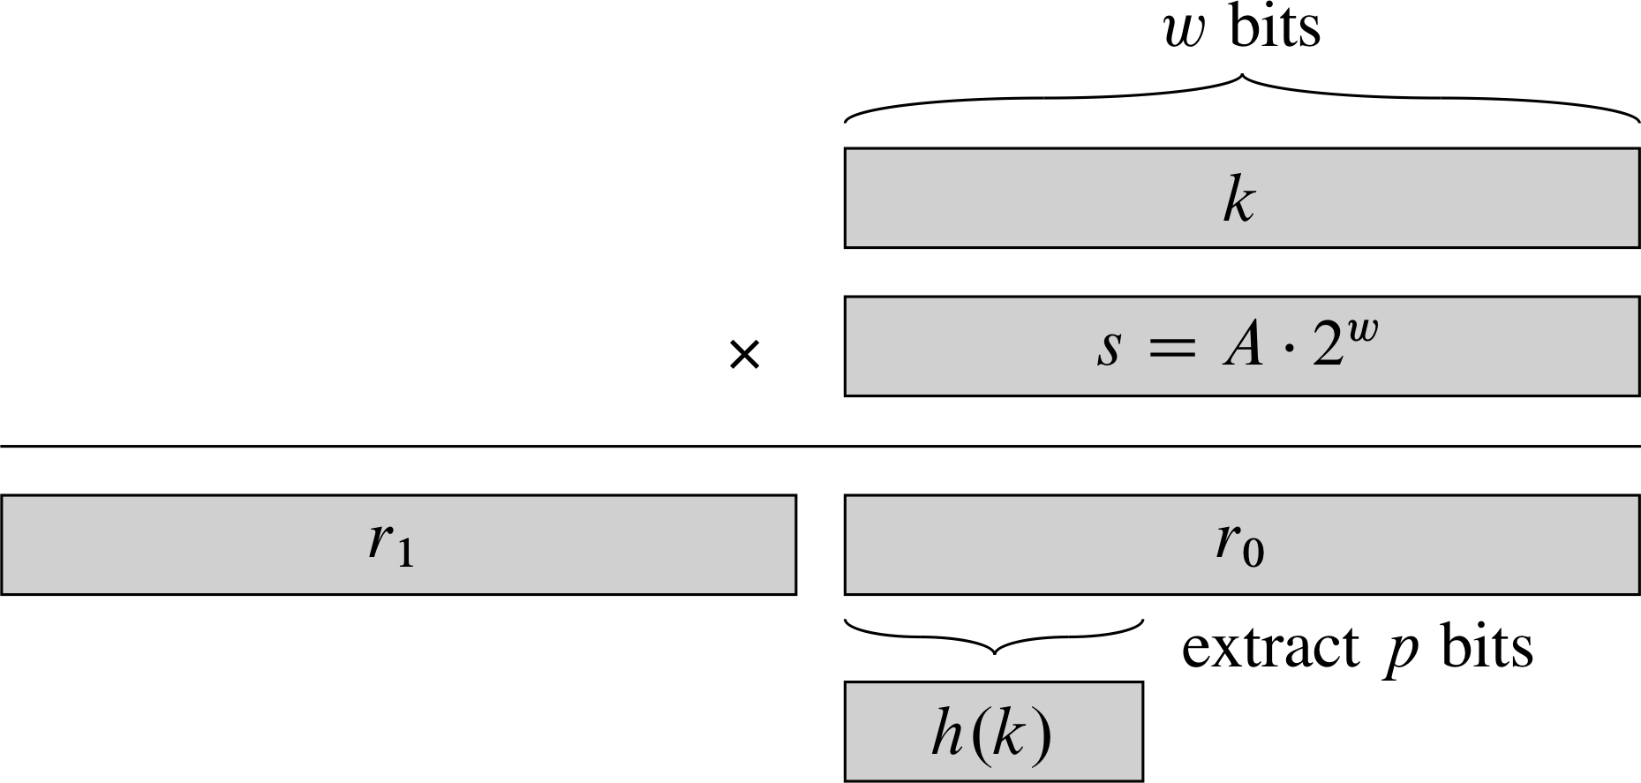
Multiplication hash
Multiplication hash: h(k) = ⎣m(kA mod 1)⎦,
where 0<A<1 is some chosen constant
Fast implementation using m=2^{p}:
  Let w be the native machine word size (#bits)
  Pick a w-bit integer s in 0 < s < 2^{w}, let A = s/2^{w}
  Multiply s*k: product has 2w bits in words r₀, r₁
  Select the p most-sig bits of the lower word r₀
try A ≈ φ – 1?

Slide 24
Universal hashes
Any fixed choice of hash function is vulnerable to pathological input specifically designed to obtain many hash collisions
Keep a pool H of hash functions, randomly select
Want pool to have the universal hash property:
  For any two keys j ≠ k, the number of hash functions in H that cause a collision h(j) = h(k) is ≤ |H| / m
Then expected size of buckets is O(1+α),
and complexity of search is still O(1).

Slide 25
Outline for today
  Proof why comparison sorts must be Ω(n lg n)
Linear-time non-comparison sorts:
  Counting sort
  Radix sort, complexity
  Bucket sort: proof w/ probabilistic analysis
Hash tables:
  Collision handling by chaining
  Hash functions and universal hashing
  Collision handling by open addressing

Slide 26
Open addressing
Another way to handle collisions, instead of chain
Keys stored directly in table, no linked lists
To search:
  Probe in slot h(k):
    if NIL, unsuccessful search (and we're done)
    if the entry is our key, we've found it
    if the entry is not our key, we hit a collision:
      Try again with next entry in probe sequence
Hash function h: U x {0, …, m-1} → {0, …, m-1}
  Probe sequence: h(k,0), h(k,1), h(k,2), …
    Must be a permutation of the slots {0, …, m-1}
Hash table may fill/overflow

Slide 27
Probe sequencing
Ideally, want uniform hashing: each permutation is equally likely to be probe sequence for a key
Linear probing:
  First try h(k), then h(k)+1, etc (mod m)
  Long filled runs get longer (more likely to hit)
Quadratic probing:
  First try h(k), then jump around quadratically:
    h(k, i) = (h(k) + c₁i + c₂i²) mod m
  Must choose c₁,c₂ to get full permutation
  Collision on initial h(k) ⇒ full sequence collision

Slide 28
Probe seq.: double hashing
Use two hash functions h₁ and h₂:
  Try h₁(k) first, then use h₂ to jump around:
    h(k, i) = (h₁(k) + i h₂(k)) mod m
  In order to get full permutation,
  h₂(k) and m must be relatively prime
    e.g., let m=2^{p} and ensure h₂(k) always odd
    or, let m be prime, and ensure 1 < h₂(k) < m
Each combination of h₁(k) and h₂(k) yields
a different probe sequence:
  total # sequences = Θ(n²)

