Slide 1
Quiz 2: ch4, 6-8, 11 ch16: Greedy Algorithms
Open book, paper notes
No electronic devices
Please show your work
29 Oct 2013
CMPT231
Dr. Sean Ho
Trinity Western University

Slide 2
Quiz 2: 30pts
  Input for all: [ 20, 8, 24, 11, 2, 4, 19, 22, 6, 16 ]
[10] Demonstrate each step of Heapsort on the input.
How many non-trivial swaps are performed?
[10] Demonstrate each step of (non-randomised) Quicksort on the input. How many non-trivial swaps?
[10] Demonstrate radix sort on the input with base-4 digits.

Slide 3
Quiz 2: solutions #1
initially not
a heap:
20
heapify(2):
[1 swap]
heapify(11):
[1]
20
20
8
24
8
24
8
24
11
2
4
19
11
16
4
19
22
16
4
19
22
6
16
22
6
2
11
6
2
heapify(8):
[2]
heapify(24),
heapify(20):
[1]
swap out 24,
heapify(2):
[3]
20
24
22
22
24
22
20
16
20
11
16
4
19
11
16
4
19
11
2
4
19
8
6
2
8
6
2
8
6
24
swap out 22,
heapify(6)
[3]
swap out 20,
heapify(8)
[2]
swap out 19,
heapify(6)
[3]
20
19
16
16
19
16
8
11
8
11
2
4
6
11
2
4
6
6
2
4
19
8
22
24
20
22
24
20
22
24
swap out 16,
heapify(4)
[3]
swap out 11,
heapify(2)
[2]
swap out 8,
heapify(4)
[2]
swap out 6,
heapify(2)
[2]
swap out 4
[1]
2
11
8
6
4
4
6
6
8
6
2
4
2
2
8
11
16
19
4
2
4
20
22
24

Slide 4
Quiz 2: solutions #1-2
Heapsort: 26 swaps
Quicksort: only 12 swaps!
Pivot=16: | 20 | 8 | 24 | 11 | 2 | 4 | 19 | 22 | 6 | 16 | Swaps
. | 8 | 20 | . | . | . | . | . | . | . | . | 1
. | 8 | 11 | 24 | 20 | . | . | . | . | . | . | 1
. | 8 | 11 | 2 | 20 | 24 | . | . | . | . | . | 1
. | 8 | 11 | 2 | 4 | 24 | 20 | . | . | . | . | 1
. | 8 | 11 | 2 | 4 | 6 | 20 | 19 | 22 | 24 | . | 1
. | 8 | 11 | 2 | 4 | 6 | 16 | 19 | 22 | 24 | 20 | 1
6: | 8 | 11 | 2 | 4 | 6 | 16 | 19 | 22 | 24 | 20 | .
2: | 2 | 4 | 6 | 11 | 8 | . | . | . | . | . | 3
4: | 2 | 4 | . | . | . | . | . | . | . | . | .
8: | . | . | . | 8 | 11 | . | . | . | . | . | 1
20: | . | . | . | . | . | . | 19 | 20 | 24 | 22 | 1
22: | . | . | . | . | . | . | . | . | 22 | 24 | 1

Slide 5
Quiz 2: solutions #3
20
8
24
11
2
4
19
22
6
16
1 | 1 | 0
0 | 2 | 0
1 | 2 | 0
0 | 2 | 3
0 | 0 | 2
0 | 1 | 0
1 | 0 | 3
1 | 1 | 2
0 | 1 | 2
1 | 0 | 0
20
8
24
11
2
4
19
22
6
16
1 | 1 | 0
0 | 2 | 0
1 | 2 | 0
0 | 1 | 0
1 | 0 | 0
0 | 0 | 2
1 | 1 | 2
0 | 1 | 2
0 | 2 | 3
1 | 0 | 3
1 | 0 | 0
0 | 0 | 2
1 | 0 | 3
1 | 1 | 0
0 | 1 | 0
1 | 1 | 2
0 | 1 | 2
0 | 2 | 0
1 | 2 | 0
0 | 2 | 3
0 | 0 | 2
0 | 1 | 0
0 | 1 | 2
0 | 2 | 0
0 | 2 | 3
1 | 0 | 0
1 | 0 | 3
1 | 1 | 0
1 | 1 | 2
1 | 2 | 0
2
4
6
8
11
16
19
20
22
24

Slide 6
Outline for today
Greedy algorithms
  Example: Activity selection
  Optimal substructure
    Naive recursive solution
  Greedy choice property
    Recursive greedy solution
    Iterative greedy solution
  Example: Knapsack problems
  Example: Huffman coding

Slide 7
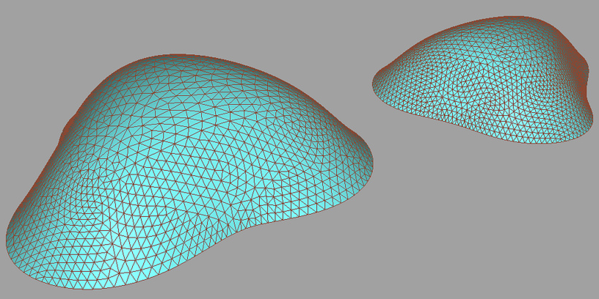
Greedy algorithms
Another approach to optimisation
  Faster than dynamic programming,
  when applicable
At each decision point, go for immediate gains
  Locally optimal choices ⇒ global optimum
Not all problems have optimal substructure
  Hybrid optimisation strategies use large jumps to get to right “hill”,
  then greedy
  “hill-climbing”
  to get to the top
Andreas Hopf

Slide 8
Problem-solving outline
Find optimal substructure (e.g., recurrence)
Convert to naïve recursive solution (code)
  Could then be converted to dynamic prog.
Use greedy choice to simplify the recurrence
so only one subproblem remains
  Don't have to iterate through all subproblems
  Prove greedy choice yields global optimum!
Convert to recursive greedy solution
Convert to iterative greedy solution

Slide 9
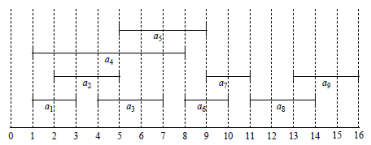
Example: activity selection
i | s | f
1 | 1 | 3
2 | 2 | 5
3 | 4 | 7
4 | 1 | 8
5 | 5 | 9
6 | 8 | 10
7 | 9 | 11
8 | 11 | 14
9 | 13 | 16
Activities S = {a₁, …, a_{n}} which each
require exclusive use of a shared resource
  Each activity has start/finish times [s_{i}, f_{i})
  Activities are sorted by finish times
⇒ Find largest subset of S where
all activities are
non-overlapping
e.g., a₂ and a₅
do not overlap:
Solutions?

Slide 10
Solving: optimal substructure
Let S_{ij} = {a_{k} ∊ S: f_{i} ≤ s_{k} < f_{k} ≤ s_{j}}: all activities that start after f_{i} and finish before s_{j}
  Any activity in S_{ij} will be compatible with:
    Any activity that finishes by f_{i}
    Any activity that starts no earlier than s_{j}
Let A_{ij} be a solution for S_{ij}:
a largest mutually-compatible subset of activities
Pick an activity a_{k} ∊ A_{ij}, and partition A_{ij} into
  A_{ik} = A_{ij} ∩ S_{ik}: those that finish before a_{k} starts
  A_{kj} = A_{ij} ∩ S_{kj}: those that start after a_{k} finishes
a_{i}
a_{k}
a_{j}
A_{ik}
a_{k}
A_{kj}

Slide 11
Proof of optimal substructure
Claim: A_{ik} and A_{kj} are optimal solutions for S_{ik}, S_{kj}
Proof (for A_{ik}): assume not:
  Let A'_{ik} be a better solution:
  non-overlapping elements, and |A'_{ik}| > |A_{ik}|.
  Then A'_{ik} ∪ {a_{k}} ∪ A_{kj} would be a solution for S_{ij}, and its size is larger than A_{ij} = A_{ik} ∪ {a_{k}} ∪ A_{kj}.
  Contradicts the premise that A_{ij} was optimal.
⇒ Optimal substructure: split on a_{k},
recurse twice on S_{ik} and S_{kj},
iterate over all choices of a_{k} and pick the best
A_{ik}
a_{k}
A_{kj}

Slide 12
Naive recursive solution
Let c[i,j] = size of optimal solution for S_{ij}:
  Splitting on a_{k} yields c[i,j] = c[i,k] + 1 + c[k,j]
  Which choice of a_{k} is best? Naive: try all
Recurrence: c[i,j] = max_{a_k ∈ S_ij} (c[i,k] + 1 + c[k,j])
  Base case: if S_{ij} = ∅, then c[i,j] = 0
Could implement this using dynamic programming
  Fill in 2D table for c[i,j], bottom-up
  Auxiliary table storing the solutions A_{ij}
With this problem, though, we can do better!

Slide 13
Outline for today
Greedy algorithms
  Example: Activity selection
  Optimal substructure
    Naive recursive solution
  Greedy choice property
    Recursive greedy solution
    Iterative greedy solution
  Example: Knapsack problems
  Example: Huffman coding

Slide 14
Greedy choice
Which choice of a_{k} leaves as much as possible of the resource available for other activities?
  One which finishes the earliest
  Since activities are sorted by finish time,
  just choose the first activity!
Recurrence simplifies: to find optimal subset of S_{kj},
include a_{k}, then recurse on
S_{k} = {a_{i}: s_{i} ≥ f_{k}}: those that start after a_{k} finishes
  Don't need to iterate over all choices of a_{k}
We need to prove the greedy choice is optimal

Slide 15
Proof of greedy choice
Let S_{k} ≠ ∅ with a_{m} ∊ S_{k} having earliest finish time.
  Claim: ∃ optimal soln for S_{k} which includes a_{m}.
Proof: Let A_{k} be an optimal solution for S_{k}.
  If it includes a_{m}, then we're done.
If not, let a_{j} be the first in A_{k} to finish.
  Swap out a_{m} for a_{j}: let A'_{k} = A_{k} – {a_{j}} ∪ {a_{m}}.
Then A'_{k} is an optimal solution for S_{k}:
  Size is same as A_{k}, and
  Elements are non-overlapping: f_{m} ≤ f_{j}
a_{j}
a_{m}
A_{k}

Slide 16
Recursive greedy solution
Input: arrays s[], f[], with f[] sorted
  Add a dummy entry f[0] = 0, so that S₀ = S.
For each recursive subproblem S_{k},
  Skip over activities that overlap with a_{k}
  Include the first activity that doesn't overlap,
  and recurse on the rest:
      def ActivitySel(s, f, k, n):
        for m in k+1 .. n:
          if (s[m] ≥ f[k]):
            return {a_{m}} ∪ ActivitySel(s, f, m, n)
        return NULL
  Initial call: ActivitySel(s, f, 0, n). (Θ(n)!)

Slide 17
Iterative greedy solution
Recursive solution is nearly tail-recursive, easy to convert to more efficient iterative solution:
      def ActivitySel(s, f):
        A = {a₁}
        k = 1
        for m in 2 .. length(f):
          if (s[m] ≥ f[k]):
            A = A ∪ {a_{m}}
            k = m
        return A
Complexity: Θ(n)
  If need to pre-sort on f[], then Θ(n lg n)
i | s | f
1 | 1 | 3
2 | 2 | 5
3 | 4 | 7
4 | 1 | 8
5 | 5 | 9
6 | 8 | 10
7 | 9 | 11
8 | 11 | 14
9 | 13 | 16

Slide 18
Greedy vs dynamic prog.
Dynamic prog. more general
  Not all problems have greedy property
Dynamic prog. fills in table bottom-up
  Greedy choice done top-down
Choice in dyn. prog. needs all smaller subprobs
  Greedy choice is simpler, so can make choice before solving subproblem
Proving the greedy property:
  Assume an optimal solution
  Modify it to include the greedy choice
  Show that it's still optimal

Slide 19
Optimising for greedy choice
Often need to pre-process input to make the greedy choice easier
  Sorted activities by finish time
  Greedy choice can be done in O(1) each time
  Sorting takes O(n lg n)
If input is dynamically generated
(can't sort whole list in advance), then
  Priority queue: pop the most optimal choice

Slide 20
Outline for today
Greedy algorithms
  Example: Activity selection
  Optimal substructure
    Naive recursive solution
  Greedy choice property
    Recursive greedy solution
    Iterative greedy solution
  Example: Knapsack problems
  Example: Huffman coding

Slide 21
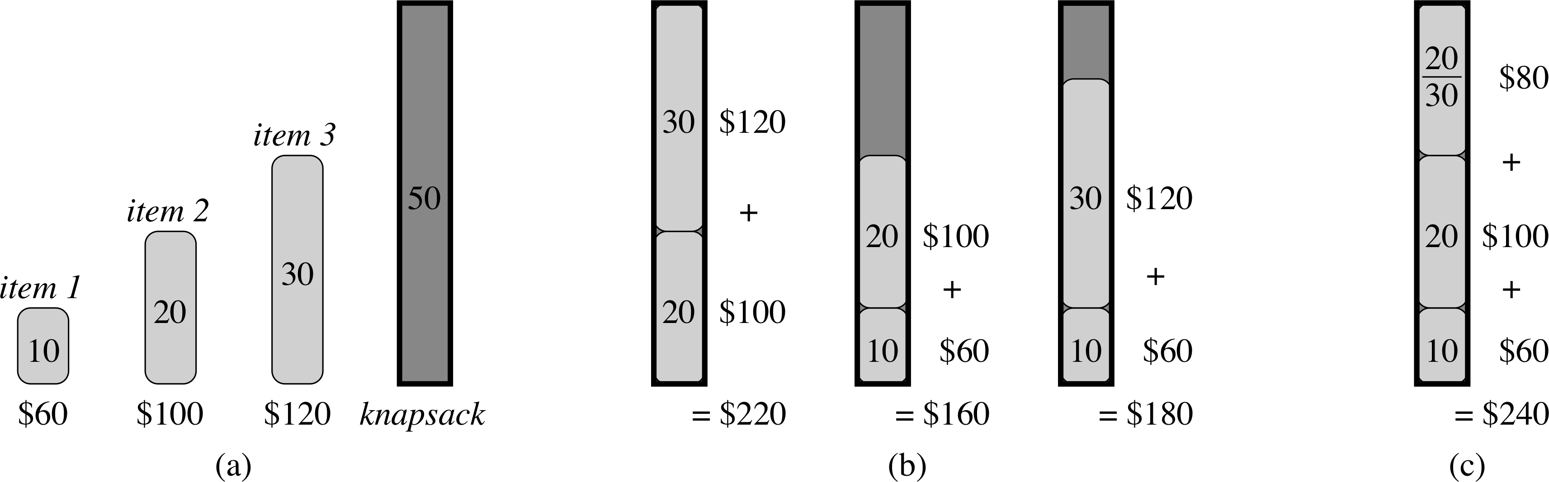
Knapsack problem
Fractional knapsack problem:
  n items, each with weight w_{i} and value v_{i}.
  Maximise total value, subject to total weight W
  Can take fractions of an item (think of liquids)
Greedy soln: sort items by value-to-weight ratio
  Greedy choice: take item with largest v_{i} / w_{i}.
  Last spot may be filled with fractional item
      def FractionalKnapsack(v, w, W):
        while totwt < W:
          add next item in decreasing order of value-to-weight
        replace last item with 1-(totwt-W) of itself

Slide 22
0-1 Knapsack
Variant that does not allow fractions of an item
Greedy strategy no longer works!
Making initial locally-optimal choices locks us out of making later globally-optimal choices
Still possible to solve using dynamic programming (Ex 16.2-2)

Slide 23
Outline for today
Greedy algorithms
  Example: Activity selection
  Optimal substructure
    Naive recursive solution
  Greedy choice property
    Recursive greedy solution
    Iterative greedy solution
  Example: Knapsack problems
  Example: Huffman coding

Slide 24
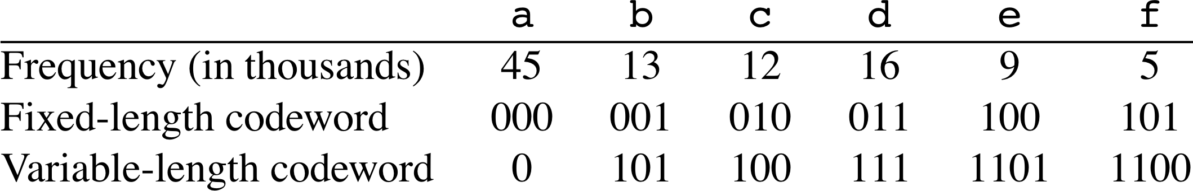
Encoding
Given a text with a known set of characters
  Encode each character with a binary codeword
Fixed-length code: all codewords same length
  “cafe” ⇒ 010 000 101 100
Variable-length code: some codes lower cost
  “cafe” ⇒ 100 0 1100 1101
  Compression: choose shorter codes for more frequent characters
Prefix code: no code is a prefix of another
  Unique parsing; don't need to delimit chars
  “cafe” ⇒ 100011001101

Slide 25
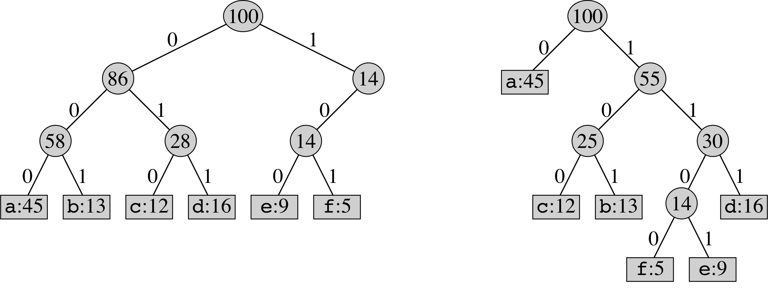
Code trees
Prefix code ⇒ code tree: binary tree where
nodes represent prefixes; characters are at leaves
  Fixed-length code ⇒ leaves all at same level
  Decoding = walk down the tree
    Cost of a char = depth in tree
Total cost of encoding a file using a given tree:
  Σ_{c} [ freq(c) * depth(c) ]

Slide 26
Huffman coding
Build tree bottom-up
  Start with two least-common chars
  Merge to make new subtree with combined freq
Min-priority queue manages the greedy choice
Input: array of char nodes with .freq attribs
      def huffman(chars):
        Q = new MinQueue(chars)
        for i in 1 .. length(chars)-1:
          z = new Node
          z.left = Q.popmin()
          z.right = Q.popmin()
          z.freq = z.left.freq + z.right.freq
          Q.push(z)
        return Q.popmin()
char | freq
a | 15
b | 5
c | 9
d | 7
e | 18
f | 10

