Slide 1
ch22: Breadth-First Search and Depth-First Search
5 Nov 2013
CMPT231
Dr. Sean Ho
Trinity Western University

Slide 2
Outline for today
Huffman coding
Graph algorithms
  Breadth-first search
Depth-first search
  Parenthesis structure
  Edge classification
  Topological sort
  Finding strongly-connected components

Slide 3
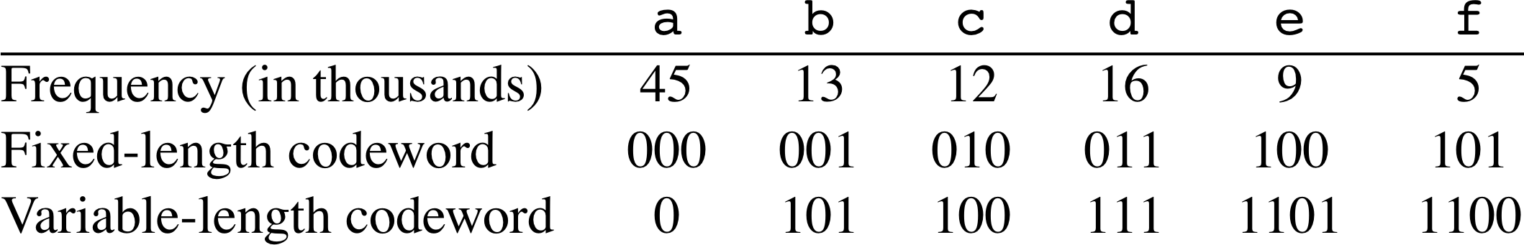
Encoding
Given a text with a known set of characters
  Encode each character with a binary codeword
Fixed-length code: all codewords same length
  “cafe” ⇒ 010 000 101 100
Variable-length code: some codes lower cost
  “cafe” ⇒ 100 0 1100 1101
  Compression: choose shorter codes for more frequent characters
Prefix code: no code is a prefix of another
  Unique parsing; don't need to delimit chars
  “cafe” ⇒ 100011001101

Slide 4
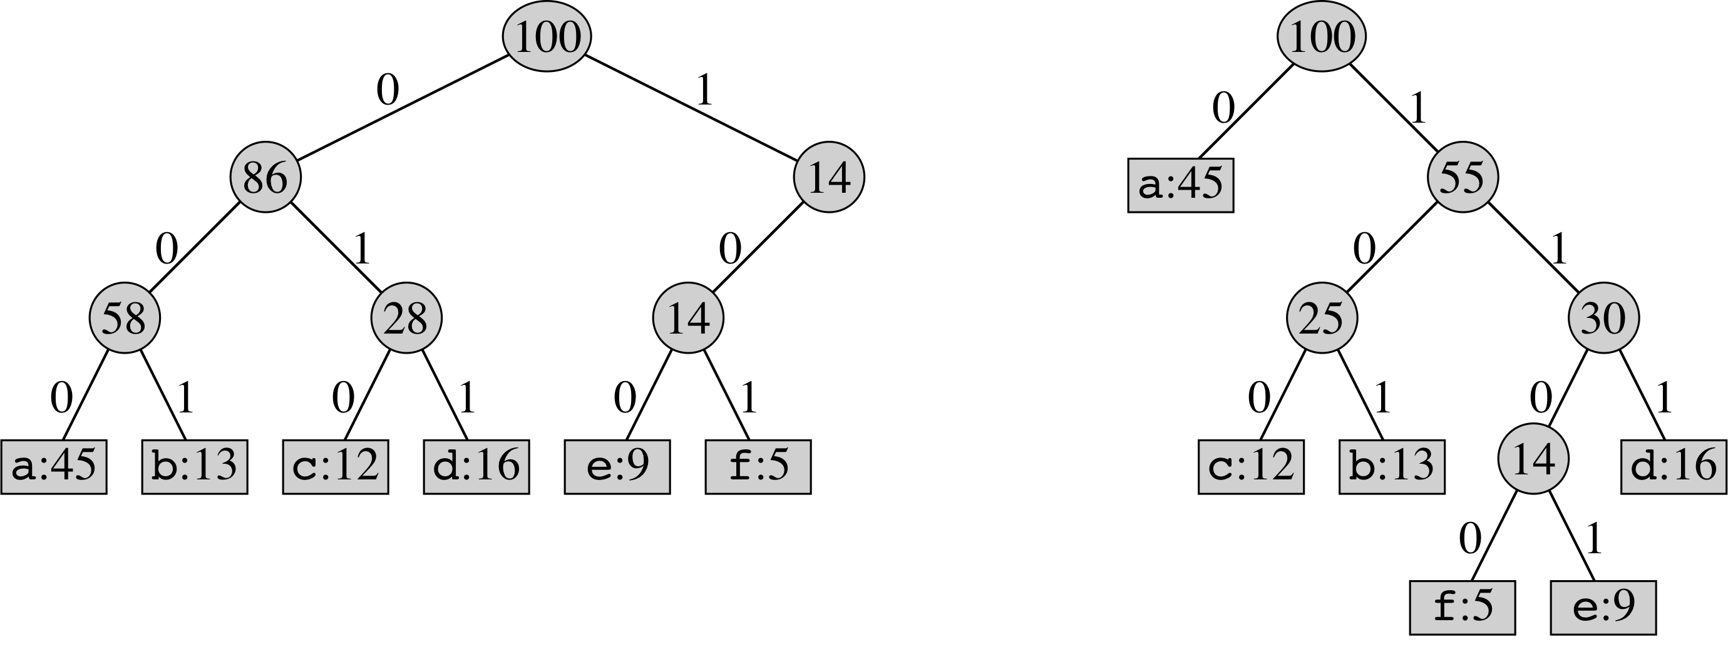
Code trees
Prefix code ⇒ code tree: binary tree where
nodes represent prefixes; characters are at leaves
  Fixed-length code ⇒ leaves all at same level
  Decoding = walk down the tree
    Cost of a char = depth in tree
Total cost of encoding a file using a given tree:
  Σ_{c} [ freq(c) * depth(c) ]

Slide 5
Huffman coding
Build tree bottom-up
  Start with two least-common chars
  Merge to make new subtree with combined freq
Min-priority queue manages the greedy choice
Input: array of char nodes with .freq attribs
      def huffman(chars):
        Q = new MinQueue(chars)
        for i in 1 .. length(chars)-1:
          z = new Node
          z.left = Q.popmin()
          z.right = Q.popmin()
          z.freq = z.left.freq + z.right.freq
          Q.push(z)
        return Q.popmin()
char | freq
a | 15
b | 5
c | 9
d | 7
e | 18
f | 10

Slide 6
Outline for today
Huffman coding
Graph algorithms
  Breadth-first search
Depth-first search
  Parenthesis structure
  Edge classification
  Topological sort
  Finding strongly-connected components

Slide 7
Intro to graph algorithms
Representing graphs: G = (V, E)
  V: vertices/nodes (e.g., via array or linked-list)
  E: edges connecting vertices (directed or un)
Representing edges:
  Edge list: array/list of (u,v) pairs of nodes
  Adjacency list: indexed by start node
    What about undirected graphs?
    How to find (out)-degree of every vertex?
  Adjacency matrix: A[i,j]=1 if (i,j) is an edge
    What about undirected graphs?
    Weighted graph: A[i,j] not limited to 0/1
1
2
3
4
5

Slide 8
Graph traversal: breadth-first
Traverse: visit each node exactly once
BFS: overlay a breadth-first tree
  Path in the tree = shortest path
  from chosen start node
  BFS tree not necessarily unique
Graph ≠ tree: could have loops
  ⇒ Need to track which nodes we've seen
Assign colour: white = unvisited,
grey = on border (some unvisited neighbours),
black = no unvisited neighbours
Use FIFO queue to manage grey nodes
1
2
3
4
5

Slide 9
Breadth-first search: algorithm
Input: vertex list, adjacency list (linked lists), start
Output: modify vertex list to add parent pointers
      def BFS(V, E, start):
        initialise all vertices to be white, with NULL parent
        initialise start to be grey
        initialise FIFO: Q.push(start)
        while Q.notempty():
          u = Q.pop()
          for each v in E.adj[u]:
            if v.colour == white:
              v.colour = grey
              v.parent = u
              Q.push(v)
          u.colour = black
Complexity: O(V + E)
V
/
E
/
/
/
/

Slide 10
Outline for today
Huffman coding
Graph algorithms
  Breadth-first search
Depth-first search
  Parenthesis structure
  Edge classification
  Topological sort
  Finding strongly-connected components

Slide 11
Depth-first search
Explore as deep as we can first
  Backtrack to explore other paths
  Recursive algorithm
Colouring: white = undiscovered
  Grey = discovered
  Black = finished (visited all neighbours)
Add timestamps on discover and finish
Overlays a forest on the graph
  Subtree at a node = nodes visited between this node's discovery and finish

Slide 12
Depth-first search: algorithm
      def DFS(G):
        initialise all vertices to be white, with NULL parent
        time = 0
        for u in vertices:
          if u is white: DFS-Visit(G, u)
      def DFS-Visit(G,u):
        time++
        u.discovered = time
        u.colour = gray
        for v in u's neighbours:
          if v is white:
            v.parent = u
            DFS-Visit(G, v)
        u.colour = black
        time++
        u.finished = time
why not just call DFS-Visit once?
start
cur
u
1/
6/
x
v
2/5
/
y
w
3/4
/
z

Slide 13
DFS: parenthesis structure
Subtree at a node is visited between the node's discovery and finish times
Print a “(_{u}” when we discover a node u,
and “)_{u}” when we finish it:
  Output will be a valid parenthesisation
  e.g., (_{u} (_{v} (_{w} )_{w} )_{v} (_{x} (_{y} )_{y} )_{x} )_{u} (_{z} )_{z}
  but not: (_{u} (_{v} )_{u} )_{v}
The (discover, finish) intervals
for two vertices are either:
  Completely disjoint, or
  One contained in the other
u
1/10
6/9
x
v
2/5
7/8
y
w
3/4
11/12
z

Slide 14
DFS: white-path theorem
From parenthesis structure: u.d < v.d < v.f < u.f
i.e., the (discover, finish) interval for v is
contained / nested within the interval for u,
⟺ v is a descendant of u in the DFS
White-path theorem:
v is a descendant of u in the DFS ⟺
when u is discovered, there is a path from u → v with only white vertices
u
v

Slide 15
DFS for edge classification
Edges in a graph are either:
  Tree edges: in the DFS forest
  Back edges: from a node to an ancestor in the same DFS tree (including self-loop)
  Forward edges: from a node to a descendant
  Cross edges: between nodes in different subtrees or different DFS trees
Lemma (22.11):
For directed graphs,
acyclic ⟺ no back edges

Slide 16
Outline for today
Huffman coding
Graph algorithms
  Breadth-first search
Depth-first search
  Parenthesis structure
  Edge classification
  Topological sort
  Finding strongly-connected components

Slide 17
DFS for topological sort
Linear ordering of vertices such that
if u → v is an edge, then u comes before v in sort
  Assumes no cycles! (DAG: directed acyclic)
  Applications: dependency resolution,
  compiling files, task planning / Gantt chart
Tweak DFS: as each vertex is finished,
insert it at the head of a linked list
  i.e., sort by decr finish time
e.g.: z, u, x, y, v, w
DFS might not be unique,
so topo sort might not be unique
u
1/10
6/9
x
v
2/5
7/8
y
w
3/4
11/12
z

Slide 18
Topo sort: example
socks
hose
pants
skates
leg pads
shorts
t-shirt
chest pad
sweater
mask
catch glove
blocker
batting glove
Proof of correctness: (u,v) ∊ E ⇒ v.f < u.f
When DFS explores (u,v), what colour is v?
  v is gray: means v is an ancestor of u
  ⇒ (u,v) is a back edge ⇒ graph has a loop
  v is white: becomes child: u.d < v.d < v.f < u.f
  v is black: v done, but u not done yet: v.f < u.f

Slide 19
DFS for connected components
Largest completely-connected set of vertices:
  Every vertex in the component has a path
  to every other vertex in the component
.
Algorithm:
  Compute DFS(G) to find finishing times
  Let G^{T} (transpose) be G with all edges reversed
  Compute DFS(G^{T}) starting at vertex with highest finishing time from step 1
  ⇒ Each tree in DFS(G^{T}) is a separate component

Slide 20
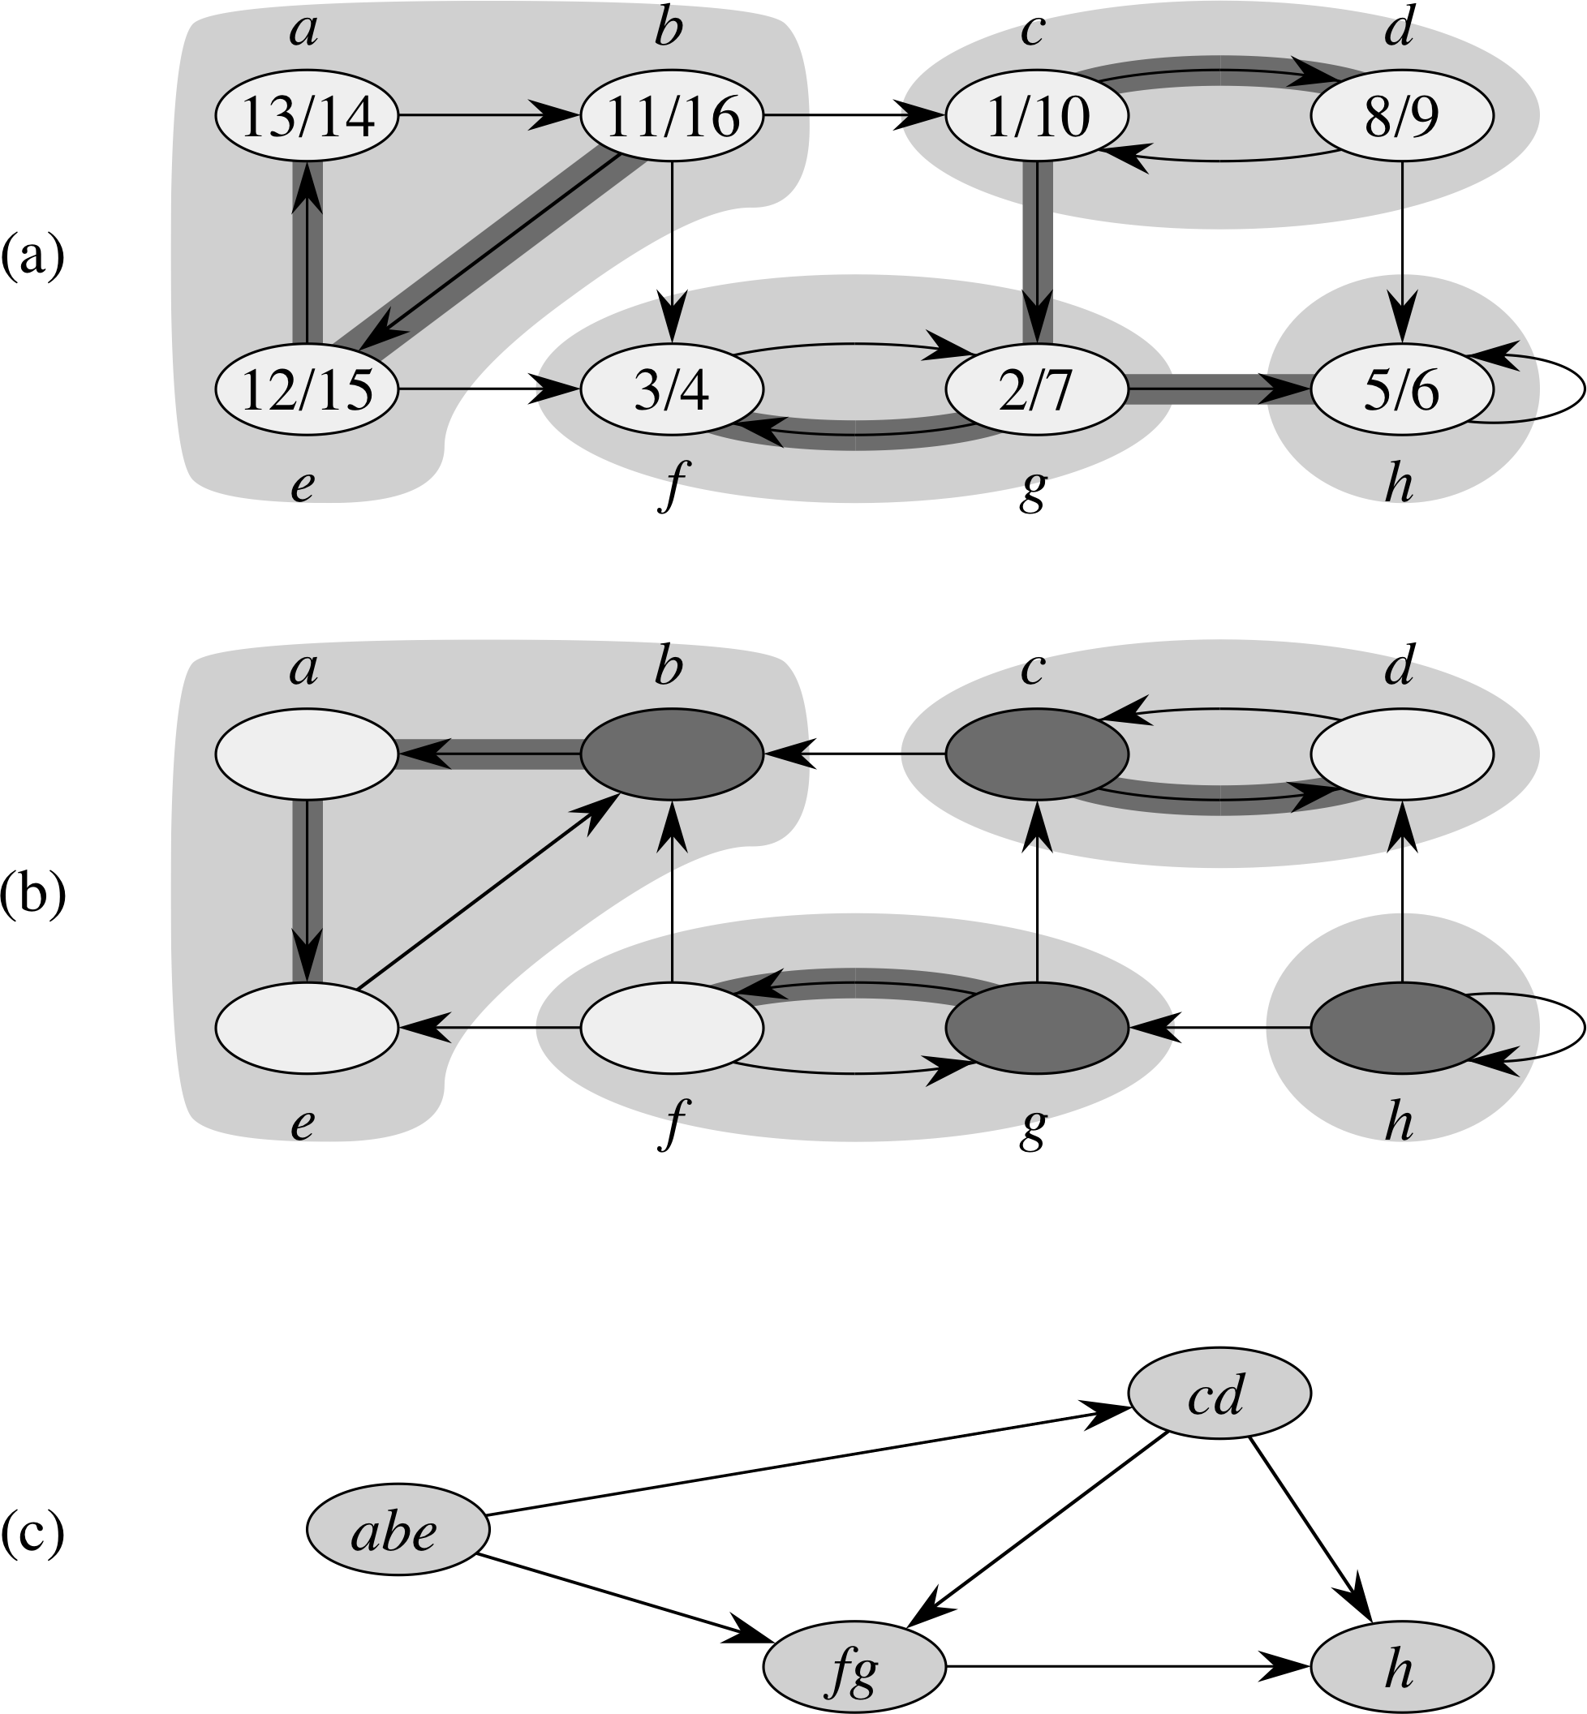
Connected components
Original graph G
and DFS
(DFS tree shaded)
Transpose graph
G^{T} and DFS(G^{T})
  Start DFS at highest-finish (b.fin == 16)
Combine vertices: component graph

