Slide 1
ch23: Minimum Spanning Tree ch24: Single-Source
Shortest Path
12 Nov 2013
CMPT231
Dr. Sean Ho
Trinity Western University

Slide 2
Outline for today
Minimum spanning tree
  Generic solution outline
  Kruskal's algorithm (builds a forest)
  Prim's algorithm (builds a tree)
  Uniqueness of MST
Single-source shortest paths
  Properties / lemmas about shortest paths
  Bellman-Ford algorithm (neg weight allowed)
  Special case if no cycles (DAG)
  Dijkstra's algorithm (no neg weight)

Slide 3
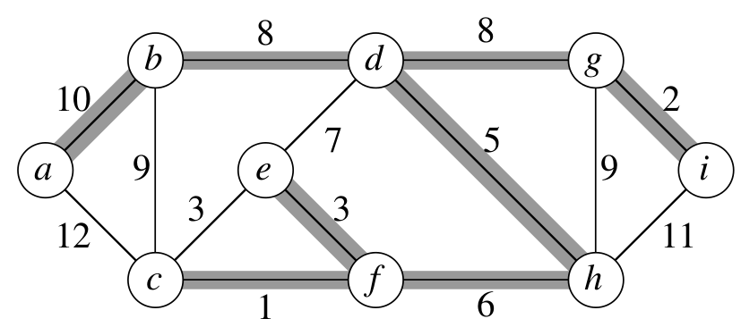
Minimum spanning tree
Given a connected, undirected graph G=(V,E)
  with weights w(u,v) on each edge (u,v) ∊ E
Find tree T ⊆ E that
  Connects all vertices
  Minimising total weight
  w(T) = Σ_{T} w(u,v)
Why must T be a tree? # edges in T? Unique?
Applications: elec wiring in Moravia (Borůvka)
  Utilities: gas/elec/water, Internet routing
  Image analysis, registration, handwriting recog

Slide 4
Generic MST solution outline
Build up solution A one edge at a time:
    Start with A = ∅
    while A is not a spanning tree:
      find a safe edge (u,v) to add
      add it to A
  Loop iterates exactly |V|-1 times
What do we mean by a safe edge (u,v)?
  if A is a subset of a MST, then
  A ∪ (u,v) is still a subset of some MST
  So adding (u,v) to A doesn't prevent us from finding a MST
How do we find safe edges?

Slide 5
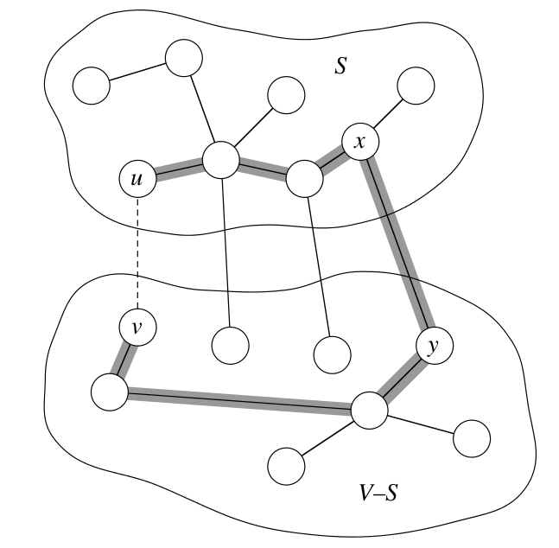
Safe edges across the cut
Let A ⊆ E be a subset of some MST:
  Let (S, V-S) be a cut: partitions the vertices
  An edge (u,v) crosses the cut iff u ∊ S, v ∊ V-S
  A cut respects A iff no edge in A crosses the cut
  An edge is a light edge crossing the cut iff its weight is minimum over all edges crossing cut
Theorem: Any light edge (u,v)
crossing a cut (S, V-S)
that respects A
⇒ (u,v) is a safe edge for A
solid lines: T
highlight: path u → v

Slide 6
Proof of safe edge theorem
Proof by “cut-and-paste”:
  Let T be a MST such that A ⊆ T
  If (u,v) ∉ T, modify T so it is
T is a tree ⇒ ∃ unique path u → v
Path must cross the cut (S,V-S):
pick a crossing edge, call it (x,y)
  Since cut respects A, (x,y) ∉ A
(u,v) is a light edge crossing cut ⇒ w(u,v) ≤ w(x,y)
Swap out edge: let T' = T – {(x,y)} ∪ {(u,v)}:
  w(T') ≤ w(T), so T' is also a MST
  A ∪ {(u,v)} ⊆ T', so (u,v) is safe for A

Slide 7
Outline for today
Minimum spanning tree
  Generic solution
  Kruskal's algorithm
  Prim's algorithm
  Uniqueness of MST
Single-source shortest paths
  Properties / lemmas about shortest paths
  Bellman-Ford algorithm
  Special case if no cycles (DAG)
  Dijkstra's algorithm

Slide 8
Kruskal's algorithm
Each vertex starts as its own component
Merge components by choosing light edges
  Scan edge list in increasing order of weight
Use disjoint-set ADT to find crossing edges
    Kruskal(V, E, w):
      A = ∅
      for each v ∊ V: MakeSet(v)
      sort E by weight w
      for each (u,v) ∊ E in order:
        if FindSet(u) ≠ FindSet(v): // crossing, so safe
          A = A ∪ {(u,v)}
          Union(u, v)
      return A

Slide 9
Kruskal: running time
Init components: |V| * MakeSet
Sort edge list by weight: |E| lg(|E|)
Main for loop: |E| * FindSet, and |V| * Union
Disjoint-set forest with union by rank and path compression (see ch21):
  FindSet and Union are O(α(V))
    α() is the inverse of the Ackermann function;
    very slow growing, α(n) ≤ 4 for all reasonable n
  ⇒ O(V + E lg E + E α(V) + V α(V)) = O(E lg E)
    note that |V| - 1 ≤ |E| ≤ |V|²
  Even better if edges pre-sorted: O(E α(V)),
  essentially linear time in |E|

Slide 10
Outline for today
Minimum spanning tree
  Generic solution
  Kruskal's algorithm
  Prim's algorithm
  Uniqueness of MST
Single-source shortest paths
  Properties / lemmas about shortest paths
  Bellman-Ford algorithm
  Special case if no cycles (DAG)
  Dijkstra's algorithm

Slide 11
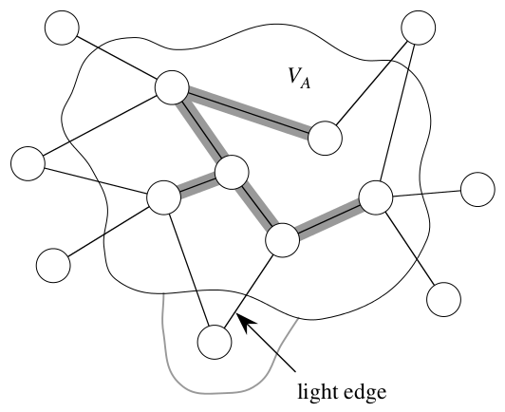
Prim's algorithm
Start from arbitrary root r
Build tree by adding light edges
crossing (V_{A}, V-V_{A})
  V_{A} = vertices incident on A
Use priority queue Q to store vertices in V-V_{A}:
  key (priority) of vertex v is min{w(u,v): u ∊ V_{A}}
So ExtractMin() returns v such that
(u,v) is a light edge crossing (V_{A}, V-V_{A})
At each iteration, A is always a tree, and
    A = {(v, v.parent): v ∊ V – {r} – Q}
    Final MST is encoded in the parent links

Slide 12
Prim: pseudocode
    Prim(V, E, w, r):
      Q = new PriorityQueue(V)
      DecreaseKey(Q, r, 0) // set r.key = 0
      while Q not empty:
        u = ExtractMin(Q)
        for each v ∊ Adj(u):
          if v ∊ Q and w(u,v) < v.key:
            v.parent = u
            DecreaseKey(Q, v, w(u,v))
v | key | prt
a | ∞ | -
b | ∞ | -
c | ∞ | -
d | ∞ | -
e | ∞ | -
f | ∞ | -
g | ∞ | -
h | ∞ | -
i | ∞ | -

Slide 13
Prim: running time
Initialise queue: |V| * Insert
1 * DecreaseKey on root
Main loop: |V| * ExtractMin + O(E) * DecreaseKey
Using binary max-heaps to implement queue:
  Insert, ExtractMin, DecreaseKey are all O(lg V)
  ⇒ O(V lg V + lg V + V lg V + E lg V)
  = O(E lg V)
Using Fibonacci heaps (ch19) instead, DecreaseKey can be done in O(1) amortised time
  ⇒ O(V lg V + E)

Slide 14
Outline for today
Minimum spanning tree
  Generic solution
  Kruskal's algorithm
  Prim's algorithm
  Uniqueness of MST
Single-source shortest paths
  Properties / lemmas about shortest paths
  Bellman-Ford algorithm
  Special case if no cycles (DAG)
  Dijkstra's algorithm

Slide 15
Uniqueness of MST
In general, there may be multiple MSTs for a graph
(p.630, 23.1-6): If every cut of the graph has a unique light edge crossing it, then MST is unique:
  Let T, T' be two MSTs of the graph
  Let (u,v) ∊ T. We want to show (u,v) ∊ T'
T is a tree ⇒ T – {(u,v)} gives a cut: call it (S, V-S)
(u,v) is a light edge crossing (S, V-S) (ex 23.1-3)
T' must cross the cut, too: call its edge (x, y)
  (x,y) is also a light edge crossing (S, V-S)
By assumption, the light edge is unique
  Hence (u,v) = (x,y), and so (u,v) ∊ T'

Slide 16
Outline for today
Minimum spanning tree
  Generic solution
  Kruskal's algorithm
  Prim's algorithm
  Uniqueness of MST
Single-source shortest paths
  Properties / lemmas about shortest paths
  Bellman-Ford algorithm
  Special case if no cycles (DAG)
  Dijkstra's algorithm

Slide 17
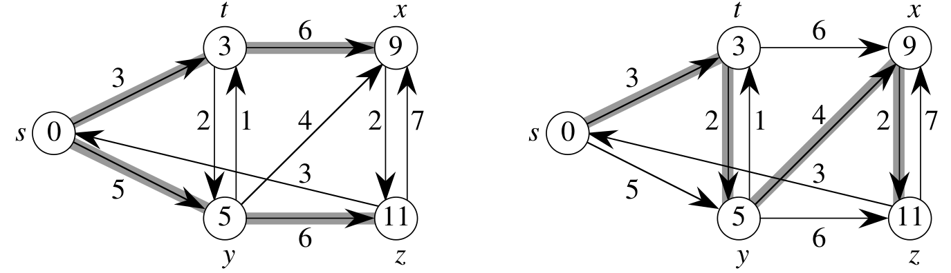
Shortest-path problems
Input: directed graph G=(V, E), edge weights w
Task: Find shortest paths between vertices
  For a path p = (v₀, …, v_{k}): w(p) = Σ w(v_{i-1}, v_{i})
  Shortest-path weight δ(u,v) = min(w(p))
    (or ∞ if v is not reachable from u)
Shortest-path not always unique
Organised as tree rooted at source
w
δ

Slide 18

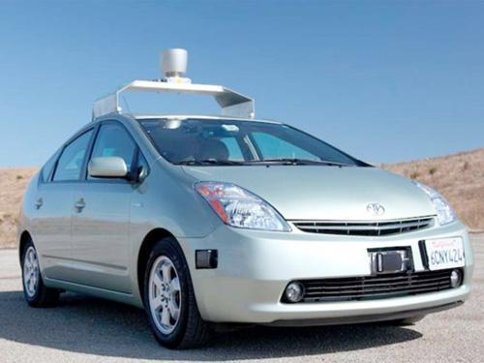

Applications of shortest-path
Willow Garage
GPS/maps: turn-by-turn directions
  All-pairs: optimise a fleet of trucks
  Logistics / operations research
Networking: optimal routing
Robotics, self-driving: path planning
Layout: factory/plant, VLSI chip design
“Six degrees”: path to a celebrity
Solving puzzles a la Rubik's Cube:
  V = states, E = transitions/moves
Intel Haswell

Slide 19
Shortest-path variants
Single-source: fix source s ∊ V, and find shortest paths from s to every other vertex v ∊ V
Single-destination: similarly for destination
Single-pair: given u,v ∊ V, find shortest path
  No better way known than using single-source
All-pairs: simultaneously find shortest paths for all possible sources and destinations (ch25)
Negative-weight edges: usually allowable
  As long as there are no net-negative cycles!
  Cycles with net weight ≥0 don't help, either

Slide 20
Generic outline of solutions
Output: for each vertex v ∊ V,
  v.d: shortest-path estimate
    Initialised to ∞ (except s.d=0). Always ≥ δ(s,v), and
    progressively reduced until v.d = δ(s,v) at solution
  v.parent: links form shortest-path tree
Edge relaxation: can we improve the shortest-path estimate for v by using the edge (u,v)?
    Relax(u, v, w):
      if v.d > u.d + w(u,v):
        v.d = u.d + w(u,v)
        v.parent = u
All our single-source shortest-path algorithms start by initialising v.d, v.parent, then relaxing edges

Slide 21

Optimal substructure
Any subpath of a shortest path is a shortest path:
  Cut-and-paste proof:
  Let p = p_{ux} + p_{xy} + p_{yv} be a shortest path u→v:
    δ(u,v) = w(p) = w(p_{ux}) + w(p_{xy}) + w(p_{yv})
  Let p'_{xy} be a shorter path x→y: w(p'_{xy}) < w(p_{xy})
  Then we can build a shorter path p' for u→v:
    p' = p_{ux} + p'_{xy} + p_{yv}
    w(p') = w(p_{ux}) + w(p'_{xy}) + w(p_{yv})
    < w(p_{ux}) + w(p_{xy}) + w(p_{yv}) = w(p)
  This contradicts the assumption that p was the shortest path for u→v

Slide 22
Properties / lemmas
Triangle inequality: δ(s,v) ≤ δ(s,u) + w(u,v)
Upper-bound property: v.d ≥ δ(s,v) always,
and once v.d = δ(s,v), it never increases again
  Relaxing an edge can only lower v.d
No-path property: if δ(s,v)=∞, then v.d=∞ always
Convergence property:
if s ↝ u → v is a shortest path with u.d = δ(s,u), then after Relax(u,v,w), we will have v.d = δ(s,v)
  By optimal substruct: δ(s,u) + w(u,v) = δ(s,v)
Path relaxation property:
if p = (v₀=s, …, v_{k}) is a shortest path to v_{k}, then after relaxing its edges in order: v_{k}.d = δ(s,v_{k})

Slide 23
Outline for today
Minimum spanning tree
  Generic solution
  Kruskal's algorithm
  Prim's algorithm
  Uniqueness of MST
Single-source shortest paths
  Properties / lemmas about shortest paths
  Bellman-Ford algorithm
  Special case if no cycles (DAG)
  Dijkstra's algorithm

Slide 24
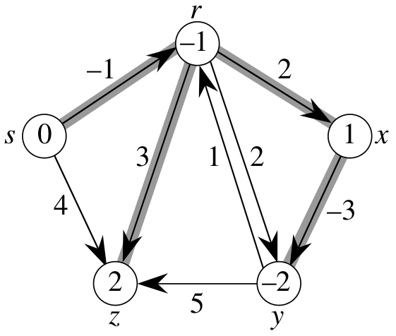
Bellman-Ford algorithm
Allows negative-weight edges
  Returns FALSE if net-negative cycle is reachable
Relax every edge, |V|-1 times:
    BellmanFord(V, E, w, s):
      InitSingleSource(V, E, s)
      for i = 1 to |V|-1:
        for each (u,v) ∊ E:
          Relax(u,v,w)
      for each (u,v) ∊ E:
        if v.d > u.d + w(u,v)
          return FALSE
Convergence: shortest paths have ≤ |V|-1 edges
  Each iteration relaxes one edge along path
  p = (v₀=s, …, v_{k}), so |V|-1 iterations is enough
Run time: Θ(VE)

Slide 25
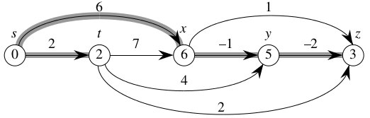
Single-source in a DAG
Directed acyclic graph: no worries about cycles
Pre-sort vertices by topological sort:
  For all paths, edges are relaxed in order
  Don't need to iterate |V|-1 times over edges
    ShortestPathDAG(V, E, w, s):
      TopologicalSort(V, E)
      InitSingleSource(V, E, s)
      for each u ∊ V in topo order:
        for each v ∊ Adj(u):
          Relax(u,v,w)
Time: Θ(V+E)!

Slide 26
Outline for today
Minimum spanning tree
  Generic solution
  Kruskal's algorithm
  Prim's algorithm
  Uniqueness of MST
Single-source shortest paths
  Properties / lemmas about shortest paths
  Bellman-Ford algorithm
  Special case if no cycles (DAG)
  Dijkstra's algorithm

Slide 27
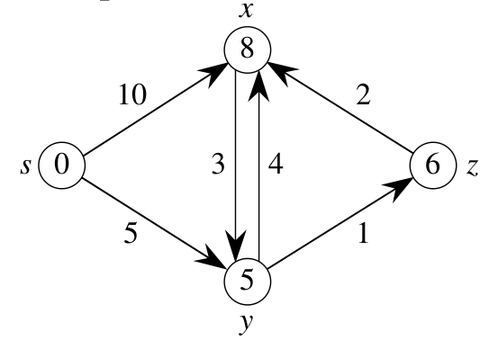
Dijkstra's algorithm
No negative-weight edges allowed
Weighted version of breadth-first search
Use priority queue instead of FIFO
  Keys are the shortest-path estimates v.d
  Similar to Prim's algo but calculating v.d
    Dijkstra(V, E, w, s):
      InitSingleSource(V, E, s)
      Q = new PriorityQueue(V)
      while Q not empty:
        u = ExtractMin(Q)
        for each v ∊ Adj(u):
          Relax(u,v,w)
Greedy choice: select u with lowest u.d

Slide 28
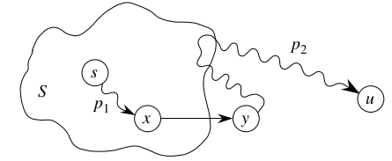
Dijkstra: correctness
Loop invariant: at top of loop, u.d = δ(s,u) ∀ u ∉ Q
Proof: suppose not: let u be the first vertex removed from Q that has u.d ≠ δ(s,u)
  ∃ path s ↝ u (otherwise, u.d = ∞ = δ(s,u))
  Let p be a shortest path s ↝ u, and let (x,y) be the first edge in p crossing from !Q to Q
    Then x.d = δ(s,d) (as u is first to have u.d ≠ δ(s,u))
  (x,y) was then relaxed, so y.d = δ(s,y) (convgc)
    y on shortest path, so δ(s,y) ≤ δ(s,u) ≤ u.d
  But both y,u ∊ Q when ExtractMin, so u.d ≤ y.d
  Hence y.d = u.d, so u.d = δ(s,u), contradiction

Slide 29
Dijkstra: running time
Init for weights and Q takes Θ(V)
ExtractMin is run exactly |V| times
DecreaseKey (called by Relax) is run O(E) times
Using binary max-heaps:
  All operations are O(lg V)
  ⇒ Total time O(E lg V)
Using Fibonacci heaps:
  ExtractMin takes O(1) amortised time
  Other operations total O(V) ops
  with amortised time O(lg V) each
  ⇒ Total time O(V lg V + E)

