Slide 1
▶
MovieLens Recommender Explorer
Seven algorithms, one evaluation lens — and why accuracy is not enough
Sean Hoet
ESADE MiBA · Recommender Systems
Prof. Marc Torrens

Slide 2
THE PROBLEM
The paradox of choice
9,724 movies. 610 users. Only 1.7% of the ratings matrix is filled. How do we find the right 10 films for each person?
9,724
610
100,836
1.7%
movies
users
ratings
matrix density
The core tension: more data means better personalisation, but extreme sparsity, popularity bias and over-specialisation pull in opposite directions. A good recommender has to balance them.
MovieLens Recommender Explorer · Sean Hoet · ESADE MiBA
2

Slide 3
SYSTEM DESIGN
One interface, seven algorithms
Every recommender implements the same BaseRecommender contract — fit() · recommend() · predict() — so they plug into a single evaluation harness and UI.
Non-personalised
Collaborative filtering
Content-based
Latent factor
Top-N · Bayesian · Associations
User-CF · Item-CF
TF-IDF tags + genre vectors
Matrix Factorisation (SVD)
HYBRID (SVD + Content, α = 0.6)
Min-max normalises each model's scores, then blends accuracy (SVD) with novelty/coverage (content-based). Same shared evaluation as every other method.
MovieLens Recommender Explorer · Sean Hoet · ESADE MiBA
3

Slide 4
ALGORITHM 1 · BASELINE
Non-personalised recommenders
HOW IT WORKS
Top-N: rank items purely by number of ratings — a strong popularity baseline.
Bayesian weighted rating: shrinks small-sample averages toward the global mean (IMDb formula).
Product associations: lift between co-liked items, seeded from each user's favourite.
0.065
0.086
Precision@10
NDCG@10
1.53
1.00
Key challenge No personalisation and 100% popularity bias for Top-N. Best used only for cold-start.
Novelty
Pop. bias
MovieLens Recommender Explorer · Sean Hoet · ESADE MiBA
4

Slide 5
ALGORITHM 2
User-based collaborative filtering
HOW IT WORKS
Builds the user×item matrix and computes Pearson similarity between mean-centred users.
Prediction = user mean + similarity-weighted deviations of the k = 50 nearest neighbours.
Vectorised top-k neighbour lookup for speed.
0.003
0.004
Precision@10
NDCG@10
6.34
0.13
Key challenge Sparsity (1.7% filled) makes overlaps tiny, so neighbour estimates are noisy — low precision but good coverage.
Novelty
Pop. bias
MovieLens Recommender Explorer · Sean Hoet · ESADE MiBA
5

Slide 6
ALGORITHM 3
Item-based collaborative filtering
HOW IT WORKS
Adjusted-cosine similarity between items (centred by user mean to remove rating bias).
Caches each item's top-k similar items; filters items with < 10 ratings for stability.
Recommends items similar to the ones the user already rated highly.
0.012
0.014
Precision@10
NDCG@10
4.58
0.44
Key challenge More stable than user-CF and easy to cache, but trades discovery for consistency.
Novelty
Pop. bias
MovieLens Recommender Explorer · Sean Hoet · ESADE MiBA
6

Slide 7
ALGORITHM 4
Content-based filtering
HOW IT WORKS
Item vectors = genre one-hot + TF-IDF over user tags, L2-normalised.
User profile = rating-weighted, mean-centred average of the items they rated.
Scores unseen items by cosine similarity to that profile.
0.002
0.003
Precision@10
NDCG@10
7.68
0.07
Key challenge Over-specialisation: it keeps recommending the user's existing niche — the tightest filter bubble (see slide 12).
Novelty
Pop. bias
MovieLens Recommender Explorer · Sean Hoet · ESADE MiBA
7

Slide 8
ALGORITHM 5
Matrix factorisation (SVD)
HOW IT WORKS
Mean-centres the user×item matrix, then factorises with truncated SVD (k = 50 latent factors).
Reconstructs a dense predicted-rating matrix from the latent space.
Captures hidden taste dimensions that explicit features miss.
0.078
0.105
Precision@10
NDCG@10
2.44
0.98
Key challenge Best accuracy of all methods — but the popular-item bias returns (0.98). Generalises well from sparse data.
Novelty
Pop. bias
MovieLens Recommender Explorer · Sean Hoet · ESADE MiBA
8

Slide 9
ALGORITHM 6
Hybrid (SVD + Content-Based)
HOW IT WORKS
Pulls a candidate pool from both SVD and content-based models.
Min-max normalises each model's scores to [0,1], then blends: α·SVD + (1−α)·Content, α = 0.6.
Tunable dial between accuracy and discovery.
0.043
0.075
Precision@10
NDCG@10
4.69
0.58
Key challenge Deliberately sacrifices some precision to roughly halve popularity bias and lift coverage and novelty.
Novelty
Pop. bias
MovieLens Recommender Explorer · Sean Hoet · ESADE MiBA
9

Slide 10
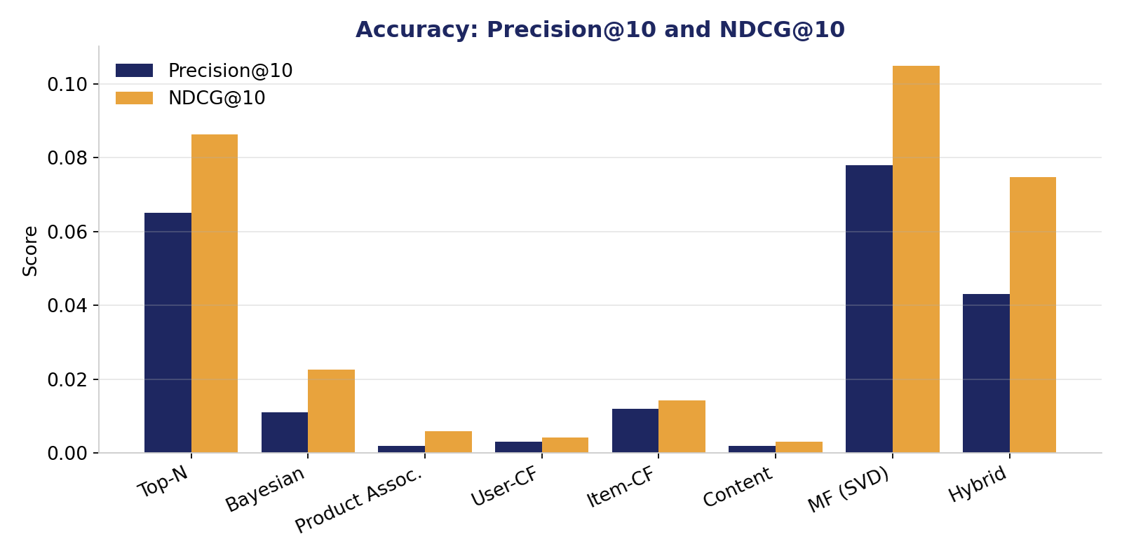
METHOD COMPARISON · PART 1
The accuracy view
What accuracy says
MF (SVD) wins
0.078 Precision@10 — even beating the popularity baseline.
Top-N is a strong baseline
Hard to beat on raw hit-rate because popular films are safe bets.
Personalised ≠ more accurate
User-CF & content score low here — but that is only half the story.
MovieLens Recommender Explorer · Sean Hoet · ESADE MiBA
10

Slide 11
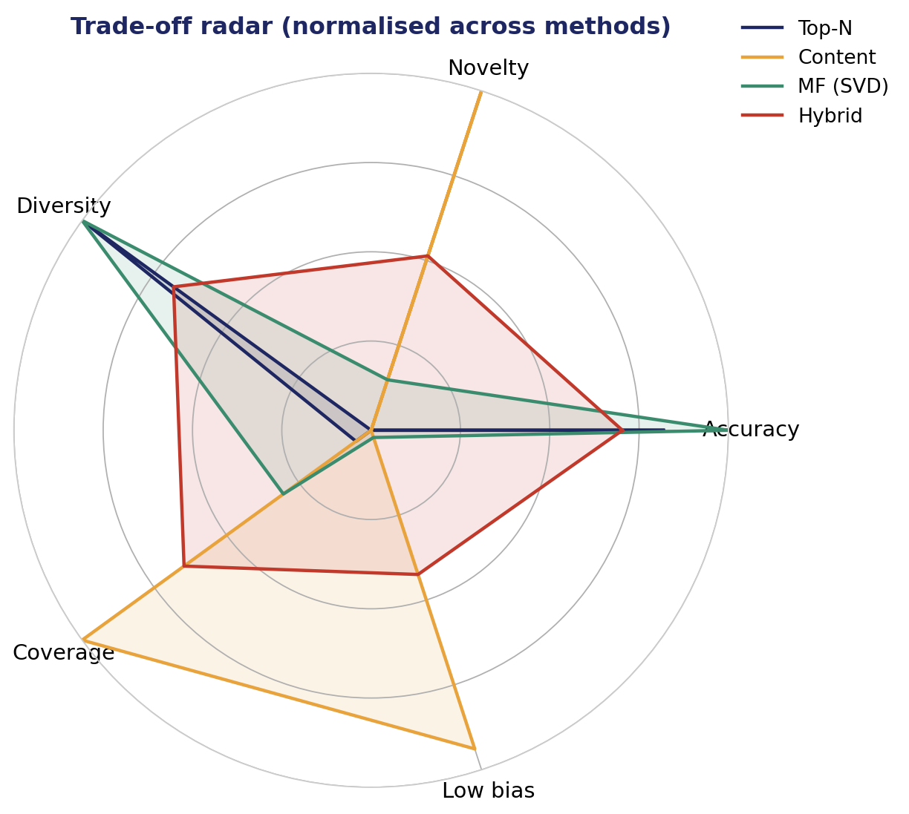
METHOD COMPARISON · PART 2
The full picture: no single winner
Five dimensions, normalised across methods
Top-N / MF (SVD): stretch toward accuracy, collapse on novelty & low-bias.
Content-Based: owns novelty, coverage and low bias — but almost no accuracy.
Hybrid: the most balanced shape — decent on every axis, dominant on none.
Takeaway: every method is a different compromise. Choosing one means choosing which trade-off you can live with.
MovieLens Recommender Explorer · Sean Hoet · ESADE MiBA
11

Slide 12
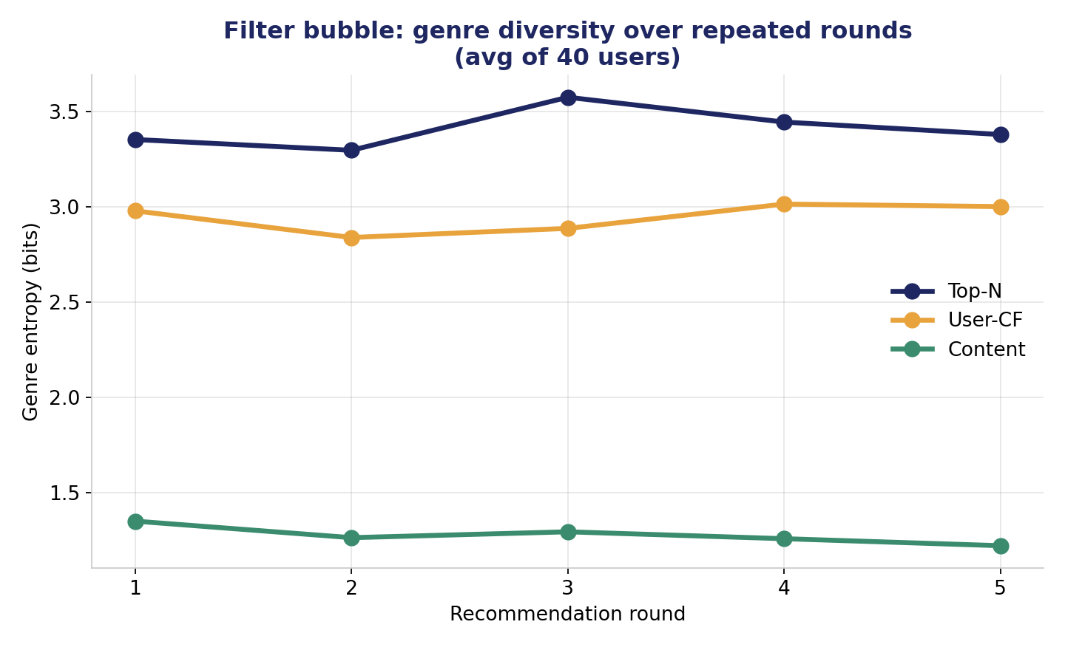
BEYOND ACCURACY
The filter bubble problem
Eli Pariser, The Filter Bubble (2011)
We simulate a user who watches everything recommended, 5 rounds deep, and track genre entropy.
The surprise: content-based — the most personalised method — sits in the tightest bubble (entropy ≈ 1.2). It keeps serving the user's existing niche.
Top-N stays diverse (≈ 3.4) only because it ignores the individual and shows everyone the same broad blockbusters.
Personalisation and diversity can directly conflict — beyond-accuracy metrics expose it.
MovieLens Recommender Explorer · Sean Hoet · ESADE MiBA
12

Slide 13
REFLECTION
Technical challenges
Sparsity
Cold start
Only 1.7% of the user×item matrix is filled — neighbour overlaps are tiny and estimates noisy.
New users and items have no history; only non-personalised methods can respond.
Computational cost
Feature engineering
User-CF similarity is O(n²m); item-CF and SVD trade memory for cached structure.
Content-based quality hinges on tag/genre quality and profile weighting choices.
MovieLens Recommender Explorer · Sean Hoet · ESADE MiBA
13

Slide 14
FINAL REMARKS
Accuracy is necessary — not sufficient
1
Evaluate beyond accuracy Precision alone rewards popularity. Novelty, coverage, diversity and bias reveal what users actually experience.
2
Real systems are hybrids No single algorithm dominates. Blending models lets you tune the accuracy–discovery dial deliberately.
3
Explanations build trust 'Liked by similar users', 'Matched: Action · Thriller' — transparency and control matter as much as the ranking.
4
Mind the bubble The most personalised method created the narrowest world. Diversity must be designed in, not assumed.
MovieLens Recommender Explorer · Sean Hoet · ESADE MiBA
14

Slide 15
APPENDIX
Evaluation methodology
Split
Per-user temporal split — last 20% of each user's ratings held out as test.
Test sample
100 users, top-10 recommendations, relevance threshold ≥ 4.0★.
Accuracy metrics
MAE, RMSE, Precision@10, Recall@10, NDCG@10, MRR.
Beyond-accuracy
Coverage, Novelty (self-information), Intra-list diversity, Popularity bias.
Built in Python — pandas · numpy · scikit-learn · scipy — with a Streamlit UI and Plotly analytics.
MovieLens Recommender Explorer · Sean Hoet · ESADE MiBA
15

