Slide 1

MovieLens · RecSys
Building a Recommender System From Scratch
11 methods on MovieLens, measured beyond accuracy.
11
12
Sean Hoet
methods, one interface
metrics tracked
ESADE MiBA · Recommender Systems · Prof. Marc Torrens · June 2026
Notes:
My individual assignment: I built 11 recommender algorithms from scratch on MovieLens and evaluated them on accuracy and beyond-accuracy metrics. The thesis of the whole deck: accuracy and discovery are in tension.

Slide 2
Foundation
Methods
Results
Reflection
MovieLens · RecSys
Dataset & EDA
Rating distribution
MovieLens Latest Small — a per-user chronological 80/20 split , not random, so the model never trains on a user's future ratings.
count per star value · 0.5 → 5.0
98.3%
100,836
of the user-item matrix is empty
ratings · 610 users · 9,742 movies
Generous raters. Ratings are left-skewed — most cluster at 3–4 stars.
A long tail. User activity and item popularity both follow a power law.
Genre concentration. Drama and Comedy dominate — the seed of popularity bias.
0.5
1
1.5
2
2.5
3
3.5
4
4.5
5
02 / 12
Notes:
The data: 100k ratings, 610 users, 98% sparse. Three EDA findings drive everything downstream — generous left-skewed ratings, a power-law long tail, and Drama/Comedy dominance that will surface as popularity bias. I split temporally per user to avoid leakage.

Slide 3
Foundation
Methods
Results
Reflection
MovieLens · RecSys
One interface, eleven methods
Baselines
Non-Personalised
Collaborative
Content-Based
Matrix Fact.
Hybrid
→
→
→
→
→
3 methods
3 methods
2 methods
1 method
1 method
1 method
A shared fit / recommend / predict contract (BaseRecommender ABC) runs the same data, metrics and test harness across every algorithm — so the comparison is genuinely fair.
0.769
0
The baseline paradox: User Average is the best rating estimator yet a useless ranker . MAE alone misleads.
best MAE of all 11
Precision@10
03 / 12
Notes:
Every one of the 11 methods implements the same fit / recommend / predict interface — a BaseRecommender ABC. That uniformity made a fair, single test harness possible. And the baselines aren't throwaways: User Average has the best MAE of any method, 0.769, yet zero Precision — it estimates ratings well but ranks nothing. Without a floor, 0.078 Precision means nothing.

Slide 4
Foundations
Method
Results
Reflection
MovieLens · RecSys
Popularity, done carefully
WR(j) =v/(v+m)·Ū(j) + m/(v+m)·C
Bayesian Weighted Rating
Product Associations
Top-N Most Popular
Shrinks small-sample items toward the global mean — 3 five-star ratings shouldn't outrank 500 ratings at 4.7.
Lift = P(X,Y) / [P(X)·P(Y)] rewards genuinely surprising co-occurrences, not just common items.
Ranks by rating count. Competitive list quality — at the cost of maximum popularity bias.
1.000 → 0.255
0.011
1.000
popularity bias vs. raw Top-N
lowest popularity bias of any method
every pick from the most-popular items
04 / 12
Notes:
Popularity done carefully. Bayesian weighting shrinks small-sample items toward the global mean — three five-star ratings shouldn't beat 500 ratings averaging 4.7. It cuts popularity bias from 1.000 to 0.255. And lift over raw conditional probability rewards surprising co-occurrences, giving associations the lowest bias of all.

Slide 5
Foundations
Method
Results
Reflection
MovieLens · RecSys
Collaborative filtering
User-Based CF
Item-Based CF
Pearson correlation over co-rated items only. Deviation-from-mean prediction normalises users who rate on different scales.
Adjusted cosine: subtract each user's mean before the dot product, removing individual rating-scale bias so similarity reflects genuine preference.
Why k = 50 : precision peaks around 50 neighbours, then plateaus. More neighbours add noise, not signal.
Cached top-k item neighbourhood with a minimum-10-ratings filter.
0.012 > 0.003
Item-CF beats User-CF on Precision@10 — item neighbourhoods are more stable because items accumulate ratings faster than users do.
05 / 12
Notes:
Two CF variants. User-CF uses Pearson over co-rated items with deviation-from-mean prediction; k=50 because precision peaks there then plateaus. Item-CF uses adjusted cosine — subtract each user's mean first, removing rating-scale bias. Item-CF wins on precision because item neighbourhoods are more stable than user ones.

Slide 6
Foundations
Method
Results
Reflection
MovieLens · RecSys
Features, factors & a hybrid
Content-Based
Matrix Factorisation
Hybrid
TF-IDF over tags + genres + year; user profile = centred-rating weighted sum of item vectors. IDF down-weights noisy common tags.
Truncated SVD, 50 latent factors. Captures abstract patterns — "cerebral thrillers" — with no explicit features. The accuracy winner.
SVD's ranking power, with Content-Based pulling picks away from the popularity cluster. A live α slider in the prototype.
0.108
0.077
0.078
0.979
α·SVD + (1−α)·CB, α=0.6
coverage — highest
diversity — lowest
Precision@10 — best
popularity bias
06 / 12
Notes:
Content-Based uses TF-IDF over tags, genres and year, with a centred-rating user profile — highest coverage but lowest diversity, a feature-space echo chamber. SVD with 50 latent factors is the accuracy winner but near-maximum popularity bias. The Hybrid blends them 0.6/0.4 — SVD's ranking power, pulled away from the popularity cluster.

Slide 7
Foundations
Methods
Results
Reflection
MovieLens · RecSys
Beyond accuracy
the accuracy leaders score worst on discovery · green = best in column
Method
Prec@10
NDCG
MAE
Coverage
Novelty
Pop.Bias
Serendip.
Random
0.002
0.005
1.617
0.115
7.62
0.062
0.002
User Average
0.000
0.000
0.769
0.001
9.25
0.000
0.000
Item Average
0.000
0.000
0.792
0.001
9.25
0.000
0.000
Top-N Most Popular
0.065
0.086
1.300
0.016
3.66
1.000
0.000
Bayesian Weighted
0.011
0.023
0.783
0.002
5.47
0.255
0.004
Product Associations
0.002
0.006
2.354
0.016
6.91
0.011
0.002
User-Based CF
0.003
0.004
0.767
0.051
6.34
0.130
0.003
Item-Based CF
0.012
0.014
0.756
0.057
4.58
0.436
0.012
Content-Based
0.002
0.003
1.243
0.108
7.68
0.072
0.002
Matrix Factorisation
0.078
0.105
0.761
0.034
2.44
0.979
0.053
Hybrid (SVD + CB)
0.043
0.075
0.873
0.071
4.68
0.582
0.030
07 / 12
Notes:
The whole story in one table. Matrix Factorisation wins ranking — 0.078 Precision — but its popularity bias is 0.979, near the maximum. The accuracy leaders are the discovery losers. Random and the Averages have the best coverage, novelty and diversity, not because they're good but because they have no preference for the popular. The features that make a recommender accurate actively suppress discovery.

Slide 8
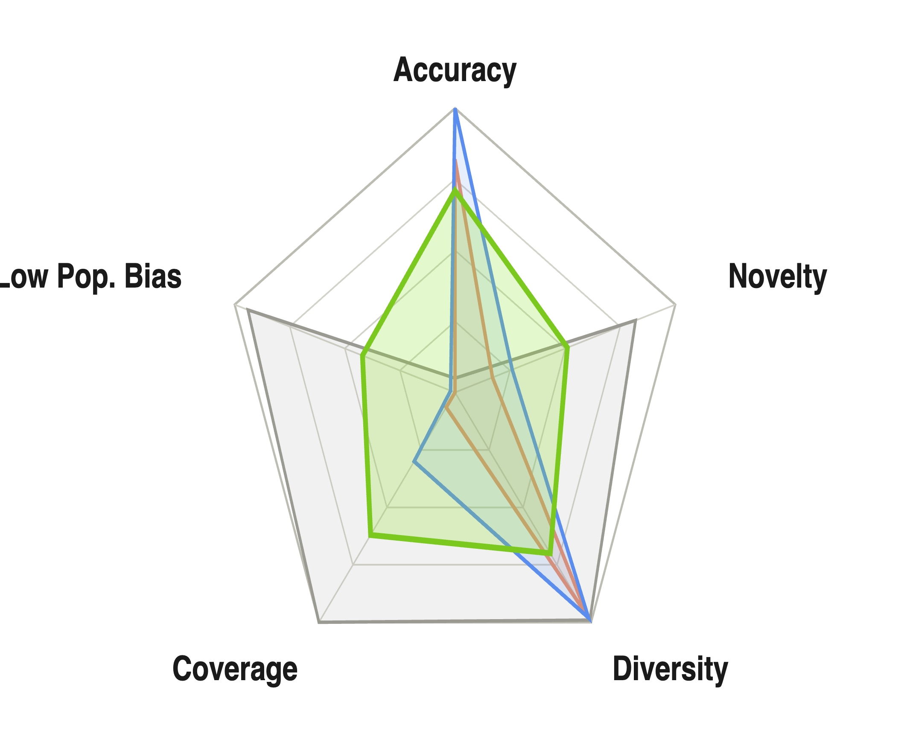
Foundations
Methods
Result
Reflection
MovieLens · RecSys
No method wins everything
Every method trades one strength for another. The radar makes it visible at a glance — and is the clearest justification for building all eleven.
Hybrid — most balanced
SVD — accuracy spike, discovery dip
Top-N — popular, narrow
Random — diverse, irrelevant
08 / 12
Notes:
This is the single most important image in the deck. Five normalised axes. SVD spikes on accuracy and diversity but collapses on coverage and low popularity bias. Random is the mirror image. Hybrid is the most balanced pentagon. No method dominates all five — every one makes a trade-off. That's why I built eleven.

Slide 9
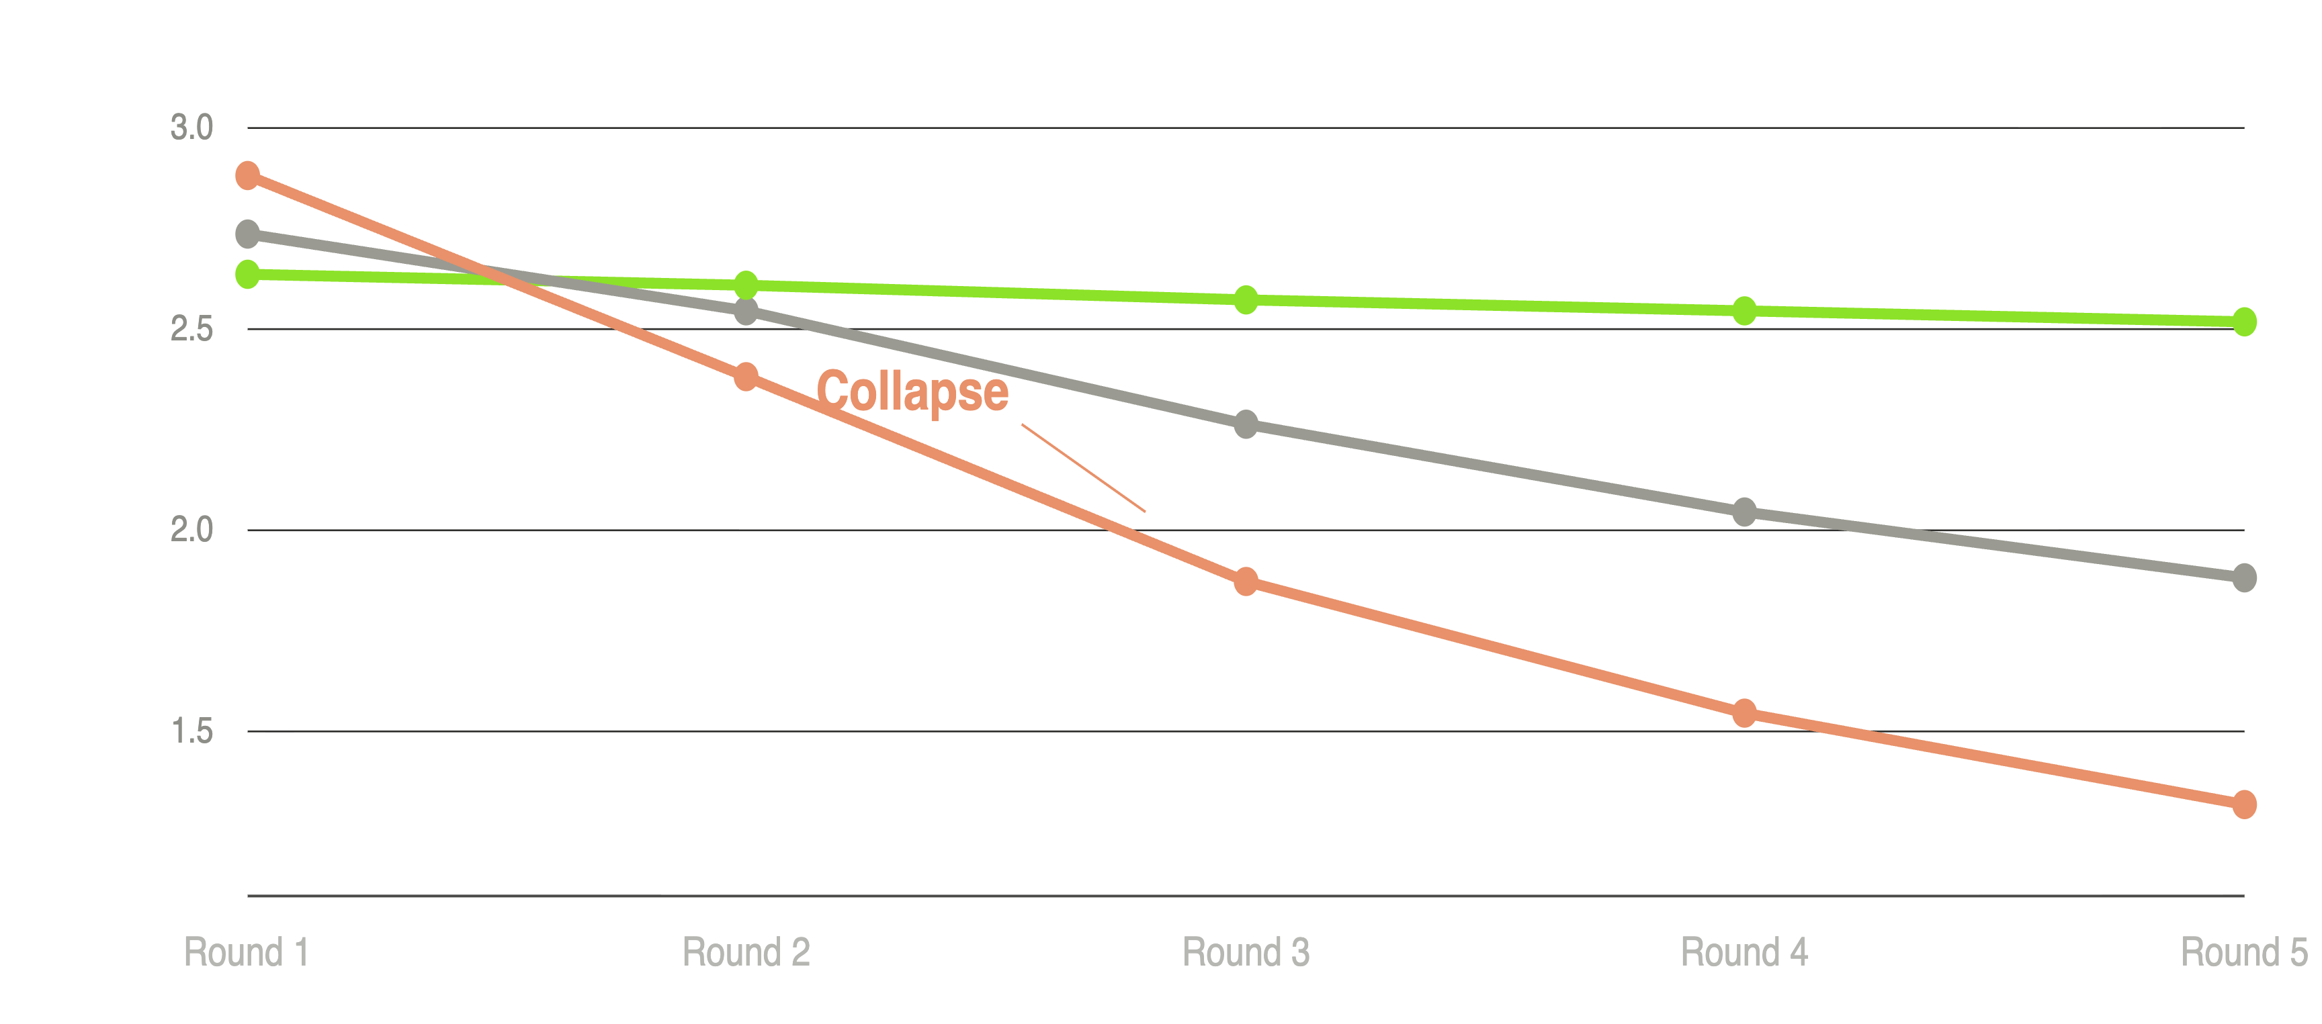
Foundations
Methods
Result
Reflection
MovieLens · RecSys
Top-N doesn't just recommend popular movies. It traps users in them.
Top-N
User-CF
Content-Based
Shannon genre entropy per simulated consumption round. Lower = narrower discovery.
09 / 12
Notes:
The centrepiece. I simulated five rounds of a user following recommendations and tracked genre entropy. Top-N's diversity collapses by round 3 — it amplifies already-dominant genres rather than learning taste. User-CF degrades more slowly. Content-Based holds, because it anchors on item features, not collective behaviour. Pariser named this in 2011; this prototype makes it measurable.

Slide 10
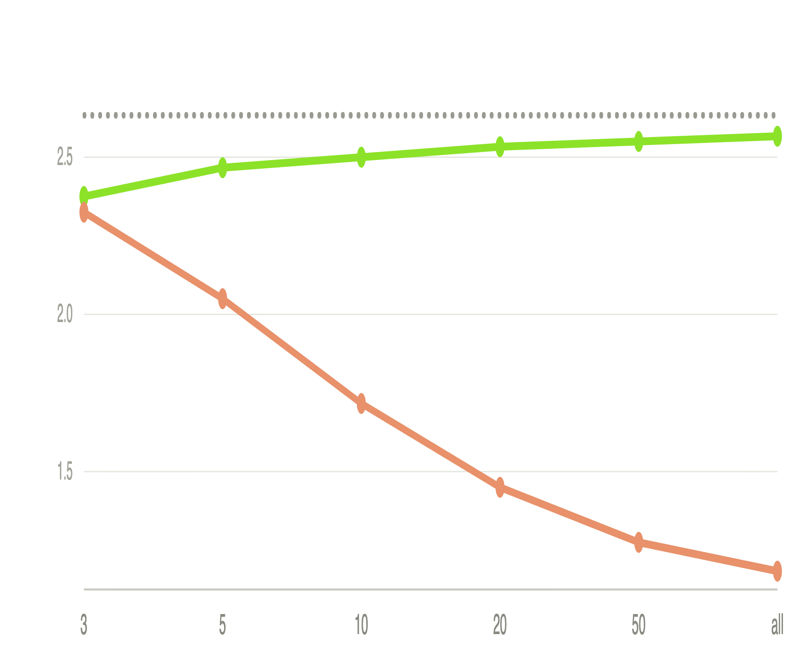
Foundations
Methods
Result
Reflection
MovieLens · RecSys
When does personalisation begin?
Random
Content-Based
Item Average
3
ratings — where Content-Based reaches reasonable diversity. It needs no neighbourhood.
The product play: personalise from signup with Content-Based, then hand off to the Hybrid as history grows. Cold start is a threshold, not a wall.
Genre entropy of recommendations vs. ratings in user history.
10 / 12
Notes:
Reframe cold start as a product question: when does each method become useful? Content-Based delivers reasonable genre diversity at just 3 ratings, because it uses item features, not collaborative signal. Item Average collapses fast toward the most-rated genres. So you can personalise almost immediately after signup with Content-Based, then transition to a hybrid as history grows. Cold start is a threshold, not a wall.

Slide 11
Foundations
Methods
Results
Reflection
MovieLens · RecSys
What I built
A live α slider lets anyone drag between accuracy and discovery and watch the list change.
01
02
03
04
05
EDA
Explorer
Filter Bubble
By Genre
Cold Start
Grounds every claim — sparsity, the long tail, genre distribution.
Recommendations + metrics side by side, with a live comparison radar.
The echo-chamber simulation — interactive and user-selectable.
Netflix-style rows that make picks legible to anyone.
The personalisation-threshold experiment, at every history size.
11 / 12
Notes:
The working Streamlit prototype — five tabs, one purpose each. EDA grounds every claim. Explorer puts recommendations and metrics side by side with a live radar. Filter Bubble is the interactive echo-chamber simulation. By Genre makes it legible to non-technical users. Cold Start is the personalisation-threshold experiment. The live alpha slider lets anyone drag between accuracy and discovery in real time.

Slide 12

Foundations
Methods
Results
Reflection
MovieLens · RecSys
Accuracy and discovery are in tension.
Two honest limitations
Serendipity is relative
Offline ≠ enjoyment
Defined against Top-N — change the baseline and the number changes.
Precision predicts held-out ratings, not whether a user returns.
Optimise purely for precision and the system converges on the same popular items for everyone. Managing that tension — not eliminating it — is the real design challenge.
If I took this further
→
Implicit feedback. Move from explicit stars to watch time and skips — replacing SVD with ALS or BPR.
→
Explanations at scale. "Because you watched X" — transparency as both ethics and product.
→
A/B test the diversity floor. Does it improve long-term engagement, or do users prefer the familiar?
Production recommendation
Hybrid · α = 0.6
0.043
0.030
0.071
Precision@10
Serendipity
Coverage
Thank you.
12 / 12
Notes:
The production recommendation is the Hybrid at alpha 0.6 — the best balance of accuracy, discovery and reach. The single most important insight: accuracy and discovery are in tension, and managing that tension is the real design challenge. Two honest limitations: serendipity is relative to the Top-N baseline, and offline metrics can't measure enjoyment. Next: move to implicit feedback, add explanations, and A/B test the diversity floor.

