Slide 1

MD
MR DIGITAG MAN
WE ADD VALUE, SECURITY & INTELLIGENCE
PREPARED FOR
A PROPOSAL FOR FLYSAFAIR
100% SOUTH AFRICAN-OWNED & OPERATED
EVERY BAG. EVERY PASSENGER.
EVERY RAND — VISIBLE.
A GPS visibility and intelligence network for FlySafair — protecting checked baggage across ±178 daily flights to 15 destinations, closing the theft-and-tampering window South African aviation is famous for, opening a self-funding revenue stream at every check-in and in every ticket sale, and putting Nexas AI to work in every division of the airline.
10.9M
±178
R246M
R3.08B
Passengers a year — 30,000+ every day (FlySafair, 2025)
Daily departures — 1,250+ flights a week, 15 destinations
Modelled annual baggage exposure at SITA's 2026 global benchmark
5-year combined recovery + new-revenue opportunity (modelled)
Prepared for FlySafair (Pty) Ltd | Mr Digitag Man (Pty) Ltd | August 2026 | Commercial in Confidence

Slide 2
EXECUTIVE SUMMARY
The opportunity, in one page
For the airline that carries six in ten of South Africa's domestic passengers, the bag journey is the one part of the operation still flying blind.
R245.8M
Up to R488.9M/yr
500+
No.1
Modelled annual exposure — SITA's 2026 global cost benchmark applied to FlySafair's 10.9M passengers
Potential passenger-funded revenue at a 15% ticket-flow attach rate
Airlines & ground handlers whose WorldTracer tracing system now accepts crowd-find location sharing (SITA, 2,800+ airports)
Most punctual airline in Africa & the Middle East — 2024 (93.82%) and 2025 (91.06%), Cirium
THE CASE, IN THREE SENTENCES
FlySafair is the most punctual airline in Africa and the Middle East two years running (Cirium), moving 30,000+ passengers and roughly 17,900 checked bags every day on 1,250+ weekly flights — and it operates on the continent SITA's 2026 Baggage IT Insights names the world's worst for baggage, at 12.1 mishandled bags per 1,000 passengers against a global average of 4.9. Apply even that global average to FlySafair's 10.9 million passengers and the exposure is ±146 mishandled bags a day — a modelled R245.8 million a year at SITA's R4,602-per-bag benchmark, R1.39 billion over five years, in a country where ACSA runs a standing Baggage Pilferage Prevention Working Group and nine airport employees have been arrested for baggage theft since April 2025 alone. Mr Digitag Man's GPS product family closes that dark window with the same crowd-find ecosystem now wired into WorldTracer at 500+ airlines, funds itself through vending or ticket-flow sales modelled at up to R2.76 billion over five years — and Nexas AI turns the data into working intelligence for every division of the airline.
One airline. One visibility layer. Two ways to fund it — both profitable.
MR DIGITAG MAN | We Add Value, Security & Intelligence | Commercial in Confidence
2 / 31

Slide 3
SECTION 01 · THE OPPORTUNITY
A R112-billion industry problem — even after a record year
SITA Baggage IT Insights 2026 — the industry's own benchmark, built on data from 500+ airlines and 2,800+ airports.
A record 5 billion passengers flew in 2025 — and 24 million bags were still mishandled, even after the global rate improved 23% year-on-year to 4.9 per 1,000 passengers.
Every mishandled bag costs an average of R4,602 ($260); a permanently lost bag costs R11,240 ($635) — the most expensive failure per incident.
1
2
The split: 74% of mishandled bags are delayed, 18% are damaged or pilfered — the share that is rising — and 8% are lost or stolen; 4% are never recovered at all.
The bill: $6.3 billion (≈R112bn) a year — equivalent to 15% of the entire airline industry's 2025 profit.
3
4
Read the trend, not just the total. The 23% improvement came from carriers investing in tracking technology — while the damaged-and-pilfered share climbed to 18%. Routing is being solved; theft and tampering are not. That is precisely the gap this proposal closes for FlySafair — on the continent where it is widest.
MR DIGITAG MAN | We Add Value, Security & Intelligence | Commercial in Confidence
3 / 31

Slide 4
SECTION 01 · THE OPPORTUNITY
Africa is the world's worst region for baggage — officially
SITA 2026: Africa records 12.1 mishandled bags per 1,000 passengers — the highest rate on earth. FlySafair flies in that environment every day.
Africa (international) — world's highest
4.9/1,000
12.1
the global-average benchmark this model applies to FlySafair — ±146 bags a day at 10.9M passengers. At Africa's actual average it would be ±361 a day; the conservative domestic case still leaves ±81.
Middle East
5.0
Global average
4.9
SOUTH AFRICA'S OWN RECORD, ON THE RECORD
▪ ACSA runs a standing Airport Baggage Pilferage Prevention Working Group (ABPPWG) across its airports — a permanent structure, for a permanent problem.
▪ Nine airport employees arrested for baggage-theft offences since April 2025 (ACSA); in January 2024 a tampering-and-theft incident at O.R. Tambo went viral and drew a public ACSA statement.
▪ ACSA is explicit that baggage handling is the airlines' and ground handlers' responsibility — the claim, the cost and the reputational hit land on the carrier.
FlySafair conservative model (point-to-point domestic)
2.7
Bags mishandled per 1,000 passengers, 2025 (SITA Baggage IT Insights 2026). Conservative FlySafair case is a modelling assumption — FlySafair publishes no rate.
The takeaway: FlySafair almost certainly runs far better than Africa's 12.1 average — but it operates inside the world's toughest baggage-crime environment, and its bags are dark from bag-drop to carousel. The next four slides put rand numbers on exactly that.
MR DIGITAG MAN | We Add Value, Security & Intelligence | Commercial in Confidence
4 / 31

Slide 5
SECTION 01 · THE NETWORK
±178 flights a day. Fifteen destinations. One exposed network.
FlySafair's published network, modelled airport by airport — every departure is a batch of bags leaving passengers' sight.
1,250+
Airport
Code
Daily departures
Est. daily boarding pax
O.R. Tambo Int'l, Johannesburg
JNB
58
±9,430
flights a week — 230,000 seats (FlySafair, 2026)
Cape Town International
CPT
46
±7,480
King Shaka Int'l, Durban
DUR
24
±3,900
30,000+
Lanseria International
HLA
12
±1,950
Chief Dawid Stuurman Int'l, Gqeberha
PLZ
10
±1,630
passengers a day — ±10.9M a year
George
GRJ
8
±1,300
King Phalo, East London
ELS
6
±980
±17,900
Bram Fischer Int'l, Bloemfontein
BFN
4
±650
Mbombela (Kruger Mpumalanga)
MQP
3
±490
checked bags a day — ≈6.5M a year (modelled at 60% check-in)
Kimberley
KIM
2
±330
Hoedspruit (Eastgate)
HDS
1
±160
Mauritius (regional)
MRU
2
±330
Indicative peak daily departures modelled from FlySafair's published schedule, August 2026 — frequencies vary by day and season. Financial model uses 10.9M passengers a year (30,000+/day, FlySafair).
Harare (regional)
HRE
2
±330
Zanzibar (regional)
ZNZ
1
±160
Victoria Falls (regional)
VFA
2×/week
—
NETWORK TOTAL
±178
±29,100
MR DIGITAG MAN | We Add Value, Security & Intelligence | Commercial in Confidence
5 / 31

Slide 6
SECTION 01 · THE CHALLENGE
Three ways value leaks — every single day
SITA's 2026 mishandling split applied to FlySafair's volumes at the global benchmark rate: “rare” becomes “daily”.
DELAYED & MISROUTED
DAMAGED & PILFERED
LOST OR STOLEN
±108 bags/day
±26 bags/day
±12 bags/day
39,500 bags a year — 74% of mishandling (SITA 2026). Late, misloaded or left behind: recovery couriering, contact-centre load and goodwill, on an airline famous for punctuality.
9,600 bags a year — 18% of mishandling, the only share that ROSE in 2025 (SITA 2026). Opened, rifled and pilfered in transit: the failure mode ACSA's own pilferage working group exists to fight.
4,300 bags a year — 8% of mishandling (SITA 2026), of which ±6 a day are never recovered at all, at R11,240 ($635) each. The highest-cost, highest-emotion failure: a passenger lost for life.
None of this is visible today. A barcode tag records scans, not journeys. From bag-drop to carousel every bag is dark — to the passenger, to the airline, and to security. Dark is where all three failure modes live, and where South Africa's baggage-theft syndicates work.
MR DIGITAG MAN | We Add Value, Security & Intelligence | Commercial in Confidence
6 / 31

Slide 7
SECTION 01 · THE CHALLENGE
Precious cargo: what actually moves through SA's airports
Not hypotheticals — the documented record of theft, heists and smuggling in the precincts FlySafair operates from every day.
THE RECORD, ON THE RECORD
2006
The infamous airside heist at O.R. Tambo — still studied as one of the boldest cargo robberies in South African history.
THE WIDER CARGO-CRIME PICTURE
R577M
2016
A theft syndicate is publicly suspected of systematically targeting checked bags on a Johannesburg–Hong Kong route.
cargo-theft losses recorded in South Africa in just 18 months — 2,670 incidents across all nine provinces (TAPA EMEA)
420
2017
Robbers in police uniform drive airside at O.R. Tambo and lift 27 bags of foreign currency — R24m+ — from a departing international flight. The trio are later sentenced to 90 years between them.
trucks hijacked in Q2 2025 alone (SAPS) — the feeder routes to every airport precinct
2020
PPE consignments pilfered at O.R. Tambo in mid-pandemic — even emergency medical cargo is not off-limits.
±R20M
average loss per major reported SA cargo crime (TAPA EMEA, 2022)
2021
73.5kg of gold bars worth R61m seized from hand luggage off a Madagascar arrival at O.R. Tambo; months later, another R11m gold-smuggling arrest.
South Africa has been called the “wild west” of global cargo theft by international freight-security analysts.
What this means for FlySafair: belly freight, AOG spares, high-value consignments, crew and company property all move through these exact precincts, on these exact feeder roads. A covert, magnetic, multi-year tracking layer (D-Pod, Section 03) is how high-value movement gets a witness that can't be intimidated.
MR DIGITAG MAN | We Add Value, Security & Intelligence | Commercial in Confidence
7 / 31

Slide 8
SECTION 01 · THE COST
What the dark window costs FlySafair
SITA's 2026 benchmarks — 4.9 bags per 1,000 passengers at R4,602 ($260) a bag, converted at R17.70/$ — applied to FlySafair's real volumes.
R673,400
R20.5M
R245.8M
THE HORIZON
modelled cost walking out the door every day
every month
every year — before any recovery layer
Monthly
R20.5M
THE ANNUAL BUILD-UP (SITA 2026 SPLIT)
Year 1
R245.8M
Failure mode
Bags/yr
Share
Delayed & misrouted (74%)
39,523
±108/day
3 years
R782.5M
Damaged & pilfered (18%) — rising
9,614
±26/day
Lost or stolen (8%)
4,273
±12/day
5 years
R1.39B
TOTAL × R4,602 SITA benchmark = R245.8M
53,410
±146/day
Growth at 6% p.a. compounding — conservative against FlySafair's own trajectory.
Even the most conservative reading — 2.7 bags per 1,000 at half the SITA cost benchmark — still leaves R67.7M a year, R381.7M over five years. The never-recovered layer alone (2,136 bags × R11,240) is R24.0M a year.
Every rand above is an operating cost FlySafair already carries today. The two commercial routes in Section 04 make the recovery layer self-funding — the passenger pays for the visibility, and the airline keeps the savings and the margin.
MR DIGITAG MAN | We Add Value, Security & Intelligence | Commercial in Confidence
8 / 31

Slide 9

SECTION 02 · THE AIRLINE — PARTNER PROFILE
FlySafair
Africa's most punctual airline, and the backbone of South African domestic travel — protecting that record is the whole point.
93.82%
on-time performance in 2024 — most punctual airline in Africa & the Middle East (Cirium), best in region 11 of 12 months; 91.06% again tops the region in 2025
THE MODELLED EXPOSURE, TODAY
Mishandled bags / year (global rate)
53,410
±60%
share of South Africa's domestic market — six in ten local passengers, 15 destinations
Damaged & pilfered / year (18%)
9,614
Never recovered / year (4%)
2,136
37
Boeing 737s — Africa's largest 737-800 operator, flown by 1,700 employees
Modelled annual cost (SITA benchmark)
R245.8M
Conservative recovery (40%)
R98.3M / yr
40M+
customers and 260,000 flights in its first decade (October 2014 – October 2024)
Moderate recovery (65%)
R159.8M / yr
Aggressive recovery (90%)
R221.2M / yr
Africa's best on-time record proves FlySafair runs the tightest operation in the region's sky. The Digitag layer extends that same discipline to the one journey the operation can't see today — the bag's.
MR DIGITAG MAN | We Add Value, Security & Intelligence | Commercial in Confidence
9 / 31

Slide 10
SECTION 03 · THE SOLUTION
Introducing Mr Digitag Man
A Johannesburg-based technology integrator — two South African champions, one passenger promise.
WHO WE ARE
Mr Digitag Man (Pty) Ltd is a full-stack technology integrator headquartered in Johannesburg, built on 17+ years of South African market experience across the exact disciplines this proposal draws on:
WHY THIS FITS FLYSAFAIR
▪ Proven global technology, not a pilot: crowd-find location sharing is now wired into the WorldTracer tracing ecosystem used by 500+ airlines and ground handlers — brought to South Africa's biggest domestic carrier first.
▪ Two SA champions: South Africa's airline and a 100% South African-owned tracking company — same time zone, same rand, no import-agent chain.
▪ A full-ecosystem integrator, not a single-product vendor — GPS visibility sits alongside CCTV, access control, signage and IT under one accountable partner.
▪ One commercial counterparty, direct engineering accountability — and a partner that can grow into sales offices, cargo and airport ops from the same platform.
✓ GPS & fleet tracking — the discipline behind this entire proposal
✓ Security, CCTV & access control — for airport-precinct hardening
✓ AV & digital signage — for passenger-facing vending and wayfinding
✓ IT infrastructure & software development — for the reporting layer your teams would actually use
✓ In-house engineering: product, firmware and support are not outsourced offshore
17+
500+
1
years in the South African market
airlines & handlers on the tracing ecosystem
accountable partner, end to end
From the vending station firmware to the Nexas AI dashboard: designed, built and supported from Johannesburg.
MR DIGITAG MAN | We Add Value, Security & Intelligence | Commercial in Confidence
10 / 31

Slide 11
SECTION 03 · THE SOLUTION
Proven technology — not an experiment
Every Mr Digitag Man GPS product in this proposal runs on infrastructure already validated at global scale.
500+
23%
18%
4.9/1,000
airlines & ground handlers whose WorldTracer baggage-tracing system now accepts crowd-find location sharing, across 2,800+ airports (SITA)
one-year improvement in the global mishandling rate in 2025 — driven directly by tracking-technology investment (SITA 2026)
of mishandled bags now damaged or pilfered — the only share still rising, and the one tracking exposes (SITA 2026)
the 2025 global benchmark rate this model applies to FlySafair — against Africa's 12.1
The gap this proposal closes: consumer crowd-find networks are now formally integrated with the industry's own baggage-tracing backbone — the technology question is settled. What no African carrier has done is deploy it as owner-operated, passenger-facing infrastructure at network scale. FlySafair can be first, on home soil, with a South African partner.
HOW EACH PRODUCT USES IT
D-Sticker
D-Card
D-Pod
Nexas AI
Global crowd-find network — hourly updates, no SIM
Global Bluetooth crowd-source network + 75dB buzzer
Global crowd-find network — multi-year covert asset layer
ClearVision AI's 77-agent command center reads all three — Section 06
MR DIGITAG MAN | We Add Value, Security & Intelligence | Commercial in Confidence
11 / 31

Slide 12
PRODUCT 1 OF 3 · MODEL PB708
D-Sticker
“Silent. Disposable. Traceable.” — one sticker outlives the whole journey, and the entire tracing window after it.
R500
8–12 wks
Hourly
4g
retail per unit — the price already shown on the vending renders
active life — outlasts the trip and the claim window
location updates via the global crowd-find network
ultra-thin: 0.4–1.2mm, invisible on any bag
WHY IT FITS A LOW-COST CHECK-IN HALL
THE NETWORK OPPORTUNITY
✓ Zero installation — peel-and-stick onto any bag, working within the hour
✓ Waterproof, eco-friendly thermal-paper construction; no bulk, no wiring
✓ Powered by the global crowd-find network — no SIM, no monthly subscription
✓ Every trip starts at 100% battery — the natural upsell at check-in and at booking
✓ Silent by design: no alerts pushed to nearby strangers' devices
218,000 – 1.64M
units a year across the two sales options — 2% walk-up vending to 15% ticket-flow attach
R109M – R489M
in passenger-funded revenue a year — this product pays for its own rollout
Sold two ways — smart vending at every airport and check-in, or one tap in the FlySafair booking flow — see Section 04, The Two Commercial Routes.
MR DIGITAG MAN | We Add Value, Security & Intelligence | Commercial in Confidence
12 / 31

Slide 13
PRODUCT 2 OF 3 · MODEL PB706
D-Card
“Loss is silent. So is control.” — a credit-card-format tracker for the wallet, laptop bag or carry-on of the JNB–CPT commuter.
R1,650
24 mo
15–20m
IP65
retail per unit, premium travel segment
battery life — no recharging, no mid-year re-purchase
Bluetooth range + global crowd-source network
rated, aerospace-grade aluminium
BUILT FOR THE FREQUENT-FLYER CORE
THE NETWORK OPPORTUNITY
✓ Lives permanently in the wallet or laptop bag of South Africa's business commuters
✓ 75dB buzzer for close-range recovery; global Bluetooth crowd network for long-range
✓ CUT-ready and linked to national stolen-asset recovery channels
✓ Positions FlySafair's premium bundles as security-forward — not just legroom
5,450
units a year — 0.05% of passengers: the Johannesburg–Cape Town commuter core, one of the world's busiest domestic corridors
R9.0M
potential retail revenue a year, sold via web shop, kiosk and on-board retail
Weighted to the JNB–CPT “golden route” and sold through kiosk, web-shop and on-board channels rather than mass vending.
MR DIGITAG MAN | We Add Value, Security & Intelligence | Commercial in Confidence
13 / 31

Slide 14
PRODUCT 3 OF 3 · MODEL PB705
D-Pod ( “The Dome” )
“Visibility doesn't ask permission.” — a magnetic, covert tracker for company assets and high-value freight. Placed in seconds, invisible for years.
R2,150
3–5 yrs
8–25/day
IP68
per unit — one-time capex for years of visibility
battery life on a single charge cycle
location updates; first position within ±1 hour
waterproof, magnetic base — no tools, no wiring
BUILT FOR FLYSAFAIR'S OWN ASSETS
THE NETWORK OPPORTUNITY
✓ Magnetic base — installed in seconds on a spares crate, cage, cart or container
✓ AOG spares and rotables tracked between JNB, CPT and DUR — a grounded 737's real cost is time
✓ Fully covert — no visible wiring, no notification to anyone nearby
✓ Built for the environment on Slide 7: R577M of recorded SA cargo-theft losses in 18 months, and feeder roads with 420 truck hijackings in a single quarter
850 units
indicative — spares crates, baggage carts, GSE and valuables pouches across the three main bases
≈ R1.83M
indicative one-time capex for the life of the device (3–5 years)
Because it lasts years, not weeks, D-Pod needs a fraction of the unit count of a consumer product — durability is the economics. Unit counts confirmed with FlySafair's ops and engineering teams at technical scoping.
MR DIGITAG MAN | We Add Value, Security & Intelligence | Commercial in Confidence
14 / 31

Slide 15
SECTION 03 · THE SOLUTION
Three products, one continuous layer of visibility
Each product is matched to where value actually leaks — not sold as a one-size-fits-all tag.
1
PASSENGER CHECK-IN & TICKET SALE
2
PERSONAL CARRY-ON & COMMUTE
3
SPARES, FREIGHT & COMPANY ASSETS
D-Sticker
D-Card
D-Pod
Peel-and-stick onto checked luggage — bought at the vending kiosk or added to the ticket at booking. Passenger-funded, single-trip.
Lives permanently in the wallet, laptop bag or premium carry-on of the frequent flyer on the JNB–CPT corridor.
Magnetic, covert, multi-year — protecting AOG spares, high-value freight, carts and ground equipment.
One app, one dashboard, one control-room view: every device across all three products reports into the same Mr Digitag Man platform — live map location, geo-zones, offline alerts and exportable reporting — and the same feed powers Nexas AI, so FlySafair's operations, security and commercial teams all see one picture, not three.
MR DIGITAG MAN | We Add Value, Security & Intelligence | Commercial in Confidence
15 / 31

Slide 16
SECTION 03 · THE SOLUTION
Where Mr Digitag fills the gaps
Failure mode by failure mode: the gap FlySafair lives with today, the product that closes it, and what Nexas AI adds on top.
The failure mode
The gap today
The Digitag answer
What Nexas AI adds
Delayed & misrouted
±108 bags/day
Barcode scans stop at the belt. Passengers queue at a desk to ask a question nobody can answer: “where is my bag?”
D-Sticker — live hourly position, shareable straight into WorldTracer-based tracing the moment a bag goes astray.
NEXA answers “where is my bag?” from the live Digitag feed; Amber runs each recovery as a tracked mission.
Damaged & pilfered
±26 bags/day
No evidence of where a bag was opened — claims default to payout, and the thief's window stays invisible.
D-Sticker + D-Pod — a timestamped location trail turns “somewhere between JNB and CPT” into “this zone, this shift”.
Sentinel-X anomaly triage flags pattern breaks; Document Studio builds evidence-grade packs for ACSA, insurers, SAPS.
Lost, stolen & never recovered
±12/day, ±6 never return
R11,240 per never-recovered bag in compensation — and a passenger, and their story, lost for life.
D-Sticker keeps reporting for 8–12 weeks — covering the entire tracing window, long after the flight has landed.
Claims triaged, correspondence drafted by legal and support agents, every case tracked in Mission Control.
Invisible company assets
& high-value cargo
Spares, carts and freight go dark between stations — in the country with R577M of recorded cargo-theft losses in 18 months.
D-Pod — covert, magnetic, multi-year visibility on every high-value asset FlySafair owns or moves.
Analytics dashboards on every tagged asset: what moved, what sat idle, what left a geofence it never should have.
Every cell above is covered by the two commercial options that follow — no separate security budget required.
MR DIGITAG MAN | We Add Value, Security & Intelligence | Commercial in Confidence
16 / 31

Slide 17
SECTION 04 · THE TWO COMMERCIAL ROUTES
Option 1 — Smart vending at every airport & check-in
Self-service GPS vending stations at all FlySafair airports — beside check-in counters, ticket-sales outlets and departures concourses.
HOW IT WORKS
THE REVENUE, MODELLED
✓ ±40 smart vending stations across the 15-destination network — sized to each airport's daily departures
✓ Passenger pays R500 at the kiosk; sticker is on the bag in under a minute, live in the app before boarding
✓ Sells to every traveller in the terminal — not only FlySafair passengers: pure upside walk-up trade
✓ Zero staffing — stations stocked and serviced by Mr Digitag Man under SLA
✓ FlySafair earns margin on every unit sold at its check-in zones; station capex carried by the programme
Opt-in
Units/yr
Per day
Month
Year 1
5 yrs
Conservative 2%
218,000
R298,600
R9.1M
R109M
R614M
Moderate 5%
545,000
R746,600
R22.7M
R272.5M
R1.54B
Aggressive 8%
872,000
R1.19M
R36.3M
R436M
R2.46B
R746,600
R272.5M
R2.46B
a day at a moderate 5% opt-in
a year at 5% — R867.5M over 3 years
5-year gross at the aggressive 8% case
Fastest to revenue: no booking-system integration, first stations live ±90 days from signature. Figures are gross passenger spend incl. VAT at R500/unit; 3-year figures: R347M (2%) · R868M (5%) · R1.39B (8%). Commercial split and volume tiers confirmed at commercial stage.
MR DIGITAG MAN | We Add Value, Security & Intelligence | Commercial in Confidence
17 / 31

Slide 18
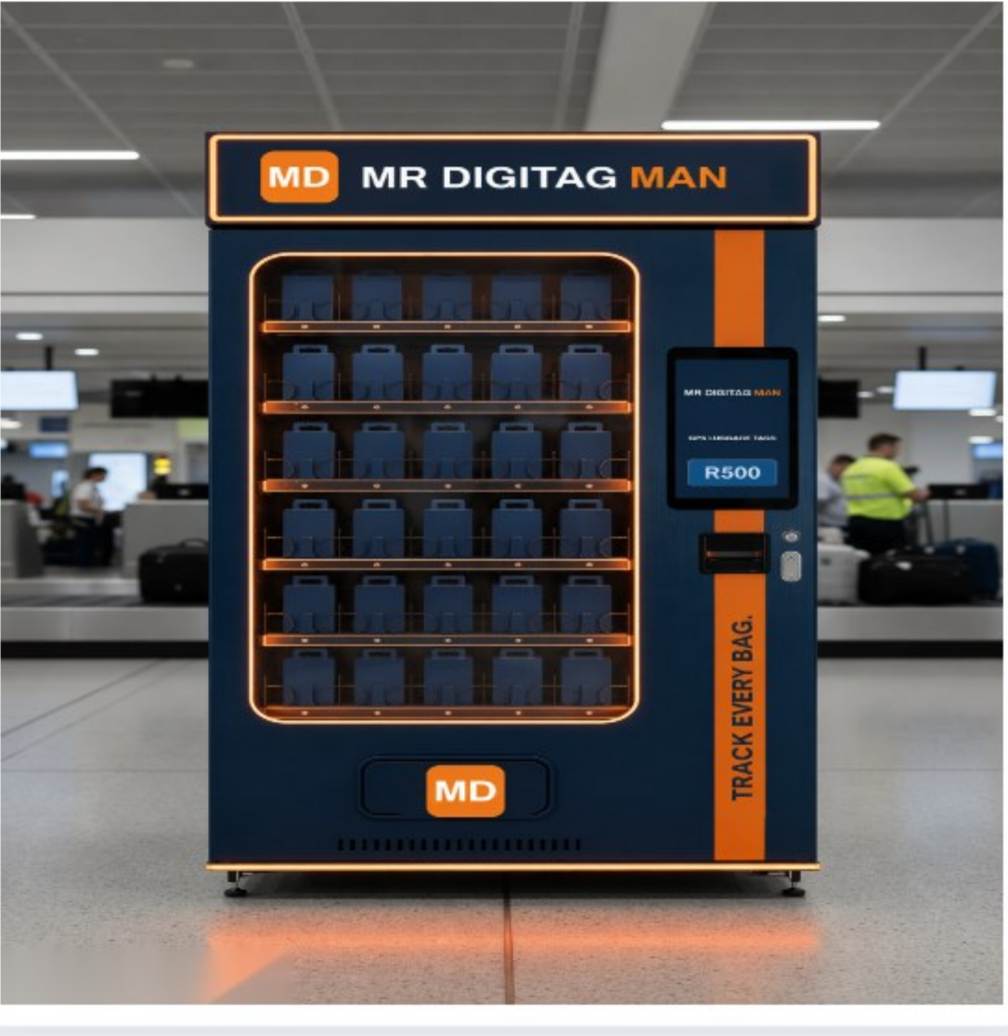
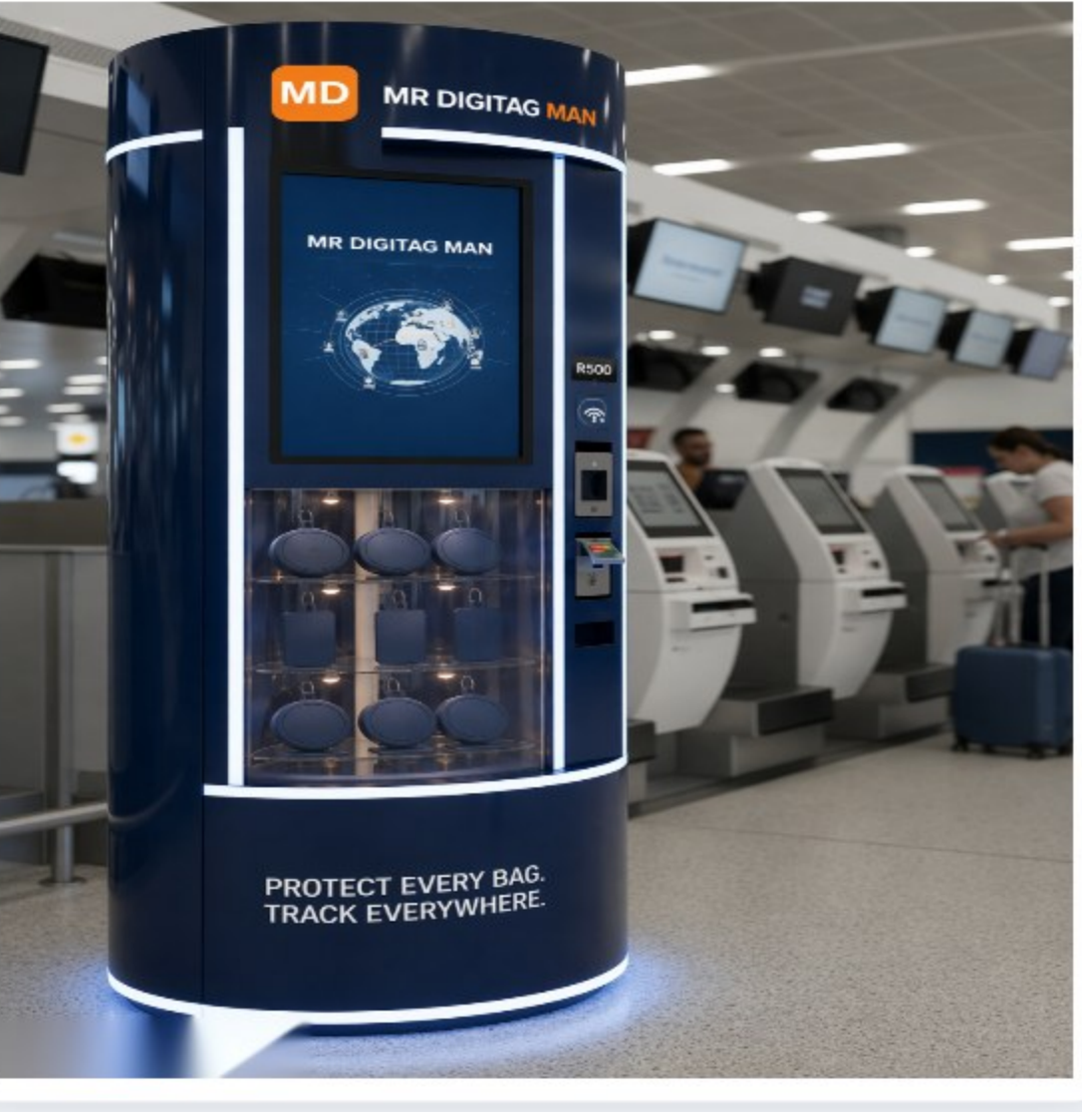
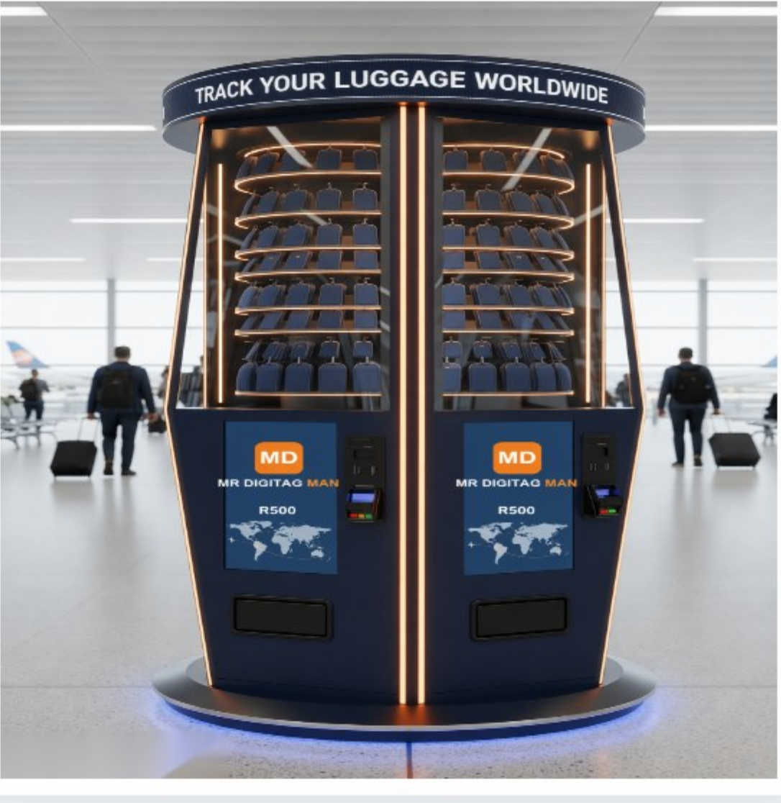
SECTION 04 · DEPLOYMENT
Where it goes: check-in, outlets & departures
Deployment-concept renders — self-service GPS vending placed exactly where FlySafair passengers already pause.
Beside FlySafair check-in counters — the natural upsell moment before bags disappear from view
Self-service kiosk zone — card/tap payment, sticker applied in under a minute
Departures concourse tower — “Track Your Luggage Worldwide”, high-footfall placement
Recommended placement: within 15–20m of check-in counters, ticket-sales outlets and self-service kiosks — visible before a passenger commits to letting a bag out of sight.
MR DIGITAG MAN | We Add Value, Security & Intelligence | Commercial in Confidence
18 / 31

Slide 19
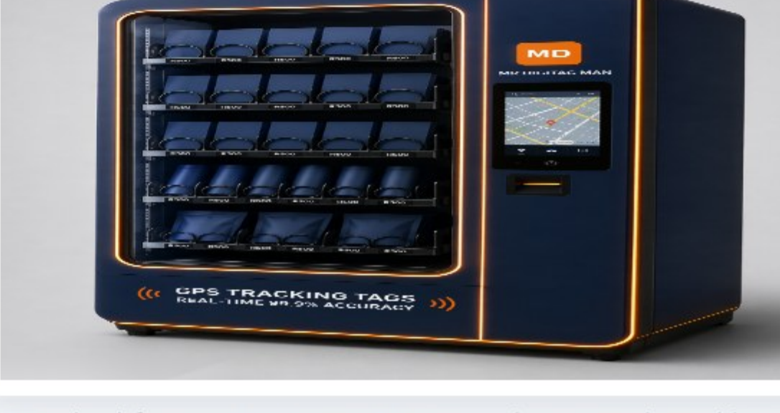
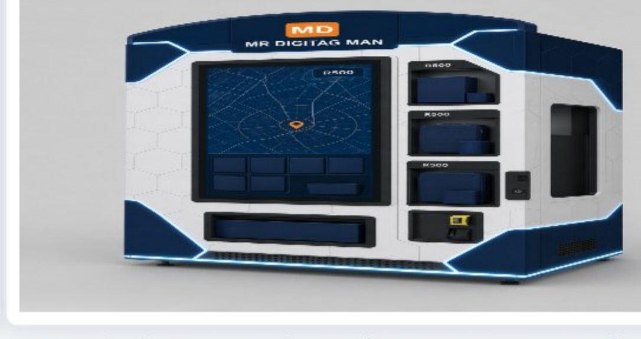
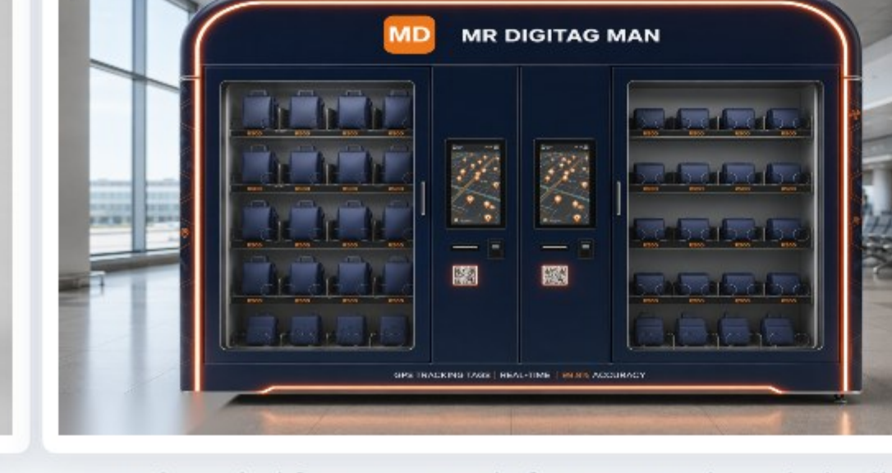
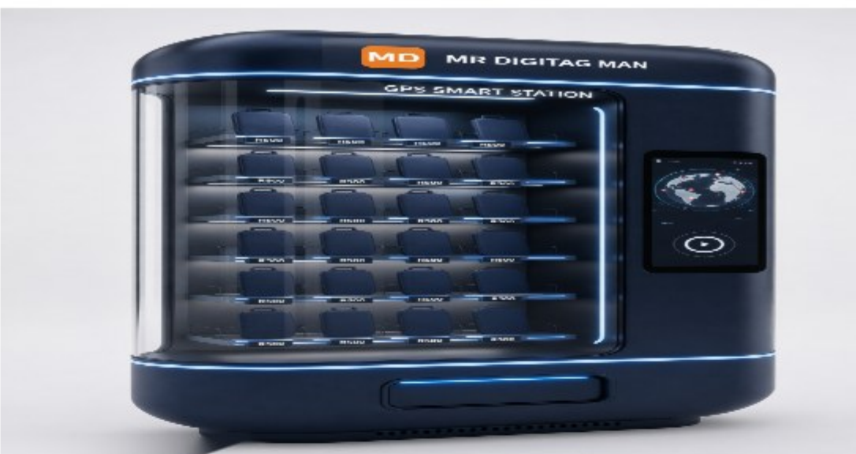
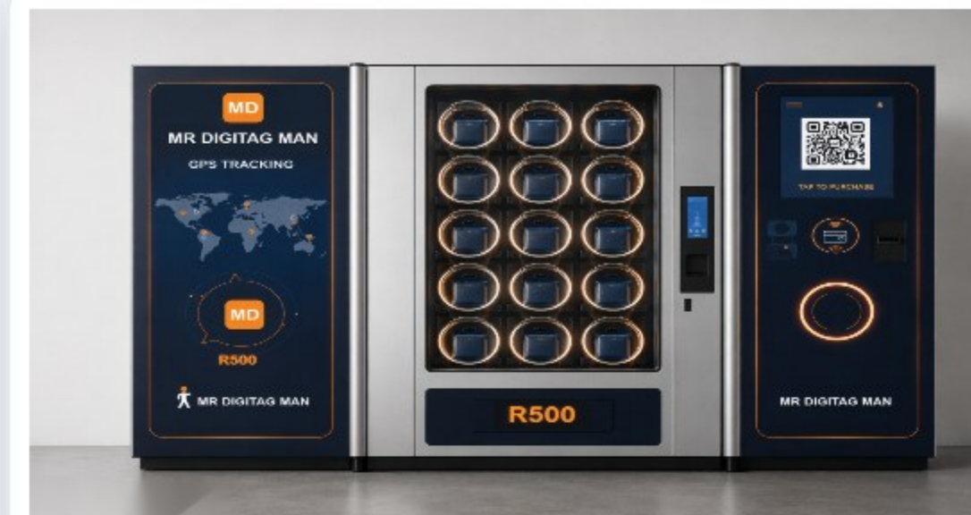
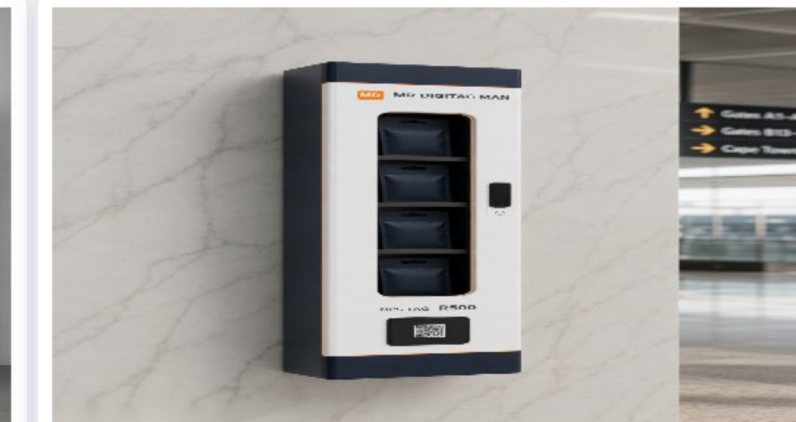
SECTION 04 · DEPLOYMENT
One platform, six physical formats
Deployment-concept renders — final unit design, FlySafair co-branding and footprint confirmed with each airport's terminal team.
Standard-format GPS Smart Station — the network workhorse
Map-display variant — live tracking preview at point of sale
Co-branded format — ready for a FlySafair-branded rollout
Curved-panel flagship — premium terminal placements
Modular twin-panel wall unit — R500 pricing on display
Slim wall-mount — corridor and washroom-adjacent placements
MR DIGITAG MAN | We Add Value, Security & Intelligence | Commercial in Confidence
19 / 31

Slide 20
SECTION 04 · THE TWO COMMERCIAL ROUTES
Option 2 — One tap in the FlySafair booking flow
FlySafair wrote South Africa's ancillary playbook — a 20kg bag is R155 online and R350 at the counter. “Digitag Protect” becomes the next toggle.
1
Passenger adds “Digitag Protect — R299” at booking
THE REVENUE, MODELLED
Attach
Units/yr
Per day
Month
Year 1
5 yrs
One toggle in the payment path, next to seat selection and the R155 checked-bag fee — exactly where FlySafair already converts best.
Conservative 6%
654,000
R535,700
R16.3M
R195.5M
R1.10B
2
Sticker applied at bag-drop in seconds
Moderate 10%
1.09M
R892,900
R27.2M
R325.9M
R1.84B
Pre-paired to the booking reference at the counter or kiosk — no queue added, no new staff process beyond peel-and-stick.
Aggressive 15%
1.64M
R1.34M
R40.7M
R488.9M
R2.76B
3
The bag is live before the aircraft doors close
R892,900
R325.9M
R2.76B
Passenger tracks it in the app; Nexas AI watches every tagged bag on the rotation. Margin stays with FlySafair — no vending capex at all.
a day at a moderate 10% attach
a year at 10% — R1.04B over 3 years
5-year gross at the aggressive 15% case
Why R299 works here: it sits naturally on FlySafair's real ancillary ladder — above the R155 online bag fee, below the R350 counter rate — and conversion in the payment path beats conversion in the concourse. 3-year figures: R623M (6%) · R1.04B (10%) · R1.56B (15%). At an illustrative 45% margin, the moderate case adds ±R147M a year to FlySafair's ancillary line.
MR DIGITAG MAN | We Add Value, Security & Intelligence | Commercial in Confidence
20 / 31

Slide 21
SECTION 04 · THE TWO COMMERCIAL ROUTES
Two options, one decision — and they compound
Both routes sell the same R500-value product through FlySafair's own front doors — they differ in speed, reach and economics.
OPTION 1
OPTION 2
Smart vending network
Ticket-flow integration
Year-1 gross (2% → 8%)
R109M – R436M
Year-1 gross (6% → 15%)
R195M – R489M
5-year gross (aggressive)
R2.46B
5-year gross (aggressive)
R2.76B
Time to first revenue
±90 days
FlySafair margin (moderate, 45%)
±R147M / yr
✓ Zero IT integration — no booking-system work at all
✓ Sells to the whole terminal, including non-FlySafair passengers
✓ Physical brand presence at every check-in and outlet
✓ Attach-rate economics — sold where FlySafair already converts
✓ Zero floor space, zero station capex, zero staffing
✓ Every unit pre-paired to a booking — cleaner data for Nexas AI
The recommended path is both: launch Option 1 in ±90 days while the Option 2 integration is built, then run them together — vending keeps serving walk-ups and visitors after the ticket flow goes live. Modelled together at R435M+ a year, without double-counting.
MR DIGITAG MAN | We Add Value, Security & Intelligence | Commercial in Confidence
21 / 31

Slide 22
SECTION 05 · THE BUSINESS CASE
How every number in this proposal was built
A transparent, source-cited model — real published statistics in, conservative assumptions where FlySafair publishes none.
1
Passengers
10.9 million a year — FlySafair's own published 30,000+ passengers a day and 1,250+ weekly flights (2025/26).
THREE RECOVERY SCENARIOS
40%
Conservative
2
Mishandling rate
A cautious first-year adoption-and-recovery assumption, before any process maturity.
4.9 bags per 1,000 passengers — SITA 2026's global average, not Africa's 12.1. A conservative 2.7 domestic case is shown alongside throughout.
3
Failure-mode split
65%
Moderate
74% delayed · 18% damaged or pilfered · 8% lost or stolen, with 4% never recovered — SITA Baggage IT Insights 2026.
Mid-point recovery once vending and ticket-flow sales are embedded and habits form.
4
Unit costs
R4,602 ($260) per mishandled bag and R11,240 ($635) per never-recovered bag — SITA 2026 benchmarks at R17.70/$.
90%
Aggressive
The stretch case: near-complete recovery once every tagged bag reports its position hourly into tracing.
5
Growth & scope
6% p.a. compounding, below FlySafair's own trajectory. Exposure covers checked baggage only; revenue is modelled separately and never blended into savings.
Full source list on the final slide: SITA 2026, Cirium 2024 & 2025, FlySafair's published figures, ACSA statements, TAPA EMEA and SAPS crime statistics — every external number in this deck traces to one of them.
MR DIGITAG MAN | We Add Value, Security & Intelligence | Commercial in Confidence
22 / 31

Slide 23
SECTION 05 · THE BUSINESS CASE
The recovery case: turning R246M a year of leaks into savings
Applying the three scenarios to FlySafair's modelled exposure — checked-baggage layer only.
R221.2M
R704.3M
R1.25B
Modelled Year-1 savings (aggressive scenario)
3-year cumulative savings (aggressive, 6% p.a. growth)
5-year cumulative savings (aggressive, 6% p.a. growth)
Scenario
Year 1
3-Year Cumulative
5-Year Cumulative
WHAT 90% MEANS, PHYSICALLY
Conservative (40%)
R98.3M
R313.0M
R554.2M
Moderate (65%)
R159.8M
R508.6M
R900.6M
±131 of the 146 bags that would go astray each day, found before the carousel empties — and tampering windows closed before claims are filed.
Aggressive (90%)
R221.2M
R704.3M
R1.25B
THE RECORD THIS PROTECTS — FlySafair is the most punctual airline in Africa and the Middle East two years running (Cirium 2024: 93.82%; 2025: 91.06%) and carries six in ten of South Africa's domestic passengers. A GPS visibility layer doesn't fix a weakness; it extends a record-breaking operation into the one journey it cannot yet see — on the continent where that journey is most dangerous.
MR DIGITAG MAN | We Add Value, Security & Intelligence | Commercial in Confidence
23 / 31

Slide 24
SECTION 05 · THE BUSINESS CASE
The combined FlySafair number
Losses recovered plus the new revenue stream, one picture — before D-Card, D-Pod or a cent of reputational upside is added.
5-YEAR COMBINED OPPORTUNITY
R3.08B
CUMULATIVE VALUE — COMBINED SCENARIO
R3.08B
cumulative modelled value: recovered losses (aggressive scenario) + Digitag Protect ticket-flow revenue at a moderate 10% attach.
R2.39B
Layer
Year 1
3-Yr
5-Yr
R1.74B
Losses recovered (90%)
R221.2M
R704.3M
R1.25B
R1.13B
Digitag Protect revenue (10%)
R325.9M
R1.04B
R1.84B
R547M
Combined
R547.1M
R1.74B
R3.08B
Y1
Y2
Y3
Y4
Y5
Deliberately not included: D-Card retail (R9.0M/yr), D-Pod asset savings, insurance-terms upside and vending sales to non-FlySafair passengers — headroom above this number, never padding inside it.
MR DIGITAG MAN | We Add Value, Security & Intelligence | Commercial in Confidence
24 / 31

Slide 25
SECTION 06 · THE INTELLIGENCE LAYER
Introducing Nexas AI
“One login. Seventy-seven minds. Zero pretence.” — the AI-agent business command center by ClearVision AI, put to work on FlySafair's own data.
77 agents
NEXA
13 modules
Proudly SA
named specialist AI agents across 16 divisions — a full virtual staff complement
the head butler and command core — one login, one interface, every domain
War Room, Mission Control, CRM, Document Studio, Quotes, Analytics and more
POPIA, SARS, CCMA and OHS fluent — priced in rand, planned around load-shedding
HOW FLYSAFAIR WOULD USE IT
WHAT IT CHANGES
✓ Ask NEXA anything — “what did baggage cost us in July?” — and get the answer with the evidence attached, straight off the Digitag feed
✓ Brief Amber, the chief orchestrator, once — she turns it into a mission with owners, steps and a finish line across the right agents
✓ Watch live operations in the War Room; track agents, missions and performance from the command dashboard
✓ Memory learns FlySafair's context between sessions; Plugins connect the Digitag device feed, DCS and booking flow
77 → 1 login
a full staff complement of specialist expertise behind a single secure command center
1 brief → 1 mission
multi-agent work planned, routed, tracked and synthesised into one answer
R0 extra headcount
every division gains capability without a single new salary line
Nexas AI is a ClearVision AI platform. Licences ride on the commercial programme — included in both Option 1 and Option 2, not a separate IT line item.
MR DIGITAG MAN | We Add Value, Security & Intelligence | Commercial in Confidence
25 / 31

Slide 26
SECTION 06 · THE INTELLIGENCE LAYER
One AI workforce, every division of FlySafair
77 named specialist agents across 16 divisions — below, the crew each FlySafair division puts to work from day one.
Ground Ops & Baggage
Customer Care
Commercial & Revenue
Flight Ops & Projects
Rita (operations analyst), Stella (QA) and Ronan (warehouse) map processes, find bottlenecks and write the SOPs — with live Digitag positions as the evidence.
Wendy fronts every enquiry, Ryan designs support systems that turn complaints into loyalty, Melissa drives retention — “where is my bag?” answered before anyone phones.
Charles, Samantha and Hannah build the Digitag Protect pipeline; Evan, Rachel and Eleanor run full-funnel marketing, SEO and PR for the launch.
Tyler runs each rollout phase on scope, schedule and budget; Erica coordinates across teams; Paula schedules around time zones and load-shedding.
Safety, Security & Fraud
Engineering & Maintenance
Finance, Legal & Tax
HR, Training & Executive
Sentinel-X monitors anomalies and triages alerts; Simon hardens the platform; Frank spots fraud before money moves; Marlene keeps OHS Act compliance tight.
Christopher coordinates crews and work orders; Tanya root-causes failures; Marius diagnoses vehicles; Natalie keeps infrastructure alive through load-shedding.
Liza owns cash flow and forecasting; Colin gets invoices paid; Sipho keeps it SARS-compliant; Cornelius and Peter handle contracts and labour law; POPIA built in.
Karen runs people strategy; Cory builds training via Classroom; Vincent and Oscar give the board strategy and evidence-first research — with sources attached.
Nobody needs to remember who does what: ask NEXA, and the head butler routes the work to the right specialist — or brief Amber and she runs it as a multi-agent mission.
MR DIGITAG MAN | We Add Value, Security & Intelligence | Commercial in Confidence
26 / 31

Slide 27
SECTION 06 · THE INTELLIGENCE LAYER
Nexas AI — capabilities and what they're worth
Built to be used by people who run an airline, not by data scientists — in plain language, priced in rand.
CAPABILITIES
✓ NEXA command core — business Q&A across every domain, with memory and context that persists between sessions
✓ Multi-agent missions — brief Amber once; she plans, routes, tracks and synthesises the result
✓ War Room and command dashboard — live view of active agents, missions and operations
✓ Document Studio and Quotes — claims packs, SOPs, reports and proposals generated where the agents work
✓ Built-in CRM and analytics — the Digitag Protect ancillary line measured live, against this very model
✓ Classroom — AI-powered training modules for ground staff, contact centre and sales teams
✓ Plugins — connect the Digitag device feed, DCS, booking flow and existing tools
✓ South African to the core — POPIA, SARS, CCMA, OHS Act and load-shedding-aware, with secure per-business sign-in
THE BENEFITS, MEASURED
Headcount leverage
a full staff complement of expertise without the payroll — 77 specialists on day one
Contact-centre load
“where is my bag?” answered from the live feed before the call is dialled
Claims cost
fewer claims, resolved faster, each one an evidence-based Document Studio pack
Ancillary revenue
attach rates, opt-ins and revenue tracked live against this deck's model
Board visibility
one live number for baggage — exposure, recovery, revenue — with sources attached
Live from Phase 1: the O.R. Tambo pilot ships with a working Nexas AI dashboard from day one — trained on FlySafair's own tracker data, not a demo dataset.
MR DIGITAG MAN | We Add Value, Security & Intelligence | Commercial in Confidence
27 / 31

Slide 28
SECTION 07 · WHY NOW
A 12-month rollout, de-risked by design
Prove it at the highest-exposure airport first — then scale with evidence, not assumptions.
PHASE 1
PHASE 2
PHASE 3
PHASE 4
MONTHS 1–3
MONTHS 4–6
MONTHS 7–9
MONTHS 10–12
O.R. Tambo Pilot
The Golden Route
Full Network
Intelligence Everywhere
Vending live at JNB domestic check-in; “Digitag Protect” A/B test in the booking flow; Nexas AI dashboard live from day one. Live data from month one.
Cape Town, Durban and Lanseria stations live; ticket-flow add-on rolled out network-wide; D-Pod on spares crates and baggage carts.
All eleven SA airports plus the four regional routes; D-Card premium retail live on the JNB–CPT corridor; ±40 stations trading.
Nexas AI live in every division; insurer engagement on the evidence base; year-one review against every number in this deck.
Every phase is independently reversible — FlySafair validates commercial and operational assumptions with real data before committing to the next. By month 12 the network is fully live, and every figure in this deck has been tested against reality.
MR DIGITAG MAN | We Add Value, Security & Intelligence | Commercial in Confidence
28 / 31

Slide 29
FOR THE BOARD, THE CEO, THE COO
This isn't a technology decision. It's a five-year bet on who owns passenger trust in South African skies.
IF NOTHING CHANGES
IF FLYSAFAIR ACTS NOW
Five years of standing still
Five years of leading the market
✗ A modelled R1.39 billion walks out the door over five years — R382M even on the most conservative reading
✗ ±146 bags a day still go dark the moment they leave the passenger's hands
✗ On the continent SITA ranks worst in the world for baggage, the next viral tampering video is a matter of when
✗ R1.84B of modelled 5-year ancillary revenue is left unbuilt
✗ Another carrier claims “the airline where bags don't disappear” first
✗ Claims keep being processed by hand — and the board only sees the cost at year-end
✓ Up to R1.25 billion recovered over five years — R221M in year one alone
✓ R1.84B+ of new passenger-funded revenue built at a moderate 10% attach
✓ Every checked bag visible from bag-drop to carousel — and every claim answered with evidence
✓ Africa's most punctual airline becomes Africa's most transparent on baggage
✓ Nexas AI working in every division, on data no competitor has
✓ A 12-month, phase-gated rollout — reversible at every step, evidence before commitment
So the only real question left: does FlySafair spend the next five years paying for invisible bags — or being the airline that made them visible?
MR DIGITAG MAN | We Add Value, Security & Intelligence | Commercial in Confidence
29 / 31

Slide 30
READY WHEN YOU ARE
Why Mr Digitag Man, and what happens next
✓ 17+ years of South African market experience — a local partner for a local champion, in the same time zone and the same rand
✓ A full-ecosystem integrator, not a single-product vendor — GPS visibility alongside CCTV, access control, signage and IT under one accountable partner
✓ Proven global technology — crowd-find location sharing wired into the tracing ecosystem of 500+ airlines and ground handlers — brought to Africa's leading low-cost carrier first
✓ Direct engineering accountability, product ownership and a single commercial counterparty — no offshore escalation chain
✓ Nexas AI included — ClearVision AI's 77-agent command center rides on the commercial programme, not on FlySafair's IT budget
PROPOSED NEXT STEP
A 45-minute working session with FlySafair's commercial, ground-operations and IT teams to scope the O.R. Tambo pilot — timeline, commercial structure, success metrics and the Digitag Protect booking-flow test.
THE OPPORTUNITY ON THE TABLE
R3.08B over five years
Recovered losses plus passenger-funded revenue — for a programme that funds itself from the first sticker sold.
MD
MR DIGITAG MAN
79 Bellairs Drive, Glenvista, Johannesburg South, 2091
WE ADD VALUE, SECURITY & INTELLIGENCE
+27 68 601 8931 · sales@mrdigitag.co.za · www.mrdigitag.co.za
MR DIGITAG MAN | We Add Value, Security & Intelligence | Commercial in Confidence
30 / 31

Slide 31
APPENDIX
Sources — every external figure in this deck
Real, published statistics. Where FlySafair publishes no figure, the deck says “modelled” and shows the assumption.
FLYSAFAIR — OPERATIONS & SCALE
SOUTH AFRICA — BAGGAGE CRIME
▪ FlySafair published figures & press (2025/26): 30,000+ passengers/day; 1,250+ flights and 230,000 seats/week; 15 destinations; ±60% domestic market share; 37 Boeing 737s — Africa's largest 737-800 operator; 1,700 employees.
▪ ACSA statements (2024–2025): standing Airport Baggage Pilferage Prevention Working Group (ABPPWG); nine airport employees arrested for baggage-theft offences since April 2025; January 2024 O.R. Tambo tampering incident and public response; baggage handling is airlines'/ground handlers' responsibility.
▪ FlySafair 10-year milestone (Oct 2024): 40M+ customers, 260,000 flights since October 2014.
▪ News reports (2016): syndicate suspected of targeting checked bags on a Johannesburg–Hong Kong route.
▪ Cirium On-Time Performance Review 2024: most punctual airline, Middle East & Africa — 93.82% across 57,000+ flights, best in region 11 of 12 months.
SOUTH AFRICA — CARGO & PRECIOUS CARGO
▪ Cirium On-Time Performance Review 2025: region's most punctual again — 91.06%.
▪ Court record via trade press (2017 O.R. Tambo heist): 27 bags of foreign currency, R24m+, taken airside by robbers in police uniform; 90-year combined sentences.
▪ FlySafair ancillary fees (2025/26, travelnews.co.za & fee guides): 20kg bag R155 online / R350 at counter; extra bag R250; sports equipment R285.
▪ News24 / Daily Maverick (Jan 2021): 73.5kg of gold bars worth R61m seized in hand luggage at O.R. Tambo; further R11m gold arrest May 2021.
BAGGAGE — GLOBAL BENCHMARKS
▪ TAPA EMEA cargo-theft intelligence: 2,670 recorded SA incidents and ±R577M losses in 18 months to mid-2022; ±R20M average loss per major SA incident.
▪ SITA Baggage IT Insights 2026 (data from 500+ airlines, 2,800+ airports): 5 billion passengers; 24M mishandled bags; global rate 4.9/1,000 (-23% YoY); Africa 12.1/1,000 — world's highest; Middle East 5.0; split 74% delayed / 18% damaged or pilfered (rising) / 8% lost or stolen; 4% never recovered; $260 per mishandled bag; $635 per lost bag; $6.3bn industry cost = 15% of 2025 industry profit.
▪ SAPS crime statistics: 420 truck hijackings in Q2 2025.
CONVERSIONS & MODEL
▪ SITA × Apple (Nov 2024): crowd-find “Share Item Location” integrated into WorldTracer baggage tracing.
▪ USD→ZAR at R17.70/$. Opt-in, attach-rate and recovery scenarios are commercial modelling assumptions, shown as ranges and never presented as published statistics.
MR DIGITAG MAN | We Add Value, Security & Intelligence | Commercial in Confidence
31 / 31

