Slide 1
COMP-293A Project 1
Sean Malloy and David Leavenworth

Slide 2
Description and motivation
San Francisco Fire Department calls for service from 2001 until now
Sean please put something here about why we chose it

Slide 3
Variables analyzed
Number of alarms at a fire incident
timeTaken = Available.DtTm – Response.DtTm
arrivalTime = On.Scence.DtTm – Received.DtTm

Slide 4
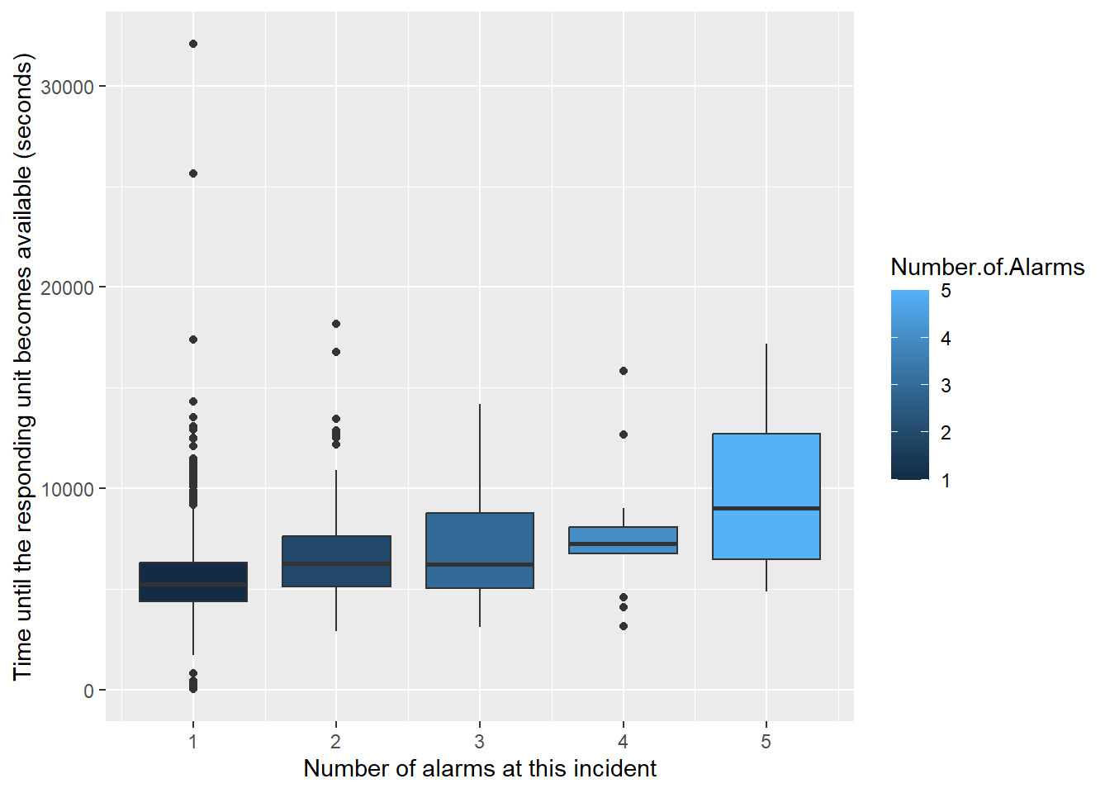
Plots

Slide 5
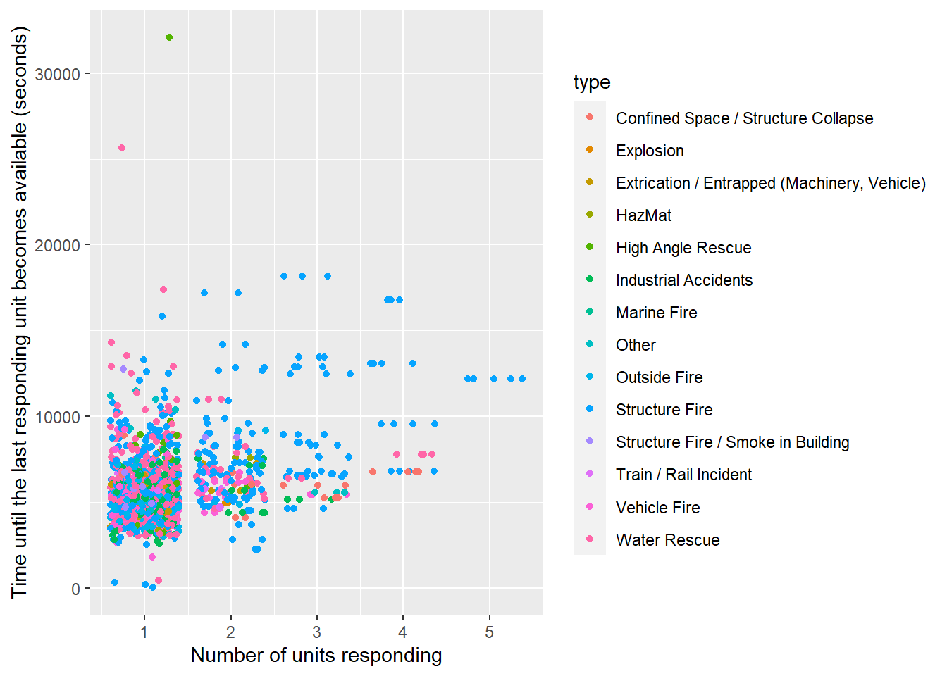
Plots cont.

Slide 6
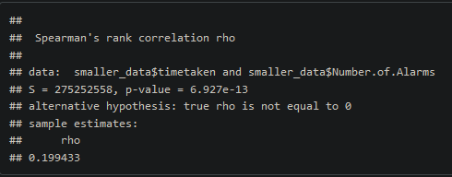
Spearman’s correlation
P-value very far below 0.05, we can conclude they are at least somewhat correlated.
A rho that low suggests very light correlation between the time taken and number of alarms.

Slide 7
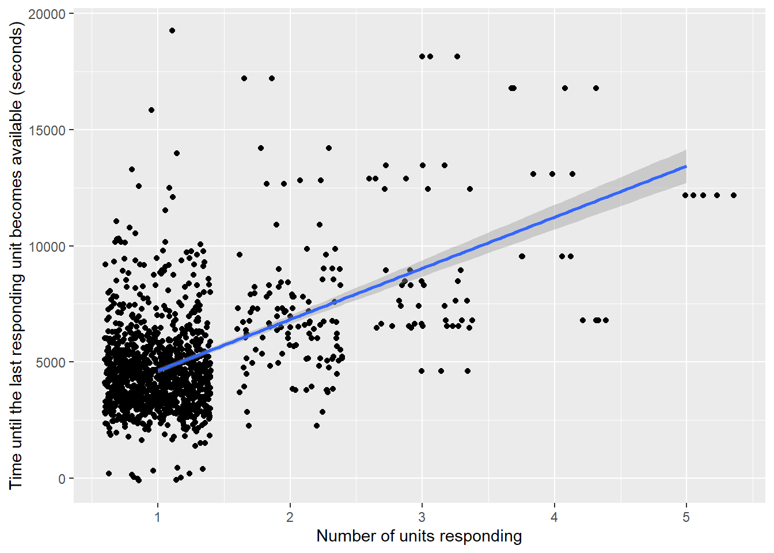
Regression
P-value < 0.00000000000000022
R-squared = 0.15
We can reject the null hypothesis and accept that there is some correlation.
An R-squared that low suggests other variables impact the time taken more than the number of units responding.

Slide 8
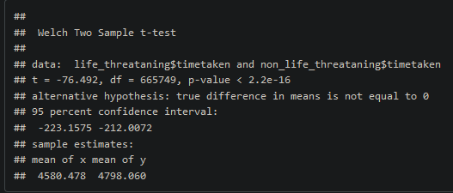
T-test
P value < 0.00000000000000022
We can conclude that the time taken for life threatening incidents is different from non-life-threating incidents
Looking at the confidence interval we can tell that the time taken for life threatening incidents is lower.

