Slide 1

General Physics II: Hw 1
Due on 2/27/2019
Problem 1: Do the integral of the following
Problem 2:
Solve q(t) of the following equations
Problem 3:
There are 9 point charges as shown in Fig. 1 and the position of the charges are given by
Determine the electric field at the point (0, 0, z) for the following cases
q_{n} = q
q_{n} = q for n = 0,2,4,6,8 ; q_{n} = -q for n = 1,3,5,7
( Express your answers in terms of R, q, z, and any other constants )
Fig. 1

Slide 2
Problem 1
Do the integral of the following

Slide 3
θ
2

Slide 4
θ
1

Slide 5
Problem 2
Solve q(t) of the following equations

Slide 7
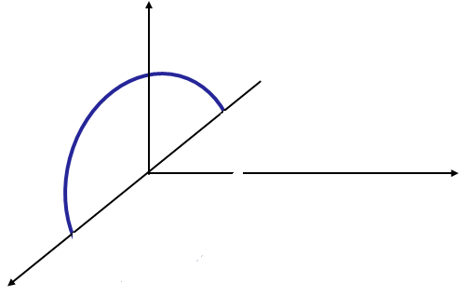
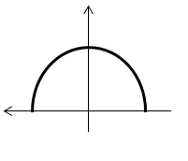
Problem 3
There are 9 point charges as shown in Fig. 1 and the position of the charges are given by
Determine the electric field at the point (0, 0, z) for the following cases
q_{n} = q
q_{n} = q for n = 0,2,4,6,8 ; q_{n} = -q for n = 1,3,5,7
( Express your answers in terms of R, q, z, and any other constants )
Solution
Method 1
Fig. 1
;

Slide 8
(b) q_{n} = q for n = 0,2,4,6,8 ; q_{n} = -q for n = 1,3,5,7

Slide 9
Method 2
(b) q_{n} = q for n = 0,2,4,6,8 ; q_{n} = -q for n = 1,3,5,7

