Slide 1
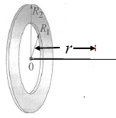
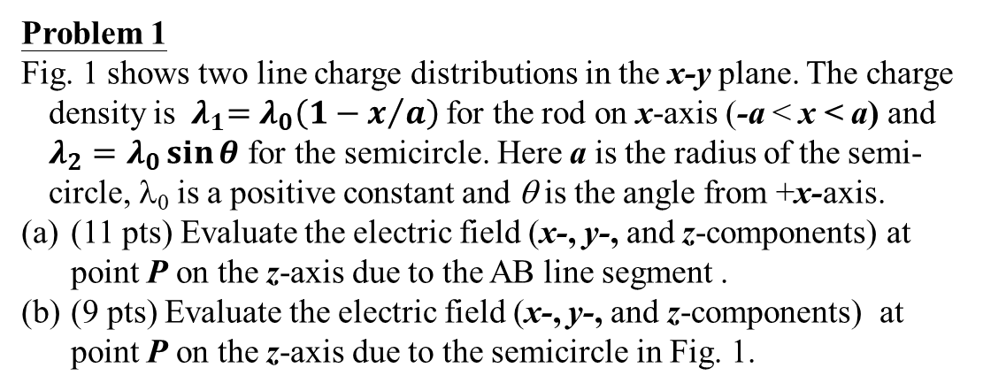
General Physics II: Hw 2
Due on 3/7/2019
Problem 1
Fig. 1 shows two line charge distributions in the x-y plane. The charge density is${ λ}_{1}=λ_{0}\left(1−x/a\right)$ for the rod on x-axis (-a < x < a) and $λ_{2}=λ_{0}\sin{θ}$ for the semicircle. Here a is the radius of the semi-circle, λ₀ is a positive constant and θ is the angle from +x-axis.
(11 pts) Evaluate the electric field (x-, y-, and z-components) at point P on the z-axis due to the AB line segment .
(9 pts) Evaluate the electric field (x-, y-, and z-components) at point P on the z-axis due to the semicircle in Fig. 1.
a
A(a,0,0)
B
(-a,0,0)
P (0,0,z)
Fig. 1
Problem 2
The x axis is the symmetry axis of a non-conducting flat ring of inner radius R₁and outer radius R₂, carrying a uniform surface charge density (σ > 0) ( as show in Fig. 2). Find the electric field at point P.
P
Fig. 2
Problem 3
(a) Determine the electric field at the point P₁ and P₂ as shown in Fig. 3 . The two charges are separated by a distance of 2a.
(b) When the distance from the field point ( P₁ or P₂ ) to the center of the dipole (O) are very large y >> a for P₁ or x>>a for P₂ , show that the magnitude of the electric field is given by 2kp/r³ and kp/r³ for P₁ and P₂ , respectively. ( p = 2qa is the dipole moment of the dipole )
Hint : use for x << 1 .
Fig. 3

Slide 2
Problem 1:
1. For the E-field results from the charge on AB line segment,
;
A(a,0,0)
Δq
B
(-a,0,0)
P (0,0,z)

Slide 3
0, odd function
0, odd function

Slide 4
2. For the E-field results from the charge on AB semi-circle,
A(a,0,0)
B
(-a,0,0)
P (0,0,z)

Slide 5
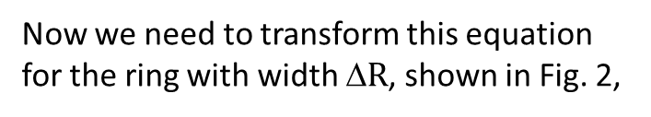
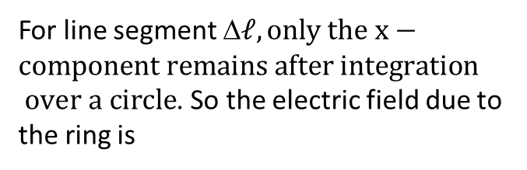
Problem 2:
x
x
P
x
Fig. 2
變數變換:
For line segment Δ$ℓ, only the x−component remains after integration$
$over a circle$. So the electric field due to the ring is
x
x
Now we need to transform this equation for the ring with width Δ$R$, shown in Fig. 2,
1
2

Slide 6
Problem 3
For 0≤x<<1
Fig. 3
Sol(a):
Suppose P₁(0,y) P₂(x,0)
Sol(b):
-

