Slide 1
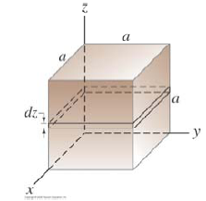
General Physics II: Hw 3
Due on 3/14/2019
1. As shown in Fig. 1, the length of each side of the cube is a, and the electric field distributed in space is ,where E₀ = 0.25 N/C and a = 2.00 m. Find the net charge within the cube .
Fig. 1
2. There are three infinite lines with line charge density λ₀. O is the origin of the coordinate and line B crosses the x-axis at (-2,0,0).
What is the electric field at position due to line B?
What is the electric field at position due to line C?
What is the total electric field at position due to line A, B and C?
z
B
C
A
(-2,0,0)
y
O
Fig. 2
x
y
3. Fig. 3 shows a cross sectional view of uniform charge distribution in an infinitely long cylindrical shell. The charge density is ρ (ρ > 0), the inner radius is 2R, and the outer radius 3R, the axis of the shell coincides with the z-axis. A second uniform cylindrical charge distribution is added to the system, with the axis of symmetry parallel to the z-axis but passing (R,0,0). The radius of the cylinder is R, and the charge density is –ρ, Determine the magnitude and direction of the E-field along the x-axis (0 ≤ x< 4R).
y
ρ
2R
R
3R
−ρ
x
Fig. 3

Slide 2
HW3-1
其中:
-1
-

Slide 3
2(a).
For line B, we choose the cylindrical Gauss’s surface with radius r and height h, as shown in figure on the right.
B
r
h
in cylindrical coordinate (r, θ, z).
For point (2,3,5), the electric field is same as above with vector:
,
z
r
2(b).
Similar as above:
y
C
2(c).
x
3

Slide 4



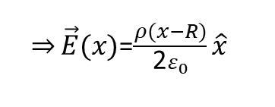

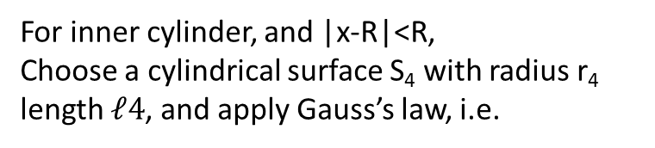


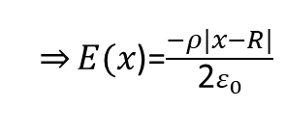

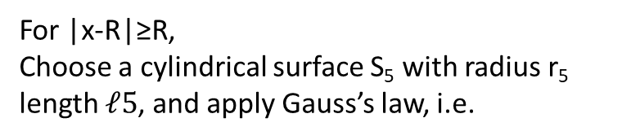

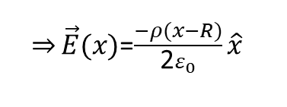

y
(I)
y
y
(III)
r₃
S₃
(II)
S₅
ρ
ρ
+
r₅
2R
R
2R
r₁
S₁
R
3R
−ρ
x
3R
r₂
x
r₄
x
S₂
−ρ
S₄
The calculation for part (III):
For inner cylinder, and |x-R|<R,
Choose a cylindrical surface S₄ with radius r₄ length $ℓ4$, and apply Gauss’s law, i.e.
For |x-R|≥R,
Choose a cylindrical surface S₅ with radius r₅ length $ℓ5$, and apply Gauss’s law, i.e.
$Φ_{E}=∯_{S_{4}}{\vec{E}∙d\vec{A}}=E(r_{4}$)2$πr_{4}ℓ$=$\frac{−ρπ(r_{4}^{2})ℓ}{ε_{0}}$
$Φ_{E}=∯_{S_{5}}{\vec{E}∙d\vec{A}}=E(r_{5}$)2$πr_{5}ℓ$=$\frac{−ρπ(R_{}^{2})ℓ}{ε_{0}}$
$\overset{⇒}{}E(r_{4}$)=$\frac{−ρr_{4}^{}}{\text{2}ε_{0}}$
$\overset{⇒}{}E(x$)=$\frac{−ρ|x−R|}{\text{2}ε_{0}}$
$\overset{⇒}{}E(r_{5}$)=$\frac{−ρR_{}^{2}}{\text{2}ε_{0}r_{5}}$
$\overset{⇒}{}E(x$)=$\frac{−ρR_{}^{2}}{\text{2}ε_{0}\left|x−R\right|}$
For $0≤$x<R ,$\left|x−R\right|=−(x−R)$
For $2R≤$x<4R ,$\left|x−R\right|=(x−R)$
$\overset{⇒}{}\vec{E}(x)$=$\frac{ρ(x−R)}{\text{2}ε_{0}}\hat{x}$
----- equ. (1)
$\overset{⇒}{}E(x$)=$\frac{−ρR_{}^{2}}{\text{2}ε_{0}\left(x−R\right)}\hat{x}$
----- equ. (3)
For $R≤$x<2R ,$\left|x−R\right|=(x−R)$
$\overset{⇒}{}\vec{E}(x)$=$\frac{−ρ(x−R)}{\text{2}ε_{0}}\hat{x}$
----- equ. (2)

Slide 5
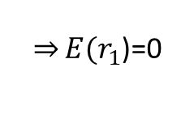
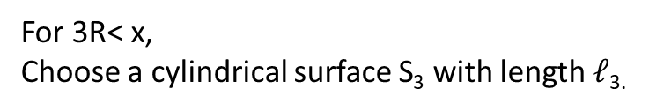

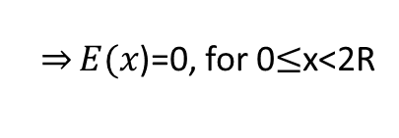


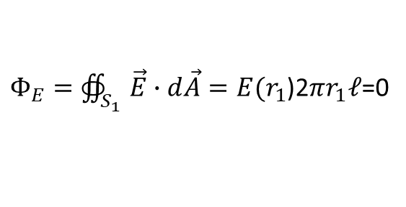

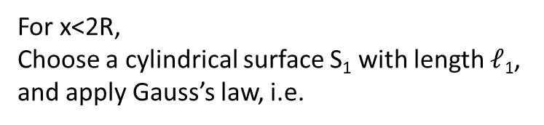



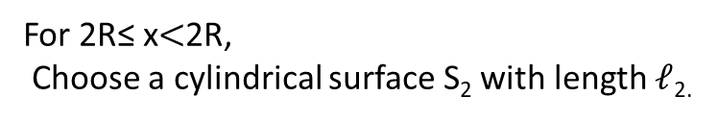

The calculation for part (II):
The final result for part (I)
= sum of results of part (II) and Part (III):
For x<2R,
Choose a cylindrical surface S₁ with length $ℓ$₁, and apply Gauss’s law, i.e.
For the total E-field with 0 ≤ x < R:
$Φ_{E}=∯_{S_{1}}{\vec{E}∙d\vec{A}}=E(r_{1}$)2$πr_{1}ℓ$=0
= equ. (1) + equ. (4)
$\overset{⇒}{}E(r_{1}$)=0
$\overset{⇒}{}E(x$)=0, for 0$≤$x<2R
----- equ. (4)
$\vec{E}(x)$=$\frac{ρ(x−R)}{\text{2}ε_{0}}\hat{x}$
For 2R≤ x$<$2R,
Choose a cylindrical surface S₂ with length $ℓ$_{2.}
For the total E-field with R ≤ x < 2R,
= equ. (2) + equ. (4)
$Φ_{E}=∯_{S_{2}}{\vec{E}∙d\vec{A}}=E(r_{2}$)2$πr_{2}ℓ$=$\frac{ρπ({r_{2}^{2}−4R}^{2})ℓ}{ε_{0}}$
$\vec{E}(x)$=$\frac{−ρ(x−R)}{\text{2}ε_{0}}\hat{x}$
$\overset{⇒}{}E(r_{2}$) =$\frac{ρ({r_{2}^{2}−4R}^{2})}{\text{2}πr_{2}ε_{0}}$
For the total E-field with 2R ≤ x < 3R,
= equ. (3) + equ. (5)
$\overset{⇒}{}\vec{E} (x$) =$\frac{ρ({x_{}^{2}−4R}^{2})}{\text{2}xε_{0}}\hat{x}$
----- equ. (5)
$E(x$)=$\frac{−ρR_{}^{2}}{\text{2}ε_{0}\left(x−R\right)}\hat{x}+\frac{ρ({x_{}^{2}−4R}^{2})}{\text{2}xε_{0}}\hat{x}$
For 3R< x,
Choose a cylindrical surface S₃ with length $ℓ$_{3.}
For the total E-field with 3R < x,
$Φ_{E}=∯_{S_{3}}{\vec{E}∙d\vec{A}}=E(r_{3}$)2$πr_{3}ℓ$=$\frac{ρπ({{9R}_{}^{2}−4R}^{2})ℓ}{ε_{0}}$
= equ. (3) + equ. (6)
$E(x$)=$\frac{−ρR_{}^{2}}{\text{2}ε_{0}\left(x−R\right)}\hat{x}+\frac{ρ({{9R}_{}^{2}−4R}^{2})}{\text{2}xε_{0}}\hat{x}$

