Slide 1
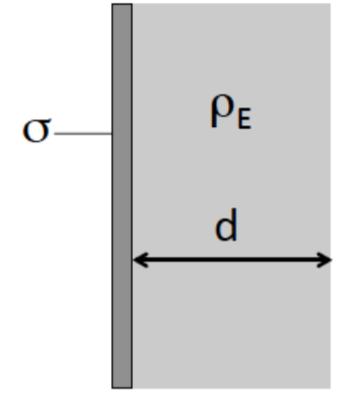
General Physics II: Hw 4
Due on 3/21/2019
1. (prob. 22-60) A very large thin plane has uniform surface charge density σ. Touching it on the right (see the Fig. 1) is a long wide slab of thickness d with uniform volume charge density .
Determine the electric field (a) to the left of the plane, (b) to the right of the slab, and (c) everywhere inside the slab.
Fig. 1
2. A spherical structure consists of four concentric spherical shells have radii 2a, 3a,4a, and 5a ( Fig. 2 ). The most inner spherical shell (r =2a) carries total charge +2Q and the outer most shell (r =5a) carries total charge -2Q. Divide the system into regions: A: r < 2a, B: 2a<r<3a, C:3a<r<4a, D: 4a<r<5a, E: r =5a (infinitely thin shell). The regions A, C, and E are conductors and other regions are empty.
Draw the Guassian surfaces and calculate the electric fields (both the direction and magnitude) and electric potential in each region. (let V = 0 at r = ∞)
Now, we connect region C and E with a wire. Once the system equilibrated, find the electric field and potential for each region in this case.
Fig. 2
3. There is charged sphere with charge density , and radius R, as shown in Fig. 3.
(A) What is total charge of the sphere?
(B) Find the electric field, magnitude and direction, for r > R and r < R.
(C) Find the electric potential for r > R and r < R. (let V = 0 at r = ∞)
R
Fig. 3

Slide 2
Solution HW4.1 :
把兩個東西拆開來分析，令slab中心為x軸

Slide 4
Solution HW4-2:
Region A:
S₁ : Interior of conductor
no electric field,
Region B:
Region C:
S₃ : Interior of conductor
no electric field,
Region D:
Charge problems:
Region E:
Charge conservation :

Slide 5
Region E:
Region D:
Region C:
Region B:
Region A:

Slide 6
(b) Connect region C and E with a wire.
The electric field:
The electric potential:
Region A:
, unchanged.
Region E:
Region B:
Region D:
,unchanged.
Region C:
Region C:
, unchanged.
Region D:
, changed.
Region B:
Region E:
, unchanged.
Region A:

Slide 7
HW4.3. There is charged sphere with charge density , and radius R, as shown in Fig. 3.
(A)
r
Δr
(B) (i) r > R case:
Choose Guass’s surface S₁ with radius r which is larger than R.
and
r
then
S₁
(B) (ii) r < R case:
Choose Guass’s surface S₂ with radius r which is smaller than R.
and
r
S₂
then

Slide 8
r > R :
R > r :

