Slide 1
numpy (python裡面很重要的基礎函式庫)
蘇永騰 陳冠儒

Slide 2
Numpy
Library of python, like stdlib.h
Strong support array or matrix

Slide 3
Import(呼叫函式)
Like “include” in c, library in python also need to be called
Syntax:
import numpy
Also can be written as
import numpy as np(把它呼叫後取名叫做np)

Slide 4
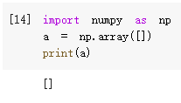
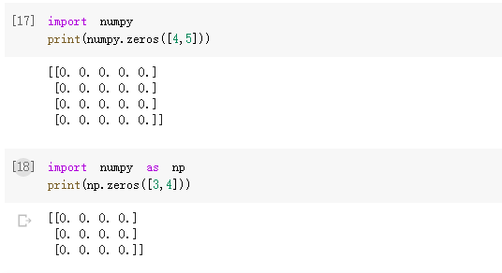
Import (建立空矩陣)

Slide 5
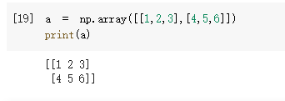
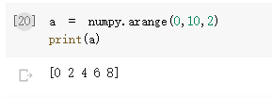
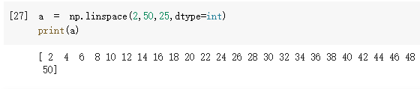
Function (numpy函式)
numpy.array(一維的)
numpy.arrange(裡面的值介於0~9，公差為2)
numpy.linspace(等差數列，從2~50，中間25個數)

Slide 6
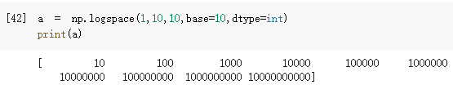
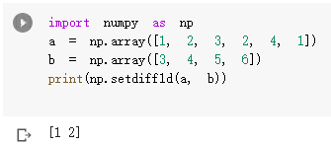
Function
numpy.logspace(對數)
numpy.setdiff1d(把兩個矩陣互相做比較) (把重複的去掉)

Slide 7
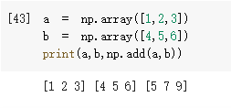
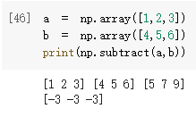
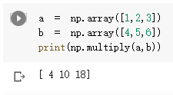
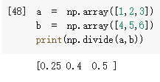
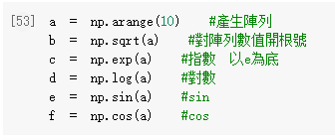
Function (矩陣的各種運算)
np.add np.subtract np.multiply np.divide
Etc.

Slide 8
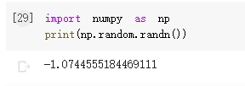
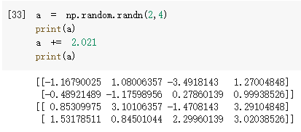
Function
Random data
from numpy.random import rand

Slide 9

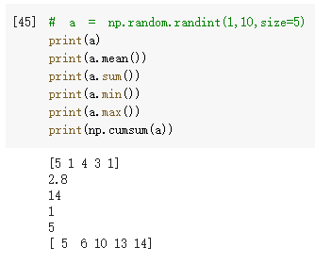

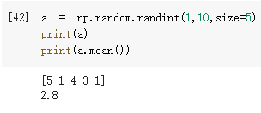
Function
random

Slide 10
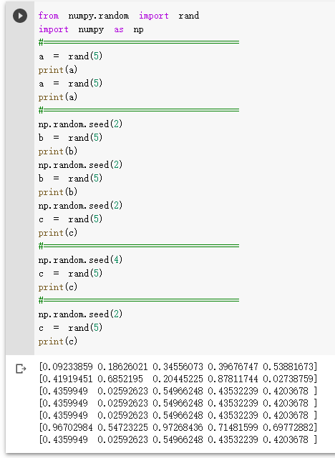
Random

Slide 11
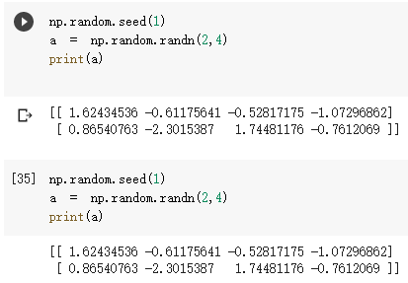
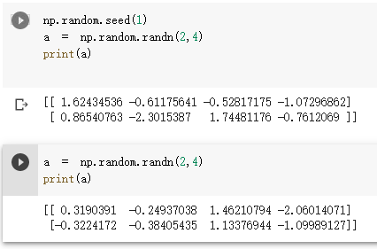
Function
random

Slide 12
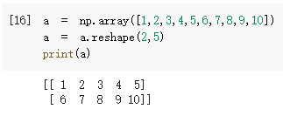
reshape

Slide 13
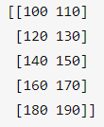
Exercise
Create a 5X2 integer array from a range between 100 to 200 such that the difference between each element is 10

Slide 14

Exercise
Please make a array calculator
The arrays that are used to test should be generated by randint and random.seed
Only “add”, “subtract”, “multiply”, “divide” are needed

Slide 15
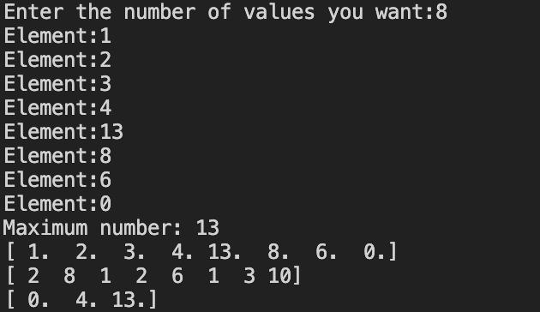
Exercise

Slide 16
https://www.w3resource.com/python-exercises/numpy/index.php

