Slide 1
Ulinkers
Acceptance Presentation
Teh Kaixin
Nicole Goh
Sean Kwok
Nabilah Banu
Chien Shu Yan
Notes:
1. Introduction of team, problem and solution. (10 mins)
2. Demo (15 mins)
3. Project plan (10 mins) <- top 3 risks
4. X factor and learning outcome (5 mins)

Slide 2
Agenda
Introduction
Problem and Solution
Project Management
Project Development
User Testing
Learning Outcomes

Slide 3



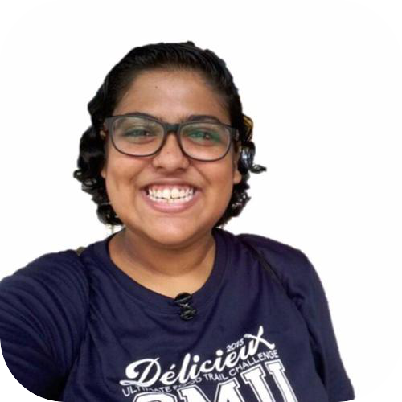
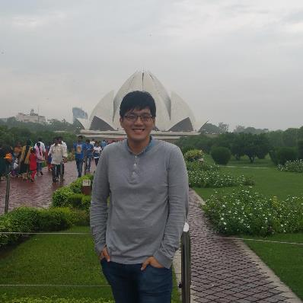
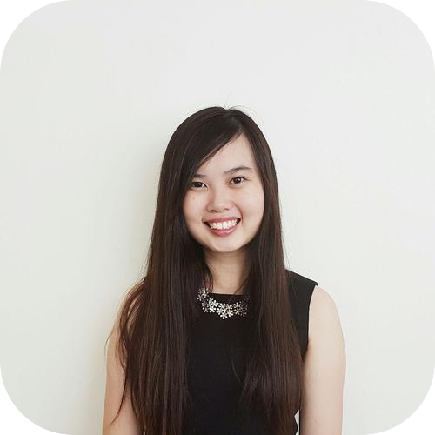
Nicole Goh
Teh Kaixin
Project Manager
Deputy Quality Assurance
Nabilah Banu
Lead Frontend Developer
Deputy Project Manager
Business Analyst
Deputy Backend Developer
Sean Kwok
Chien Shu Yan
Lead Backend Developer
Lead Quality Assurance
Deputy Frontend Developer

Slide 4



Operating since 1996
Our Sponsor
Medical concierge provider:
Clinic & hospitalisation arrangements
Treatment plans & price estimates
Travel arrangements & visas
Standby assistance in Singapore
Linda Siow, Executive
Patients:
Indonesia, Malaysia, Cambodia, Vietnam, Myanmar & China
Makes more than
1000 appointments every year

Slide 5
Problem
Unable to keep track of teams’ performances
Unable to follow up with patient
Views are not optimised
Difficult to determine most number of referral, doctors, specialty
Client’s records are duplicated

Slide 6
Solution
Ulink Web Application
Analytical tools for decision making
(Specific KPI of different teams, Gender and Age, Ranking of referral, doctor, specialty)
1
2
Timeline function for recommended screenings
Optimised views
(reduce duplicates, group by client name)
3

Slide 7
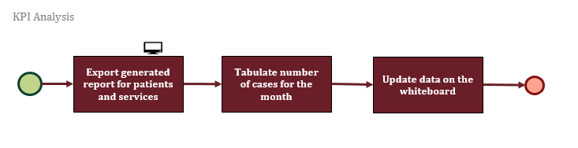
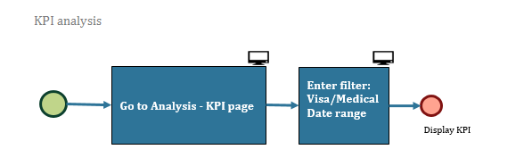
Solution
Workflow
AS-IS
TO-BE

Slide 8
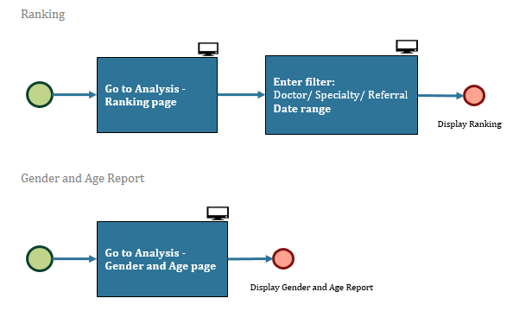
Solution
Workflow
TO-BE
TO-BE

Slide 9
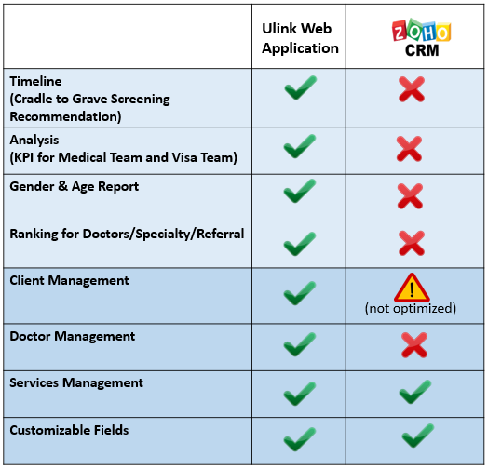

Market Research

Slide 10

DEMONSTRATION

Slide 11
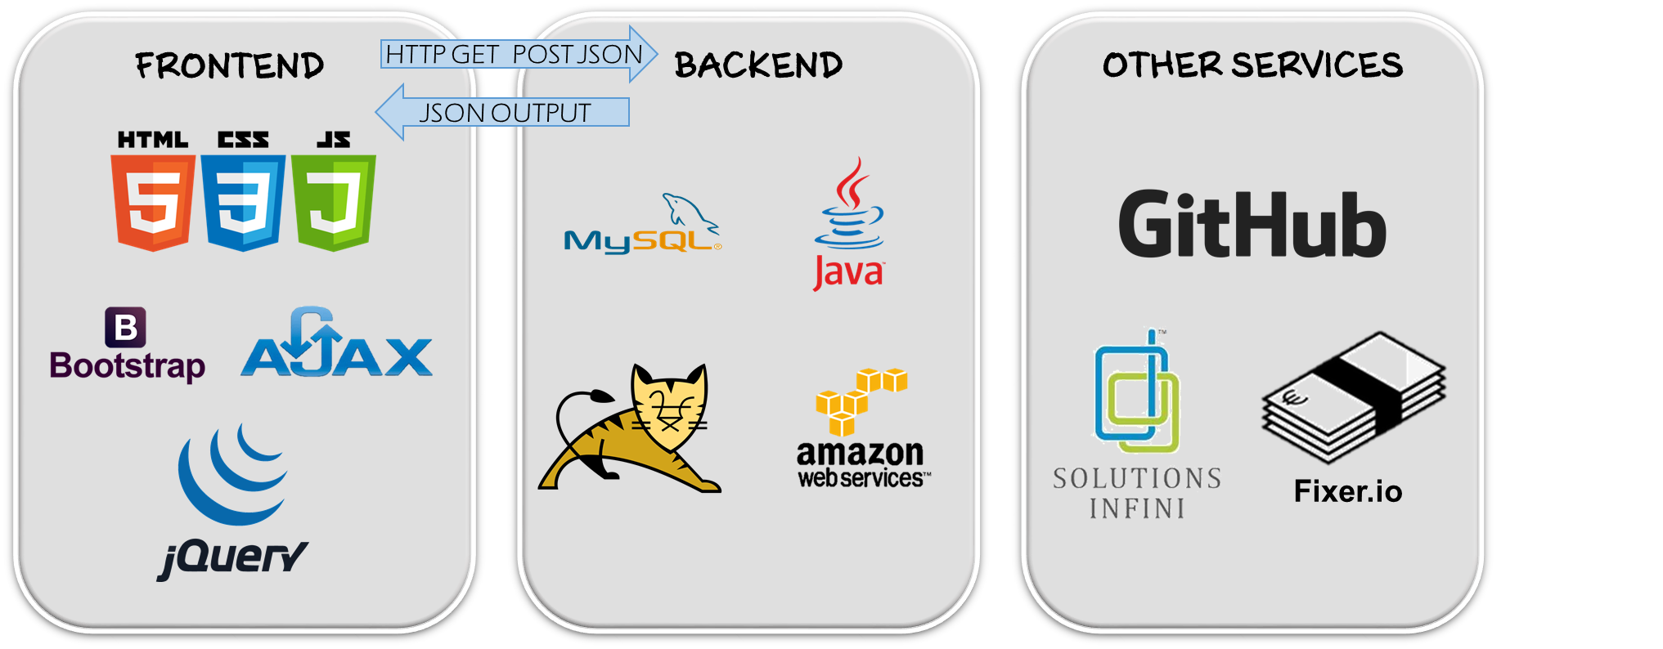
TECHNICAL
Architecture Diagram

Slide 12
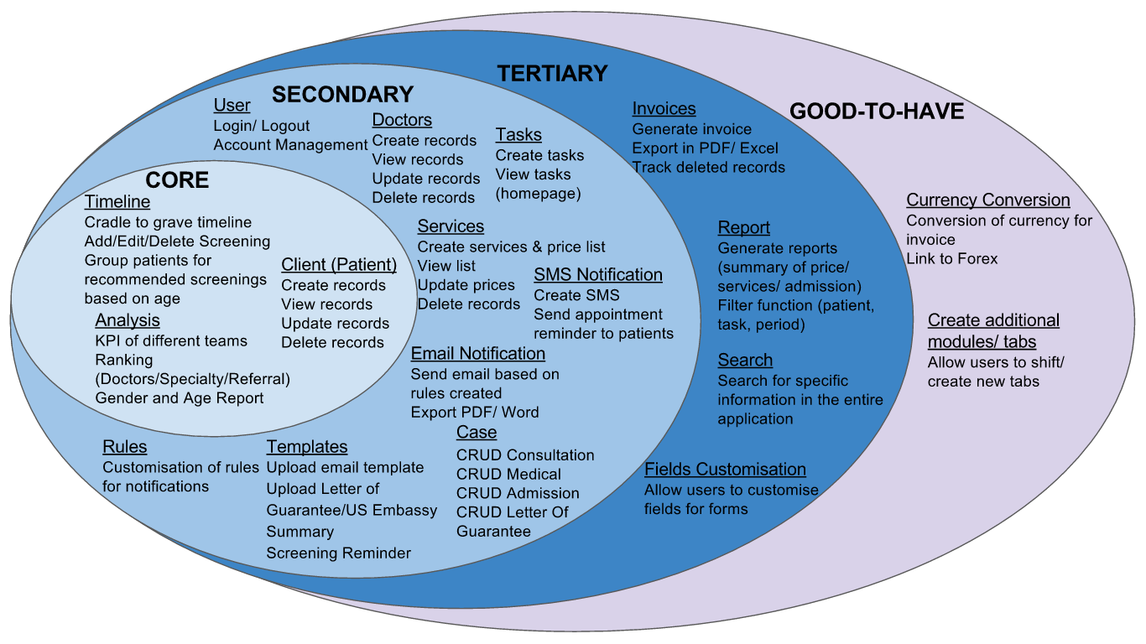

Project Management
Scope
Notes:
10/34

Slide 13
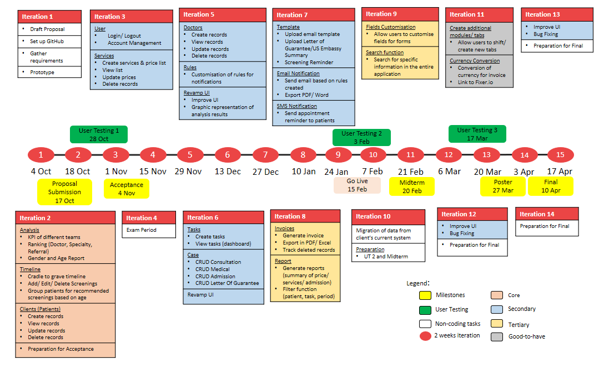
Project Management
Planned Schedule

Slide 14
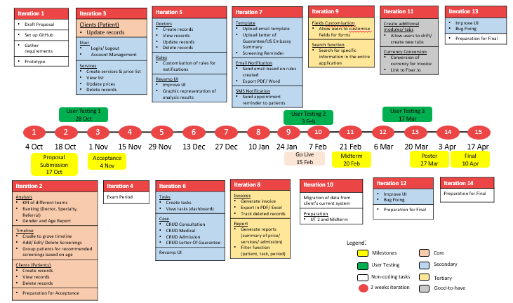
Project Management
Actual Schedule

Slide 15
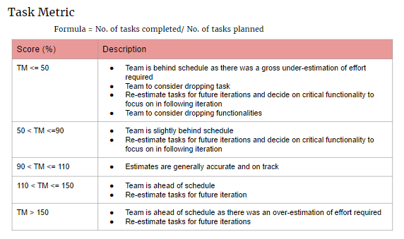
Project Management
Task Metric
Iteration 2
Planned Tasks: 12
Completed Tasks: 11
TM Score: 91.6%

Slide 16
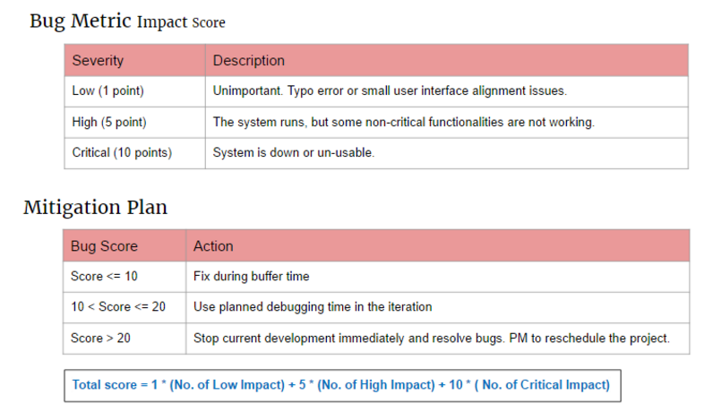
Project Management
Bug Metric
Iteration 2
Bug Score: 10
After debugging: 5
Action Plan: Debug during planned debugging time

Slide 17
Project Management
Risk Management
Risk | Risk Event | Likelihood | Impact | Mitigation
Project Management Risk | Allocation of too much/ little time for development of functions | Medium | High | 1) Include buffer days before final submission. Allocate more time to develop complex functions. 2) Update & Review metrics regularly

Slide 18
Project Management
Risk Management
Risk | Risk Event | Likelihood | Impact | Mitigation
Client Risk | Change in client’s requirement | Medium | High | Meet and update client weekly to ensure that development is on par with client’s requirements

Slide 19
Project Management
Risk Management
Risk | Risk Event | Likelihood | Impact | Mitigation
Human Risk | Team member is not available due to illness or unforeseen circumstances | Medium | Medium | Each member has dual role to take over member who is unavailable

Slide 20
User Testing 1
Ulink Assist Pte Ltd
User: Linda Siow
Usability of UI
OCTOBER
28

Slide 21


UT 1 Feedback
Easy to create clients
Easy to navigate
Timeline design is not intuitive
Naming of columns and fields are confusing
Notes:
Client prefers to choose which patient to send email to instead of automated sending of email
Analysis results to be in numbers

Slide 22
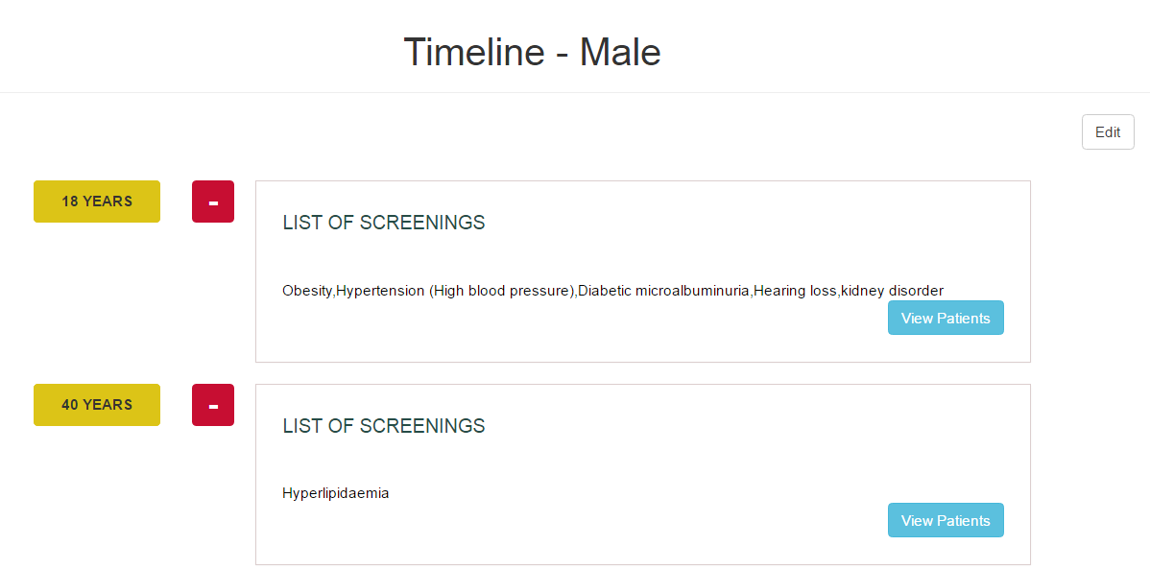
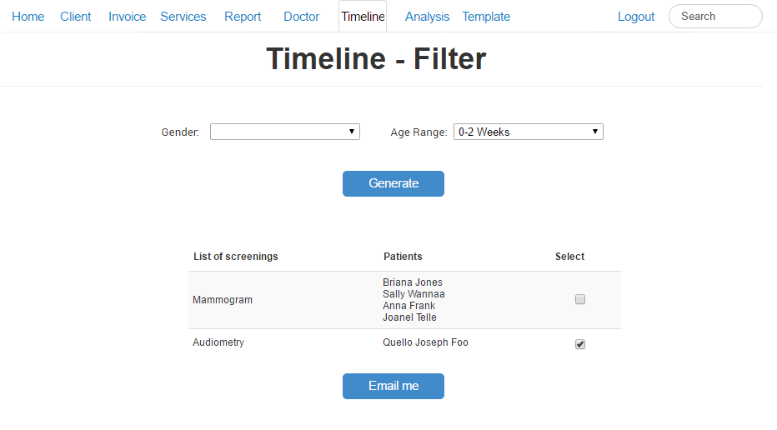
UT 1 Feedback
Timeline display is not intuitive, user suggested to change to table format
Stick to one color scheme
Client prefers to choose which patient to send email to instead of automated sending of email
Changes to be made

Slide 23
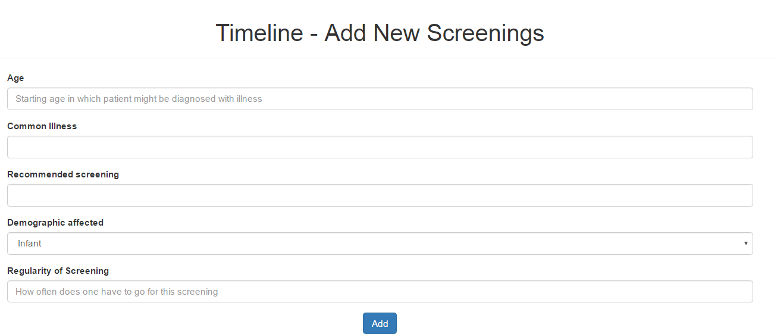
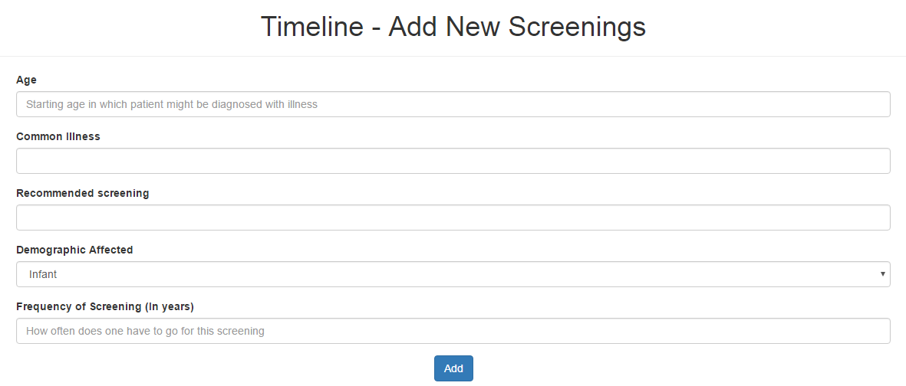
UT 1 Feedback
Rename Regularity field to Frequency of Screening (In Years) for easy understanding
Changes Made

Slide 24
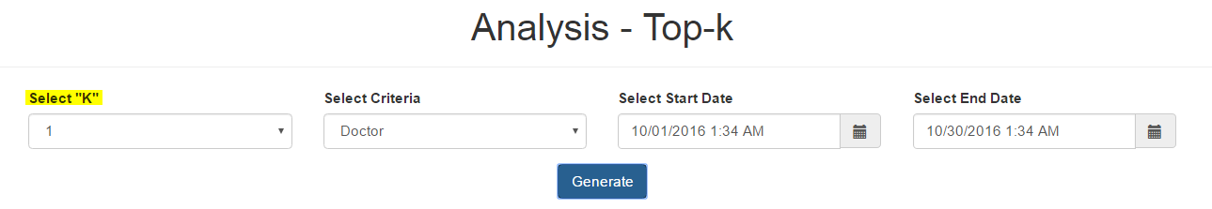
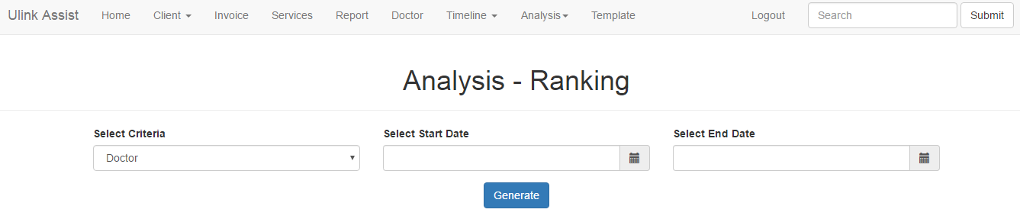
UT 1 Feedback
Top-K function to rename as "Ranking" for easy understanding
List all results in a ranked list instead of selecting “K” value
Changes Made

Slide 25
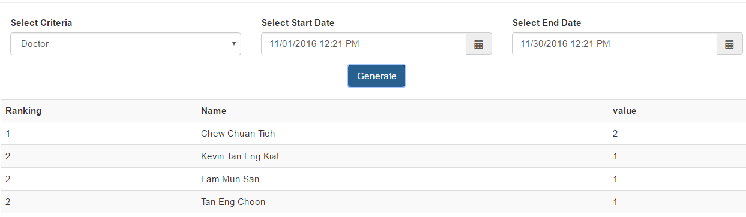
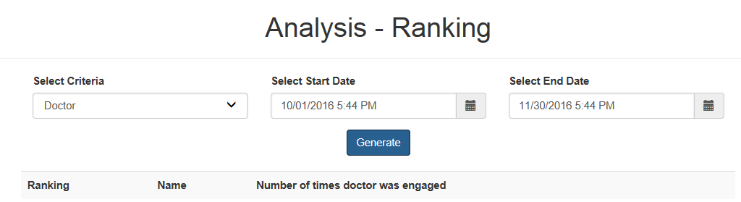
UT 1 Feedback
Confusing naming
Changes Made

Slide 26
X-FACTOR
Midterm
5 users using the application
Final
8 users with at least 5 interactions with the system per day

Slide 27
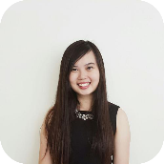

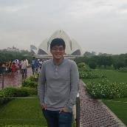

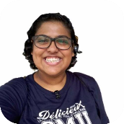
Learning Outcome
Shu yan
nicole
Learn to conduct UAT effectively to collect users feedback, analyse the feedback and devise solution catered to their needs
Gain more knowledge on UI development and improve communication skills
Sean
Have a better understanding on how technology can help my client have a better view of their business performance
Nabilah
Kaixin
Manage team and schedule effectively to deliver product on time
Apply knowledge of design processes and translate business problems into application functions

Slide 28

Thank you

