Slide 1
Jupyter Notebooks and Miscellaneous Extras

Slide 2
What is a Jupyter Notebook
Document containing both code (e.g. python) and rich text elements (figures, equations, text, etc…)
Allows for a cohesive environment for presenting and working with data
Jupyter is a ‘loose acronym’ meaning Julia, Python and R; Other languages are supported as well

Slide 3
Running Jupyter Notebooks
Make sure Jupyter is installed (obviously)
Cmd line
    >jupyter notebook
    OR
    >jupyter notebook ‘name of notebook’
Notebook files end in .ipynb
If no notebook is specified, opens the Notebook Dashboard
Numerous shortcuts listed in ‘Jupyter-Shortcuts.pdf’

Slide 4
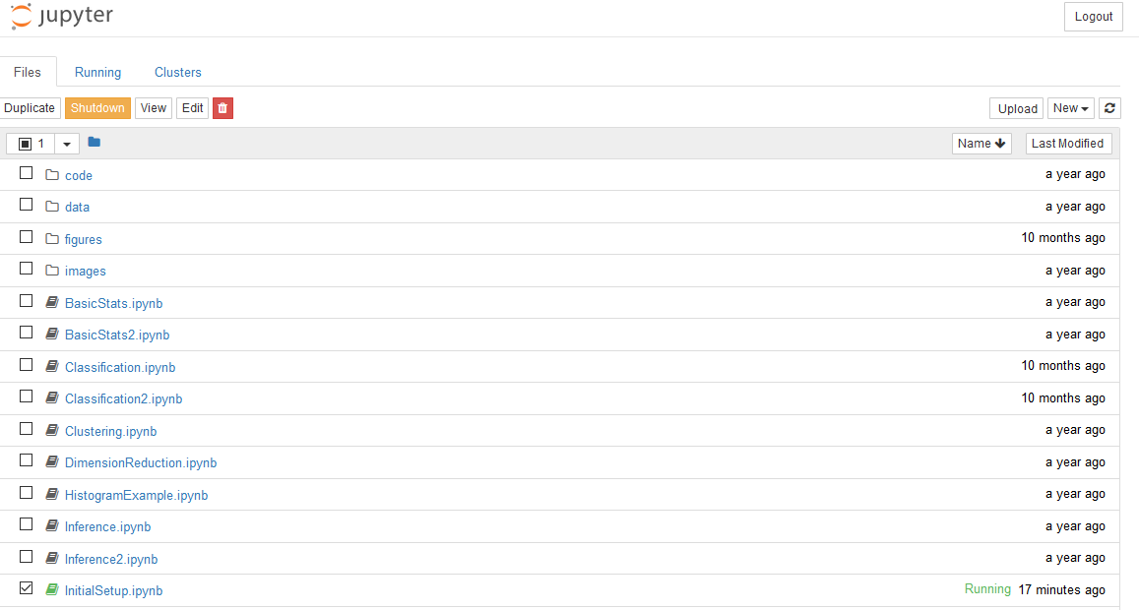
Notebook Dashboard
Used for opening individual notebooks from list, and managing kernels (computational engines).

Slide 5
Example Notebooks – Curve Fitting
Use scipy.optimize from the scipy library
Open ErrorEllipse.ipynb for illustration of technique

Slide 6
Example Notebooks - Pandas
Pandas is an open source library for high-performance data structure and data analysis
Simple library to install and initialize
>pip install pandas
>import pandas
Open PandasIntro.ipynb for illustration of technique

Slide 7
Exporting Notebooks
Command line prompt for turning a notebook into pdf/latex file/presentation slides/.py script/etc…
Commands:
  >jupyter nbconvert --to script ‘filename’
  >jupyter nbconvert --to pdf ‘filename’
  >jupyter nbconvert --to latex ‘filename’
  >jupyter nbconvert --to html ‘filename’
  >jupyter nbconvert --to slides ‘filename’
  …

Slide 8
Exporting Notebooks
Example Notebook from Josh Wall: Homework_1.ipynb
Turned into PDF
Turned into TeX file
NOTE: Setting this up can be a pain, is OS dependent, and will require some tinkering to install the proper libraries in the proper path structure.

