Slide 1
Call heating_and_cooling (heat FUV, CR, PE)
Get ionization fraction (change mu if vary atomic frac)
Calculate change in ion frac (delion)
Set values ei, pres, ei/temp
If “time_evolve” write data
If ”dens_evolve” write data
Increment density
Initialize values
ei, temp, mu, delion
☺
Is time < tend?
Is ndens < ndens_final?
Is delion < delion_min?
Yes.
Yes.
Yes.
No.
No.
No.

Slide 2
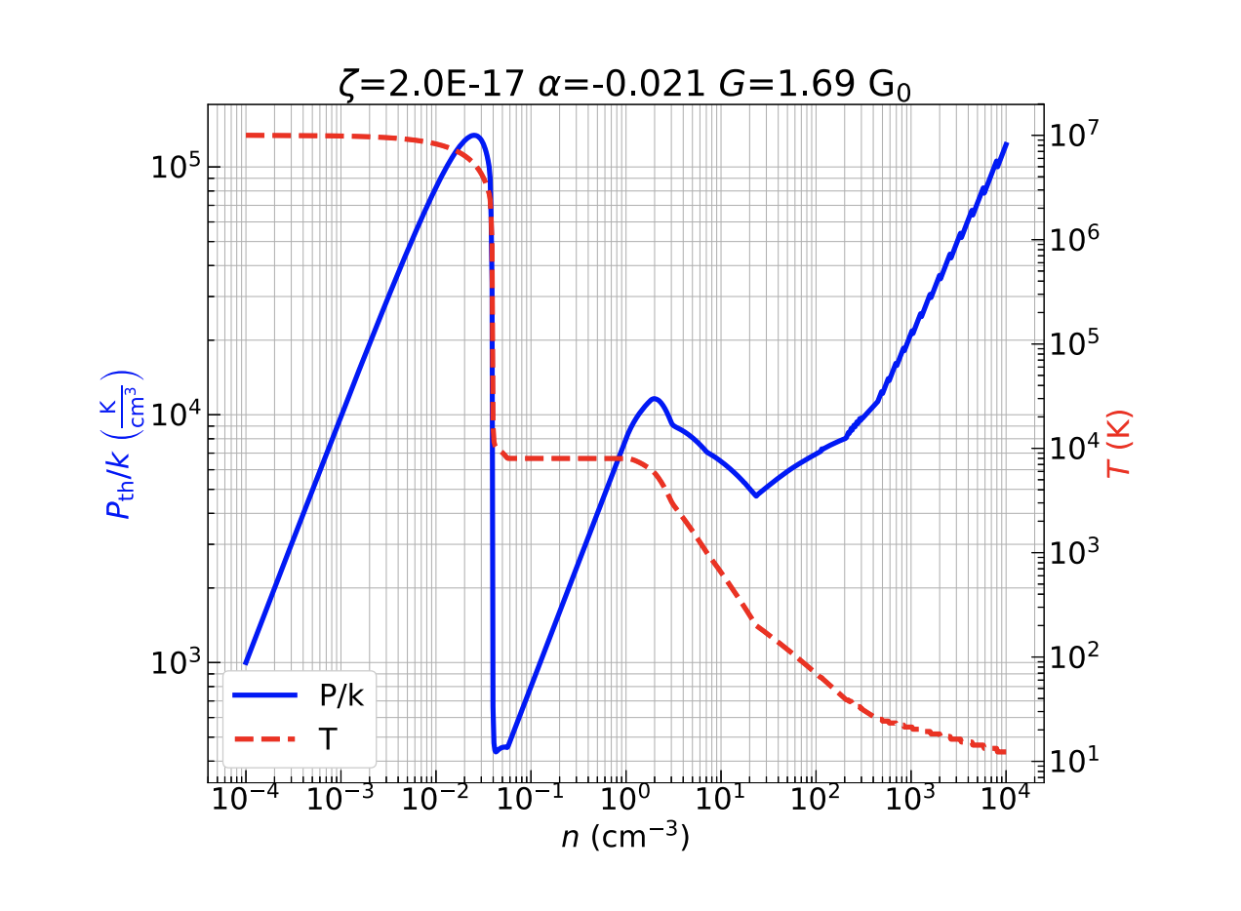
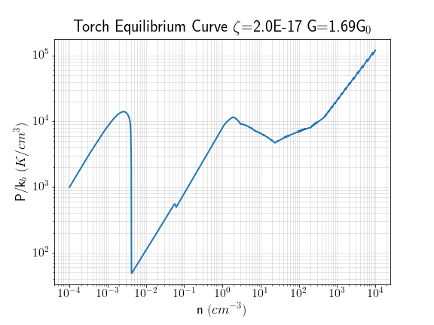

Slide 3
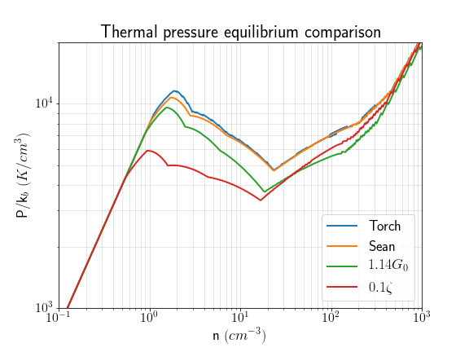

Fiducial:
Notes:
One of the culprits appears to be the applied Habing flux (Habing 1968)
Draine uses FUV flux heating values from Mathis 1983 which is described by a Habing flux of G_0 = 1.14
We use a FUV flux heating rate of G_0 = 1.69; 150% of the rate used in Draine

Slide 4
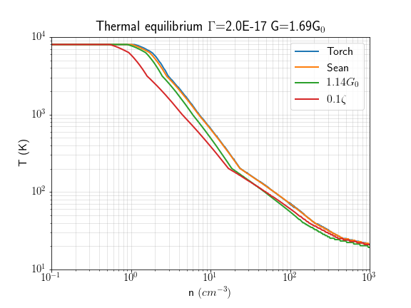

Slide 5
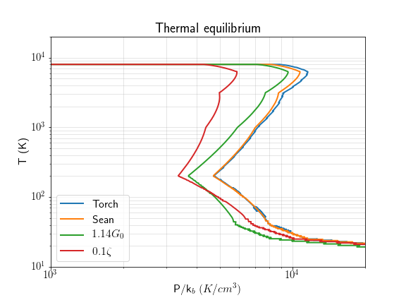

Slide 6
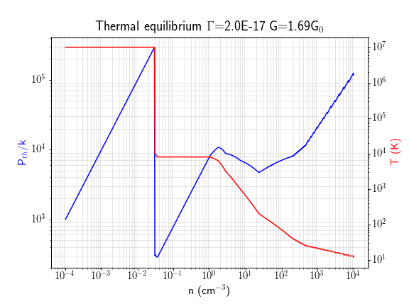

Slide 7
Parameters that effect Equil curve (Wolfire 1995)
Habing flux (FUV photoionization)
CR ionization rate
Column density
Gas to dust ratio
Mu (we initialize at 0.63)

