Slide 1
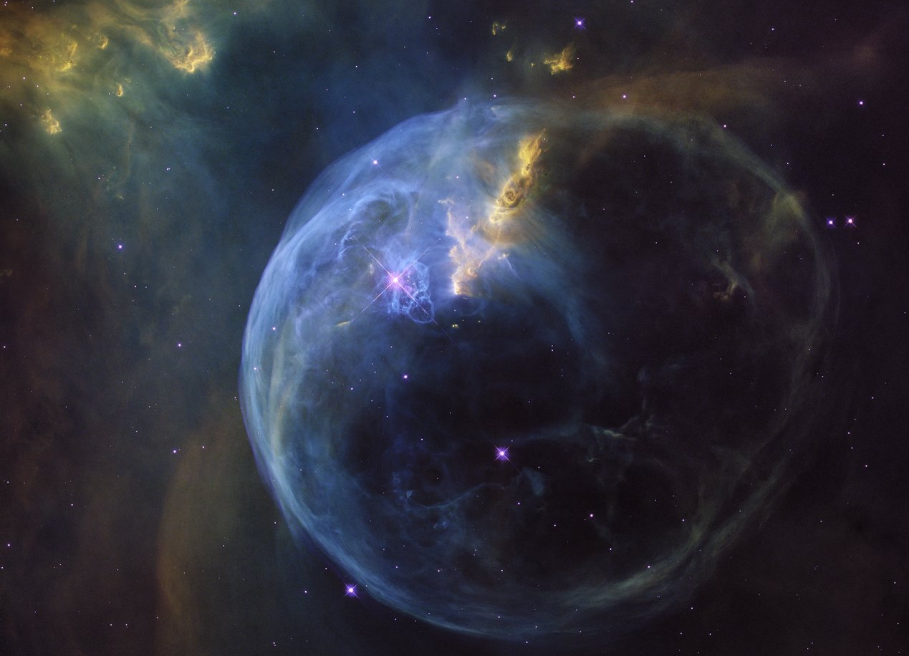
Star Cluster Formation: The Effects of Early Forming Massive Stars and Building a Bridge Between Voronoi Mesh and Block-Structured Codes
Sean C. Lewis, Stephen McMillan, Mordecai-Mark Mac Low, Claude Cournoyer-Cloutier,
Brooke Polak, Aaron Tran, Martijn Wilhelm, Alison Sills, Ralf Klessen, Joshua Wall
Notes:
Sean Lewis from Drexel University
Two parts to this talk:
Most recent published paper: effects of early forming massive stars
Novel method for porting data from Voronoi mesh to Block-structured codes

Slide 2
NASA, ESA, Hubble Heritage Team
Notes:
Massive stars play very important role in star cluster formation
Their feedback disrupts natal gas, quenching star formation
How rapidly their feedback evacuates gas has implications for subsequent cluster assembly
An unexplored parameter is “WHEN” a massive star forms
We hypothesize that early forming massive stars disrupt natal GMC resulting in slower star formation and will also suppress the hierarchical assembly of the cluster

Slide 3
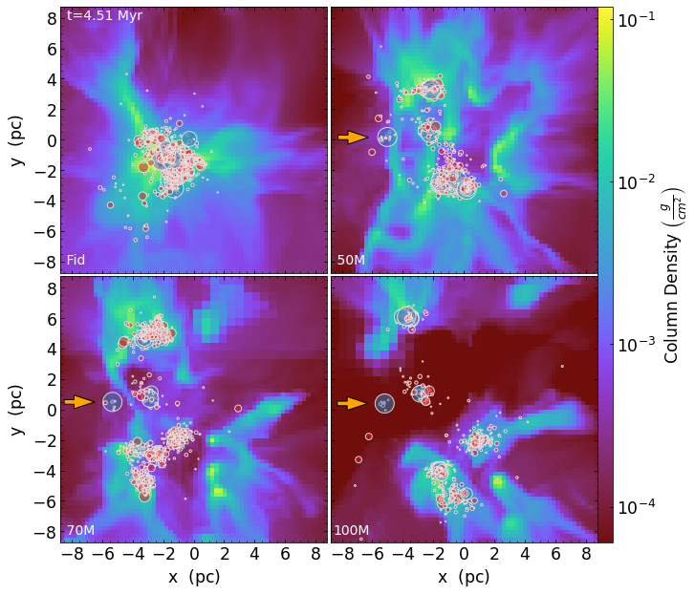
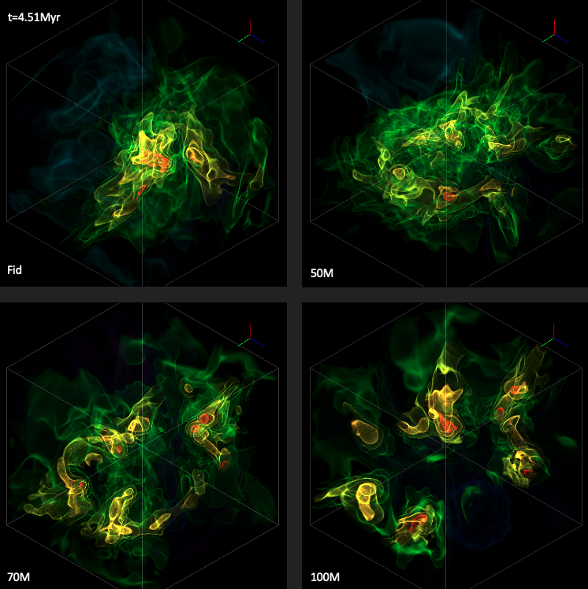
Early Forming Massive Stars Comparing Four Torch Simulations
Lewis et al. 2023
Gas Column Density; Projected Stars
Gas Density Contours
Torch: Wall, McMillan, Mac Low, Klessen, and Portegies Zwart (2019);
Wall, Mac Low, McMillan, Klessen, Portegies Zwart, and Pellegrino (2020)
Notes:
To test this, we use the star formation software suite. Torch integrates the MHD code FLASH with the N-body and stellar evolution suite AMUSE
In a Torch simulation Our stars form from sink particles which accrete gas and then spawn stars with masses randomly sampled from Kroupa IMF
With Torch we perform a controlled experiment comparing a fiducial run with 3 runs where we force a 50, 70, 100 Msun star to form first
In these plots we see gas, stars…
These plots show…

Slide 4
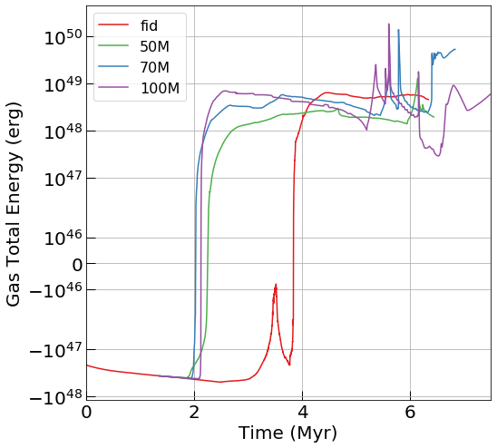
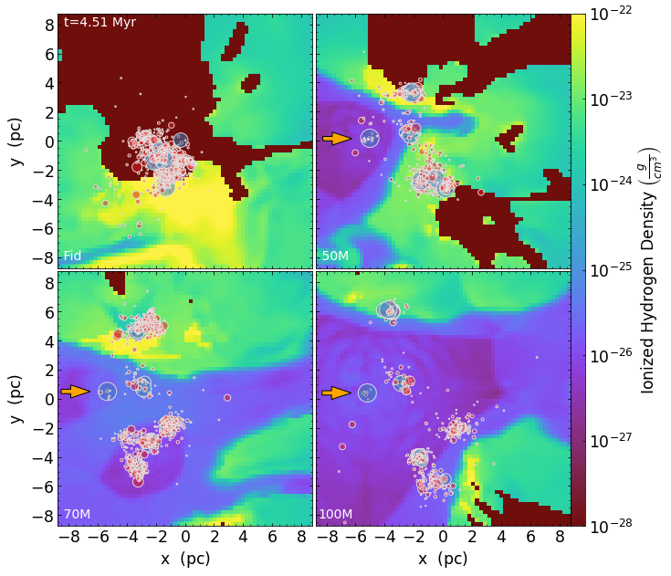
Early Forming Massive Stars Rapidly Unbind GMC Gas
Lewis et al. 2023
Notes:
We find that early forming massive stars rapidly unbind the natal GMC gas

Slide 5
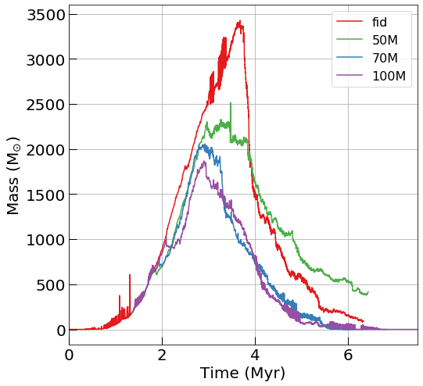
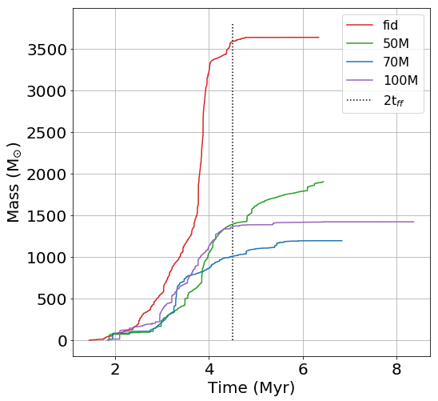
Early Forming Massive Stars Suppress Gas Accretion and Star Formation
Lewis et al. 2023
Gas Mass Satisfying Jeans Criterion
Cumulative Stellar Mass
Notes:
We also find that EFMS suppress the gas available for accretion (Jeans criterion)
And total stellar mass formed

Slide 6
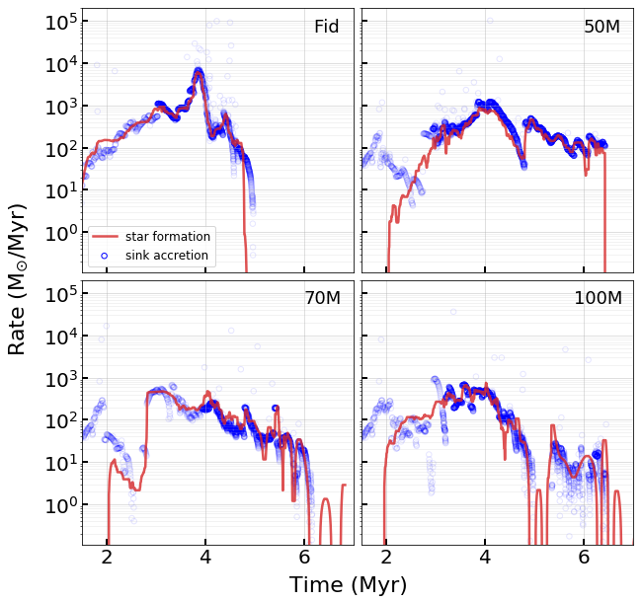
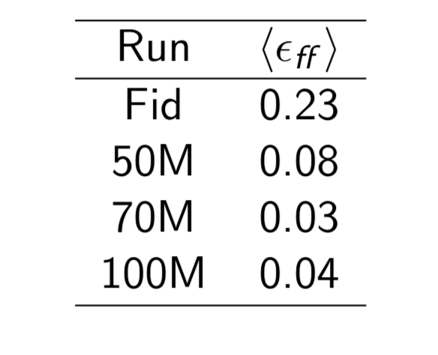
Early Forming Massive Stars Suppress Gas Accretion and Star Formation
Lewis et al. 2023
Notes:
EFMS Suppress gas accretion and star formation rates
SFR per freefall time by factor of 3-7

Slide 7
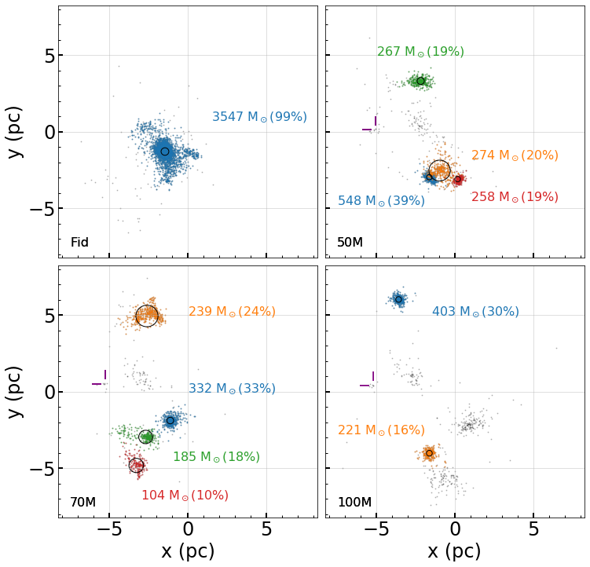
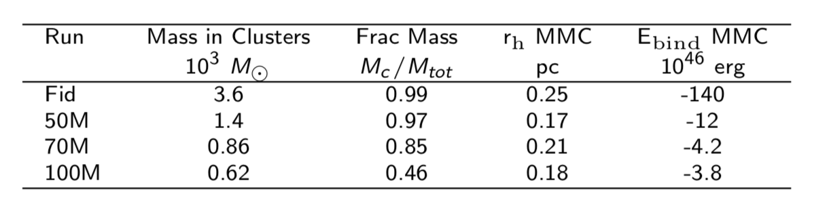
Early Forming Massive Stars Promote Formation of Fragmented, Low Mass, Loosely Bound Clusters
Lewis et al. 2023
Notes:
We find that EFMS promote formation of fragmented low-mass loosely-bound clusters
Use DBSCAN to identify
Point out mass percentages

Slide 8
Early Forming Massive Stars Conclusions
Lewis et al. 2023
Star Formation Rate and Cumulative Star Suppression
Gas Disruption and Unbinding
Cluster Assembly Disruption
Notes:
Disrupt the gas structure, resulting in earlier unbinding of GMC.
Suppress SFR per free-fall time by up to a factor of seven, reducing the total mass of stars formed.
Stifle the hierarchical assembly of massive star clusters; promoting the formation of spatially separate and more loosely bound subclusters.

Slide 9
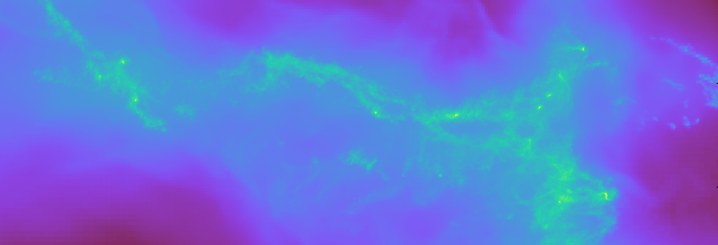
In Pursuit of a Self-Consistent Star Formation Simulation Using the Torch computational framework
VorAMR
Data from: Li, Vogelsberger, Marinacci, Sales, and Torrey (2020)
Using AREPO (Springel 2010) with SMUGGLE (Marinacci, Sales, Vogelsberger, Torrey, and Springel 2019)
Notes:
Common problem – lack of realistic initial conditions
Start from isolated spherical cloud or colliding gas cylinders
Missing physics: galactic influences like tidal and shearing effects on clouds, galactic-scale feedback

Slide 10
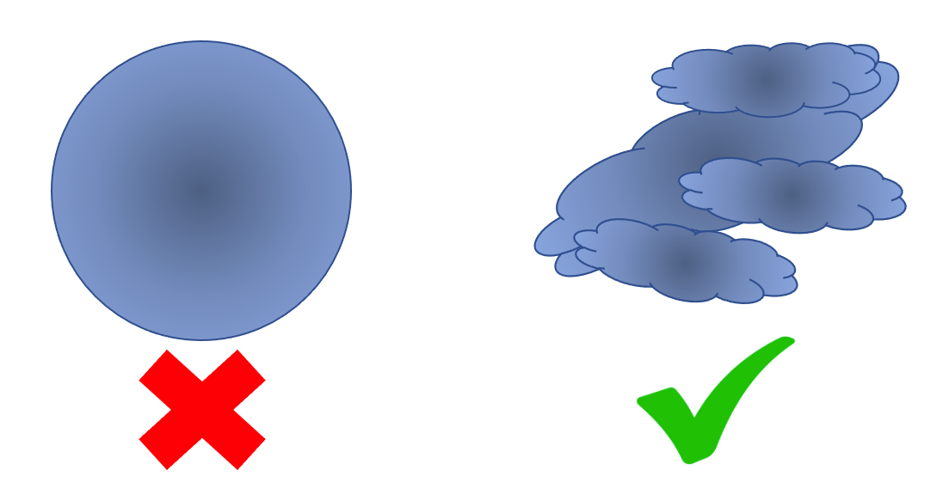
In Pursuit of a Self-Consistent Star Formation Simulation The kinds of clouds we want
VorAMR
Notes:
Just to recap
Self-consistent Torch simulations
Ideally, use data of clouds that form in galactic simulations as initial conditions
Where do we get these self-consistent clouds?

Slide 11
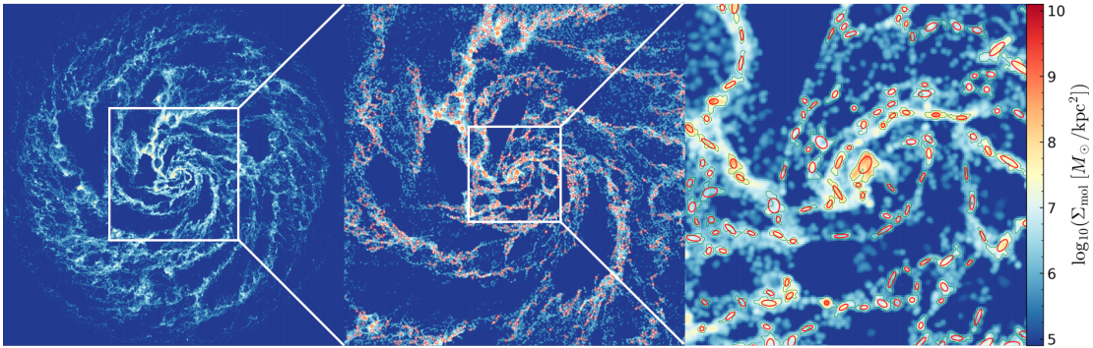
In Pursuit of a Self-Consistent Star Formation Simulation Self-consistent clouds
VorAMR
Image from: Li, Vogelsberger, Marinacci, Sales, and Torrey (2020)
Using AREPO (Springel 2010) with SMUGGLE (Marinacci, Sales, Vogelsberger, Torrey, and Springel 2019)
Notes:
Part of Li et al. 2020 takes a big step in this direction, Identifying GMCs that form during their galactic sim\
We’s like to use these clouds in Torch
BUT there;s a problem; Li et al runs use a moving mesh MHD code called AREPO
We use the adpaptive grid-based code FLASH
How do we accurately transfer data from one to the other

Slide 12
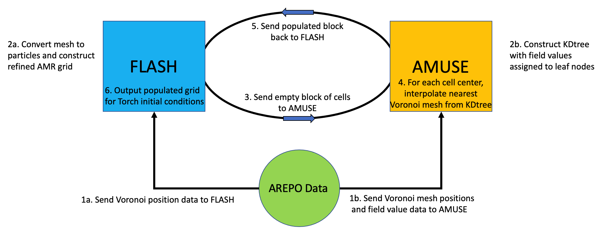
In Pursuit of a Self-Consistent Star Formation Simulation The Logic of VorAMR
VorAMR
FLASH: Fryxell et al. (2000) with FERVENT: Baczynski, Glover, and Klessen (2015)
AMUSE: Portegies Zwart et al. (2009, 2013); Pelupessy et al. (2013); Portegies Zwart & McMillan (2019)
Notes:
Can be used for data conversion from ANY moving mesh code OR SPH code OR

Slide 13
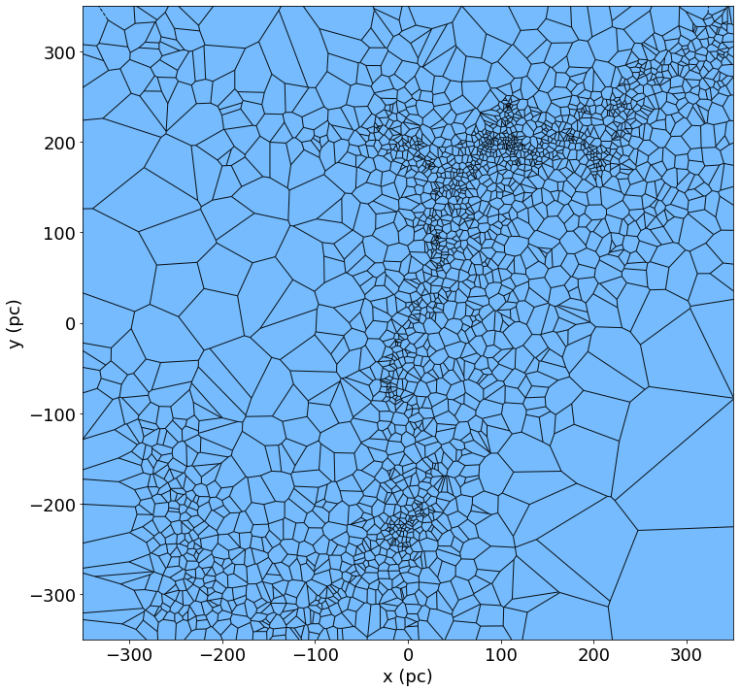
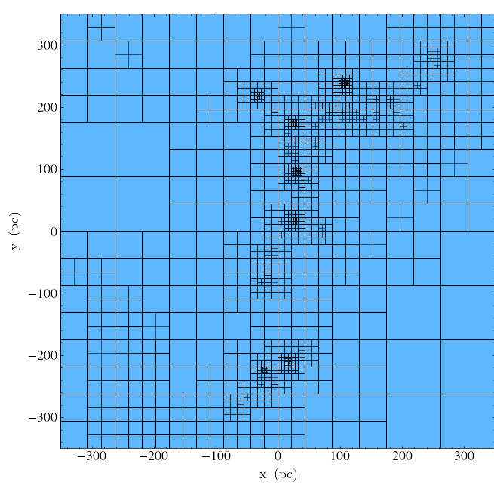
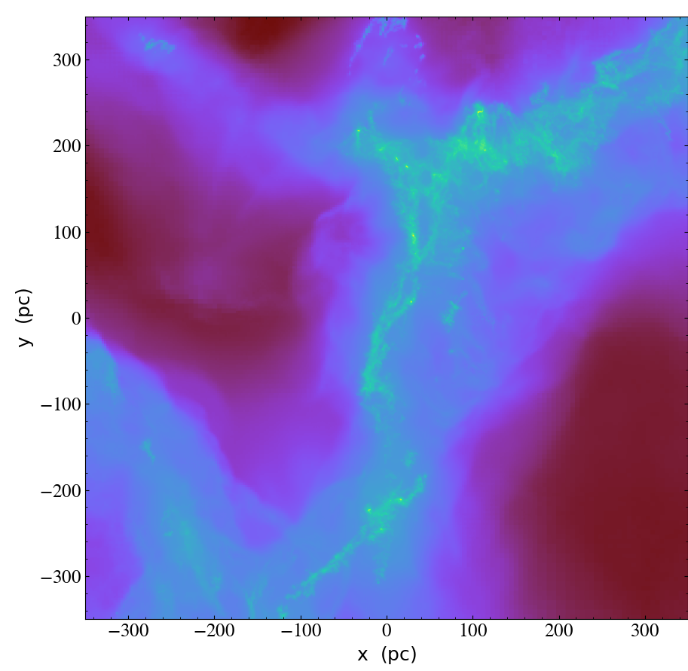
In Pursuit of a Self-Consistent Star Formation Simulation VorAMR in action
VorAMR
AREPO Voronoi Mesh
FLASH Adaptive Mesh Refinement Grid
Populated FLASH AMR Grid

Slide 14
Conclusions
VorAMR…
Provides a novel way to visualize Voronoi mesh-based hydrodynamical data.
Represents a critical linkage in the star cluster simulation pipeline which will allow Torch to use realistic GMC initial conditions.
Provides an avenue for increased collaboration between research groups using different methods.
Early Forming Massive Stars…
Significantly disrupt the natal gas structure, resulting in earlier unbinding of GMC.
Suppress the star formation rate per free-fall time by up to a factor of seven, reducing the total mass of stars formed.
Stifle the hierarchical assembly process of massive star clusters, instead promoting the formation of spatially separate and more loosely bound subclusters.

