Slide 1
Star Cluster Formation: The Effects of Early Forming Massive Stars and Building a Bridge Between Voronoi Mesh and Block-Structured Codes
Sean C. Lewis, Stephen McMillan, Mordecai-Mark Mac Low, Claude Cournoyer-Cloutier, Brooke Polak, Aaron Tran, Martijn Wilhelm, Alison Sills, Ralf Klessen, Joshua Wall

Slide 2
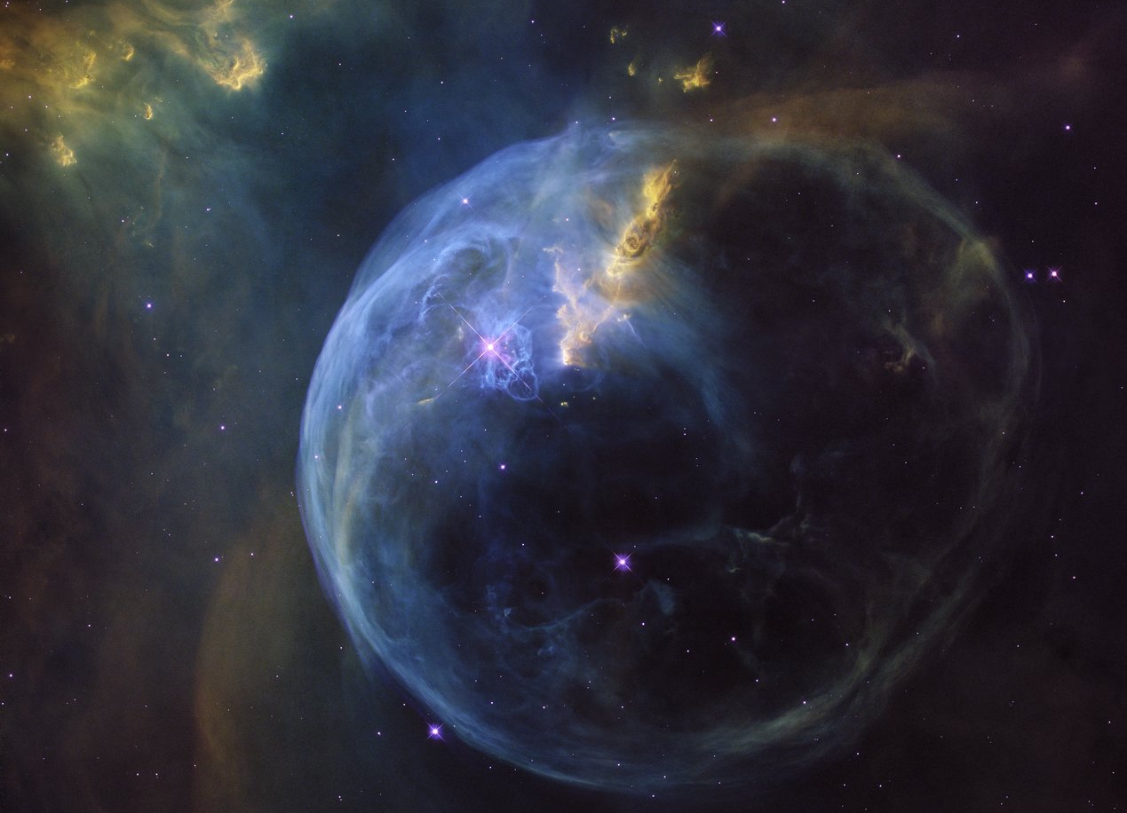
NASA, ESA, Hubble Heritage Team

Slide 3
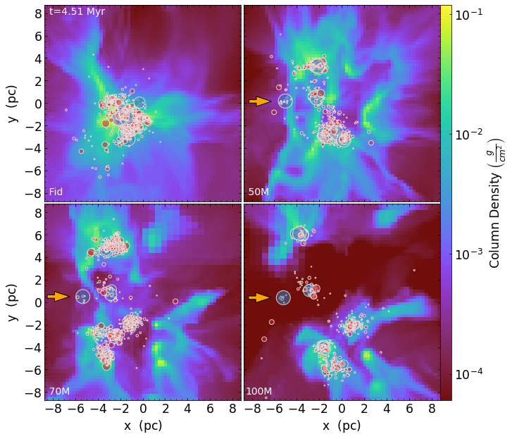
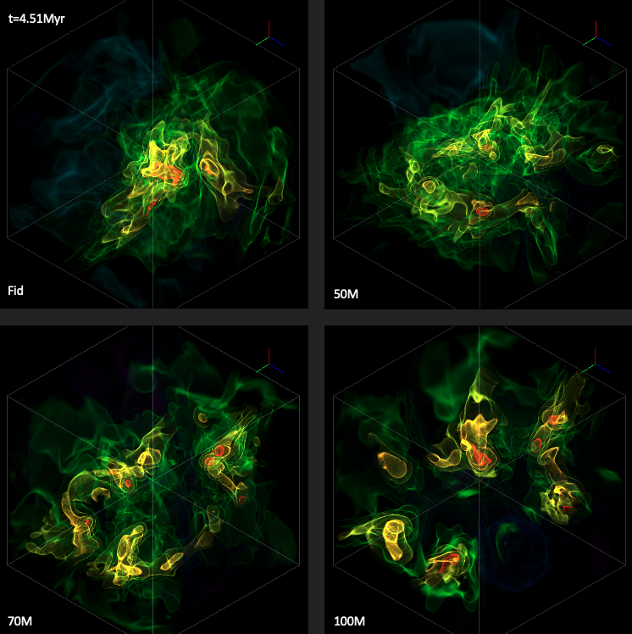
A Controlled Experiment Using the Torch computational framework
Lewis et al. 2023
Gas Column Density; Projected Stars
Gas Density Contours

Slide 4
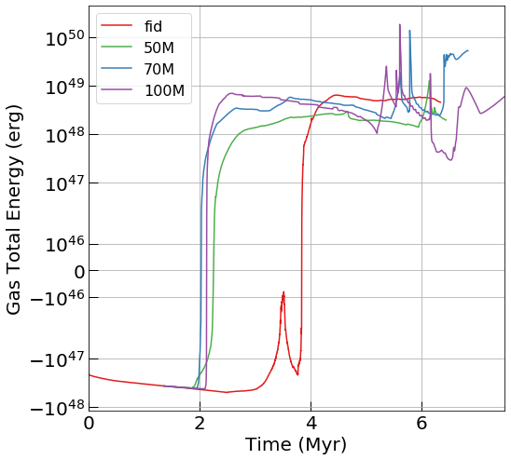
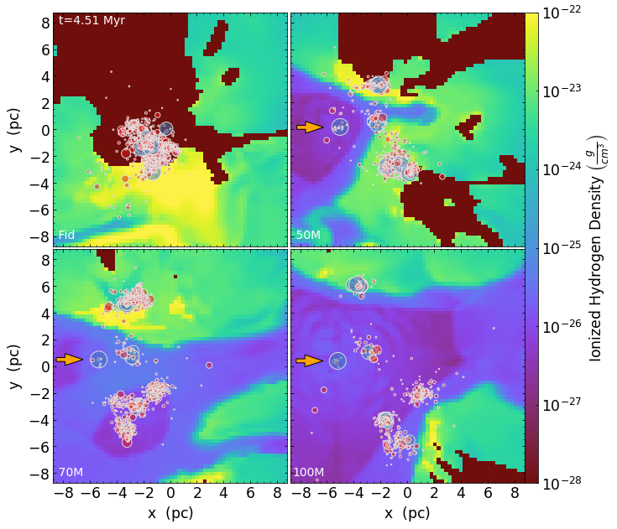
A Controlled Experiment Using the Torch computational framework
Lewis et al. 2023

Slide 5
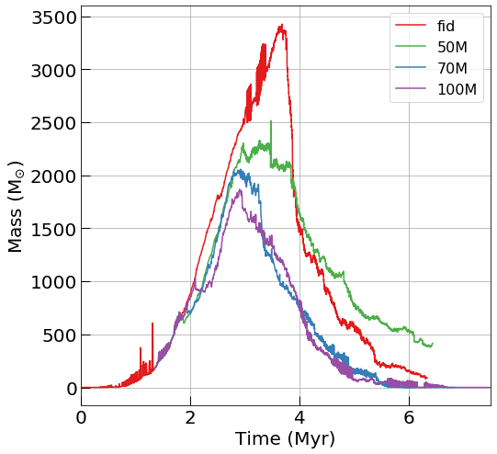
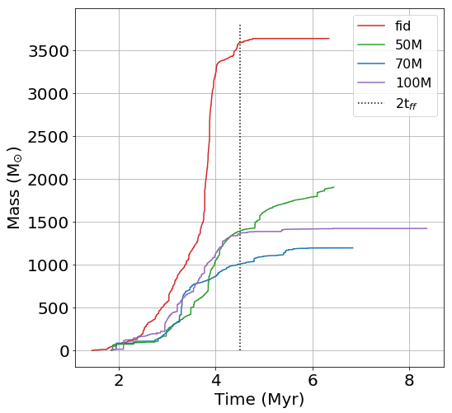
A Controlled Experiment Using the Torch computational framework
Lewis et al. 2023

Slide 6
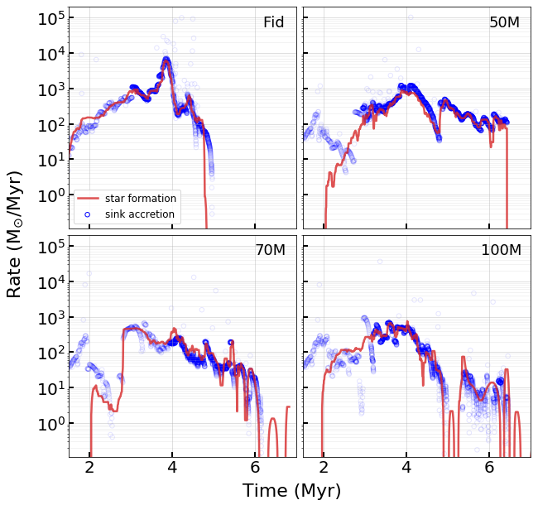
A Controlled Experiment Using the Torch computational framework
Lewis et al. 2023

Slide 7
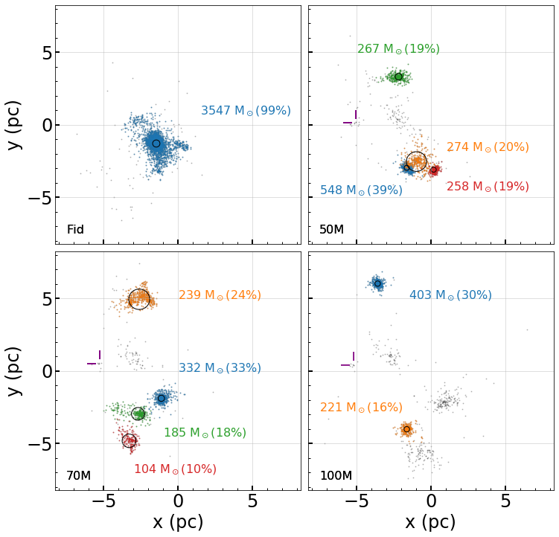
A Controlled Experiment Using the Torch computational framework
Lewis et al. 2023

Slide 8
Conclusion 1 Using the Torch computational framework
Lewis et al. 2023

Slide 9
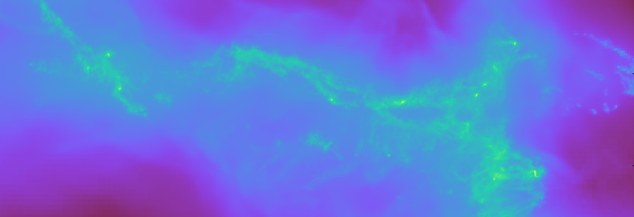
In Pursuit of a Self-Consistent Star Formation Simulation Using the Torch computational framework
VorAMR

Slide 10
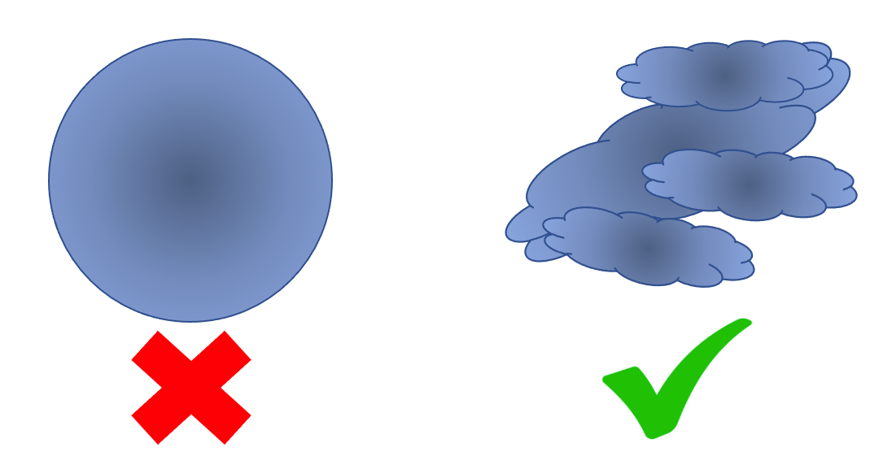
In Pursuit of a Self-Consistent Star Formation Simulation Using the Torch computational framework
VorAMR

Slide 11
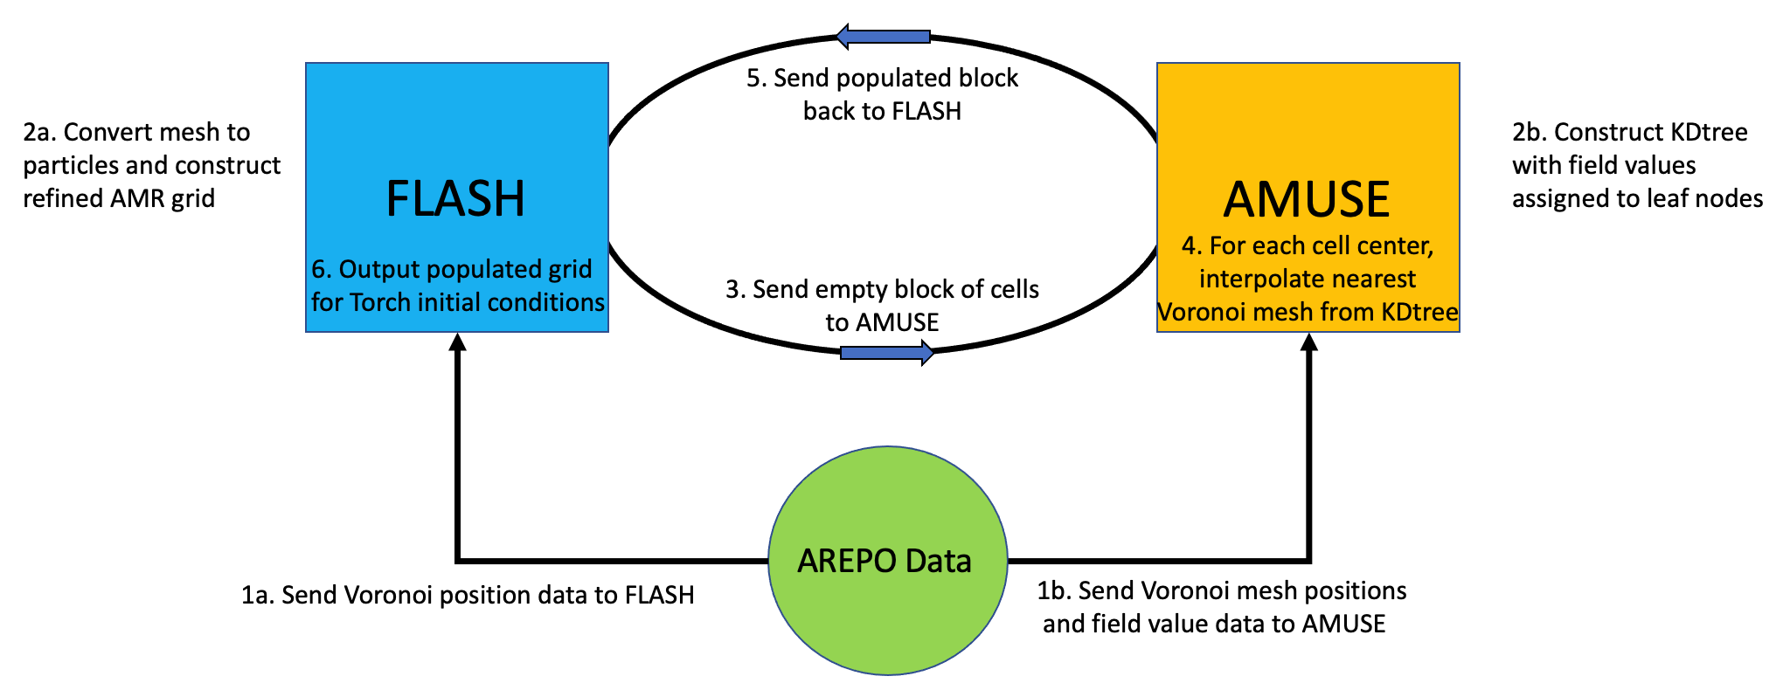
In Pursuit of a Self-Consistent Star Formation Simulation Using the Torch computational framework
VorAMR

Slide 12
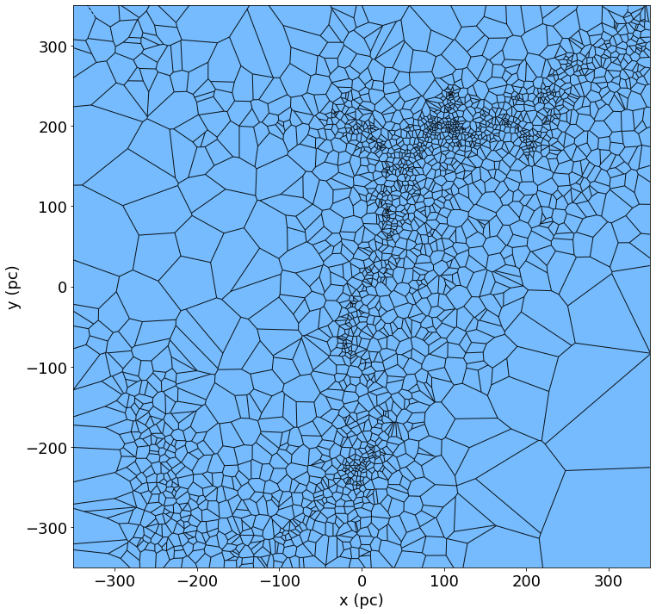
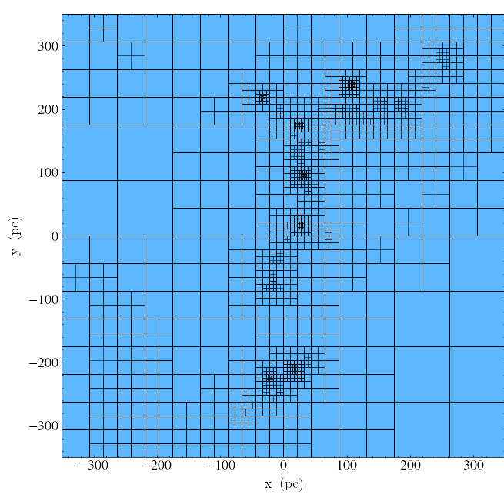
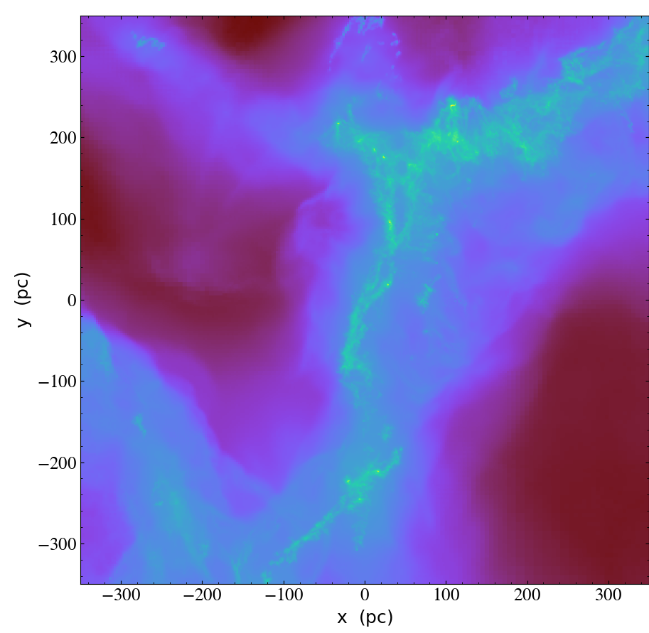
In Pursuit of a Self-Consistent Star Formation Simulation Using the Torch computational framework
VorAMR
AREPO Voronoi Mesh
FLASH AMR Grid
Populated FLASH AMR Grid

Slide 13
Conclusions
Early Forming Massive Stars…
Significantly disrupt the natal gas structure, resulting in earlier unbinding of GMC.
Suppress the star formation rate per free-fall time by up to a factor of seven, reducing the total mass of stars formed.
Stifle the hierarchical assembly process of massive star clusters, instead promoting the formation of spatially separate and more loosely bound subclusters.
VorAMR…
Provides a novel way to visualize Voronoi mesh-based hydrodynamical data.
Represents a critical linkage in the star cluster simulation pipeline which will allow Torch to use realistic GMC initial conditions.
Provides an avenue for increased collaboration between research groups using different methods.

