Slide 1
Cross-browser fingerprinting
Song Li
Yi Hu
This is the subtitle, but I do not know what to say here
You can not see me! You can not see me! You can not see me!

Slide 2
Fingerprinting
Websites need to know: Who are you? To provide a lot of annoying advertisements
Governments need to know: Who are you? To log your activities.
A lot of stupid things

Slide 3
What we can do
Use different accounts –But they can fingerprint your browser
Use different browsers –That is a good choice

Slide 4
Why this project
When you visit some website use chrome
And then you attack this website by Firefox
When you visit Amazon using chrome
And then you visit Amazon again using Firefox

Slide 5
How to do cross-browser fingerprinting
System font
Different system render same fonts in different ways
Different graphic libraries render same fonts in different ways
The problem is the entropy is not really good
Has been done by other papers
WebGL and Graphic card
WebGL is a web-based OpenGL
Based on HTML5
Use Graphic card to render complex graphs
The render result by different GPU is different

Slide 6
Find difference
Run WebGL tests in
5 computers
5 Operating systems //OS X El Capitan‎, Windows 10, Windows 7, Ubuntu, ChromeOS
481 test errors
Most of the errors are browser caused
Mainly try to find cross-browser errors

Slide 7
4 major Errors
High precision float calculation error //happens in 1 computer, cross browser
RGB calculation error //happens in 1 computer, cross browser
Null-pointer Fragment shader Init error //happens in Ubuntu and ChromeOS systems
Temp-expression crash //happens in Ubuntu and ChromeOS systems

Slide 8
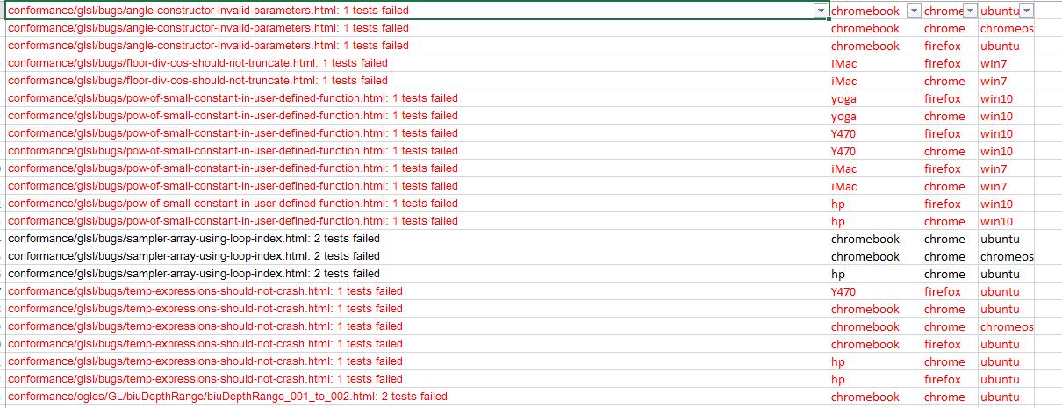
Example
Red color is
cross browser problems

Slide 9
How GPU works
Take in the position of points
Draw dots by “vertex shader”
Connect points, fill it by some color
Calculate detailed colors by “fragment shader” //Light, texture, shadow and so on
Output to screen
Three things: Dots position, vertex shader, fragment shader.

Slide 10
Small rendering difference
Different GPUs use different algorithms to optimize graphs
For complex graphs, different GPU drivers make different “errors”
We need to try different ways to get the errors.
Example:
My blog : songli.us
My server

Slide 11
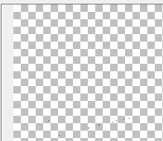
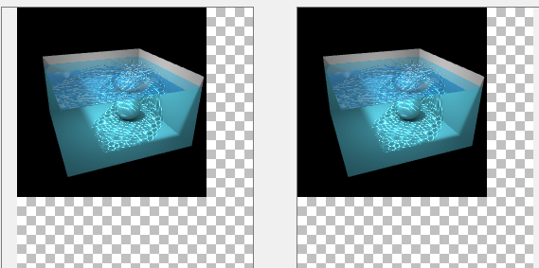
Difference

Slide 12
Compare different pictures
Get the canvas image
Compare the hash result of all the pixels

Slide 13
Problems
For basic graphs, different computers have same results
For complex graphs, one browser have different results in different tests
We need to figure out the optimization that made by GPUs

Slide 14



Thank you!

