Slide 1

CrowdPillar:
Improving Machine Learning Results by Leveraging Support from the Crowd
Sean Goldberg, Sunny Khatri

Slide 2

Introduction
As the amount of content on the web grows, organization for ease of searching, querying, and analyzing data becomes critical.
Existing internet: web of documents.
Future internet: web of data.
-- Tim Berners Lee

Slide 3

Information Extraction
The automated retrieval of information from a collection of unstructured text.
Ultimate goal: Cast information on the web into relational form

Slide 4
Overview
This presentation concerns the application of information extraction to bibliographic data.
Intro
  Discussion of Task and State-of-the-Art
Uncertainty
  Entropy in Conditional Random Fields
Clamping
  Reducing Uncertainty and Increasing Accuracy
Crowd
  Utilizing the AMT for Increased Clamping Efficiency

Slide 5
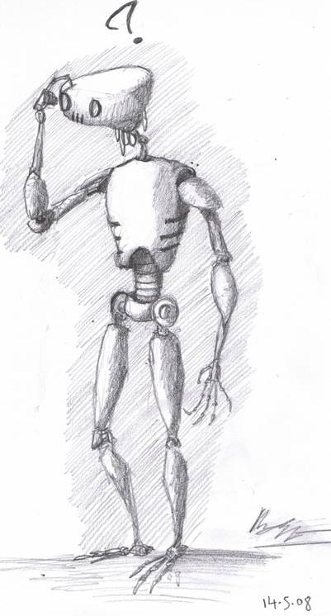

Goal: Perform information extraction on a collection of bibliographic data
Collective Tree Exploration
Pierre Fraigniaud, Leszek Gasieniec, Andrzej Pelc, Dariusz R. Kowalski
3-540-43400-3
Springer
Lecture Notes in Computer Science
LATIN 2002: Theoretical Informatics, 5th Latin American Symposium,
Cancun, Mexico, April 3-6, 2002, Proceedings
2002

Slide 6
Goal: Perform information extraction on a collection of bibliographic data
Collective Tree Exploration
Pierre Fraigniaud, Leszek Gasieniec, Andrzej Pelc, Dariusz R. Kowalski
3-540-43400-3
Springer
Lecture Notes in Computer Science
LATIN 2002: Theoretical Informatics, 5th Latin American Symposium,
Cancun, Mexico, April 3-6, 2002, Proceedings
2002

Slide 7
State-of-the-Art for IE:
Conditional Random Fields
Tree
Exploration
Pierre
Fraigniaud
Title
Title
Author
Author
Features: relationships between observation sequence and hidden labels as well as relationships among hidden labels

Slide 8

Entropy
Measure of uncertainty for a probabilistic output
Uneven Distribution
Even Distribution
Low Entropy
High Entropy

Slide 9
System Design
CRF Model
Labeled
Output
Entropy
Model
Test
Data
Training
Data
Crowd

Slide 10
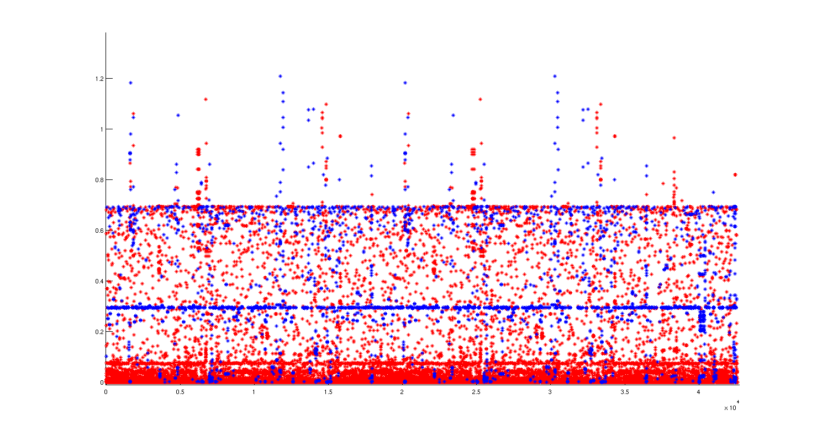
Uncertainty vs. Accuracy:
Token-by-Token
Correct
Incorrect
Mean Entropy
.0498
.3418
Median Entropy
1.06e-5
.2947

Slide 11
Uncertainty vs. Accuracy:
Whole Sequence
Show Figure and Threshold

Slide 12
Partial Sequence Experiments
Discuss motivation behind using only part of a sequence to ask a question
Clamping nodes upon receiving response
How do we determine the best node(s) to clamp?

Slide 13
Clamping Nodes:
Constrained Viterbi
1
2
3
4
5
6
. . .
i-1
i
i+1
. . .

Slide 14
Marginal Entropy

Slide 15
Highest Marginal vs. Random
Show experiments
Need to regenerate numbers
Highest marginal statistically better than random

Slide 16
Single Node: Increase in Accuracy

Slide 17
Multiple Nodes

Slide 18
Three Nodes: Increase in Accuracy

Slide 19
Full sequence vs. Partial sequence
What domains do we find either?
Costs and Benefits of either

Slide 20
Constrained Forward-Backward
Average marginal entropy after clamping
How does the reduction in entropy compare to the increase in accuracy?

Slide 21
Sequence Example 1
Ground truth
Machine output
Constrained output
Compare all of the above

Slide 22
Sequence Example 2
Ground truth
Machine output
Constrained output
Compare all of the above

Slide 23
Sequence Example 3
Ground truth
Machine output
Constrained output
Compare all of the above

Slide 24
Eventual System Design
Discuss flow from input to machine output to question input to question output
Mechanical Turks

Slide 25

There are many ways to ask questions...
Which is the best?

Slide 26
Whole Sequence Tagging
Highlighting:
Collective Tree Exploration
Pierre Fraigniaud, Leszek Gasieniec, Andrzej Pelc, Dariusz R. Kowalski
3-540-43400-3
Springer
Lecture Notes in Computer Science
LATIN 2002: Theoretical Informatics, 5th Latin American Symposium,
Cancun, Mexico, April 3-6, 2002, Proceedings
2002
Number Labeling:
Collective Tree Exploration |1
Pierre Fraigniaud, Leszek Gasieniec, Andrzej Pelc, Dariusz R. Kowalski |2
3-540-43400-3 |3
Springer |4
Lecture Notes in Computer Science |5
LATIN 2002: Theoretical Informatics, 5th Latin American Symposium, |6
Cancun, Mexico, April 3-6, 2002, Proceedings |6
2002 |7

Slide 27
Partial Sequence Tagging

Slide 28
Conclusion

Slide 29
Future Work

Slide 30
Questions?

