Slide 1

Intro to Programming with Scratch
-Presented By: Sean Li

Slide 2
Class Rules
Please have your camera on
Please stay mute unless you are told not to
If you have a question, please use the raise hand function
There will be a rewarding system. I’ll keep track of each group’s points and the winning group will get a reward after each lesson.

Slide 3
Let’s introduce yourself to your new friends

Slide 4
What is programming?
And where is it used?

Slide 5
What is Scratch?
And what can you do with it?

Slide 6
Stories: https://scratch.mit.edu/projects/2760970/
Games: https://scratch.mit.edu/projects/10128407/
Animations: https://scratch.mit.edu/projects/115688906/

Slide 7
Syllabus
1
Intro to Scratch, Repeat
2
Drawing, Variables
3
Coordinates, Conditions
4
5
6
7
8
9
10
11
12
Iteration/Loops
Game Design - First Attempt
Functions
Broadcast and Random Numbers
Game Design - Towards Perfection
Scratch Project Start
Project
Project
Project Complete
https://scratch.mit.edu/

Slide 8
Structure of a Scratch Program
Layers:

Slide 9
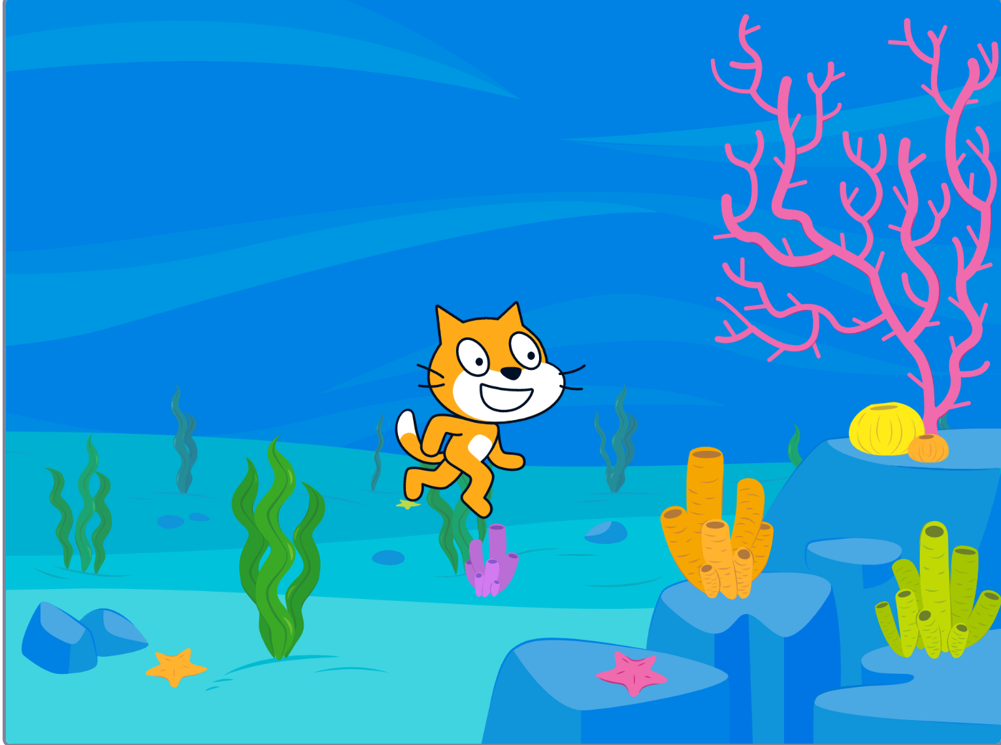
How many layers are there

Slide 10


Structure of a Scratch Program
Layers:
Characters
Background

Slide 11



Structure of a Scratch Program
Layers:
Characters
Costumes
Code
Background
Paint
Code

Slide 12
Exercise:
Change the background

Slide 13
Exercise:
Change the background
Change the costume with a line of code

Slide 14
Repeat

Slide 15
How to make the kitten run?
(Simulate human’s motion of running)

Slide 16
It might be hard to simulate this movement all at once.
But…

Slide 17
It might be hard to simulate this movement all at once.
But…
Can we break this into small pieces?

Slide 18
2 Step Process:
Move your left leg forward
Move your right leg forward
Repeat this process again and again

Slide 19
How to achieve this process through code?

Slide 20
2 Step Process:
Costume 1
Costume 2
Repeat this process again and again

Slide 21
Let’s try it out!

Slide 22
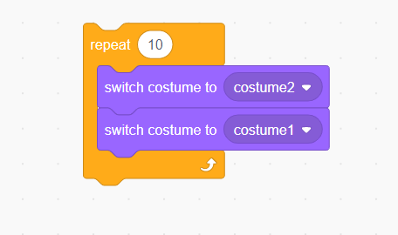
Naïve approach:
Does it work? Why?

Slide 23
Computer Programs are very fast
Fast enough that your eyes cannot capture

Slide 24
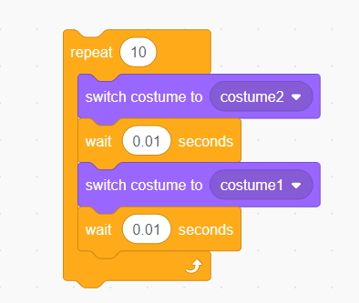
Second approach:
Does it work? Why?

Slide 25
Can only repeat a certain number of times
Unable to control the exact stopping time

Slide 26
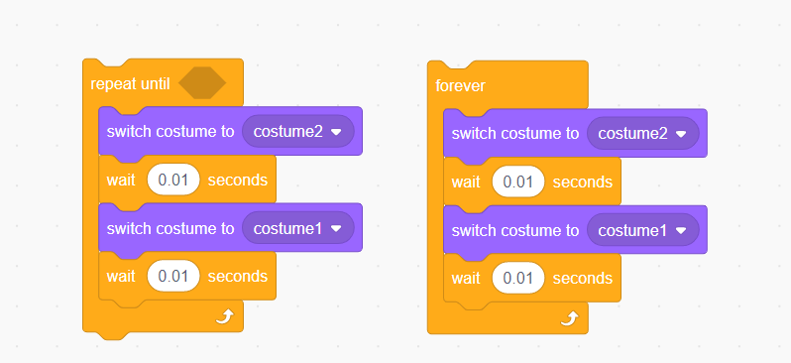
Third approach:
Which one is better?

Slide 27
How to improve even more?

Slide 28
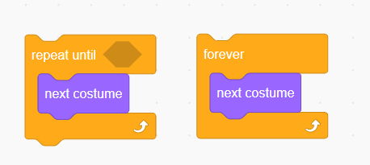
Final approach:

Slide 29
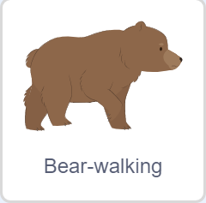
Exercise:
Can you make the bear walk?

Slide 30
Exercise:
Can you make the bear walk?

Slide 31
Challenge:
Imagine that I’m shooting a basketball.
Can you simulate the motion of the ball?
It does not just fly in a straight line! It also rotates.

Slide 32
More Challenge:
Can you control the ball’s movement using arrow keys while keeping it rotating.

