Slide 1
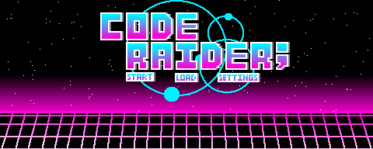










COSC SENIOR DESIGN
A Project by:
Connor Harber
Sean McConnell
Hayden Moritz
Johnathan Tibbetts
University of Wyoming
Start
Execution
Hosting
Animation
Current
We wanted to develop a unique video game that provides both COSC and non COSC students the definitive COSC department experience.
Program the game and develop the art and music from scratch to provide a unique user experience.
Use GitHub temporarily for demo hosting. The main host is still being discussed (possibly purchase a domain).
Dynamic sprite swapping to implement smooth movement of various objects.
Finish animation class
Finish boss movement
Implement level one
Idea
Program
Sprites
Demo
Next Steps
Develop a video game representing what we went through these past few years, and poke fun at the department.
Most sprites and background population have been completed, but more specific components such as buttons and particle effects are still in production.
goo.gl/t8jKhR
Add more levels
Music/sound effects
Any other features…
We decided to use Aseprite to develop visuals, JavaScript for backend logic, and HTML for the frontend.

