Slide 1


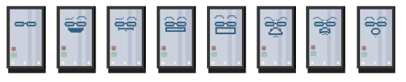
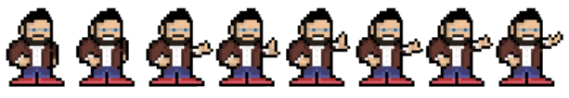
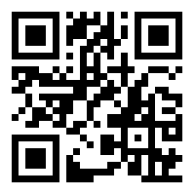

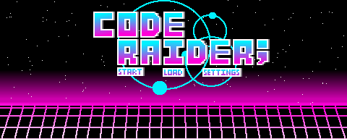


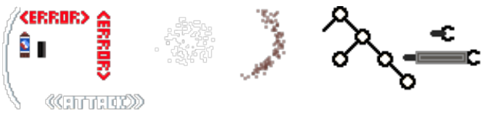
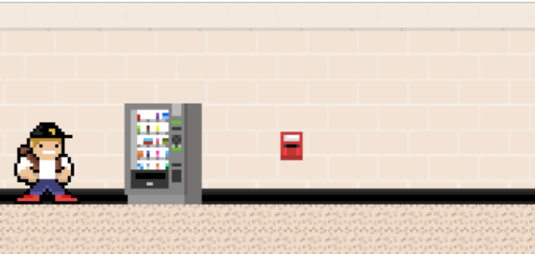
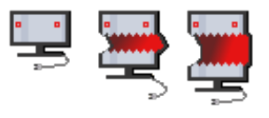
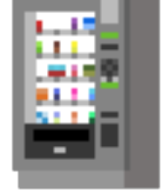

8-Bit Side Scroller: CodeRaider
Connor Harber, Sean McConnell, Hayden Moritz, and Johnathan Tibbetts
COSC Senior Design
University of Wyoming
Introduction
Sprites
Gameplay
Current Progress
Goal:
Create a game that encompasses the core experiences of a Computer Science student at the University of Wyoming. We wanted to give the computer science experience to people who have never even programmed before.
Existing Solutions:
Currently, there are no games (that we could find) that emulate the life of a computer science student. This project is the first of its kind.
Technologies:
JavaScript for backend logic
HTML for frontend UI/UX
Aseprite for graphic design
Challenges:
Developing the definitive computer science experience
Ensuring smooth, reliable, browser-independent gameplay
Mobile porting
Benefit:
If successful, this project will give non-computer science students the computer science experience without the segfaults.
Sprite design is a major component of our project. We want the player to experience the computer science department, and the best way to provide that is with in-depth graphical representations.
The game is set to take place in the 4th floor of the Engineering Building. The goal of the game is to “graduate” from the computer science program at the University of Wyoming. To do so, players must pass a series of “classes”, or levels. Each level consists of Mario style gameplay combining platforming and enemies. At the end of each level, the player must battle a boss (a.k.a. the professor of the class). If the player succeeds, they are given a check on their “degree evaluation” and move on to the next class/level.
Once the player beats all the classes/levels, they are awarded a computer science degree. They will then be provided the opportunity to go to “graduate school”, which essentially restarts the game with harder enemies.
Throughout the game, the user will be able to collect bitcoins from enemies that can be used at vending machines to purchase armor, weapons, health, etc.
The progression of the game will be as follows:
Boss #1: Professor Ward
Boss #2: Dr. Gamboa
Boss #3: Dr. Buckner
Boss #4: Dr. Borowczak
The boss mechanics are as follows:
Professor Ward
  Floats around and shoots segfaults and assembly code
Dr. Gamboa
  Throws his Pepsi
Dr. Buckner
  Throws erasers
Dr. Borowczak
  Shoots merkle trees and blockchains
Currently, we can generate the background of the game using
a tile map. The player can move around using the W-A-S-D
keys, though the physics are a little buggy currently. Boss
movement (A.I.) is in development, but should be
implemented early next semester. A user menu to track
progress, items, and statistics is also in development and will
be deployed early next semester.
Main Character
Professor Ward
Demo
We currently have a live demo hosted on GitHub Pages at the link below. We have provided a QR code for mobile users, though touch input has not been implemented yet.
Dr. Borowczak
https://goo.gl/m8qeis
Dr. Buckner
Graphics
Dr. Gamboa
Menu:
Next Steps
Hosting
Miscellaneous
Finish the animation
Perfect player movement
Implement boss movement & enemies
Add levels
Add user menu(s)
Add music and sound effects
Possibly port to mobile devices
Level 1:
Currently, the demo game is being hosted on GitHub Pages. However, since GitHub Pages are linked to personal accounts, the current deployment is not a long-term solution. One idea we have is to purchase a domain and host the game from there. Another option is to create a “dummy” GitHub account that is dedicated to hosting the game repository. The latter option would likely be better because the repository can be contributed to by future computer science students long after our departure.
A Special Thanks…
To all University of Wyoming Computer Science Department staff
and faculty for being good sports and allowing this project to come
to life. Thank you for all you do!

