Slide 1
Selenium Extent Reports
Introduction

Slide 2

PURPOSE
To learn how to generate Extent Reports

Slide 3
Extent Report – What is it?
Extent Reports are generated via the ExtentAPI
They have numerous benefits:
Interactive Reports
Real-Time Reports
Email Reports
Highly Configurable
Notes:
ExtentX is the analysis tool
Documentation:
http://extentreports.com/docs/versions/3/java/

Slide 4
TestNG
TestNG is a testing framework inspired by Junit.
Covers a wider range of test categories such as:
Unit
Functional
End to end
Integration
Overall has a lot more functionality than JUnit.
Notes:
Annotation support. (Priorities)
Support for parameterized and data-driven testing (with @DataProvider and/or XML configuration).
Support for multiple instances of the same test class (with @Factory)
Flexible execution model. TestNG can be run either by Ant via build.xml (with or without a test suite defined), or by an IDE plugin with visual results. There isn't a TestSuite class, while test suites, groups and tests selected to run are defined and configured by XML files.
Concurrent testing: run tests in arbitrarily big thread pools with various policies available (all methods in their own thread, one thread per test class, etc.), and test whether the code is multithread safe.
Embeds BeanShell for further flexibility.
Default JDK functions for runtime and logging (no dependencies).
Dependent methods for application server testing.^{[clarification needed]}
Distributed testing: allows distribution of tests on slave machines.

Slide 5
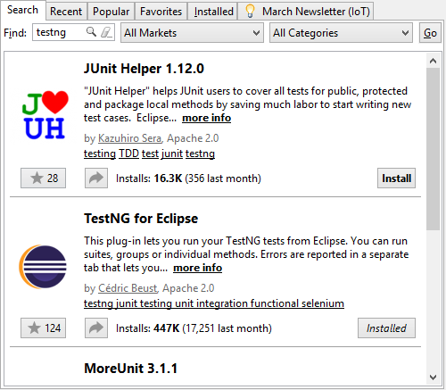
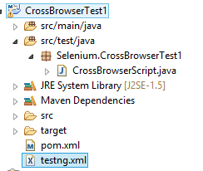
Installing TestNG
Eclipse MarketPlace (Help->Marketplace)
BuildPath -> testng.jar
Notes:
Testng jar should be provided by your trainer.
If not you can use maven to install it, or find the jar online (look for latest version)
As well as selenium if it’s not installed already.
*note* this will only work for browsers you have installed, it can’t run chrome without chrome installed etc.

Slide 6
Setting up ExtentReport
Add as either a maven dependency or to your buildpath.
You’ll Need:
ExtentTest
ExtentReport
// initialize ExtentReports with a file path
ExtentReports extent = new ExtentReports(filePath, replaceExisting);
// initialize / start the test
test = report.startTest("Verify application Title");
// add a note to the test
test.log(LogStatus.INFO, "Browser started");
// report the test as a pass
test.log(LogStatus.PASS, "verify Title of the page");
Notes:
<!-- pom.xml -->
<dependency>
<groupId>com.aventstack</groupId>
<artifactId>extentreports</artifactId>
<version>3.0.3</version>
</dependency>

Slide 7
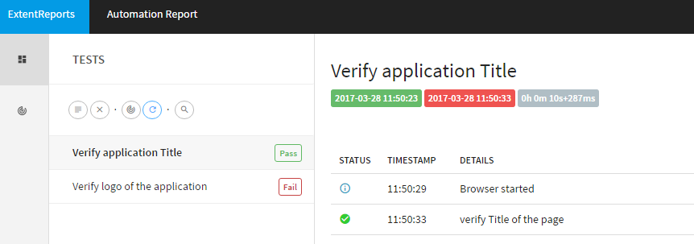
Example - Output

Slide 8
Example - ExtentReports
https://github.com/womackx/SeleniumExtentReport/blob/master/AppTest.java

Slide 9
Exercise
Install ExtentAPI
Implement ExtentReports into a previous project.

