Slide 1
Microsoft Azure Service Fabric

Slide 2
Microservices 101
Notes:
10 min

Slide 3
The trouble with monoliths…

Slide 4
The trouble with monoliths…
Tightly coupled components
All components updated together
Not agile, time to market suffers

Slide 5
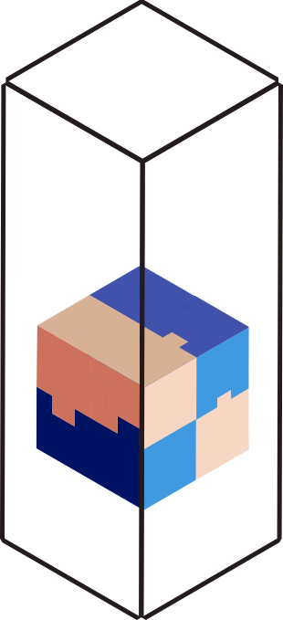
The trouble with monoliths…
Tightly coupled components
All components updated together
Not agile, time to market suffers

Slide 6
The trouble with monoliths…
Tightly coupled components
All components updated together
Not agile, time to market suffers
Scale by cloning entire apps
All components scaled similarly → expensive

Slide 7
The trouble with monoliths…
Tightly coupled components
All components updated together
Not agile, time to market suffers
Scale by cloning entire apps
All components scaled similarly → expensive

Slide 8
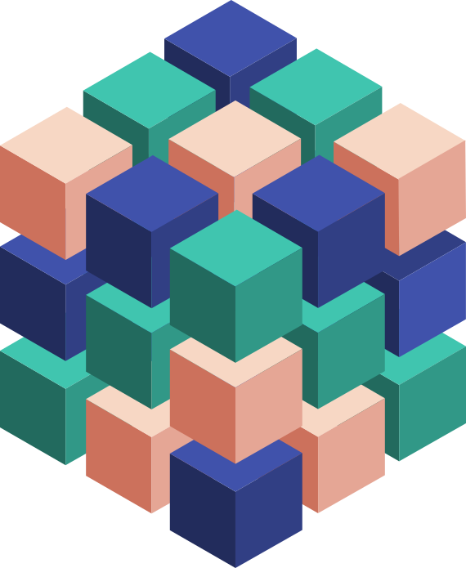
Microservices…
Do one thing well
Manage independent code and state
Are generally developed by a small cross-functional team
Are built with task-appropriate languages/frameworks
Notes:
Microservices applications are composed of small, independently versioned and scalable services that communicate with each other over standard protocols with well-defined interfaces
.
You as a developer think about code and data
You think about how you are going to upgrade it independent of other microservices
It is code that is versioned and scaled independently, having n copies of the service
You need to know how to find its endpoint by name
Microservices are code and config hosted in containers - When I say container I mean it in the broader sense of the word, may be processes, maybe in a Windows Job Object or may be a Windows or Linux container
Microservices is a great way of codifying this thinking
We think Microservices should be logically consistent

Slide 9
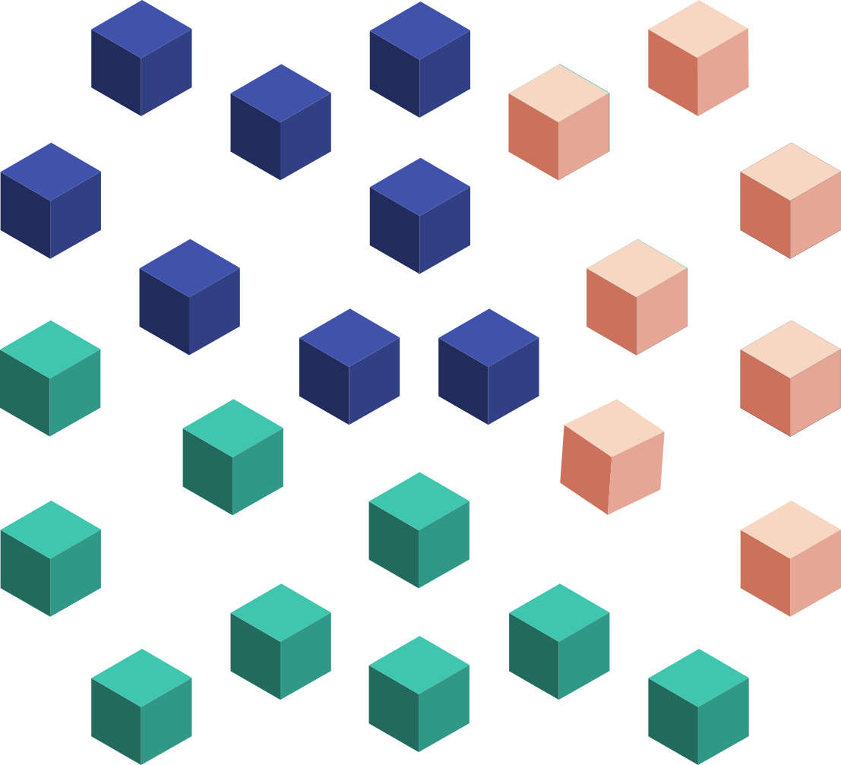
Microservices…
Do one thing well
Manage independent code and state
Are generally developed by a small cross-functional team
Are built with task-appropriate languages/frameworks
Are loosely coupled
Communicate over well-defined interfaces/protocols
Have unique names (URI) that can be resolved
Are independently updated
Are independently scaled
Notes:
Microservices applications are composed of small, independently versioned and scalable services that communicate with each other over standard protocols with well-defined interfaces
.
You as a developer think about code and data
You think about how you are going to upgrade it independent of other microservices
It is code that is versioned and scaled independently, having n copies of the service
You need to know how to find its endpoint by name
Microservices are code and config hosted in containers - When I say container I mean it in the broader sense of the word, may be processes, maybe in a Windows Job Object or may be a Windows or Linux container
Microservices is a great way of codifying this thinking
We think Microservices should be logically consistent

Slide 10


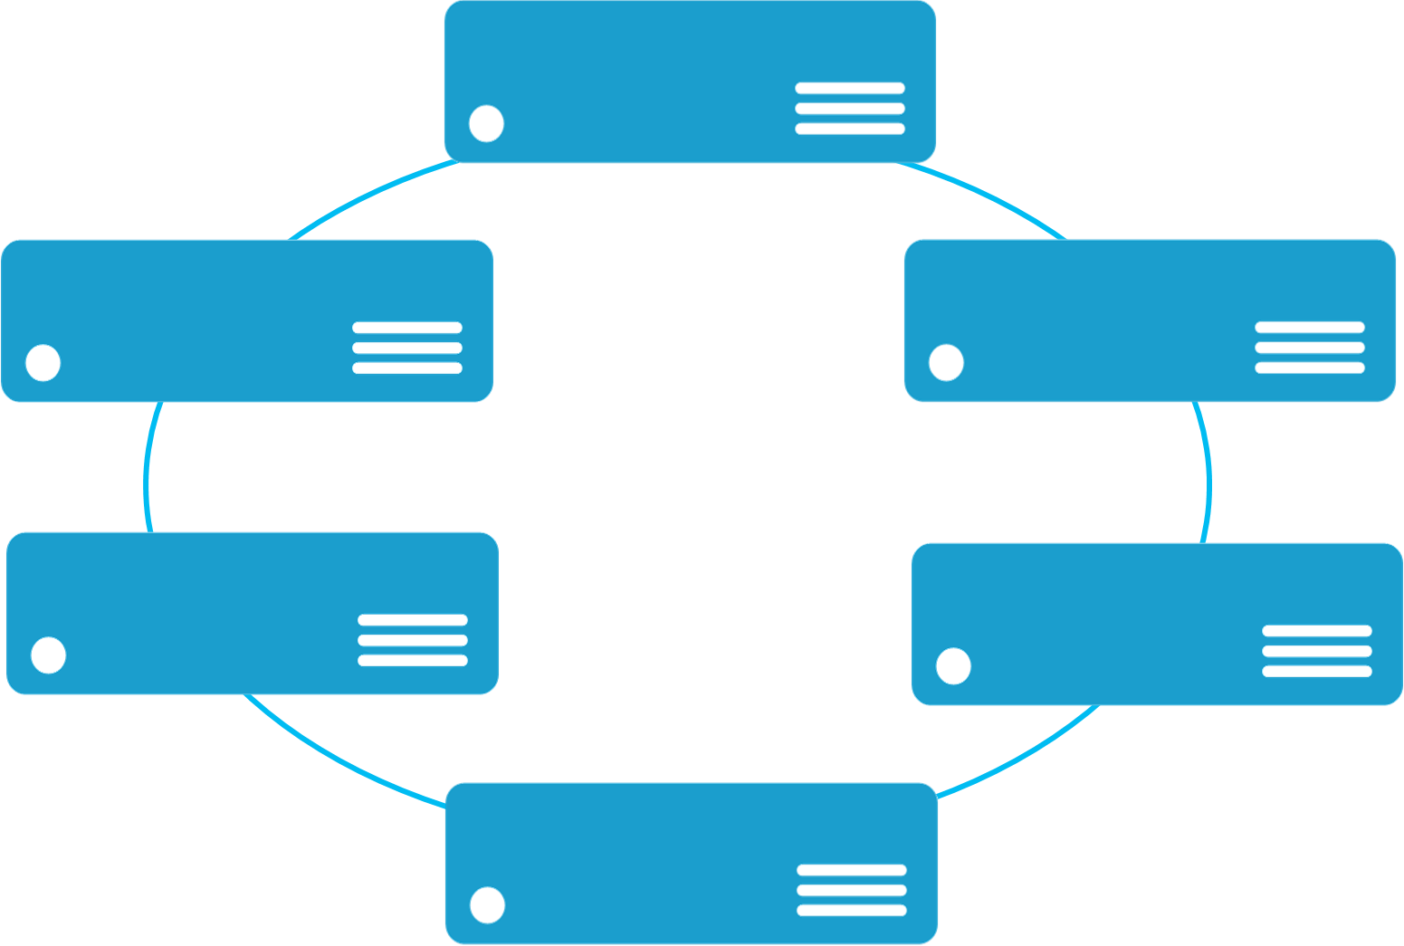


Monolithic application
Microservices application
App 1
App 1
App 2
Scales by cloning the app on multiple machines
Scales by deploying each service independently

Slide 11
Monolithic application
Microservices application
State: Single monolithic database
Tiers of specific technologies
Graph of interconnected services
State typically scoped to the service
Variety of technologies used
stateless presentation services
stateless services
stateful services
stateless services with
separate stores
Notes:
Make this more generic

Slide 12
Goodness…
Increase agility through componentization
Simplify upgrades through independent versioning
Maximize productivity through heterogenous technologies
Improve hardware utilization through granular resource balancing
Limit the impact of failures through isolation
Notes:
Increase agility:
You can match services to team boundaries
Interservice boundaries defined by strong service contracts ensure that individual teams can make changes under the hood without worrying about weird dependencies
Simplify upgrades:
By upgrading your application surgically, upgrades don’t need to be white-knuckle affairs run overnight or on Saturdays
Maximize productivity:
The team working on the customer service are all PHP experts? They can use that. The team building the payments service needs to use a legacy C++ library? They can build their service in native. You should never have to compromise on productivity for the sake of consistency.
Improve hardware utilization:
In the previous slide, we looked at how monolithic apps are scaled, by deploying multiple copies and load balancing. But if if you have a particular code path that is particularly hot, you need to scale out the HW for the whole application based on that bottleneck rather than just scaling that service.
Limit the impact of failures
- In a monolithic app, failures often impact the whole app. With microservices, failures are isolated, both because a crash in one place doesn’t bring down the whole application and because the more explicit boundaries force teams to think about fault tolerance.

Slide 13
However, devs now need to code for…
Service discovery
State management
Service lifecycle management
Health reporting
Resource usage reporting

Slide 14
However, devs now need to code for…
Service discovery
State management
Service lifecycle management
Health reporting
Resource usage reporting

Slide 15
Microsoft Azure Service Fabric A platform for reliable, hyperscale, microservice-based applications
Microservices
High Availability
Data Partitioning
Service Fabric
Health Monitoring
Container Orchestration & lifecycle management
Hybrid Operations
Self-healing
Simple programming models
High Density
Rolling Upgrades
Low Latency
Placement Constraints
Replication & Failover
Stateful services
Fast startup & shutdown
Resource balancing
Hyper-Scale
Automated Rollback
Azure
Private cloud
Other clouds
Notes:
So now that you understand a little bit about microservices, let me introduce you to Microsoft’s microservices platform, Service Fabric. Service Fabric provides an application model and runtime that naturally enables microservices-based development and operations. You’ll also note that it is environment-agnostic. We will provide a 1st class service running in Azure but the technology can be used anywhere that you can string a set of machines together, including on-premise or in other clouds.

Slide 16
Service Fabric intro for developers
Notes:
10 min

Slide 17
Service Fabric Cluster
FD1/UD6
Node
Machines stitched together
Scales to 1000+ machines
Laid out to limit impact of individual hardware failures
Provides abstracted management endpoint
FD0/UD0
FD1/UD5
Node
Node
FD0/UD1
FD2/UD4
Node
Node
FD2/UD3
Node
Notes:
A set of machines (physical or virtual) , that service fabric stiches together to form a reliable and fault tolerant unit called a cluster. These clusters can be scaled to 1000s of machines.
For example - SQL Azure has regional clusters that are made of 1000s of machines.
When setting up your cluster service fabric allows you to specify the failures that the cluster should survive. For example you can choose to set up a cluster that spans three azure data centers, so that the cluster can survive the loss of a data center.
Bing Cortana service runs on a cluster that spans three regions, making is tolerant of regional failures. Last year they had a widespread outage in one of the data centers , taking a third of the capacity down, but the service suffered no disruption. They service just failed over real time to the other two datacenters in the other regions. That is the kind of reliability you can get with azure service fabric.
More about the planning for production later in the session.
Let us now go to understanding what a service fabric application is made of..*

Slide 18
Service type
Composed of code/config/data packages
Code packages define an entry point (dll or exe)
Config packages define service specific config information
Data packages define static resources (eg. images)
Packages can be independently versioned
<ServiceManifest Name="QueueService" Version="1.0">
<ServiceTypes>
<StatefulServiceType ServiceTypeName="QueueServiceType" HasPersistedState="true" />
</ServiceTypes>
<CodePackage Name="Code" Version="1.0">
<EntryPoint>
<ExeHost>
<Program>ServiceHost.exe</Program>
</ExeHost>
</EntryPoint>
</CodePackage>
<ConfigPackage Name="Config" Version="1.0" />
<DataPackage Name="Data" Version="1.0" />
</ServiceManifest>
Service Type 1
Code
Config
Data

Slide 19
Application type
Declarative template for creating an application
Based on a set of service types
Used for packaging, deployment, and versioning
Application Type A
Service Type 1
Service Type 2
Service Type 3
Code
Config
Data
Code
Config
Data
Code
Config
Data

Slide 20
Categories of services
Guest executables and guest containers
Deploy and manage arbitrary services written in any framework
Stateless Services
State persisted to external storage, such as Azure DBs
Existing web (ASP.NET) and worker role applications
Stateful Services
Reliability of state through replication and local persistence
Lowers latency
Reduces complexity in traditional three tier architectures
Notes:
With that short background, let talk about what and how you can build applications with Service Fabric
First stateless applications are no different from the web and worker roles that you build today, in that the state is retained in an externalized store such as SQL Azure or Azure storage. This is a fine approach for certain application designs and of course you still need to handle scaling out each tier. Serivce Fabric brings benefits to the stateless approach with its microservices architecture by enabling fast deployment time (applications are now deployed in seconds) as well as much, much higher density. You can package 1000s of microservices on a VM, where are with Cloud Service today you are forced to have only one service per VM, underutilizing the resources
Stateless services are where you let Service Fabric take care of the application state through replication and local persistence. This is really the democratization of high availability. Everyone, not just databases and high ends stores, can now have HA in your applications through simple programming models with full data consistency. Think about this. Your apps do not need to do lots of data manipulation to write data to another store.
Stateful services are recognition that there are limitation with just a pure stateless service design to address two issues. Reduces latency of your applications and makes it more responsive to users, since data is locally stored. Reduces complexity of you application since you no longer need to have additional caches (which only deal with read latency) and additional queues in order to make your services reliable. You literally remove these extra services from your design, making the overall service simple and have a SINGLE approach to management.
Finally although Service Fabric provides a runtime for you to build applications, this does not prevent you from using other runtime in you applications. So you may have a service that has a node.js front end that communicate with backend stateless and stateful services. Or you may deploy application that run in Java VM or simply deploy some EXE that you have that need to be used by your service. Service Fabric will makes these other runtime reliable, if needed, but ensuring that the specified number of instances is always running. You will get the full benefits of the deep resource balancing of the Service Fabric microservices built with the Service Fabric runtime and ALM capabilities; you can reuse existing code and have the benefit of a SINGLE approach to management. Not bad!

Slide 21
Service Fabric frameworks
Reliable Services
Reliable Actors
Simple API for service lifecycle events
Pluggable communication model
Familiar data structures for reliably storing state: dictionary and queue
Independent unit of state and compute (large number in parallel)
Prescriptive communication model based on async messaging
Automatic state management and turn based concurrency
Notes:
The actor API allows you to build objects with virtual actor programming model. The actors are just like objects, you write your services in a natural object-oriented way. It is suitable for applications with multiple independent units of state and compute. The framework provides automatic state management and simple turn based concurrency model that eliminates the needs to write synchronization code. Let’s go ahead and build a reliable actor using the APIs.

Slide 22
Service partitioning
Services can be partitioned for scale-out
You can choose your own partitioning scheme
Service partitions are striped across machines in the cluster
Node 100
Node 101
Node 102
Node 103
Node 104
Node 105
P1
P2
P3
S
S
S
S
S
S
P4
S
S
S
P
S
S
Notes:
Mark: So far we have been working with a single partitioned service. However having a single partition for storing all of your data and processing the request will not scale. That’s not the cloud way of doing things. Service Fabric allows your services to be partitioned. Each partition is an independent consistency and failover unit. It operates independently on a subset of the state and can be failed oved or load balanced independently from other partitions in the system. You can partition the service using either “Named partitioning scheme” or “Uniform Int64 range partitioning scheme”. The named partitions are identified by the name and uniform int64 partitions are identified by int64 key. Each partition has a primary and number of secondary replicas that are placed across various nodes in the cluster. Two replicas of the same partition are never placed on the same node. The partition count of the service defines the scalability factor, the replica count defines the state reliability factor.

Slide 23
Application upgrades
Upgrades proceed one upgrade domain at a time
App-reported health dictates whether to proceed
Failure behavior is configurable
Automatic rollback
Pause for investigation

Slide 24
Application upgrade example
Upgrade Domain #1
Upgrade Domain #2
Upgrade Domain #3
App Repository
VM_1
VM_0
App A v1
VM_2
App C v2
App A v1
App C v1
Fabric
Node
App B v2
Fabric
Node
Fabric
Node
App C v2
App B v2
App C v1
App C v1
App C v2
VM_5
VM_4
VM_3
Fabric
Node
App B v2
App C v2
App B v2
App C v1
Fabric
Node
App A v1
App A v1
Fabric
Node

Slide 25
Demo: app upgrade

Slide 26
Status and roadmap
Azure service and .NET SDK for Windows is GA
Azure standalone installer is GA
Azure service for Linux and Java SDK is in preview
GA planned for next year

