Slide 1
Network Routing Optimization
Eli DeSha, Sean McKnight, Erick Ramirez

Slide 2

Github repository QR code

Slide 3
What is “network routing optimization?”
Network routing optimization (NRO) is the process in which the most efficient route is found for a given target. This target can be a data packet, a car, a shipment, etc. NRO is essential to daily life, a few examples of which are
GPS apps (Google maps, Apple maps, Waze etc.)
Sending/receiving data over the internet
Routing server traffic
And many more!

Slide 4
Algorithms used
Four algorithms were used, with one being the benchmark these algorithms were:
Dijkstra’s algorithm (benchmark)
A* algorithm
Ant Colony Optimization algorithm
Bellman-Ford algorithm
Notes:
We implemented four algorithms, one being the benchmark and the other three being comparisons. Of these three, two are heuristic, and one is exact.
Exact
Heuristic
Metaheuristic
Exact
These will be expanded upon later

Slide 5
Exact
Heuristic
Metaheuristic
Notes:
These algorithms will find the best possible solution every time, although they may take longer to compute
These algorithms use approximations or “shortcuts” to reduce the computation time but may generate a non-optimal solution.
These algorithms are general-purpose, high-level algorithms that are good at computing large datasets within reasonable amounts of time, even if the solution is not perfect (unlike Exact)

Slide 6
THe Data-genERATION
The data generation was done in a separate program(datagen.cpp) which is given an argument in the cli for how many nodes to make (./datagen 300). The data generator works by randomly generating 3 points for every x value. The only points with a guaranteed location are the start position(0,0) and the end position(nodes/3 -1, nodes/3 -1)
We decided on there being three points for every x (and most y's) so that every point can connect to one or more points.
Notes:
These algorithms will find the best possible solution every time, although they may take longer to compute
These algorithms use approximations or “shortcuts” to reduce the computation time but may generate a non-optimal solution.
These algorithms are general-purpose, high-level algorithms that are good at computing large datasets within reasonable amounts of time, even if the solution is not perfect (unlike Exact)

Slide 7
What does Dijkstra’s Algorithm do?
Finds the exact answer by repeatedly relaxing edges.
Uses a minimum priority queue
Only works with positive weights on edges.

Slide 8
How does the A* algorithm work?
A more efficient version of Dijkstra’s algorithm
Uses the equation f(n) = g(n) + h(n)
Guaranteed to find the shortest possible path
Uses h(n) to steer towards target
An “open set” and “closed set” are used to manage its search
Notes:
The A* algorithm is a more efficient version of Dijkstra’s algorithm, using heuristics to achieve this. The equation f(n) = g(n) + h(n) is used, with g(n) being the actual distance and h(n) being estimated distance. This guarantees that the shortest possible path will be found. It uses h(n) to steer towards the target, avoiding unnecessary exploring, thus saving time. It uses an “open set” (nodes to explore) and “closed set” (nodes already evaluated) to manage its search.

Slide 9

How does the Ant colony optimization (ACO) algorithm work?
Metaheuristic
It does not guarantee the optimal solution and is inspired by a natural process
Inspired by behavior of ants
Ants deposit pheromones on paths, which guides future ants
Uses the equation: probability based on pheromone level τ and heuristic η
Not guaranteed to find the absolute shortest path
Pheromone evaporation prevents the algorithm from getting stuck
Balances exploration of new paths and exploitation of known good paths

Slide 10
Describe bellman ford
Exact, similar to Dijkstra, but differs in approach
A shortest path algorithm that can handle negative edge weights
Repeatedly relaxes all edges in the graph V-1 times
Uses the equation: d(v) = min(d(v), d(u) + w(u,v))
Guaranteed to find the shortest possible path
Slower than Dijkstra's but more flexible due to negative weight support
Can detect negative weight cycles in a graph

Slide 11
IMPLEMENTATION
All the heavy lifting was done in c++ because it’s a language we all knew and were comfortable in.
The graphs were made with python.
In order to make all of this happen with a single command into command prompt. A makefile compiles all the code, then runs data gen for each value of nodes (150 * 2^n with n starting at 1). The algorithms are then run against the different data sets.
Finally, the python script makes the graphs.
Notes:
Python was a bad idea because its slow. Another choice could have been c, it is as fast as c++ but without the occasional weird syntax in some places.

Slide 12
Code Output discussion
All algorithms were tested across 8 node sizes from 300 to 38,400 nodes
Weight: Dijkstra's, A*, and Bellman-Ford all found the shortest path at every size, with their weights being almost the same and near zero on the scale of the graph. ACO was a massive outlier at 300 nodes, producing the highest weight before dropping down, suggesting it failed to find a valid path at the smallest size and struggled to converge early on
Time: A* and Dijkstra's almost impossible to tell apart graph, both staying near 0ms even at 38,400 nodes, Bellman-Ford also stayed low, never exceeding roughly 50ms,ACO was the extreme outlier, starting at around 175ms at 300 nodes, spiking to 750ms at 9,600 nodes, and reaching about 1,620ms at 38,400 nodes
Operations: Dijkstra's and A* were nearly flat across all sizes, staying close to zero relative to the scale, Bellman-Ford grew linearly, while ACO was again the worst performer
The graph slide shows the visual of this information

Slide 13
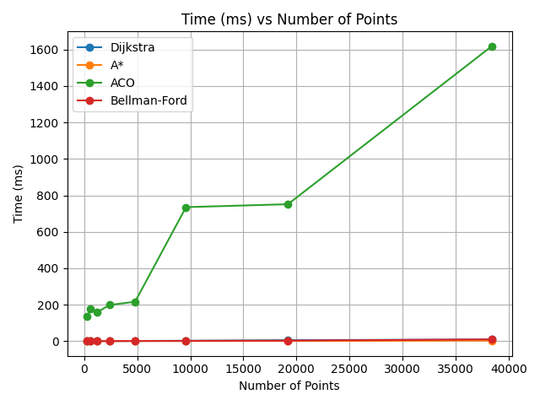
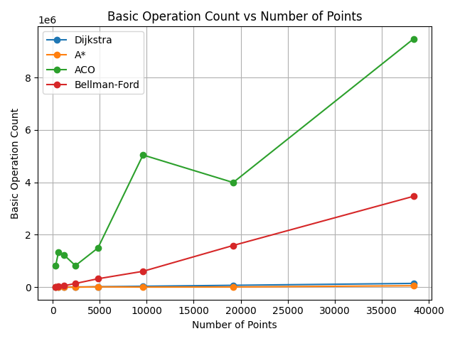
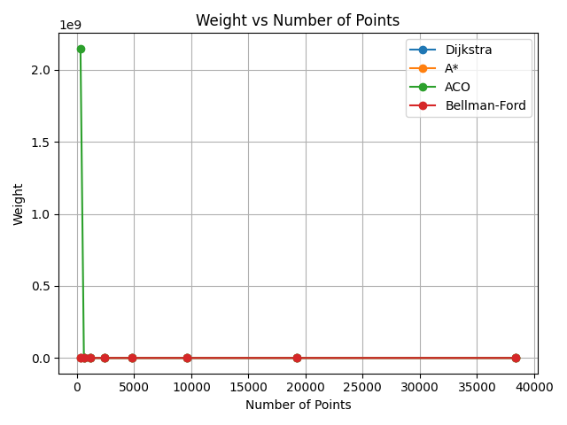
Graphs

Slide 14
Final thoughts
Notes:
Overall, the experiment went very smoothly. Although there were some issues here and there, there were no major issues that took up major chunks of time. If we were to repeat this experiment though, a major change we would have made is to decide on input and output structures from the start. We spent a lot of time reworking how the output should look, which made us refactor each algorithm multiple times. Other than this, though, not many large issues were faced.

Slide 15


Q&A

Slide 16
references
https://www.geeksforgeeks.org/machine-learning/introduction-to-ant-colony-optimization/
https://www.youtube.com/watch?v=1qpvpOHGRqA
https://www.youtube.com/watch?v=783ZtAF4j5g
https://www.youtube.com/watch?v=u7bQomllcJw&t=16s
https://www.youtube.com/watch?v=qfeymoF8pb4&t=1s

