Slide 1
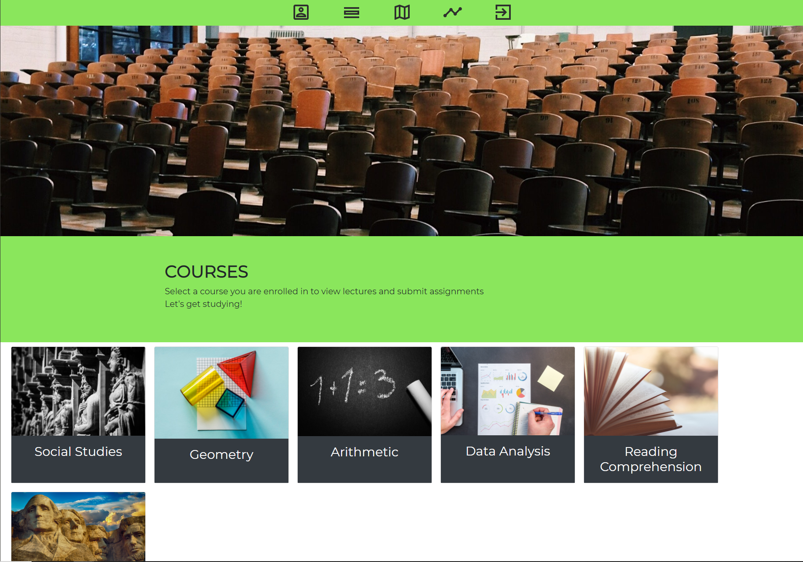
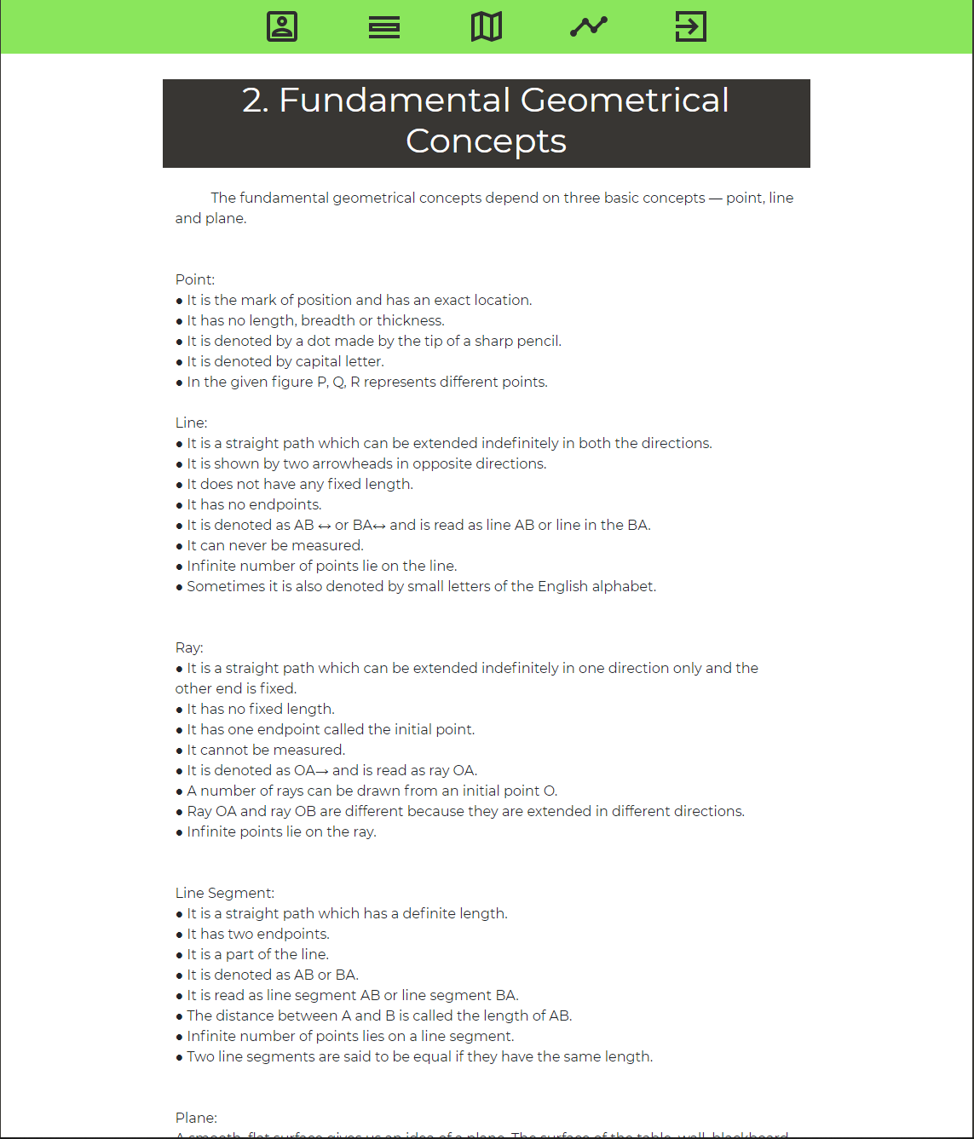
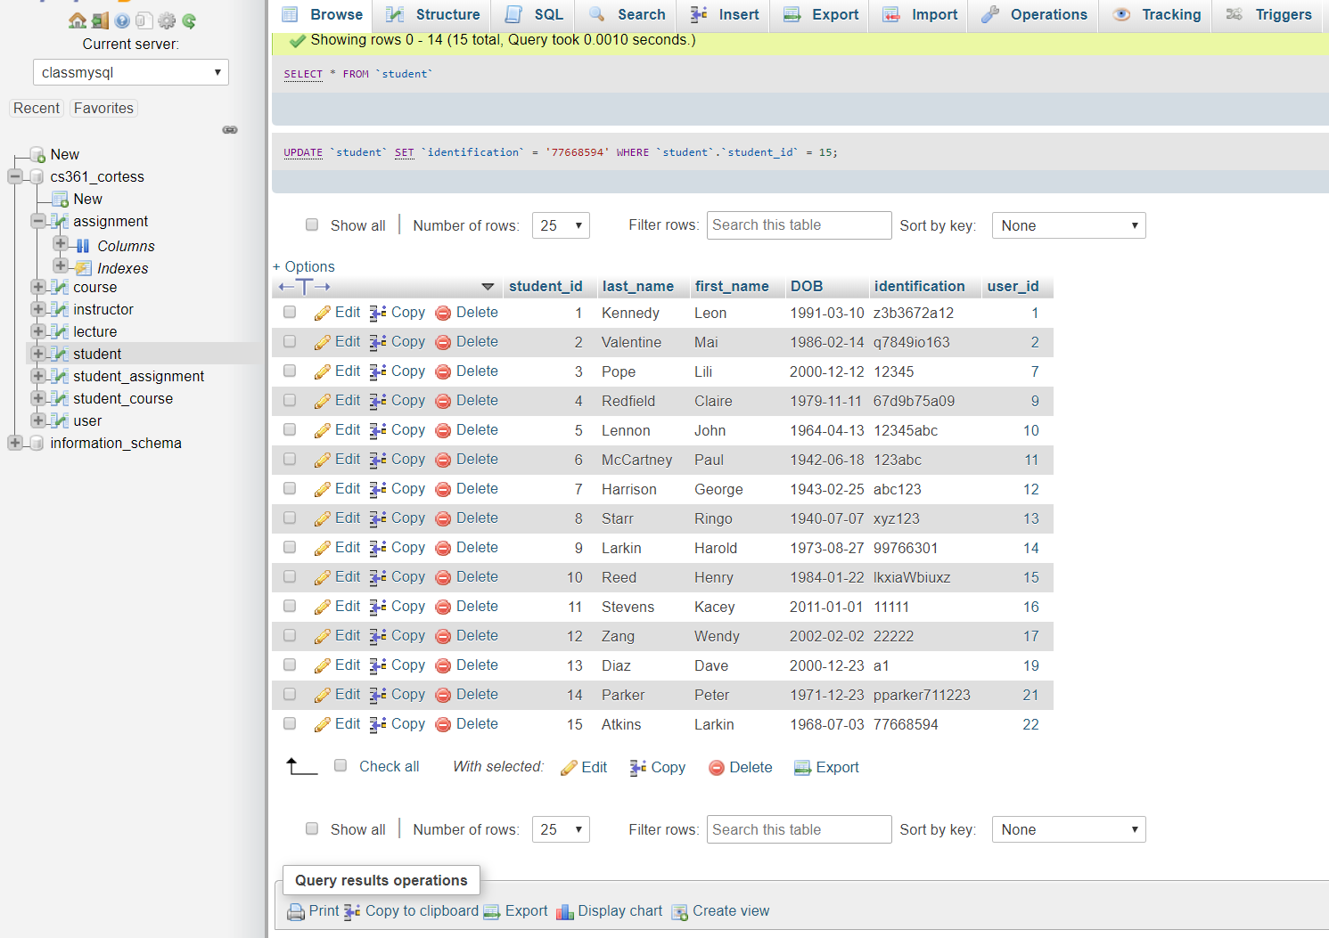
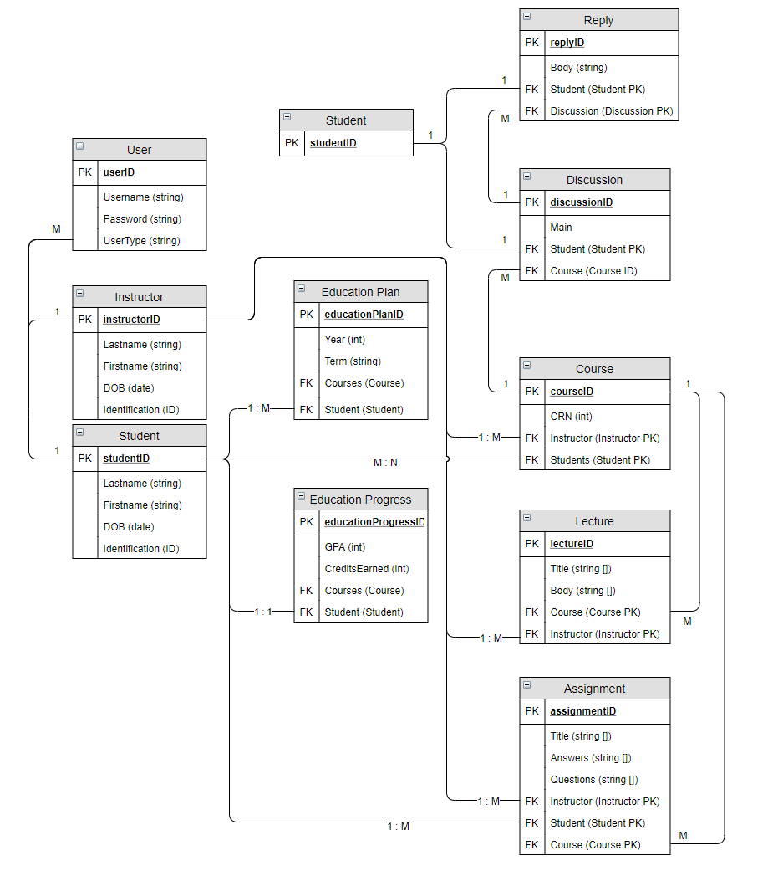
Education for all
An online program to provide opportunities for individuals who are incarcerated to obtain their GED and to gain skill that will help them adjust to the larger world upon release.
Background
Features
Millions of individuals are incarcerated in the United States and the number continues to trend upwards. Much of this is due to the lack of any rehabilitative programs, especially in the realm of education, which has resulted in a “warehousing crisis”. Quite often incarcerated individuals have a desire to enroll in educational programs, but are unable to do so.
In 2003 Eric Holder, the RAND corporation, and the Departments of Justice and Education released a nationwide study in 2013 that says in-prison education reduced the risk of an individual recidivating by 43%.
This study also concluded that it costs only $5 a day to educate someone in prison vs. $105 per day to house and fulfill their basic needs, if they recidivate.
Focusing on the state of Illinois as an example, there were 22,747 people in prison in Illinois without a GED or 12th grade education in 2015, which accounts for 46% of the total prison population. Additionally, In 2014, 5,814 people in prison participated in GED classes, but only 1,872 were offered the test (Illinois Department of Corrections Office of Constituent Services, 2014).
In 2017 the Department of Education proposed the National Education Technology Plan which states that “Moving forward, increasingly sophisticated technology-driven assessments will enable more powerful personalized learning, likely accelerating the shift from time-based learning to competency-based learning.“
Vision Statement by Jacob Carter
Students, instructors and administrators can log in to the system by having their username/password combination authenticated.
Students and instructors can view their dashboard, which displays all courses which they are enrolled in.
Students and instructors can view the contents of lectures and assignments that are provided by a specific course.
Students can complete assignments by answering questions and submitting their work for grading.
Administrators can create new users by providing the correct fields for database entry.
Handle user authentication through state management. Prevent users from accessing pages they do not have permission to (e.g. students accessing lectures in a course they are not enrolled in).
Front-End
Handlebars.js, Javascript, HTML/CSS
Handlebars is a key framework which enabled us to dynamically render data which is queried from our back-end.
Templates and partials drastically reduced the amount of HTML elements we had to code.
Back-End
Node.js, Javascript, MySQL
All data is stored in a MySQL database and structured to be in 1NF (2NF easily obtainable).
Node-Express handles routing, querying, and compiling objects to be sent to the front-end for rendering.
Express-Sessions and middleware functions allows us to handle user authentication via state.
IN-PROGRESS
Instructors can create lectures and assignments to be submitted into the database for integration with a chosen course.
Education Planner for students which enables them to plan which courses they study ahead of time.
Education progress page which provides students with a road map of the courses they have completed.
Message board for each course which gives students and instructors a method of interacting and collaborating with each other.
Design and planning
Implementation and Testing
Our team of five took on our customer – Jacob Carter’s vision and worked collaboratively on the design and planning of the Education For All application.
Our team identified a web application as the best platform for the stated goals.
The design/planning phase was performed using the water model.
We chose a three-tier architecture for our program (presentation tier: front-end, logic tier: back-end, data tier: database).
Mapped out an entity relationship diagram for our database. Created dataflow diagrams for the high-level architecture and message sequence charts for critical use cases.
Due to each function building off the other, we approached development in an incremental fashion. We began by estimating effort values for each user story and then chose from the bottom-up which ones to implement in the given two week window.
Before each function’s implementation, we wrote simple unit tests. After implementation, we performed integration and acceptance testing to meet quality targets.
Agile’s rapid feedback cycle allowed us to identify problems/issues and resolve them quickly. Our customer, Jacob, was included in discussions at all stages of the development cycle.
Weekly meetings enabled us to analyze code for any possible faults, or areas that would benefit from refactoring.
Design and Implementation by:
Customer: https://github.com/seanmcortes/education-for-all
Jason Anderson | anderja6@oregonstate.edu
Sean Cortes | cortess@oregonstate.edu
Joel Huffman | huffmajo@oregonstate.edu
Tingting Lin | lintin@oregonstate.edu
Ting Sheppy | chit@oregonstate.edu
Jacob Carter | cartjaco@oregonstate.edu

