Slide 1
0
Applesoft's Loaded Dice
The Truth About Randomness on the Apple II, Then and Now
Jeff Robison · VCF Midwest 21 2026
Notes:
Name and title. Fifteen seconds. No bio slide.
BEFORE THIS SLIDE: power-cycle the machine (power switch off, wait, power on), then PRINT RND(1). Do it three times. Do NOT use Ctrl-RESET or PR#6: they keep the fifth seed byte from the last run, so the number changes (Aldridge 1987; Sander-Cederlof, AAL May 1984).
Rehearse on the exact machine you are bringing. Your machine may not print .973136996. What matters is that it prints the same number every power-on.
Applesoft is Microsoft's 6502 BASIC, licensed by Apple. Keep that in mind; it matters on slide 5.

Slide 2
The Problem
1
PRINT RND(1)
.973136996
Rerun the program: different numbers. Power-cycle: the same ones again.
“exactly the same sequence each time the machine is powered on.”
J. W. Aldridge, Behavior Research Methods, Instruments, & Computers 19(4), 1987
Notes:
This is the number they just watched three times. Don't explain it yet. "Hold onto that number. By slide 5 you'll know exactly where it lives."
Why it hid for years: rerunning a program, or even rebooting DOS, gives different numbers. Only a power cycle repeats. A programmer at a desk never sees it; the first user of the day does.
If someone says their machine gives a different number: one of the five seed bytes is never initialized (Sander-Cederlof, AAL May 1984), so the exact value can vary by machine. It is still the same on every power-on of that machine.

Slide 3
Pseudo-random means repeatable
2
Truly random
Pseudo-random
Comes from something physical. A die. Thermal noise. You can't compute it.
A formula. You give it a starting number. It does math on that number and hands back an answer. The answer becomes the next starting number.
Same starting number → same “random” numbers. Entropy only picks the start.
Notes:
Thirty seconds. This room knows what a PRNG is.
The only line that matters is the amber one: same starting number, same numbers. Integer BASIC (next slide) depends on it.
If asked: a random seed makes the starting point unpredictable. It does not make a weak generator's output pattern-free. This talk is mostly about the seed.

Slide 4
Integer BASIC, 1977
3
Woz wrote a generator at $EF4E
Seeded by your keypress timing
15-bit shift register: repeats every 32,767 calls
RND(n) returns the register MOD n (integers only)
Plenty for games. Not for statistics.
There's a counter at $4E and $4F that goes up while the monitor sits waiting for a keypress. Integer BASIC's generator is that counter: RND reads it, scrambles it, writes it back.
Sander-Cederlof, Apple Assembly Line, August 1981 · Integer BASIC disassembly: Paul Santa-Maria, via Andy McFadden
Notes:
Say out loud that $4E/$4F is not a jiffy clock. That's a Commodore term. The Apple II has no timer doing this.
Speaker line: "This isn't a toy. It's a 15-bit maximal shift register with a zero-lock guard, in 50 hand-assembled bytes." The whole Integer BASIC RNG is 56 bytes: 6 in KEYIN, 50 in RND, in an 8K ROM that couldn't even fit the hi-res routines.
Concede it before someone else does: every Integer BASIC program walks the same 32,767-step cycle; the keypress only picks where you start. Good for games, not for statistics.
Don't make the regression argument yet. Just show what worked.

Slide 5
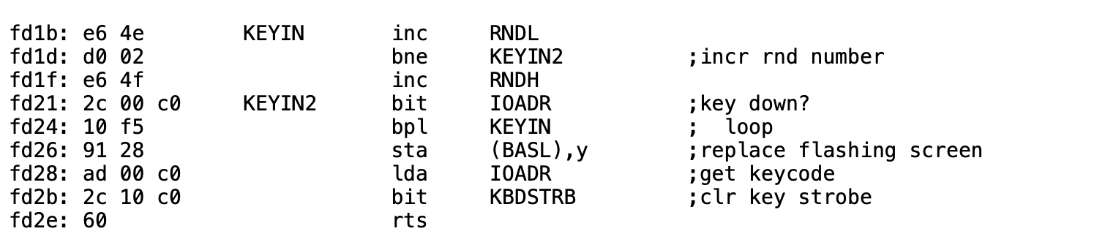
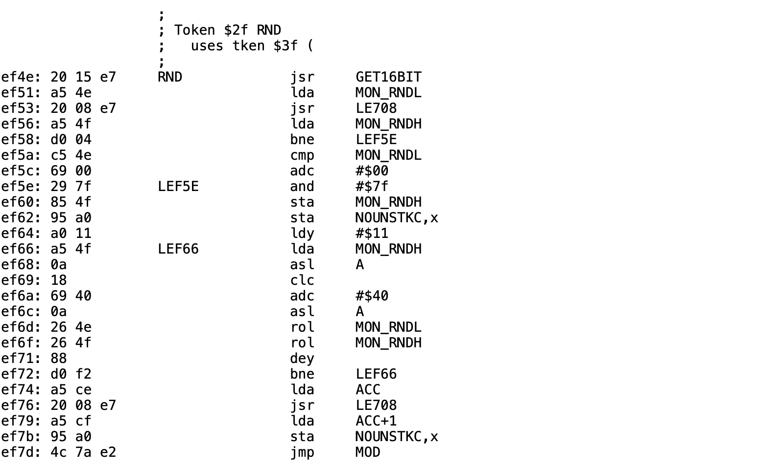
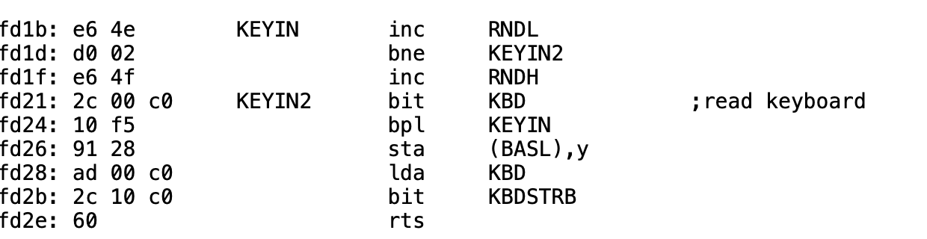
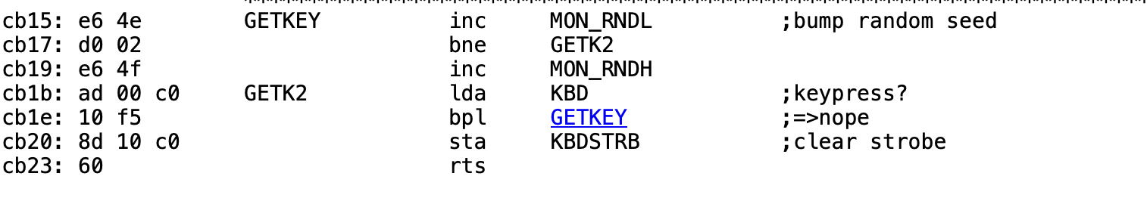
Built-in Entropy Source
4
Same counter in the II, II+, IIe and IIc ROMs shown
Integer BASIC, at $EF4E
https://6502disassembly.com/a2-rom/OrigF8ROM.html
$4E/$4F
https://6502disassembly.com/a2-rom/AutoF8ROM.html
https://6502disassembly.com/a2-rom/IIc_16kb.html
https://6502disassembly.com/a2-rom/Unenh_IIe_80col.html
Notes:
Walk the left side first. Point at the bne going back to KEYIN. That's the whole entropy source.
The counter gets bumped before the keyboard is read, every pass. It's a loop count, not a keystroke count. The loop is 15 CPU cycles, so about 68,000 counts a second; the 16-bit counter wraps roughly once a second.
It only moves while a KEYIN-style routine waits for a key. A game that polls $C000 directly never stirs it.
Then the right side, in one line: the second thing Integer BASIC's RND does is read $4E. Same counter in the Autostart ROM, the IIe and the IIc; links are on the slide. Don't walk each image.
Sources: 6502disassembly.com OrigF8ROM and IntegerBASIC. The monitor listing credits S. Wozniak and A. Baum. Woz wrote Integer BASIC with no assembler, so there is no original source, only hand-written pages. The disassembly is Paul Santa-Maria's work, converted by Andy McFadden.
Only claim the ROMs shown. If asked about the IIgs or later IIc ROMs: not checked.

Slide 6
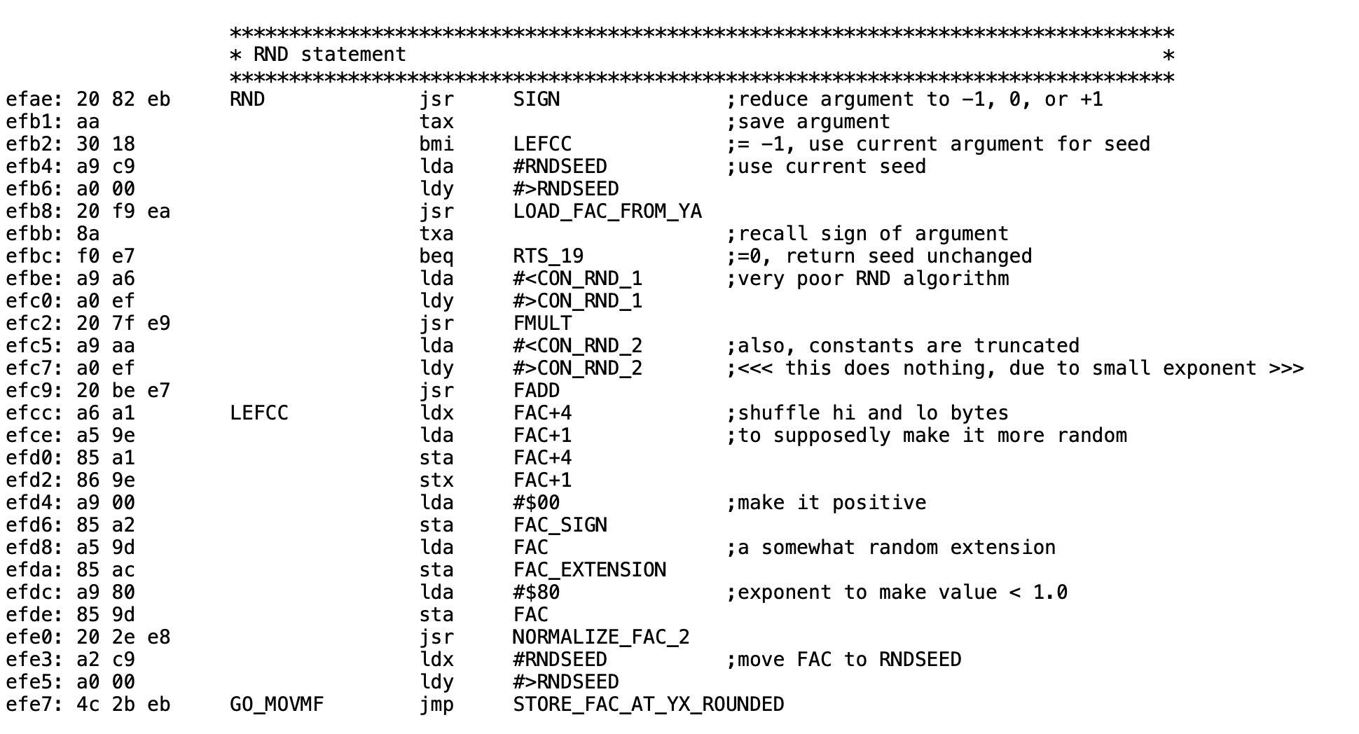
Applesoft II: Microsoft's RND
5
Microsoft wrote this generator. Apple licensed it and shipped it unchanged in ROM.
Seed: $C9, filled from ROM
$4E/$4F still counts. Applesoft never reads it.
What it does
Loads the seed at $C9, multiplies, adds (lost to precision), swaps the high and low mantissa bytes, forces the result under 1, writes it back to $C9. Nothing else touches $C9.
Listing and comments: Bob Sander-Cederlof, S-C DocuMentor, via Andy McFadden (6502disassembly.com). The comments are Sander-Cederlof's, not Microsoft's.
Notes:
This is the whole thing. Twenty-eight instructions.
Point at the top: the seed comes from $C9, which got four of its five bytes from ROM at power-on. Point at the bottom: the answer goes back to $C9. Nothing else feeds it.
Read the comments aloud: "very poor RND algorithm", "this does nothing, due to small exponent". Say whose they are: Bob Sander-Cederlof's annotations, not Microsoft's source. (The add isn't literally nothing: emulated, it changed 5 of 57,021 steps. "Lost to precision" is safe.)
This is Applesoft II as it sits in the ][+ ROM (1979) and the IIe ROMs, byte-identical. If asked about the 1978 cassette version: not checked.
Microsoft's source had two RNDs: the Commodore build read hardware timers for RND(0); every other target, including Apple, got this fixed-seed one. Apple edited the very loop that loads the seed and never connected the counter. Say "nobody connected it", not "nobody knew".
If someone wants the source: McFadden's disassembly at 6502disassembly.com, and Microsoft's own BASIC-M6502 source release.

Slide 7

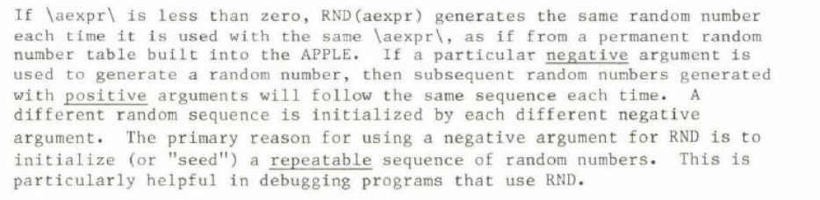
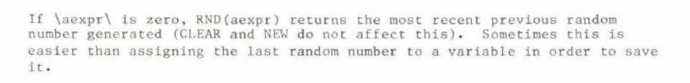
Applesoft Manual, 1978
6
RND(n)
RND(-n)
…starting here, every power-on.
Repeatable on purpose: documented.
Repeatable by accident: not.
RND(0)
Notes:
Read the RND(n) line aloud: "generates a new random number each time it is used." True. It just never tells you the sequence starts in the same place every power-on.
RND(-n): Apple documents repeatability as a feature, for debugging.
The manual tells you how to get the same sequence on purpose. It never tells you you're getting it by accident. Aldridge's word for this, in 1987: "undocumented."
When Aldridge's lab called Apple, the advice was X = RND(-1*(PEEK(78)+256*PEEK(79))). Hold that for the fix slide.
(Consider showing this slide before the code slide: the promise, then the reality.)

Slide 8
Found. Published. Worked around.
7
Kaner & Vokey (1982; MICRO, 1984)
RND fell into an endless loop of 202 numbers.
Call-A.P.P.L.E., Jan 1983, pp. 29–34
“RND is Fatally Flawed.”
Sander-Cederlof, AAL May 1984
Seed copy is off by one ($F151: $1C→$1D). Repeats at number 37,758.
Aldridge, BRMIC 19(4), 1987
Each day's first subject got the same “random” word list.
Gleason, Collegiate Microcomputer, 1988
Tested Apple IIe RND; published suggested seeds. ERIC EJ372427.
Empson, GS WorldView, 1999
Wrote up R. C. Moore's 1989 shift-register RNG, seeded from $4E/$4F.
Notes:
Lead with the harm: Aldridge's memory experiment. Every subject was supposed to get an individually randomized word list. The ones who got the repeated list were the first tested each day, right after the computer was turned on. A published experiment, contaminated by this bug.
Then the timeline: found, reported, worked around one program at a time, never fixed in the ROM.
202 is measured on real Applesoft by two psychologists who needed randomized experiments. Sander-Cederlof got 37,758 two years later. Same generator, different uncopied byte: emulating the ROM code, $CD=$58 falls into the 202-number loop and $CD=$FF into the 37,758 one.
Say the personal line out loud: Dr. Kaner sent you the paper directly. The paper is marked 1982 but was published in MICRO in June 1984, so don't call it the first published account; Call-A.P.P.L.E. ran in January 1983.

Slide 9
The Fix: Put the Counter Back
8
Part 1 · LC_Loader.bin
Enables language card write mode while keeping ROM readable
Copies $D000-$FFFF (all of Applesoft and the monitor ROM) from ROM to LC RAM
Writes the patch code into the LC at $F5CB, over HFIND, which no Applesoft routine calls
Writes JMP $F5CB at $EFAE in the LC copy
Switches the language card to read mode
“Just seed it first.”
New code: X = RND(-(PEEK(78)+256*PEEK(79))) after a keypress. Apple's own advice (Aldridge 1987).
Existing code: you can't edit it, and it fails silently.
Patch budget
HFIND spans $F5CB–$F5FF: 53 bytes.
$F600 is an RTS that HLIN (HPLOT TO) branches to: leave it.
No JSR or JMP to $F5CB anywhere in the ][+ ROM.
Part 2 · Patch_lc.bin
RND(−n) and RND(0) behave as documented; RND with a positive argument draws on the KEYIN counter.
Fixes the seed, not the generator. Needs a language card.
Notes:
Somebody will say just seed it first. It's on the screen: say it yourself before they do, and agree with it for new code. Apple itself gave that one-liner to Aldridge's lab.
Then: you can't edit software you didn't write, the failure is silent so only people who already know can fix it, and this machine used to do it automatically.
HFIND: "not called by any Applesoft routine" (S-C DocuMentor). Only a program that calls 62923 ($F5CB) directly would break. The patch must fit $F5CB-$F5FF, 53 bytes; $F600 is the RTS that HLIN branches to.
CONFIRM BEFORE THE SHOW (see 01_Edited_Deck/CHANGES.md):
- Exactly what positive RND does: reseed on every call, once, or when the counter changed? A tight 52-card loop with no keypress must not return near-identical values.
- Patch length <= 53 bytes; HPLOT TO, DRAW, XDRAW still work after install.
- RND(-1) then five RND(1) repeats, with and without a GET in between.
- Behavior under DOS 3.3 (FP/INT), ProDOS, and after Ctrl-RESET on a IIe/IIc.
Limits to say out loud if asked: it fixes the seed, not the generator, so the 202-number loop is still reachable; a turnkey program that calls RND before any keypress gets leftover counter bits.

Slide 10
9
Try it yourself
1977: Integer BASIC's RND was seeded by you.
1978: Applesoft's RND was seeded by ROM, and the counter went unread.
It hid for years: rerun looked random; only power-on repeated.
[ presenter: add link text and QR code here ]
Jeff Robison · VCF Midwest 21 2026
Notes:
Three lines, then the link and QR. Put the URL on screen as text too: the back rows can't scan a QR, and the PDF needs a clickable link.
"Then and Now", the now: the same shape keeps recurring. Debian's OpenSSL (CVE-2008-0166): a 2006 change removed nearly all the entropy mixing, and predictable keys were generated for about two years before anyone noticed. A parallel, not a lineage.
Questions to expect:
- Does the C64 have this too? Same Microsoft generator, same constants. But Microsoft's own Commodore build made RND(0) read hardware timers and added TI, back in the first PET ROM in 1977; Commodore carried it to the C64. On a Commodore the idiom is RND(-TI); on the Apple it's RND(-PEEK(78)-256*PEEK(79)).
- Why not replace the generator? Speed, no space, and RND(-n) has to keep repeating.
- What's at $F5CB? HFIND. Answer it straight: no Applesoft routine calls it.
- Does the patch fix the 202 loop? No. It fixes the seed.
- ProDOS lives in the language card. Answer only with what you've tested.

